Slide 1


NATIONAL LUNG CANCER SCREENING PROGRAM
Screening will begin from July 2025
RACGP Victoria Webinar Series - 29 May 2025
Prof. Vivienne Milch
Medical Director, Cancer Australia
Dr. Diane Pascoe
Deputy Director of Medical Imaging, Royal Melbourne Hospital

Slide 2





National lung cancer screening program
The Program was announced in the 2023-24 Budget, with the Government committing $263.8 million to establish a National Lung Cancer Screening Program.
Screening services will begin for eligible people from July 2025.
Two-yearly Screening
50 – 70 years
Asymptomatic (no signs or symptoms of lung cancer)
Person who smokes/person with smoking history
(10 years or less since cessation)
30 pack-year smoking history
and
and
and

Slide 3







Key Program Elements
Screening and Assessment Pathway and supporting resources
Two new bulk-billed MBS items for low-dose CT scans
National Cancer Screening Register (NCSR)
Use of existing Low-Dose CT infrastructure in private and public settings and mobile screening
National Communications Campaign and Healthcare Provider Education Strategy

Slide 4
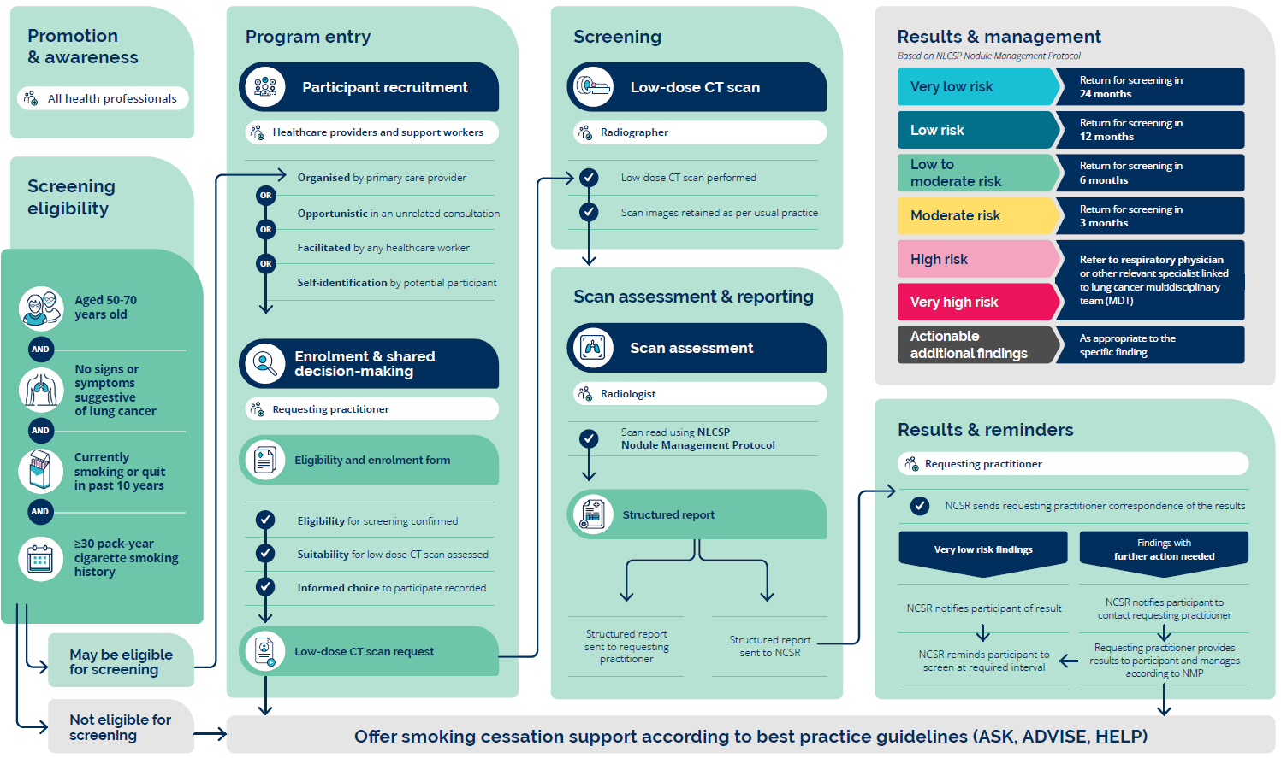
SCREENING AND ASSESSMENT PATHWAY

Slide 5
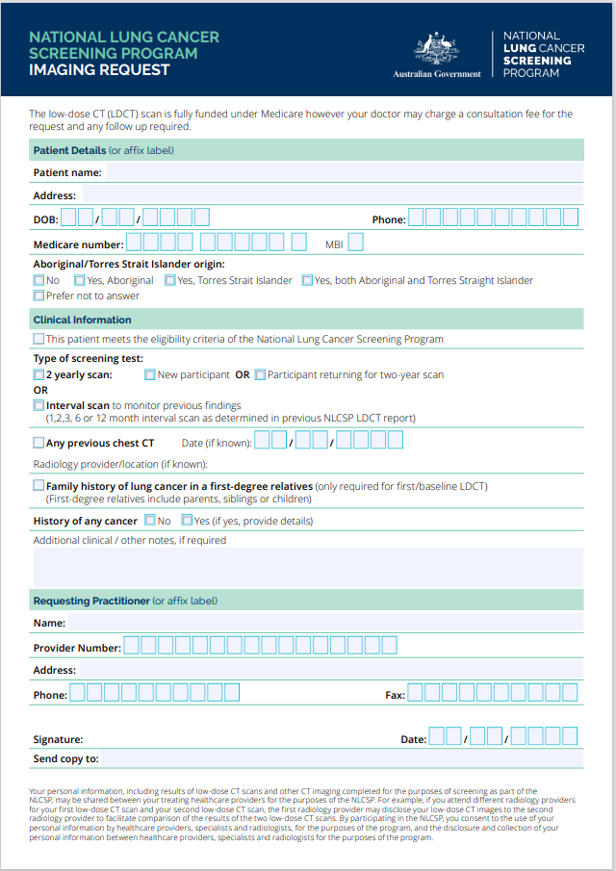
SCREENING AND ASSESSMENT PATHWAY
1
2
3
4

Slide 6
SCREENING AND ASSESSMENT PATHWAY

Slide 7
SCREENING AND ASSESSMENT PATHWAY

Slide 8
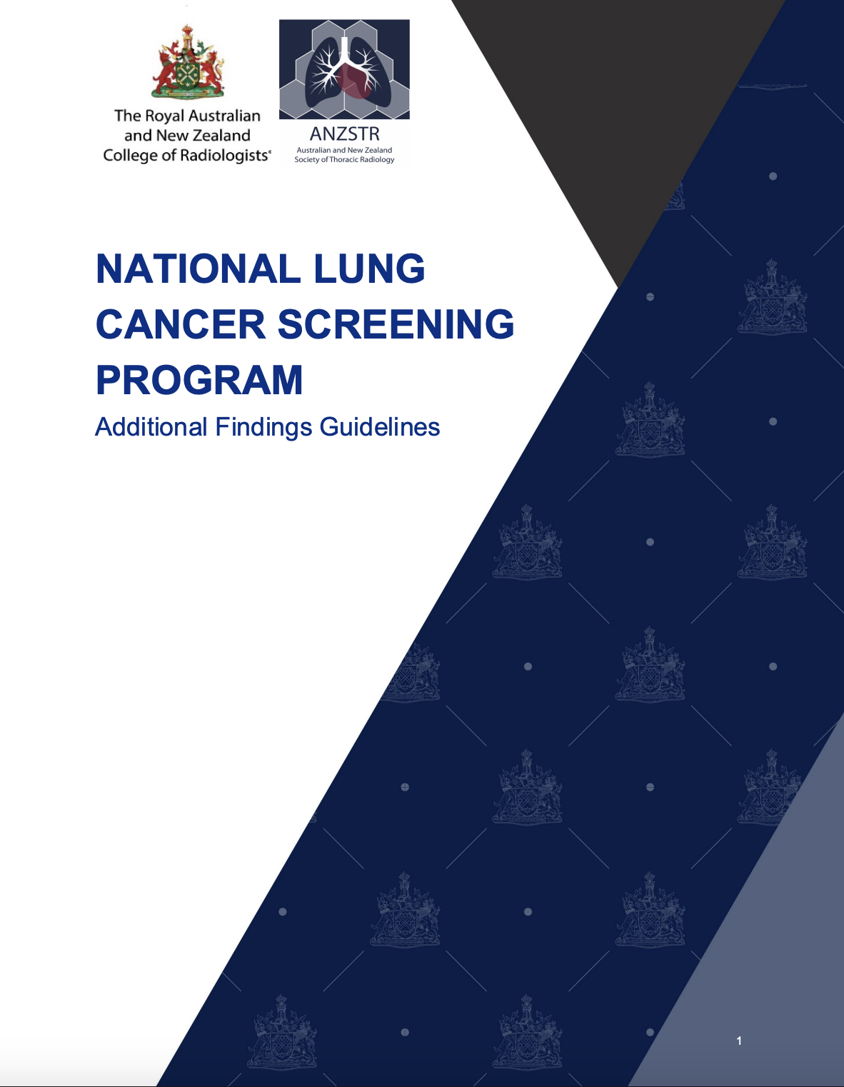
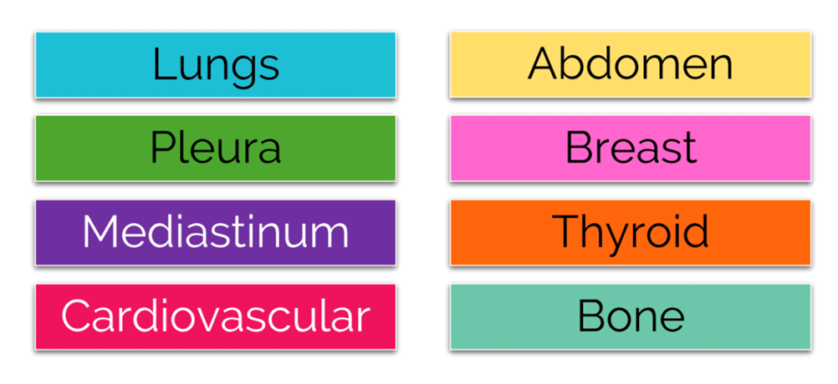
ADDITIONAL FINDINGS
‘Actionable Additional Findings’
Additional Findings are defined as abnormal findings on low-dose CT scans that are unrelated to lung cancer.
Radiologists will aim to report these ‘Actionable Additional Findings’:
Reporting with opportunity to improve health outcomes for the participant.
Avoid reporting that may harm or lead to low-value care.
Rare and urgent reportable findings excluded from guidelines.
26 categories, across 8 systems included:

Slide 9
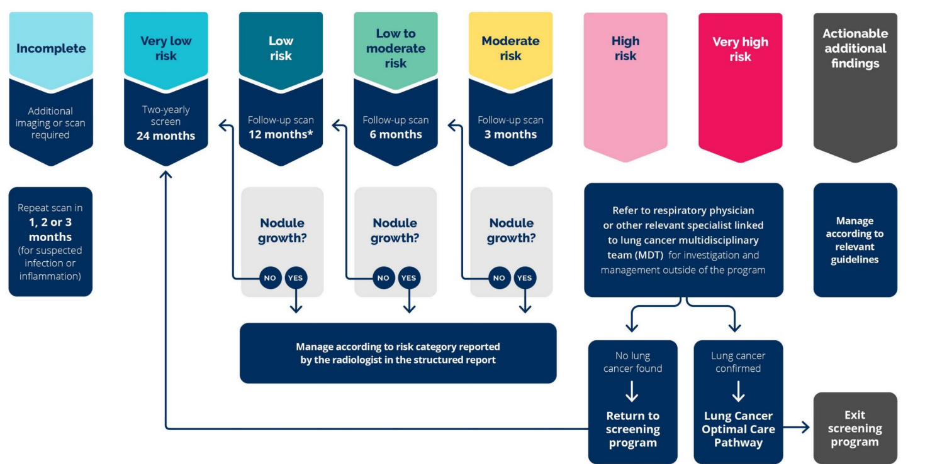
REPORTING RESULTS
Structured Clinical Reporting
Structured clinical report to be sent to referrer as per usual practice & uploaded to NCSR in-line with the Nodule Management Protocol
1 of 6 nodule risk categories
Very low risk – 24-month scan
High & very high risk – refer to clinician linked to MDM
Stepped management of low to moderate risk nodules
Clear recommendation on next scan or referral
Actionable Additional Findings documented.
Pg59 NLCSP Program Guidelines

Slide 10

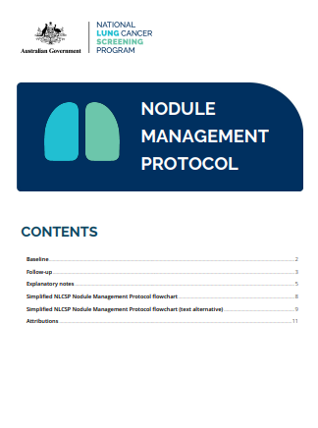
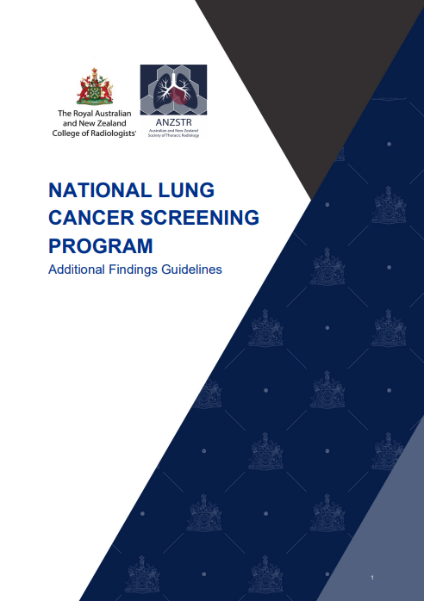
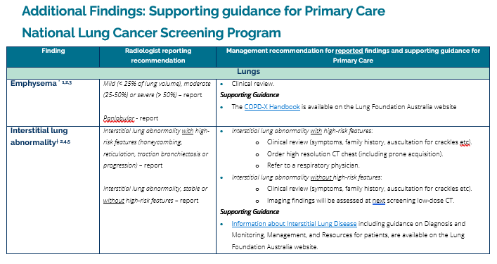
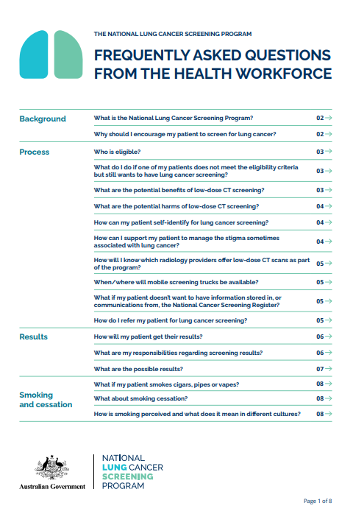
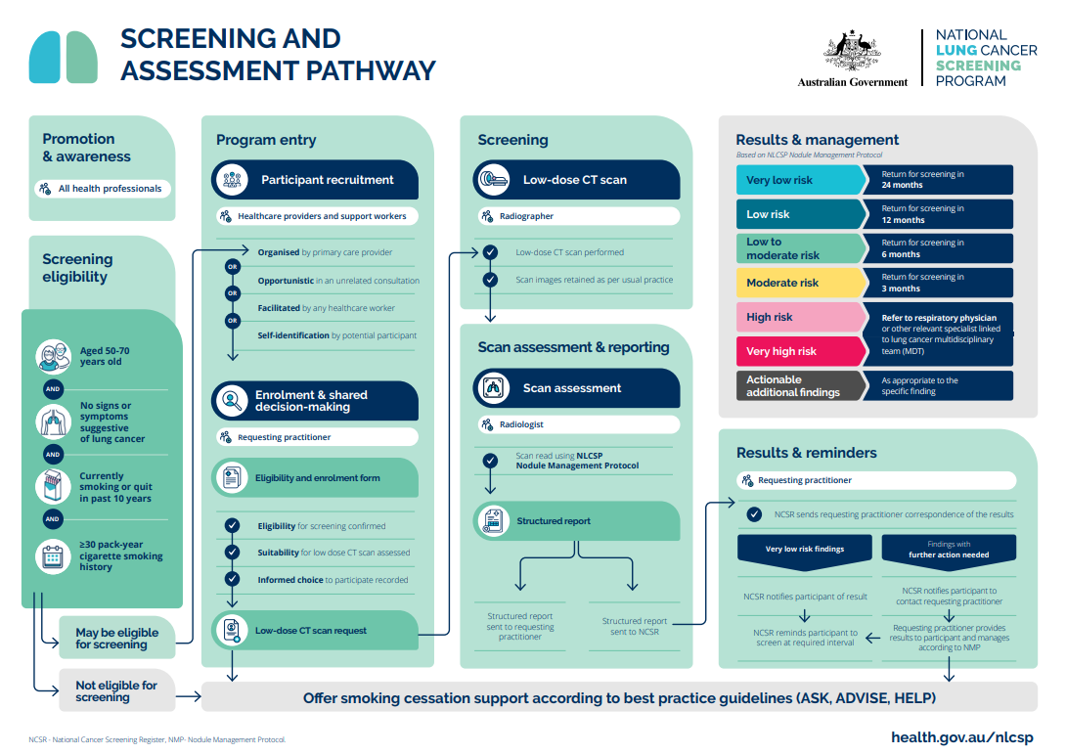
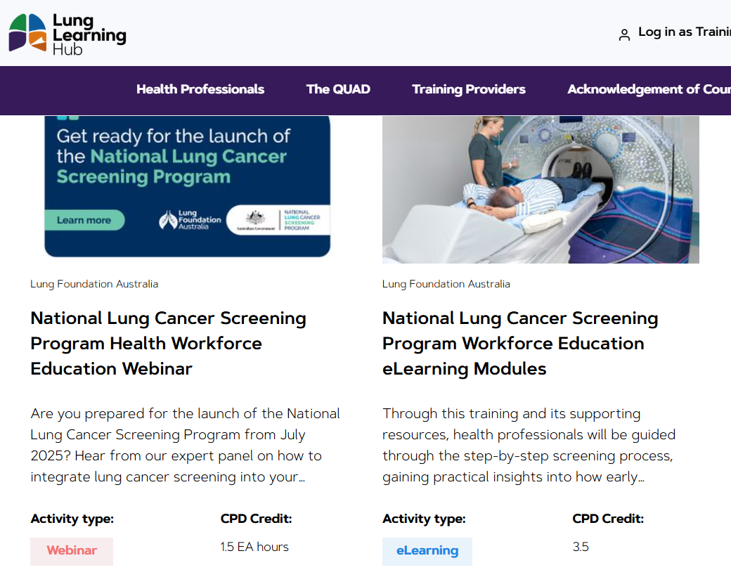
Supporting Resources - Healthcare providers
Program Guidelines - published on the Department of Health, Disability and Ageing (DoHDA) website
Nodule Management Protocol- published on the DoHDA website.
Information materials across the pathway
Additional Findings Guideline – published on RANZCR’s website
Additional Findings Guidance for Primary Care

Slide 11
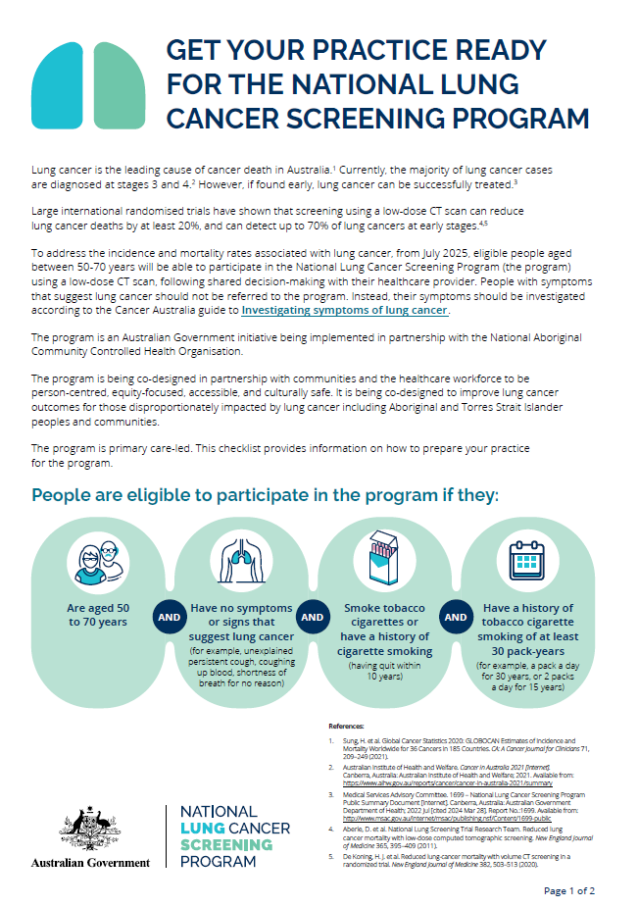
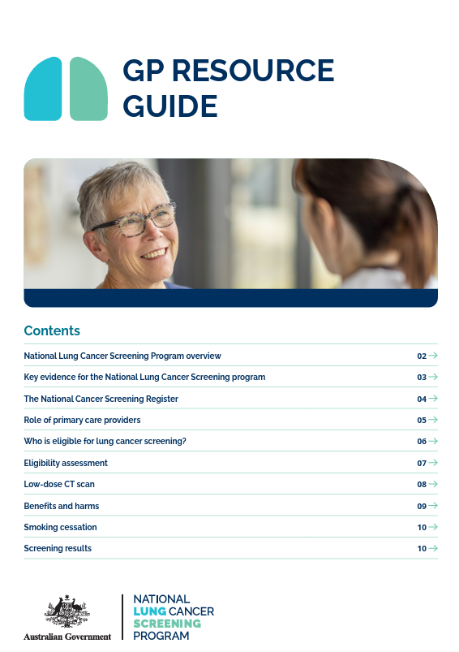
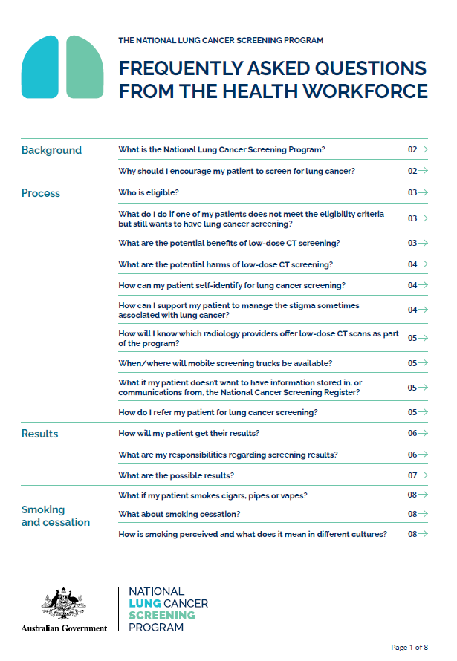



Slide 12






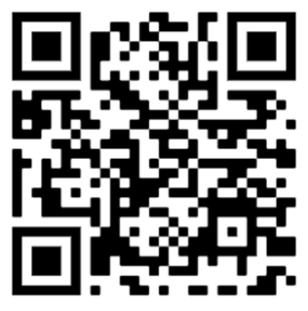

eLearning Education Modules
1. Lung Cancer in Australia
2. National Lung Cancer Screening Program
3. Program Recruitment & Eligibility
4. Effective Communication Strategies
5. Low-Dose CT scan, assessment & results
6. Knowledge Bank
Follow six patients in interactive case-based scenarios building throughout the modules
Six self-paced modules – approximately 3.5 hours

Slide 13
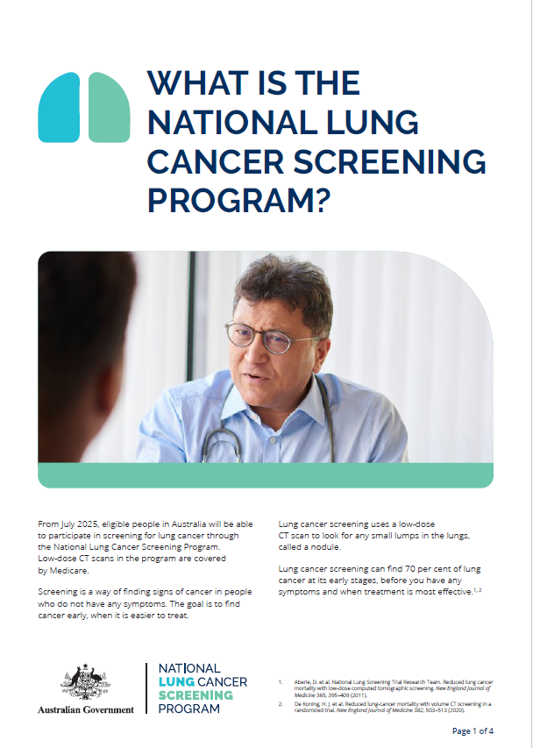
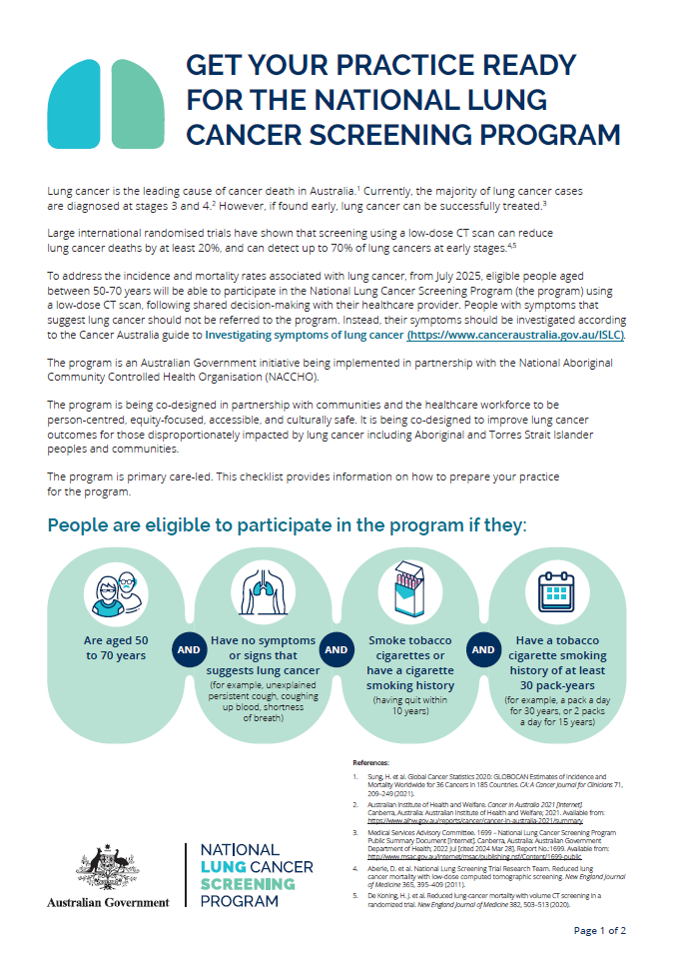
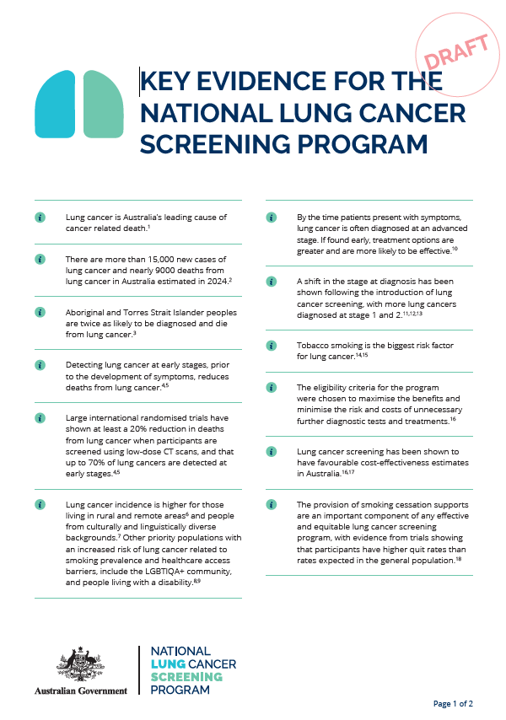
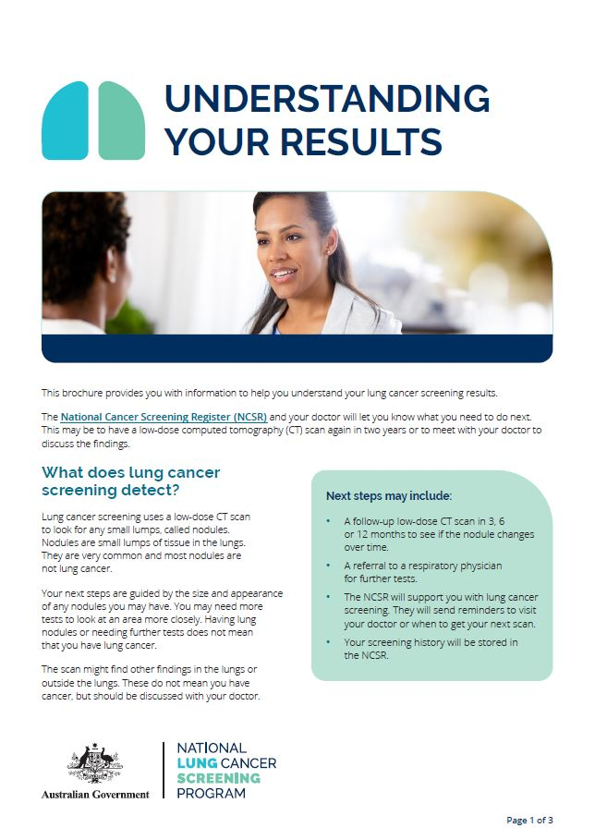

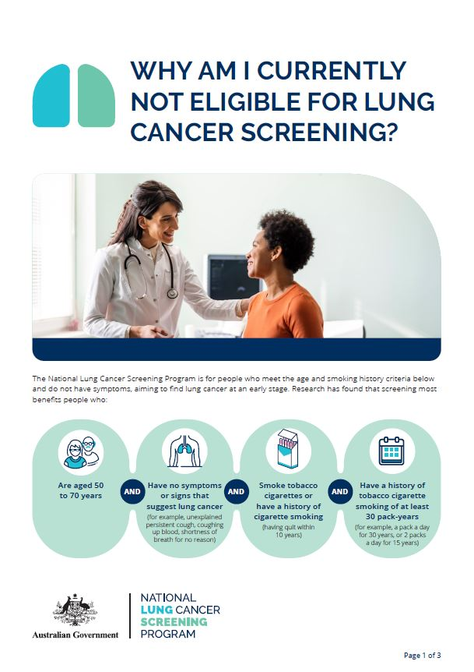
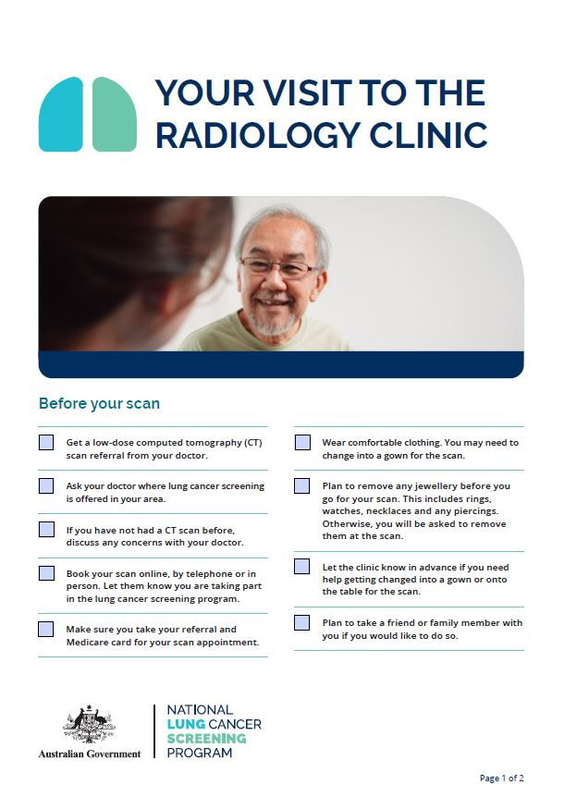
Supporting Resources - participants

Slide 14

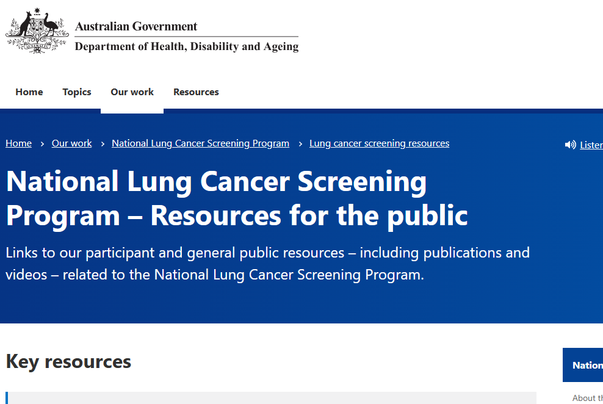

CASE STUDY - JEFF
1
Profile
65-year-old male
Sheet metal worker
Married with adult children
Scenario
Received a text from his GP, Dr Paul to make an appointment to discuss lung cancer screening.
The text included a link to the NLCSP public resources page.
health.gov.au/our-work/nlcsp/resources/general-public

Slide 15
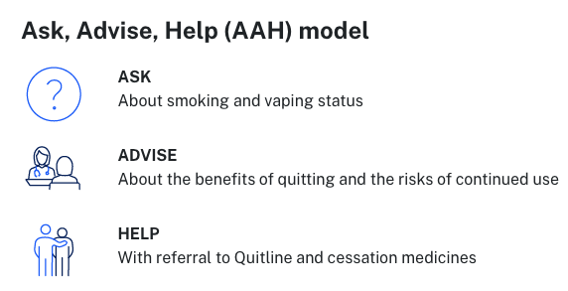
CASE STUDY - JEFF
2
Jeff visits Dr Paul
Visit Frequency
Jeff usually sees Dr Paul 6-monthly for his BP meds – last time was 2 months ago.
Medical History
Hypertension diagnosed 5 years ago, no other illnesses.
Jeff attends at the encouragement of his wife, who has had regular cervical screens by her GP for decades.
Dr Paul updates Jeff’s smoking history in his medical records and again offers him help to quit smoking.
Jeff has smoked since age 16 years
Intermittent quitting, not sustained
Currently 10-15 cigarettes/day
Has been up to 30 cigarettes/day

Slide 16

CASE STUDY - JEFF
3
Jeff’s Eligibility
Assessable Factors
Pack years = 15/20 x 50 = 37
Age = 65
No symptoms
Jeff is at high risk of lung cancer.
Lung cancer is curable if detected early.
5-year survival approx. 25% in Australia.
LC detected via screening: 5-year survival is 70%+
Trials have shown a 21% mortality reduction with screening¹
health.gov.au/resources/publications/nlcsp-conversation-guide-participation
1. health.gov.au/resources/publications/nlcsp-key-evidence

Slide 17
CASE STUDY - JEFF
4
Jeff is enrolled in the NLCSP
Dr Paul:
Enrols Jeff via the NCSR.
Checks the local private radiology firm offers the LDCT scan for the NLCSP.
Provides Jeff with the request form adapted from a NLCSP imaging request template found on his clinic’s management software.
Reassures Jeff the scan will be bulk-billed, he will receive correspondence from the NCSR, followed by a letter about the results.
Confirms Jeff may need to come back to discuss his results – but that doesn’t mean he has lung cancer.
Explains there may be some out-of-pocket expenses for follow up tests if other findings are found in the scan.

Slide 18
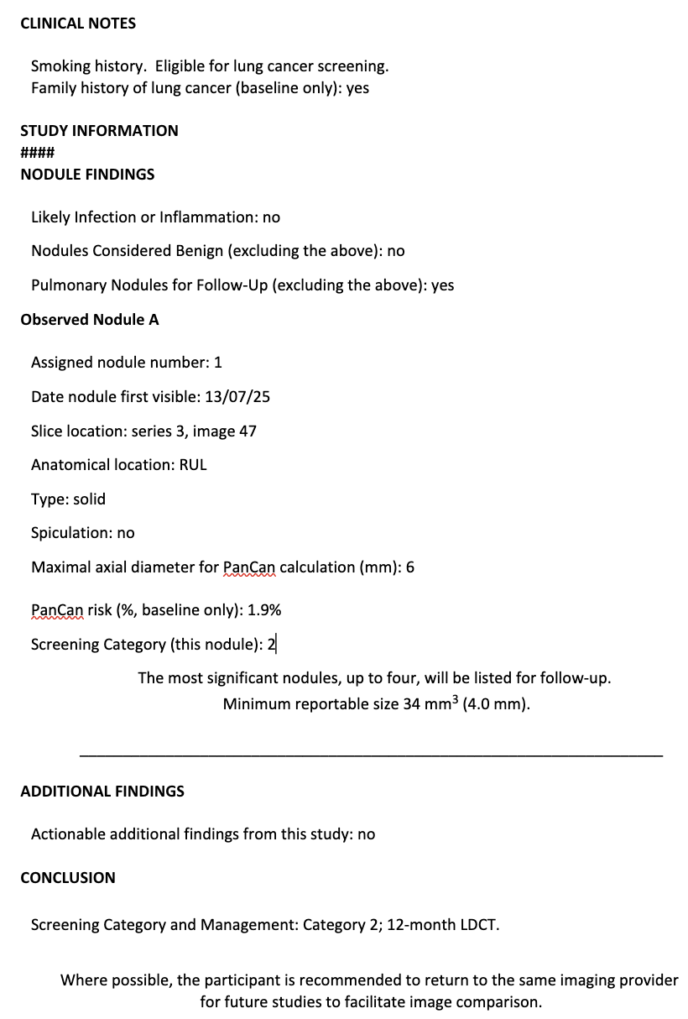
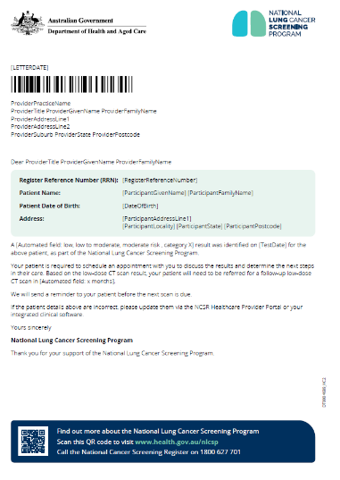
From the NCSR:
Low to moderate result
Patient to discuss results with GP
Patient for follow-up LDCT in 12 months
NCSR to send patient a reminder
CASE STUDY - JEFF
5
Jeff attends his LDCT Scan
Jeff attends a radiology provider participating in the program with the imaging request form completed by Dr Paul.
6
Dr Paul Receives the Results
A structured template is sent to the requesting practitioner Dr Paul, on Jeff’s results.
From Radiologist:
Category 2: low risk
Participant interval scan in 12 months

Slide 19
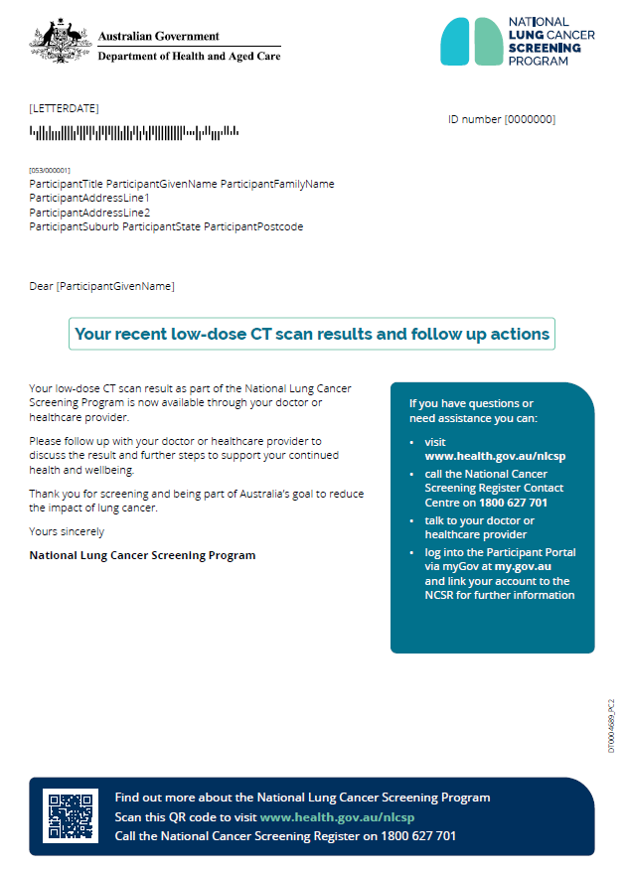
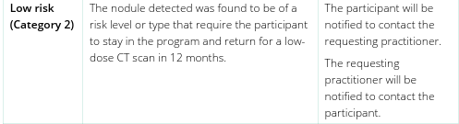
CASE STUDY - JEFF
7
Jeff receives a letter from the NCSR
Following his LDCT, Jeff receives correspondence from the NCSR informing him his results are now available for discussion with his requesting practitioner.
8
Jeff visits Dr Paul
Dr Paul arranges to see Jeff to discuss:
His ‘low risk’ lung nodule
A reminder to complete an interval scan in 12 months via the eMR.
Dr Paul counsels Jeff about smoking cessation – Jeff is motivated to quit.
Jeff is referred to Quitline, prescribed pharmacotherapy and a follow up appointment is made for 3 weeks time.

Slide 20



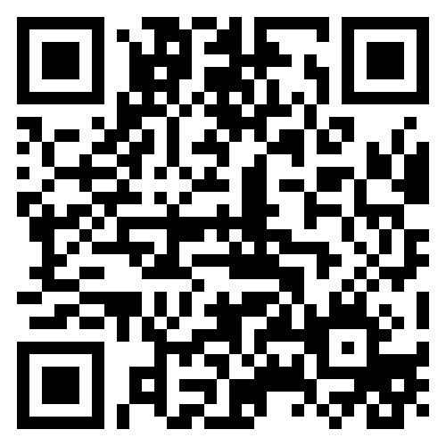
More information
health.gov.au/nlcsp
lungcancerscreening@health.gov.au

Slide 21
Category |  | Action | % Cohort | PPV 12 months (%)
Very Low Risk | Pancan 1 (no nodules or <1.5%) | LDCT 24 months | 75.2 | 0.06
Low Risk | Pancan 2 (1.5 to <6%) | LDCT 12 months | 13.8 | 0.8
Moderate Risk | Pancan 3 (6-30%) | LDCT 3-6 months | 8.2 | 5.2
High Risk | Pancan 4 and 5 | Refer to Respiratory Physican | 2.8 | 44
Triaging ILST Screening Participants at Program Entry: Comparative Performance of PanCan versus LungRADSv1.1 Protocol
A.M. McWilliams

