Slide 1
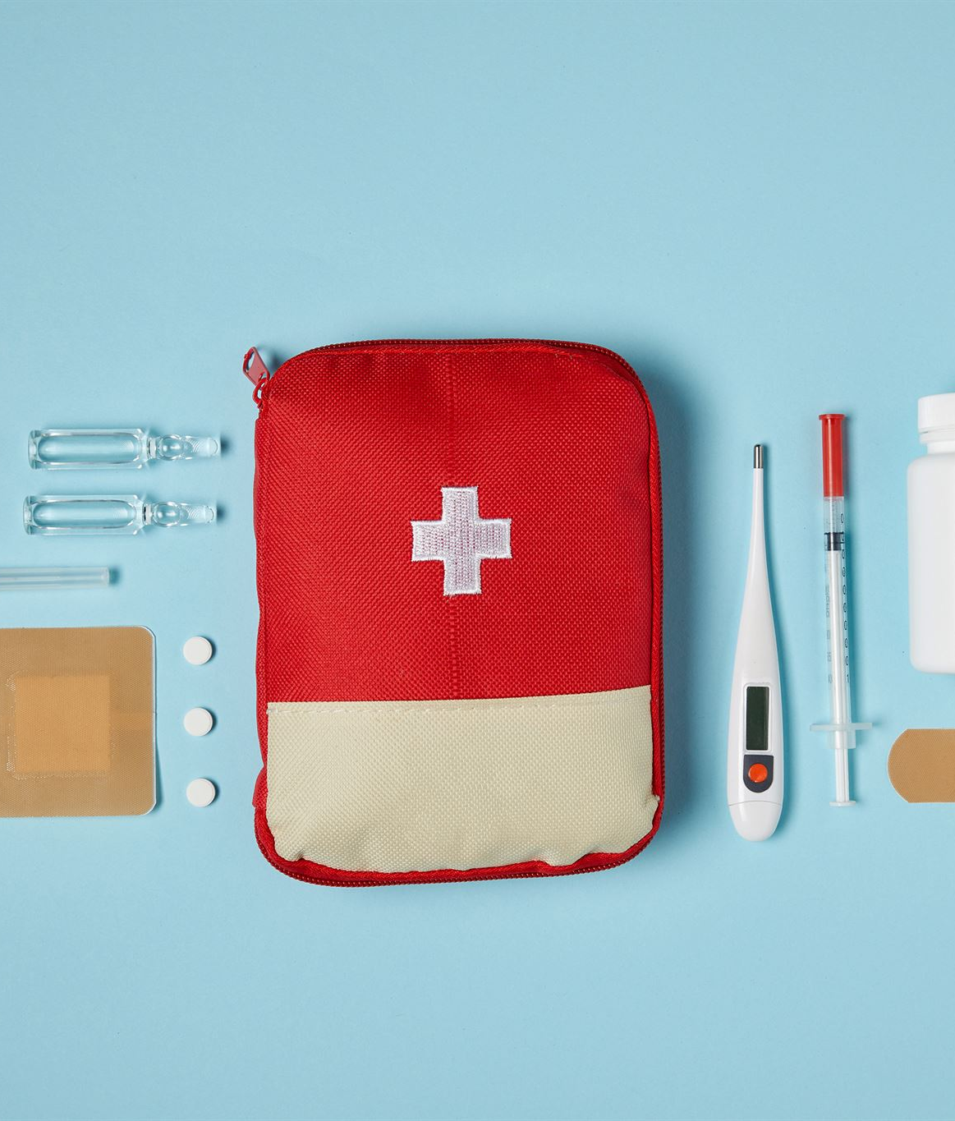
Disasters are not rare enough
Assoc Prof Chris Hogan OAM
This presentation is part of the ongoing RACGP support for Disaster Preparedness & Response
Notes:
---
Disasters can strike unexpectedly, affecting lives, economies, and the environment. This presentation will help us understand the different types of disasters, their impacts, and the importance of preparedness and response.

Slide 2
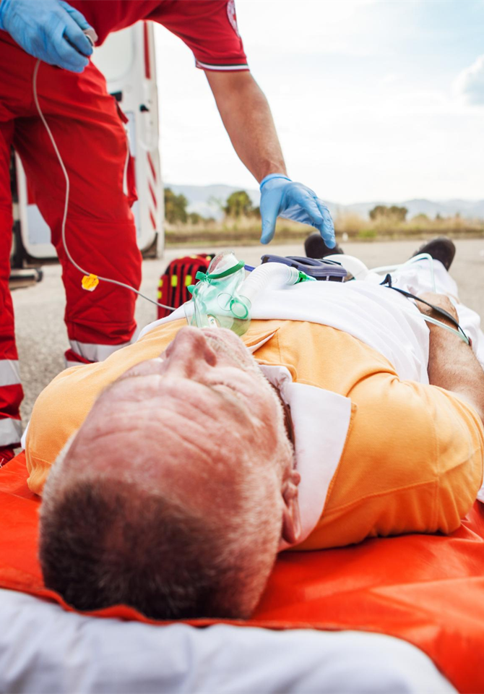
Overview
Incidence
Disasters affect all regions including metro.
How are GPs involved?
Disasters are Different
Key role of GPs
Prepare, rehearse, respond
Never waste a false alarm or a near miss as a means of preparation

Slide 3
Key Points
Disasters can occur anywhere & any time
Not just from extreme weather events
Be Prepared with plans & resources
Rehearse & Adapt
Disasters are Different
There are lots of resources

Slide 4
Disasters are not Rare enough
Extreme Weather Events have affected 84% of Australians since 2019
Heatwaves
Floods
Bushfires
Droughts
Destructive Storms
Thunderstorm Asthma
Landslides

Slide 5
Other Disasters in living memory
Mass evacuations
Major Car, Bus, Train & Plane crashes
Pandemics
Epidemics & Pseudo-Epidemics
Hazmat Incidents
Mass Hysteria
Terror & Criminal Incidents
Lone wolf stabbing & shooting incidents
Assault by vehicle
Off gassing suicides
Bomb threats
Malicious Hoaxes

Slide 6
Metro Areas have Disasters too
Terror incidents & lone wolf attacks can occur anywhere
“Our practice is 3 blocks from a major hospital. There was a major collision out the front with time critical patients”
“I was in a major city & we got flooded”
“Our city had major green wedges & plantations throughout.
When they caught alight there was fire everywhere.”

Slide 7
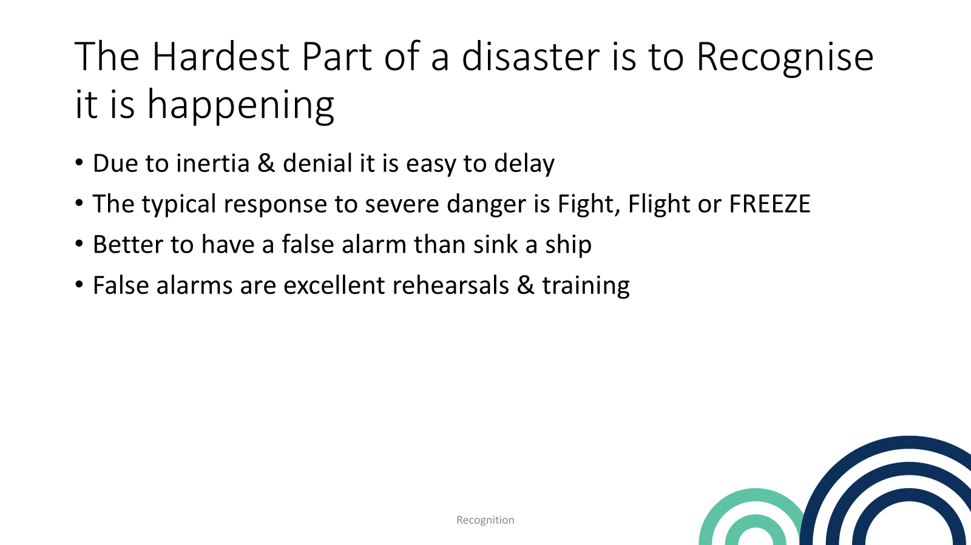

Slide 8
Disasters are Different-from Emergencies
Disasters
Emergencies
Not Rare Enough
Chaotic & protocols can be fragile
Inadequate resources for optimal outcomes
Last for days or weeks
Responders are often at risk
Communication is often difficult
Often Multiple causative factors
Common enough
While urgent have rehearsed protocols
Have adequate resources to treat everyone optimally
Last about 1-2 hours
Responders are rarely at risk
Communication is normal
Often only one cause

Slide 9
How do GPs get involved in Disasters?
As a victim.
As a friend/ relative of a victim
As a responder at the site of a disaster
In their own practice dealing with victims
In their own practice dealing with victims
Caring for their patients at an Evacuation centre
Caring for strangers at an Evacuation centre or another surgery
As a responder at an overwhelmed hospital
We Always get involved during recovery

Slide 10
Key Role of GPs in Disasters.
All Disasters affect health across all body systems and result in increased morbidity and mortality within affected communities.
Survive
Maintain Practice Continuity
Keep Seeing Patients
Our patients need us more than ever in disasters
Even a minor contribution has a major impact
We may get involved in direct incident response.

Slide 11
Resources
-Standards for General Practice
-RACGP Publications
Standards insist on practice continuity even with disasters
Prepare a disaster plan based on local & general risks
Prepare an emergency kit & access to patient records
Prepare ways to maintain communication
Rehearse the disaster plan
Activate it
Review it after rehearsals & disasters

Slide 12
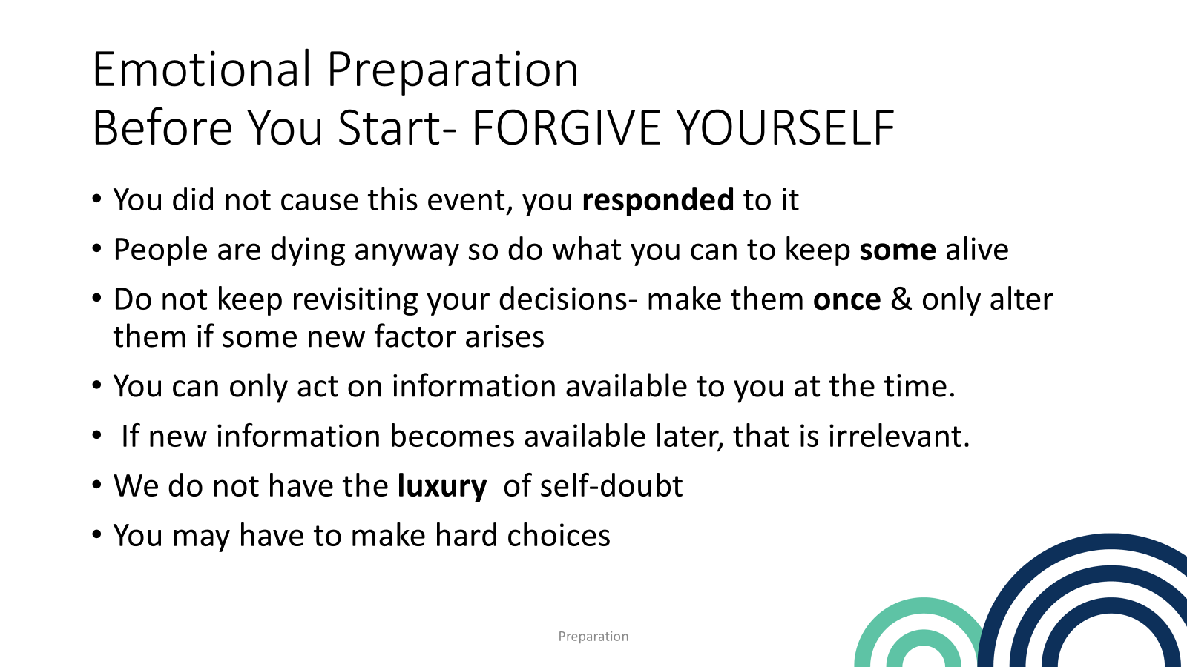

Slide 13
Disasters are chaotic
Events are usually only obvious in retrospect
Hindsight is only helpful if you are an investigator or historian
Mis-steps & mistakes are inevitable –Initially
Very few have had military level training, rehearsals & experience.
Suddenly , everyone has to act totally differently from their routine.
People who have been crushed into mundane uniformity are expected to think for themselves in a totally new & deadly environment.
Many cannot think for themselves- initially- and experience a baptism of fire

Slide 14
A Good Plan is written in pencil
As few plans survive first contact with a catastrophe
However, the experience that informs the plans are written in blood , sweat & tears
Be prepared to adapt your plans in the presence of unexpected events
Writing & rehearsing plans also helps you adapt.

Slide 15
Take Home Message
While Disasters are chaotic, you can still contribute
Think of this talk as you prepare your own Disaster Plans- for home, for work & any community groups you belong to.
Prepare, rehearse, respond & adapt
Never waste a false alarm or a near miss as a means of preparation

