Slide 1
RACGP Webinar Presentation Emergency Management
Jason Helps Coordinator Emergency Management Sector Operations Readiness & Response Department of Health
OFFICIAL

Slide 2


Acknowledgment
I would like to begin by acknowledging the Traditional Custodians of the land on which we meet today and pay my respects to their Elders past and present.

Slide 3
Emergency Management Arrangements
OFFICIAL

Slide 4
Role of Department of Health
DH is the Control Agency for: | DH is the Support Agency for:
Incidents involving biological releases and radioactive materials Human disease and food / drinking water contamination | All emergencies with health risks or consequences Significant risks to the health system that impact the system’s ability to deliver healthcare

Slide 5
Role of Department of Health
Department of Health objectives
Maximise health outcomes by providing treatment in a safe, timely and coordinated manner
Minimise impacts on the health system
Provide timely, tailored, and relevant health information and warnings to the community, to assist community members with making informed decisions about their safety
Ensure clarity on roles, responsibilities, escalation and communication channels to enable an effective and efficient health emergency response, particularly for the health system
Identify and protect health sector critical infrastructure, assets and services that support community resilience
Strengthen accountability for managing and mitigating risks associated with health emergencies.

Slide 6
State Emergency Management Plans
State Emergency Management Plan (SEMP)
Sub Plans

Slide 7
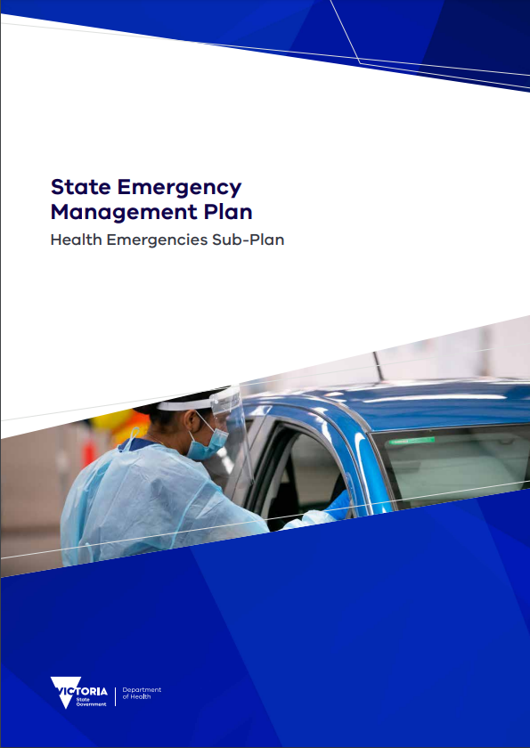
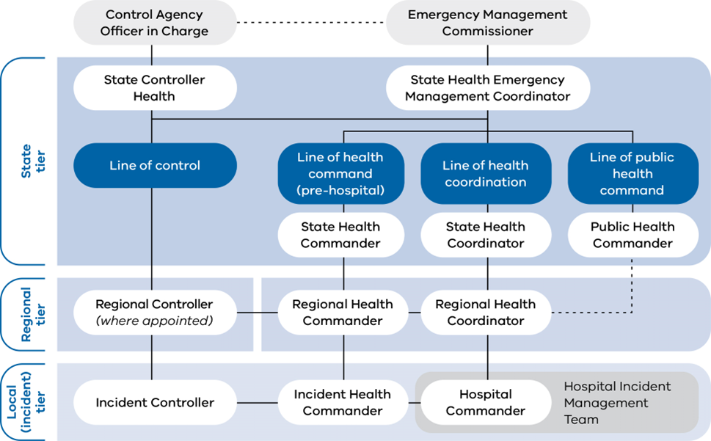
Response Arrangements - Health Emergency Subplan
Health Emergency Sub Plan https://www.emv.vic.gov.au/responsibilities/state-emergency-management-plan-sub-plans/semp-health-emergencies-sub-plan

Slide 8
How the department Coordinates across the Health Sector
OFFICIAL

Slide 9
Coordination
Systems
Emergency Warning Alert System (EWAS) - https://www.health.vic.gov.au/subscribe
First Wave Notifications
SynSurv
State and Regional Health Emergency Management Team meetings
Direct PHN engagement
Emergency Management Information Technology System (EMITs)

Slide 10
Engagement Activities
Current activities
In November of 2023 PHN appointed a lead project staff member to work with the department to redesign and reengage the quarterly meeting structure, to better understand the agreement and the role of PHN in emergency response.
VTPHNA’s - Emergency and Disaster Management across Victoria and Tasmania working group was established on the 1st of December with representatives from PHN and department in attendance.
October 2023 the department provided the VTPHNA’s a seasonal outlook briefing and detailed overview of the regional emergency management structure virtually from within the Regional Control Centre.
Regional DH teams presented at several General Practice dinners on seasonal preparedness and the importance of the volunteer list.
December 2023/Jan2024 jointly produced an on-call factsheet outlining PHN and DH contact details for emergencies.
Preparedness forums for the 2024/2025 high risk season were conducted in November 2024.

Slide 11
Primary Health During Emergencies
OFFICIAL

Slide 12
State & Regional Health Coordination
The department coordinates health response depending on the response required, including,
Emergency advice, warnings and communication
CHO alerts
Public Health sector engagement
Enhanced AV response and capacity
Enhanced Hospital response and capacity
AusMat & VMAT deployment
FEMO
Field Primary Care Clinics
Relief centre services

Slide 13
Field Primary Care Clinics – Activation
The clinics are established to
Ensure appropriate and timely access to primary health care support for people affected by emergencies.
Provide access to primary health care close to where people affected by an emergency are congregating.
Support existing primary care services that may still be operating in the affected area but may be overwhelmed by demand.
Key activation triggers for a field primary care clinic
Usual access to primary health care is limited or non-existent.
Neighboring general practices’ and community health services’ capacity is already at a maximum, or indications are that capacity is expected to be exceeded in the near future.
Transportation or road access is difficult, and clients are unable to access neighboring services.
The affected community is highly traumatised or considered to be at a greater risk of harm if movement from the local environment occurred.
Source - Field primary care clinic guidelines <https://www.health.vic.gov.au/publications/field-primary-care-clinic-guidelines>

Slide 14
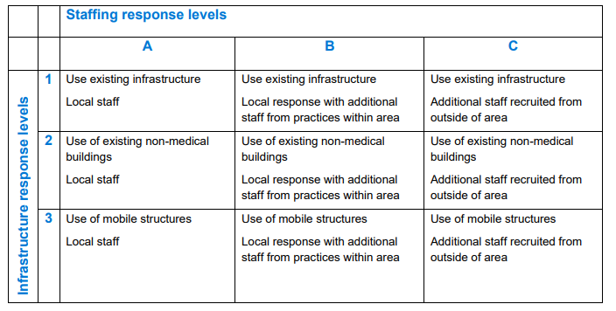
Response Levels

Slide 15
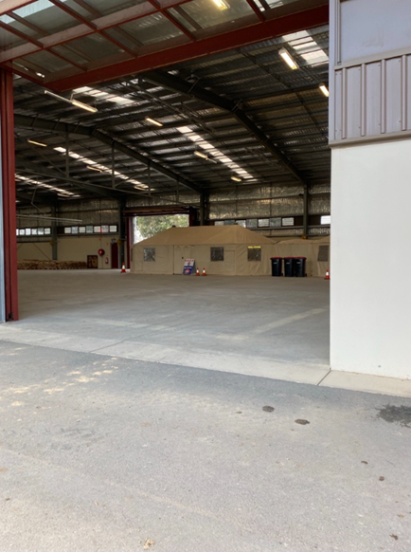
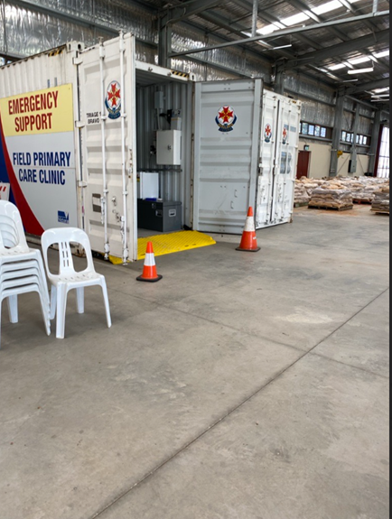
Primary Health During Emergencies (State)
Field Primacy Clinic – Shepperton October 2022 Floods
Emergency Relief Centre
Operated between Ambulance Victoria and General practice (GP’s and Nurses) from the volunteer list.
General practice unable to open during to flood damage and access.
Increase primary health presentation to emergency departments.
Increased need for primary care due to exposure to water and cleanup.
Community seeking information around prescriptions and medication.

Slide 16
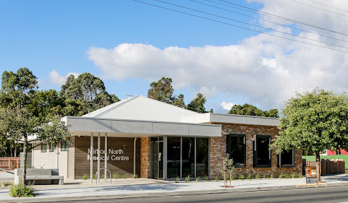
General Practice (Regional)
Gippsland, South Metro & East Metro February 2024 Severe Strom
Mirboo North Medical Centre
The Mirboo North Medical Clinic worked closely with the Mental Health and Wellbeing Local based in Morwell to provide a physical location for the team to work out of.

Slide 17
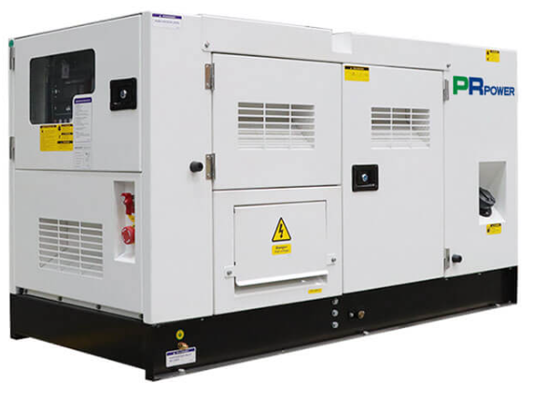
PHN & General Practice (Regional)
Gippsland, South Metro & East Metro February 2024 Severe Strom
Emerald Medical Centre
Regional Health Emergency Management team meeting chaired by Department worked with PHN to contact General Practices in the impacted areas.
PHN notified department that the Emerald medical centre was a key source of intel regarding health impact to community and that they were impacted by power loss.
The department listed the medical clinic for priority reconnection and facilitated the connection of the clinic to the town generator that was being installed.
The clinic provided critical intel to the department regarding the health of the community and was able to remain operational once connected to the town generator system.

Slide 18
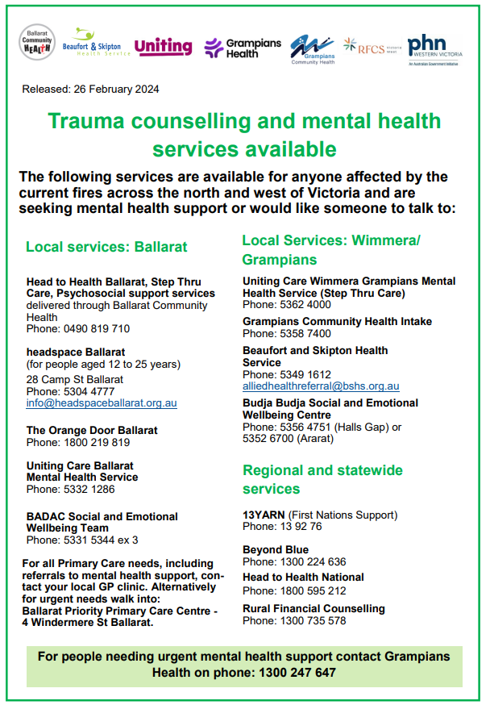
PHN & Mental Health Support (Local)
Grampians response Daylesford pub accident
Primary Health Network & Health Sector
Car accident at Daylesford pub resulting in several fatalities.
Regional health coordination called incident management team meeting including the PHN, resulting in a communications working group made up of PHN, Local health service, General Practice, department communication team. The group produced a factsheet to support community and General Practice accessing mental health supports.

Slide 19
Conclusion of presentation
Thank you for your time today.
Any questions?

