Slide 1
Public Health update - Victoria
RACGP, 29 May 2025
Dr Liz Bennett
Principal Public Health Medical Officer (Communicable Diseases)
Office of the Chief Health Officer, Victorian Department of Health
OFFICIAL

Slide 2
Agenda and Objectives
Agenda
Objectives
Measles update
Mpox update
Syphilis update
Recognise current epidemiological trends and key features of measles, mpox and other relevant communicable diseases in the local population
Understand the latest public health guidance on case management, testing, vaccination and reporting requirements for measles, mpox and other relevant communicable diseases

Slide 3
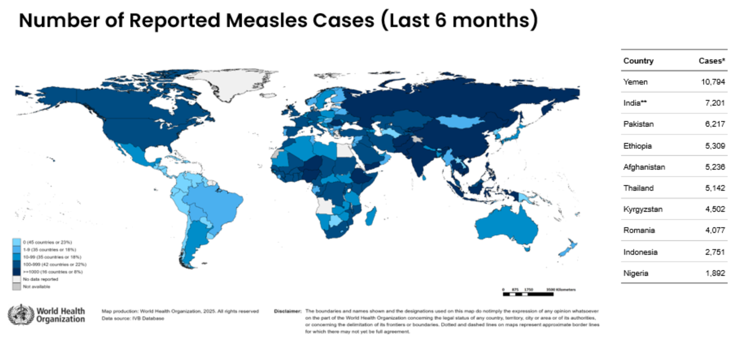
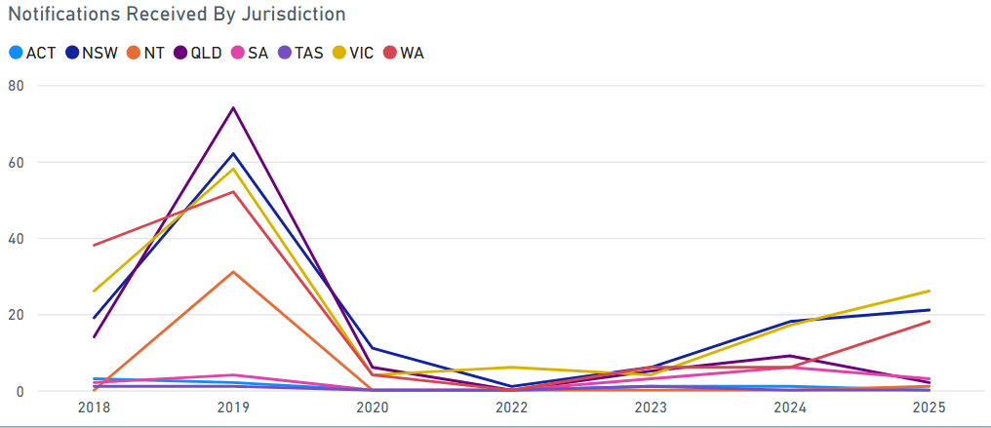
Measles in Victoria
There is an increased risk of measles in Victoria, with imported cases and unlinked local transmission
Drivers include, 1) global measles resurgence and 2) declining immunisation rates post COVID
Cases are occurring across all ages and most are not fully vaccinated against measles.
Almost all cases in this outbreak have had typical presentation of prodrome followed by maculopapular rash.
Complications are common, occurring in 10-30% of reported cases. 40% recent cases have been hospitalised
Source: World Health Organization Measles and Rubella Global Update (April 2025), Australian Centre for Disease Control Dashboard · NNDSS Portal (May 2025)

Slide 4
Measles – in health settings
Be alert for measles in patients with fever, cough, conjunctivitis and rash, and have lower threshold for testing.
Immediately isolate suspected cases in a closed room (ideally negative pressure) with a fitted face mask (ideally N95).
Urgently notify suspected cases, Local Public Health Units can provide advice on testing and precautions
Leave the consultation room vacant for 30 minutes after use and advise patients to isolate at home while waiting for results.
Post-exposure prophylaxis for susceptible contacts – MMR within 72 hours, NHIG within 144 hours
Unimmunised healthcare workers, including medical practice staff, are at high risk of measles infection
Check your immunity status today

Slide 5
Measles – vaccination
Offer the MMR vaccine to anyone born during or after 1966 without documented evidence of receiving two doses of MMR vaccine, or documented evidence of immunity.
Be proactive in opportunistically checking patients’ vaccination status
Free MMR vaccine is available under the National Immunisation Program and state-funded MMR program. No Medicare card is required to access free state-funded MMR vaccine.
National Immunisation Program (dependent on Medicare eligibility) | State-funded program (not dependent on Medicare eligibility)
Infants at 12 (MMR) and 18 months (MMRV) Children and adolescents ≤19 years as catch up Refugees and humanitarian entrants of any age | Infants aged 6 to 11 months prior to overseas travel (does not replace NIP schedule) All people born ≥1966 without evidence of full vaccination or immunity to measles

Slide 6
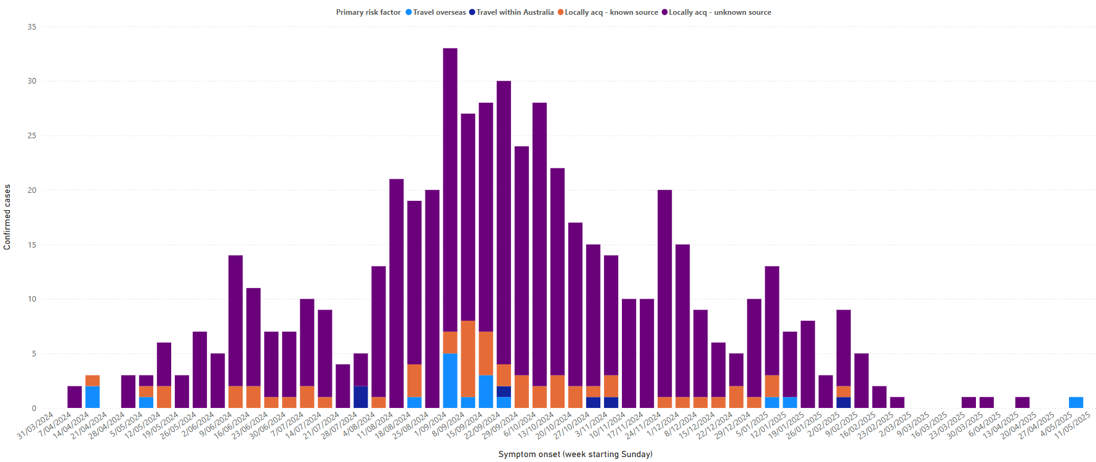
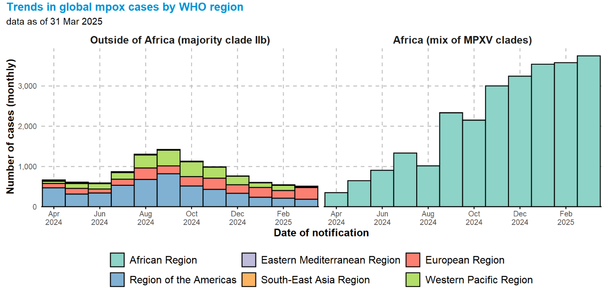
Mpox in Victoria
Mpox is an infectious disease cause by the monkeypox virus, primarily spread through prolonged physical or intimate/sexual contact
Typically mild, self-limiting illness with prodrome and skin rash/pimple-like lesions or sores
There have been declining case numbers in Victoria in recent months, however global risk still high
Ongoing risk of sporadic cases and local transmission given global epidemiology and scope to increase vaccination coverage
Australia recently had our first Clade Ib case in NSW
Mpox is here to stay, remain vigilant and continue to proactively offer vaccination to eligible patients
Mpox cases in Victoria
Source: Dashboard · NNDSS Portal, WHO - Global Mpox Trends

Slide 7
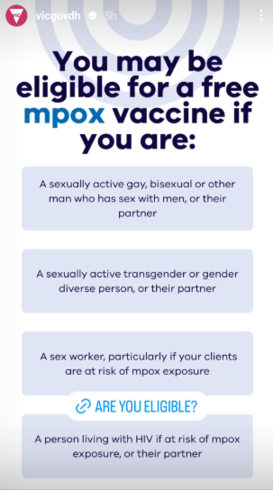
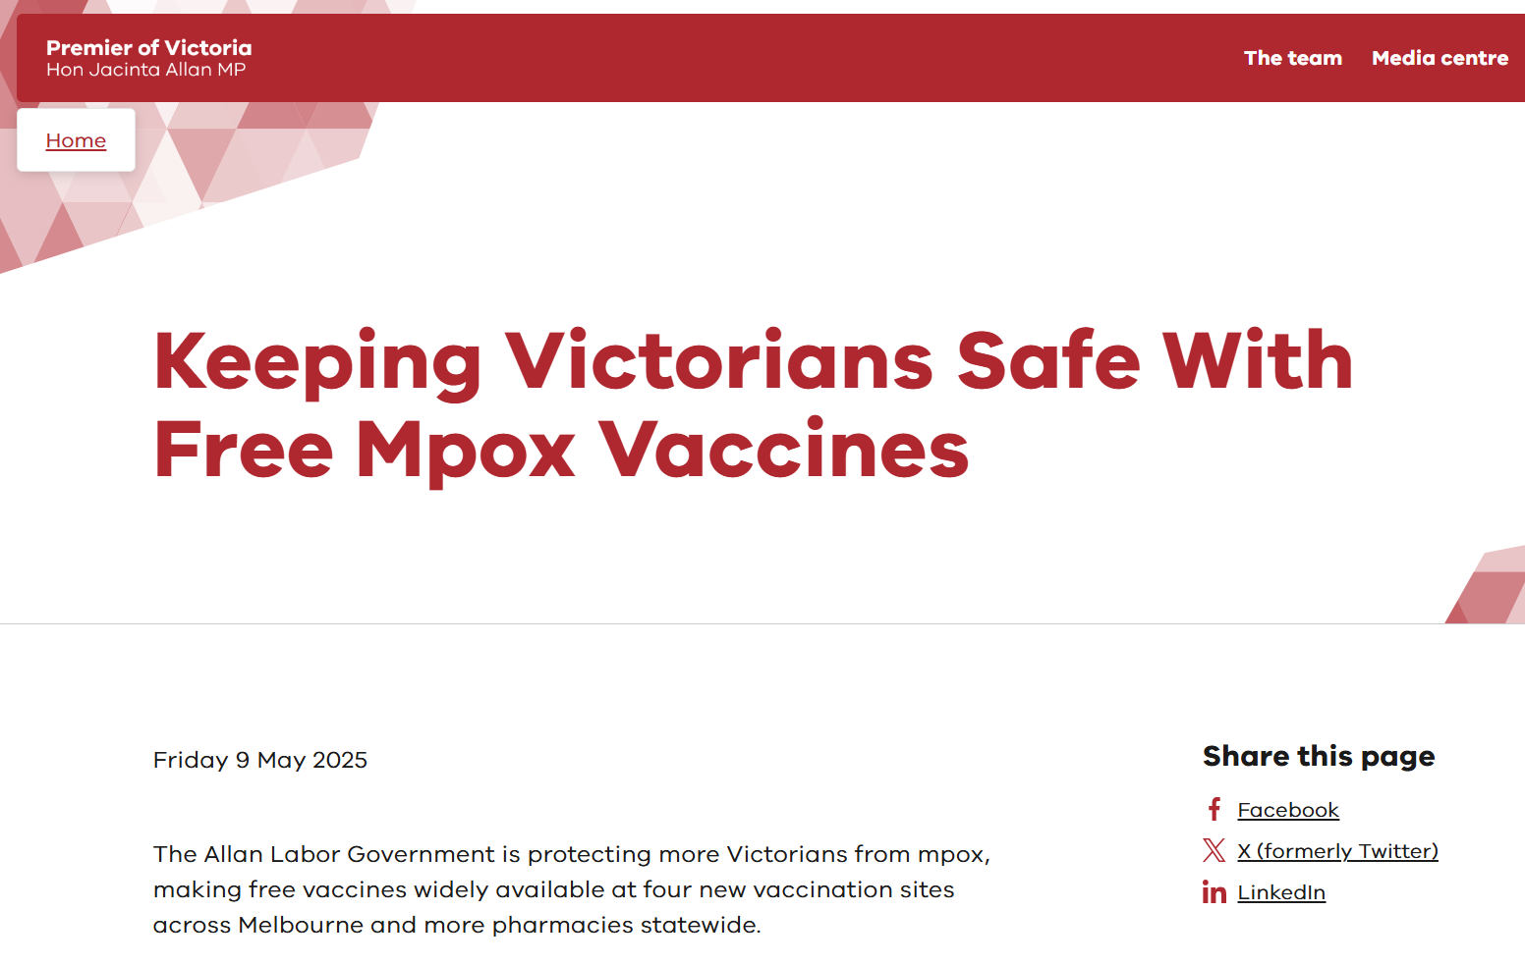
Mpox – vaccination is widely available
Victorian mpox vaccination program
2 doses for optimal protection
Fixed site vaccination clinics
4 extra fixed site clinics in greater Melbourne
Mpox community pharmacy initiative
Medicare not required
Free for eligible at-risk groups, incl. partners
Covers vaccine administration costs in participating pharmacies
Until 30 June 2025*
Remove cost barrier
Notes:
measure and let them know that vax is now very widely available and accessible, and plug the new CPP initiative and free fixed site clinics!
Tell them where to go to get all the info on vax sites/clinics – DH website.

Slide 8
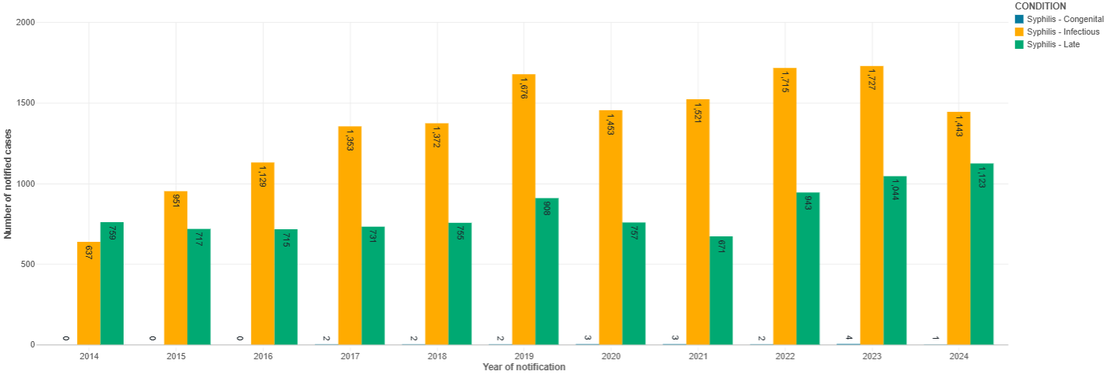
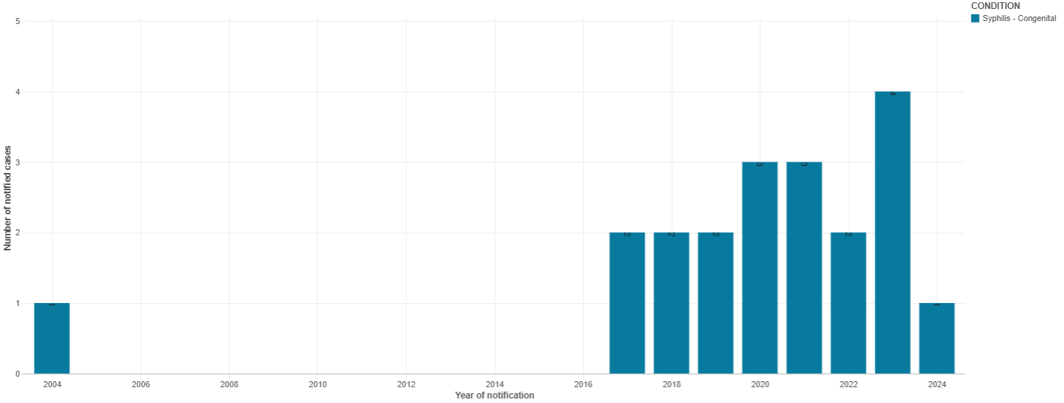
Syphilis in Victoria
Syphilis, one of the oldest known sexually transmissible infections is now resurging at an alarming rate.
Syphilis cases have more than doubled in Victoria the past decade.
Alarmingly, Victoria has seen the re-emergence of congenital syphilis with 18 cases since 2017.
Syphilis notifications in Victoria (2014–2024)
Congenital syphilis notifications in Victoria (2004–2024)

Slide 9
Changes to testing recommendations in pregnancy
In Victoria, all pregnant persons should be tested for syphilis at least three times: at the first antenatal visit, at 26-28 weeks and at 36 weeks/birth (whichever is earlier).
Additionally, neonates should not be discharged without confirming that the mother’s syphilis status has been documented at least once during pregnancy.
Integrated clinical and public health management throughout pregnancy is key for preventing congenital syphilis
Do not delay treatment
Contact trace and treat partners
Beware of reinfection
Help is available from DH and LPHUs with contact tracing and patients lost to follow-up

