Slide 1
Mpox in Victoria
RACGP, 27 February 2025
Dr Helen O’Brien
Senior Medical Adviser (Communicable Diseases)
Office of the Chief Health Officer, Victorian Department of Health
OFFICIAL

Slide 2
Agenda
What is mpox?
Current outbreak in Victoria – epidemiology, public health response
Could it be mpox?
Recent changes to vaccine eligibility
Key messages for GPs

Slide 3
Objectives
Understand the clinical presentation and diagnosis of mpox
Understand recent epidemiology of mpox around the world and in Australia
Learn about current mpox prevention and recent updates to vaccination strategies

Slide 4

RACGP mpox webinar
How confident are you in your current ability to recognise, test and diagnose mpox?
All responses are anonymous
Notes:
https://forms.office.com/Pages/DesignPageV2.aspx?origin=RevampFRE&subpage=design&id=H2DgwKwPnESciKEExOufKDMjfP5hTs1BkKtRdLxeHqBUQ1haUTRESEszMkNUSUZaNTMzTUpLUjJEVC4u&branchingelementid=rec4f629ee9c44544a03485723517d5c4&analysis=false&topview=Presentation

Slide 5
RACGP mpox webinar
How confident are you in your knowledge of mpox vaccination eligibility?
All responses are anonymous
Notes:
https://forms.office.com/Pages/DesignPageV2.aspx?origin=RevampFRE&subpage=design&id=H2DgwKwPnESciKEExOufKDMjfP5hTs1BkKtRdLxeHqBUQ1haUTRESEszMkNUSUZaNTMzTUpLUjJEVC4u&branchingelementid=rec4f629ee9c44544a03485723517d5c4&analysis=false&topview=Presentation

Slide 6


A bit about mpox
What is mpox?
How does it spread?
Mpox is an infectious disease cause by the monkeypox virus.
There are 2 genetic clades of the monkeypox virus, clade I and II.
Clade Ib causes more severe disease & is spreading through the Democratic Republic of Congo and neighbouring African countries
All Australian cases to date have been Clade IIb.
Mpox is primarily spread through prolonged physical or intimate/sexual contact with an infectious person or contaminated materials.
There have been some cases of transmission through respiratory droplets.
Most people with mpox will experience mild signs and symptoms, however it can cause severe disease in certain groups:
Older people
Pregnant women
Children
Those living with HIV or immunosuppressed
Notes:
Image reference: WHO

Slide 7
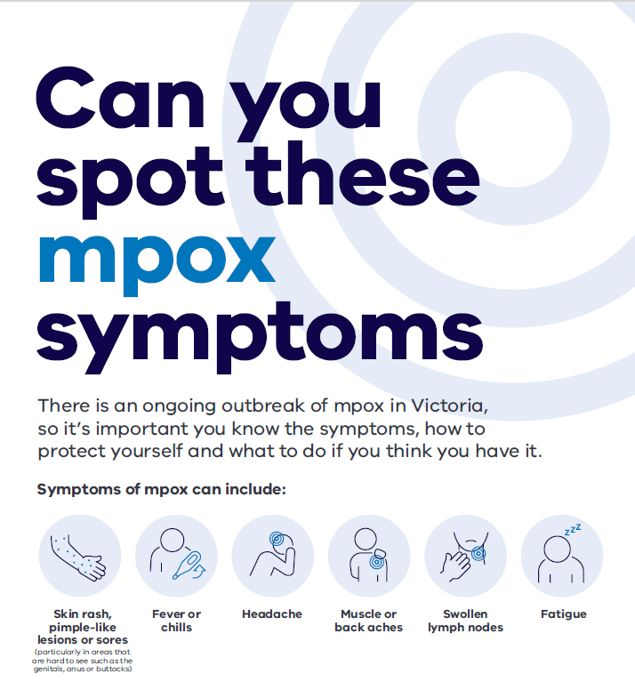
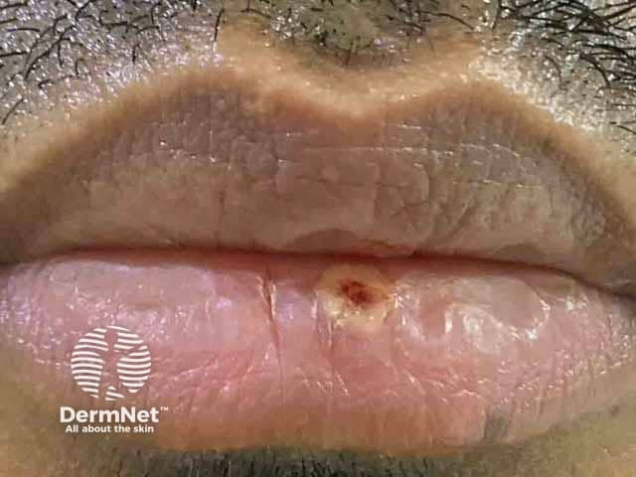
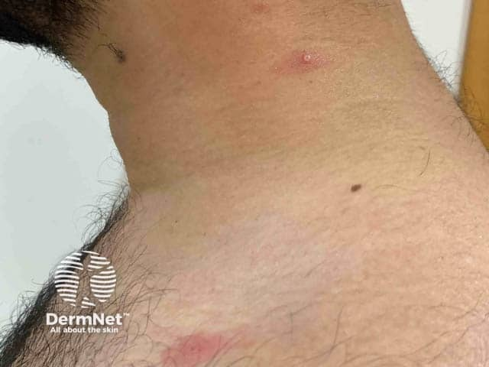
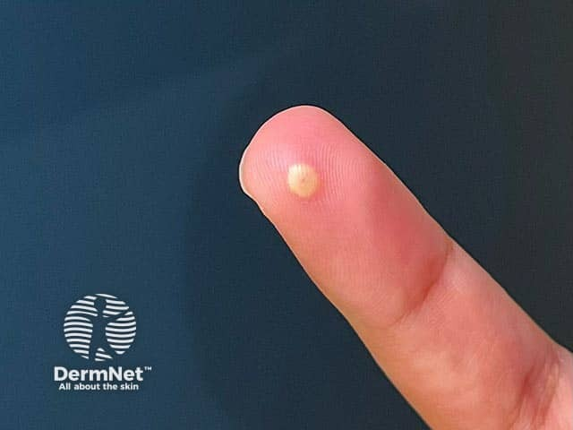
Could it be mpox?
Anyone can get mpox, regardless of sexual orientation, age, race or gender.
Consider mpox where a case has recent new sexual partner, contact with a known or suspected case of mpox or a travel history to a country where mpox is currently common
Symptoms of mpox may be mild and can include:
A prodrome (fever or chills, headache, myalgia or backache, lymphadenopathy, fatigue, sore throat)
A skin rash, pimple-like lesions or sores on the skin (face, limbs, extremities, torso), mucosae (including oral, genital, anal), or symptoms of proctitis/urethritis
Notes:
Image reference: https://dermnetnz.org/topics/mpox

Slide 8
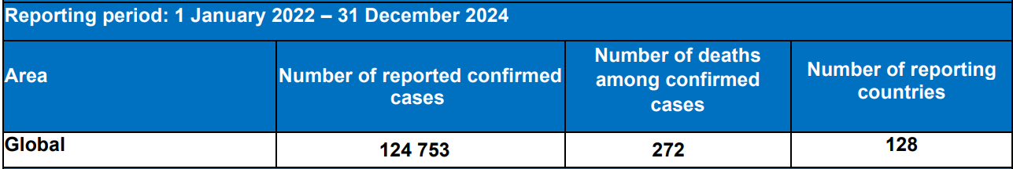
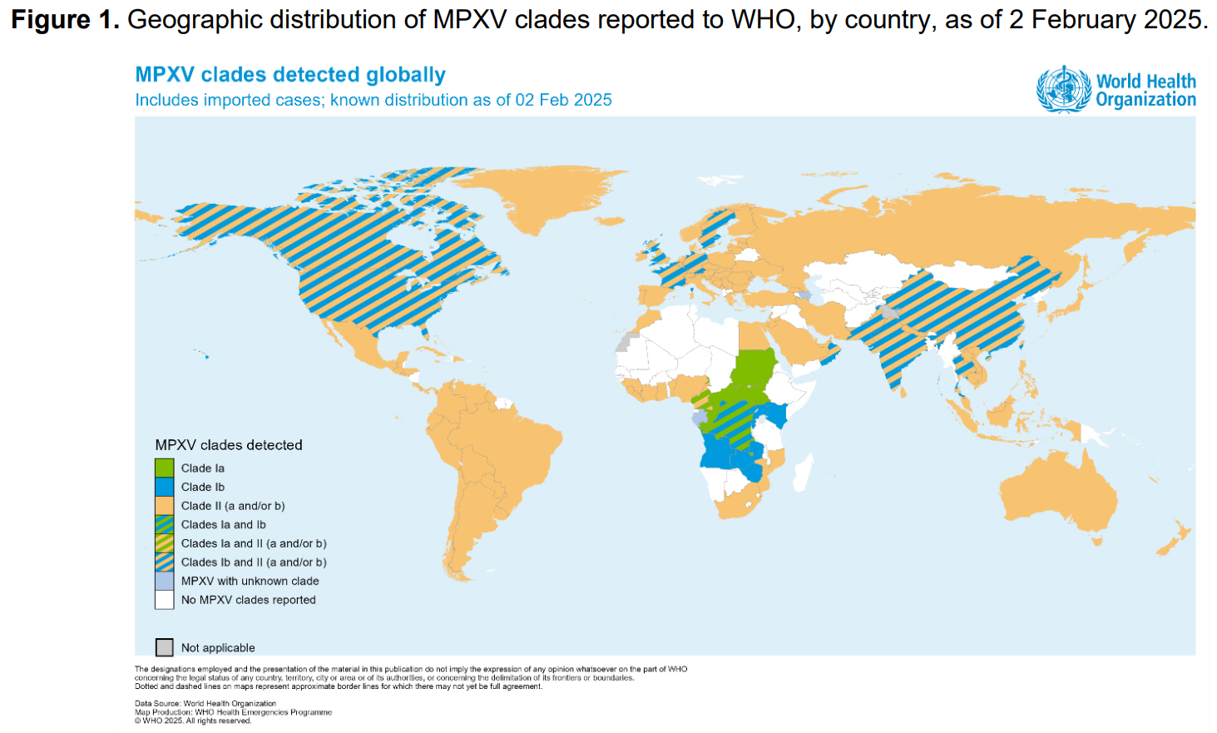
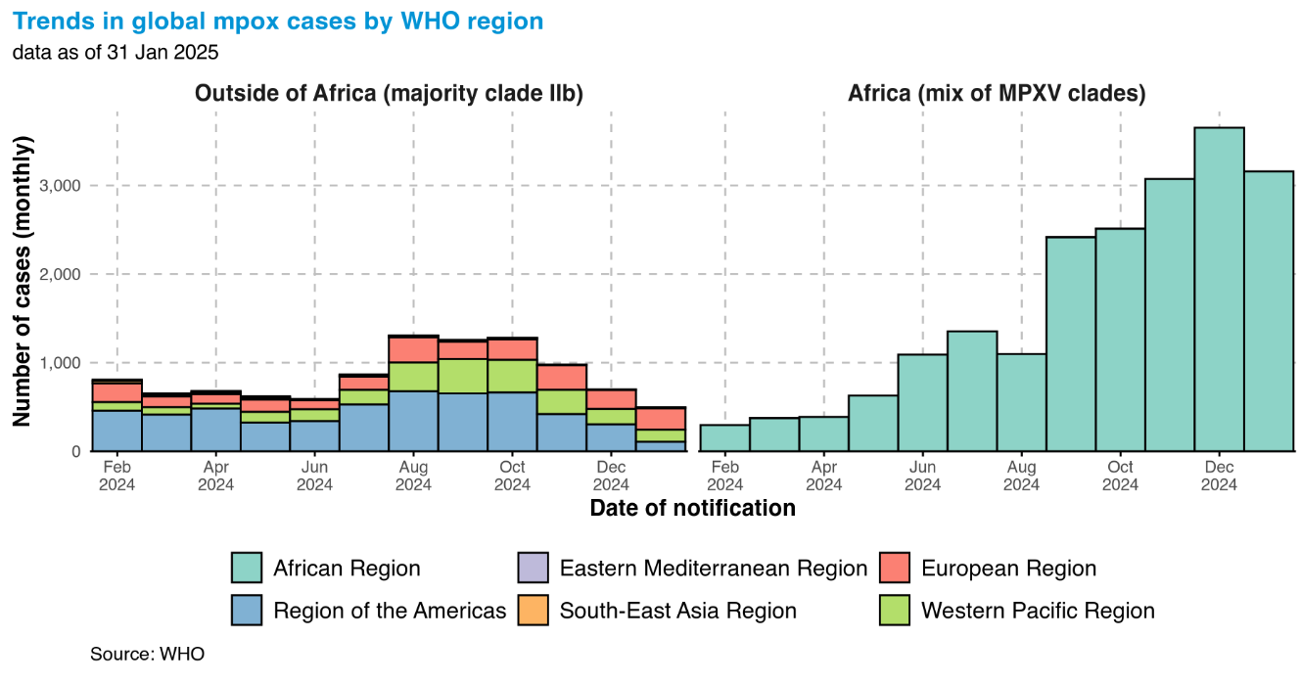
Mpox around the world

Slide 9
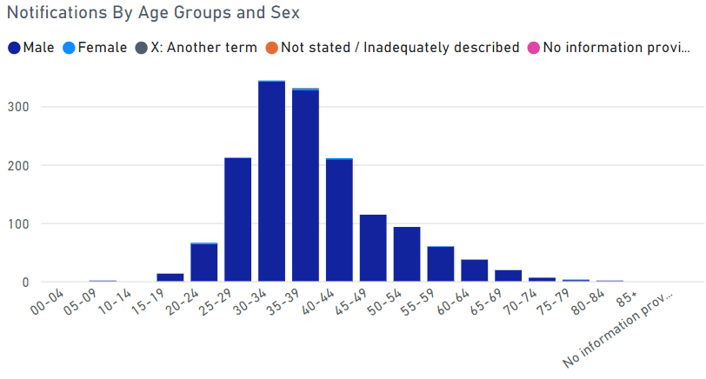
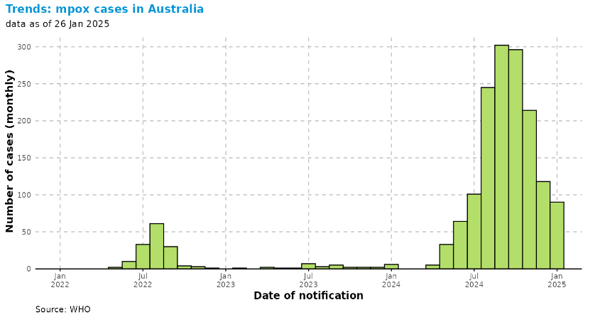
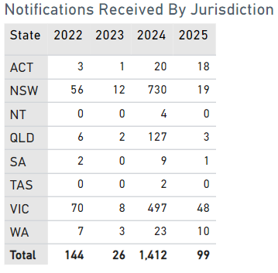
Mpox in Australia
Notes:
In 2024, Australia recorded 1,412 mpox cases, while in 2025, as of February 20, there have been 99 cases nationwide.

Slide 10
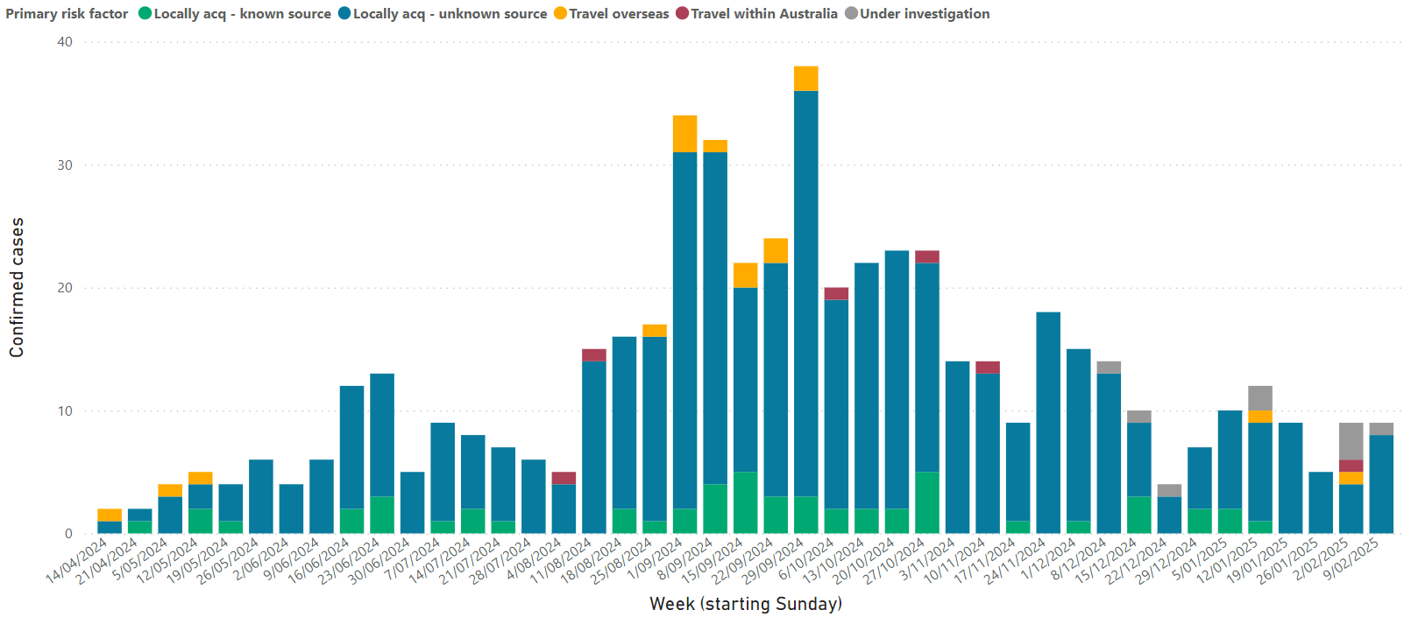
Mpox in Victoria in 2024
Between 14 Apr 2024 and 15 Feb 2025, 543 cases have been notified statewide

Slide 11
Mpox outbreak in Victoria, 2024–25: Acquisition and Demographics (n=543 cases)
99% male, mostly identify as GBMSM, median age 36 yrs.
90% report MSM contact. 19 reports (3%) of M-F or F-M transmission. 6 female cases (1%).
Attendance at sex-on-premises venues, participating in group sex, or attending GBMSM-focused, sex-positive events: 33%
Hospital admissions: 54 (10%), including two ICU admissions to date. ED attendances: 46 (8%).
PLHIV: 22%
On PrEP (of HIV –ve): 61%
Vaccination status | Number (%)
Fully vaccinated (2 doses) | 214 (39%)
Partially vaccinated (1 dose) | 100 (18%)
Not vaccinated | 210 (39%)
Unknown | 19 (3%)

Slide 12
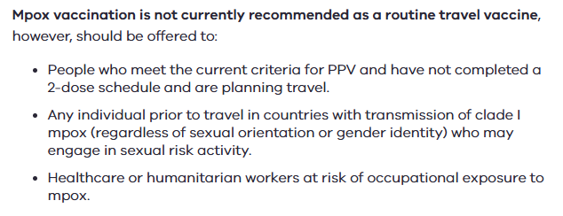
In Victoria, the mpox vaccine is available free-of-charge for eligible people
Mpox vaccine
Eligibility
2 doses JYNNEOS® vaccine, at least 28 days apart (SC)
Requires 14 days for maximum protection.
People who are vaccinated can still get mpox, but they may have milder symptoms, and it may reduce the risk of hospitalisation.
Available at sexual health clinics, some GPs, community pharmacies, hospitals and some local councils – could you offer mpox vaccination in your practice?
Sexually active GBMSM, sexually active transgender and gender diverse people, if at risk of exposure
Sex workers, sex-on-premises venue staff and attendees
People living with HIV, if at risk of exposure
Sexual partners of the above
Lab staff working with orthopoxviruses and some healthcare workers at risk
Recent updates to eligibility

Slide 13


Key messages for GPs
Who is at risk
Anyone can get mpox, regardless of sexual orientation, age, race or gender.
Assumptions create barriers – ask open-ended, inclusive questions to reduce stigma around seeking mpox testing and vaccination
Testing
Testing for mpox is easy and should be integrated into sexual health consultations.
Test all patients with compatible symptoms (including anogenital lesions, rash, proctitis) even if the symptoms are mild.
Consider testing for mpox alongside other conditions, such as HSV, syphilis, chlamydia and gonorrhoea.
Send samples to VIDRL (mark URGENT).

Slide 14

Key messages for GPs (cont)
Vaccination
Offer mpox vaccination to all sexually active people at risk of mpox or eligible travellers (patients do not need to say which of the eligibility criteria they meet).
Integrate mpox vaccination into routine sexual health and travel consultations.
It is strongly recommended immunisation providers report all mpox vaccinations to the Australian Immunisation Register (AIR). However, if this is a barrier to vaccination, respect the wishes of the patient.
Anyone identifying themselves as at risk of mpox should not be denied vaccination.
If you’re unable to provide the mpox vaccine, make sure to refer your patients to a local vaccination provider.
For a list of providers & referral pathways, see: www.betterhealth.vic.gov.au/mpox-immunisation-providers

Slide 15

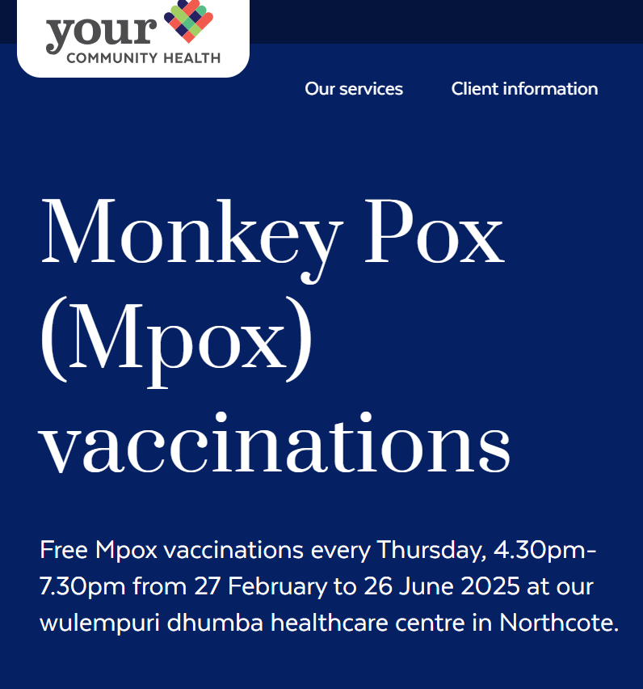
Free mpox vaccine clinics
Notes:
Also there are a number of fixed sites operating where vaccination is completely free for the patient, running at accessible times. Thorne Harbour Health have been running a Saturday walk-in clinic at their Abbotsford site, and this week Your Community Health have opened another free vaccine walk-in clinic at their Northcote site. See our website and partner organisation websites for the latest on fixed site free vaccine access.

Slide 16

Key messages for GPs (cont)
Case and contact management
Public health management guidelines were updated in late 2024, now less restrictive case and contact advice.
Advise patients to cover lesions and abstain from sexual activity while awaiting the result. If +ve, LPHU will provide further advice.
Reassure patients with suspected or confirmed mpox that they will generally be able to go about their daily activities, with some measures in place to reduce the risk of further transmission.
Anonymous partner notification pathways/websites available.
Consider pain management (e.g. OTC analgesia, etc.).
Resources for clinicians available at: www.health.vic.gov.au/infectious-diseases/mpox-monkeypox (posters, clinician factsheet etc.).
Be vigilant for Clade Ib in returned travellers.
Notes:
Also new THH video ‘Could it be mpox?’ for clinicians – will circulate after.

Slide 17
Acknowledgements
Thank you to the many partner organisations and individuals who have been working on the public health response to mpox and providing feedback, including:
Local Public Health Units
Thorne Harbour Health
Melbourne Sexual Health Centre
Victorian Infectious Diseases Reference Laboratory

