Slide 1
Breast density reporting in BreastScreen Victoria’s program
Dr David Speakman

Slide 3
About the BreastScreen Victoria program

Slide 4
BreastScreen Victoria program
Population screening program for breast cancer
For women and eligible trans and gender diverse people
Free
Mammogram every two years
(annual for some higher-risk people)
People aged 50-74 receive invitations/reminders to screen. People aged 40-49 and over 74 are also eligible
For people without symptoms

Slide 5
Screen all patients for risk factors
Consider using a risk assessment tool such as iPrevent
Age above 50
Lifestyle
  Smoking
  Alcohol
  Obesity
  Diet
  Exercise
Personal history of breast or ovarian cancer
Strong family history of breast or ovarian cancer
Genetic mutations such as BRCA1 or BRCA2
Ashkenazi Jewish heritage
HRT use
Breast density

Slide 6
About breast density

Slide 7
What is breast density?
Breasts are made up of a combination of tissue:
  Fatty tissue
  Glandular tissue
  Connective/fibrous tissue
Women with high breast density have more fibroglandular tissue and less fatty tissue
Breast density is commonly classified into four categories (A, B, C & D)
Dense breasts are common, most women fall into categories B & C
Can only be measured from a mammogram

Slide 8
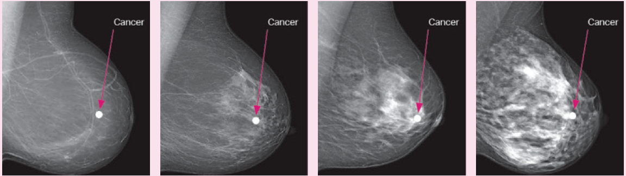
Fatty
Dense
Category a | Category b | Category c | Category d
10% of women | 40% of women | 40% of women | 10% of women
Almost entirely fatty | Scattered areas of fibroglandular density | Heterogeneously dense | Extremely dense
Breast imaging reporting and data systems (5th edition)

Slide 9
Why is breast density important?
Masking effect
Dense breast tissue can mask the appearance of cancers in a mammogram, making them harder to detect
Risk
High breast density can increase a person’s risk of developing breast cancer
  Risk should be considered in the context of other risk factors

Slide 10
What influences breast density?
Age, particularly after menopause
Genetics
BMI
Hormone therapy
Having had children
Tamoxifen

Slide 11
What are the recommended options for patients with dense breasts?

Slide 12
Key considerations
Mammograms still detect the majority of breast cancers
Breast density should be considered alongside other risk factors
Encourage patients to reduce their risk with lifestyle modifications
A risk tool such as iPrevent or the Tyrer-Cuzick risk model can be used to facilitate discussions with patients
All patients, regardless of breast density, should be encouraged to stay breast aware and continue to regularly screen
Options should be considered in the context of the patient’s:
  Other risk factors
  Personal circumstances
  Preferences

Slide 13
Supplementary tests
Supplementary tests are not currently available as part of the BreastScreen program
High breast density alone does not necessarily mean a patient needs additional imaging
Can consider:
  MRI
  Ultrasound
  Tomosynthesis
  Contrast enhanced mammography

Slide 14
Comparison of imaging modalities
 | 2D MMG | Tomosynthesis | CEM | MRI
Radiation | Yes | Yes | Yes | No
Compression | Yes | Yes | Yes | No
IV contrast | No | No | Yes | Yes
False negative | Current standard of care | Better | Better | Better
False positive | Low, current standard of care | Low | ?Lower | Higher
Contraindication | N/A | N/A | Iodine allergy | Implanted metal e.g., pacemaker
Rebate for screening | Available free at BreastScreen | Maybe, see MBS item 59300 | Maybe, see MBS item 59300 | Sometimes, see MBS item 63464

Slide 15
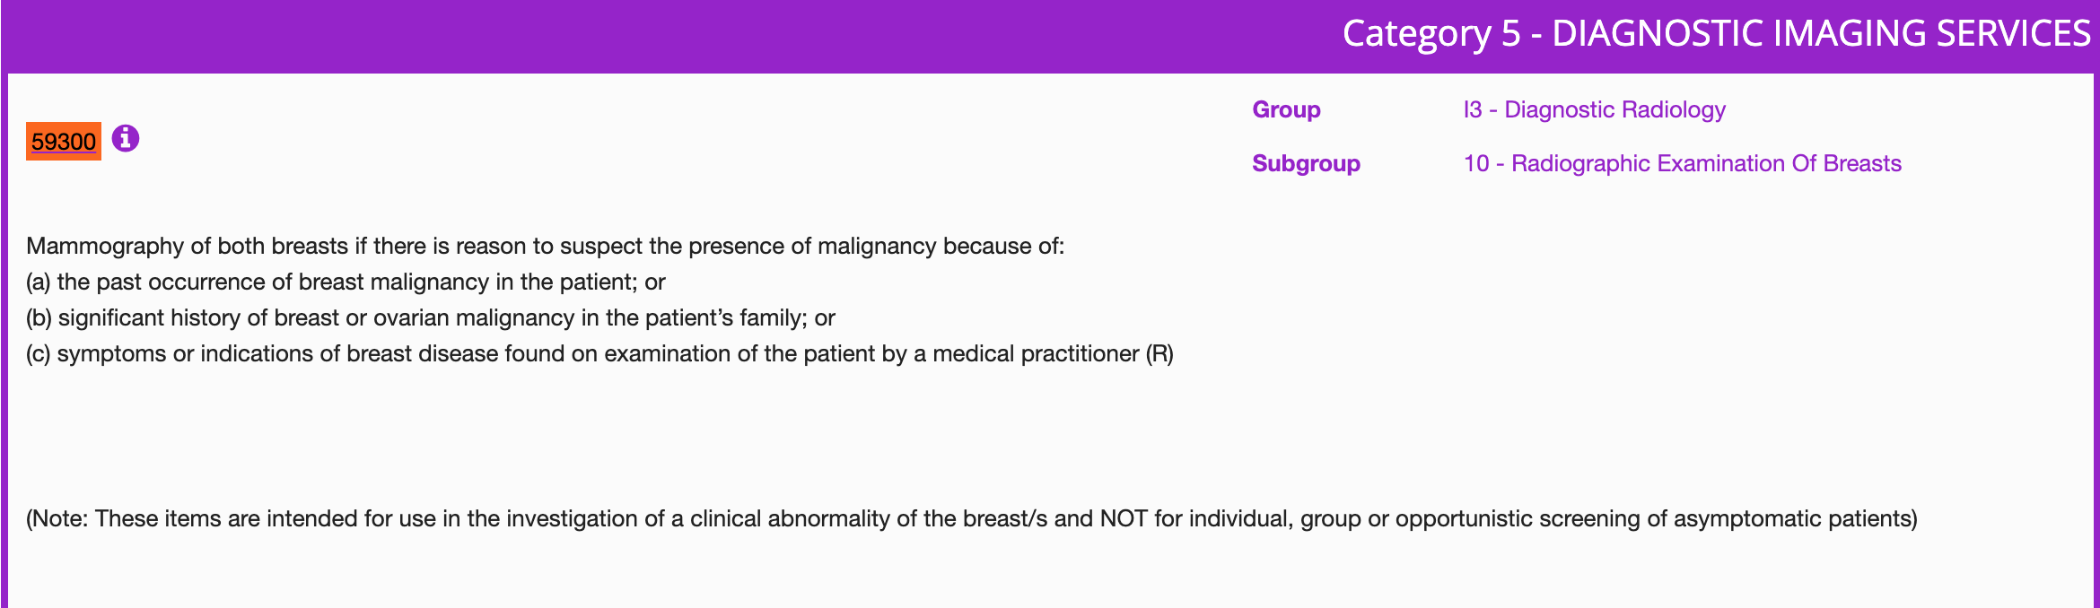
MBS Items
Item 59300
Item 63464: MRI: Eligibility for MRI
A lifetime risk estimation greater than 30% or a 10 year absolute risk estimation greater than 5% using a clinically relevant risk evaluation algorithm (accepted algorithm is the Tyrer-Cuzick algorithm version 8 or later – breast density is an input)
Or use iPrevent

Slide 16
Case study
Female patient
Age 54
Category D breast density
Mother diagnosed with breast cancer when 55
Overweight
Smoker
Discuss the patient’s risk factors with them
  Consider using a tool such as iPrevent
Encourage patient to modify lifestyle – diet, exercise, smoking
Discuss supplementary testing with patient

Slide 17
Case study
Female patient
Age 72
Category C breast density
No family history
Non-drinker
Very active
Discuss the patient’s risk factors with them
  Consider using a tool such as iPrevent
Encourage patient to maintain lifestyle
Unless indicated otherwise by other risk factors, supplementary testing unlikely to be warranted

Slide 18
Case study
Female patient
Age 63
Category B breast density
Two aunts diagnosed with breast cancer in their 60s
BMI 26
Drinks 1-2 days/week
Discuss the patient’s risk factors with them
  Consider using a tool such as iPrevent
Encourage patient to modify lifestyle – diet, exercise, alcohol
Encourage patient to stay breast aware and continue to have a regular mammogram

