Slide 1





THE NATIONAL CERVICAL SCREENING PROGRAM GUIDELINES
Dr Rebecca Starkie, Medical Educator
Australian Centre for the Prevention of Cervical Cancer
RACGP May 2025

Slide 2

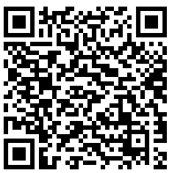
2025 NCSP GUIDELINE UPDATES
Effective from April 14th 2025
The Cervical Screening Clinical Guidelines came into effect on 14 April 2025.
This means that self-collection will be an option for those people who are completing Test of Cure.
Access the cervical screening guidelines via the Cancer Council Australia website, or directly via the MAGICapp platform:
www.cancer.org.au/clinical-guidelines/cervical-cancer/cervical-cancer-screening

Slide 3







SUMMARY OF CHANGES IN 2025
National Cervical Screening Guidelines
Guidelines shifted to MagicAPP platform, creating a more user-friendly experience
New chapter ‘Cervical screening in clinical practice’ which includes links to resources
Changes to post-treatment management for people who have been treated for HSIL
Categories of people considered immune-deficient clarified and expanded
Change in recommendation for screening participants with HPV (not 16/18) detected on a self-collected sample who do not return for cytology until 9 months or more after the HPV test
Screening after total hysterectomy (where indicated) simplified to annual testing
Changes to surveillance following treatment of AIS

Slide 4
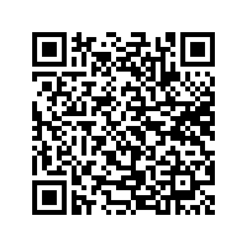
NEW RESOURCE AVAILABLE
Summary of the guideline updates
New resource is now available summarising the updated guidelines.
https://acpcc.org.au/wp-content/uploads/2025/02/updated-CS-guidlines-April-2025.pdf

Slide 5
SUMMARY OF CHANGES IN 2025
National Cervical Screening Guidelines
Guidelines shifted to MagicAPP platform, creating a more user-friendly experience
New chapter ‘Cervical screening in clinical practice’ which includes links to resources
Changes to post-treatment management for people who have been treated for HSIL
Categories of people considered immune-deficient clarified and expanded
Change in recommendation for screening participants with HPV (not 16/18) detected on a self-collected sample who do not return for cytology until 9 months or more after the HPV test
Screening after total hysterectomy (where indicated) simplified to annual testing
Changes to surveillance following treatment of AIS

Slide 6
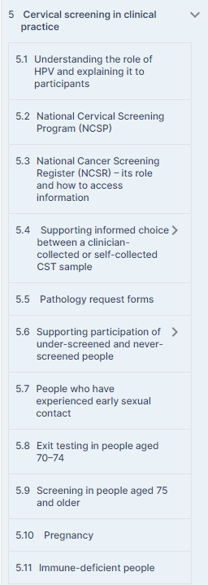
2. NEW SECTION
Chapter 5: Cervical screening in clinical practice
Brings together into one location the most important concepts and information for those performing cervical screening, particularly in the primary care setting.
Also links to other specific sections, such as ‘Management of HPV test results’ and ‘Screening and management in specific populations’,
Also links to NCSP and other updated resources including the NCSP Healthcare provider toolkit, which supports healthcare providers in engaging under-screened and never-screened people in cervical screening.

Slide 7
4. CHANGES TO TEST OF CURE
Test of Cure refresher
The risk of recurrence and invasive cervical cancer remains elevated for 10–25 years in people who have been treated for HSIL [CIN2/3]
Post-treatment surveillance (‘Test of cure’) is important to detect residual or recurrent disease
  2 x negative tests
‘Test of cure’ following treatment for HSIL involves annual testing, until:
  1 year apart (consecutive tests)
  Before they are considered ‘baseline’ risk and can return to 5 yearly screening

Slide 8


CHANGES TO TEST OF CURE
Following treatment for HSIL
2024
2025 (NEW GUIDELINES)
Annual co-tests until 2 x consecutive negative tests (negative HPV and LBC)
Annual HPV tests until 2 x consecutive test with HPV not detected
Recommendation
Self-collection an option?

Slide 9
5. REPEAT SELF-COLLECT AT 9 MONTHS
If have not returned for cytology after HPV (not 16/18) detected
LBC must be performed when HPV (not 16/18) detected to determine risk and further management
If self-collected → return within 6 weeks for LBC
offer a follow-up self-collected HPV test, rather than LBC
However, for those who do not return until 9 months or more after the HPV test:
this will determine if the HPV infection has now been cleared and the person can return to routine screening
An estimated 67% of infections resolve by 12 months

Slide 10
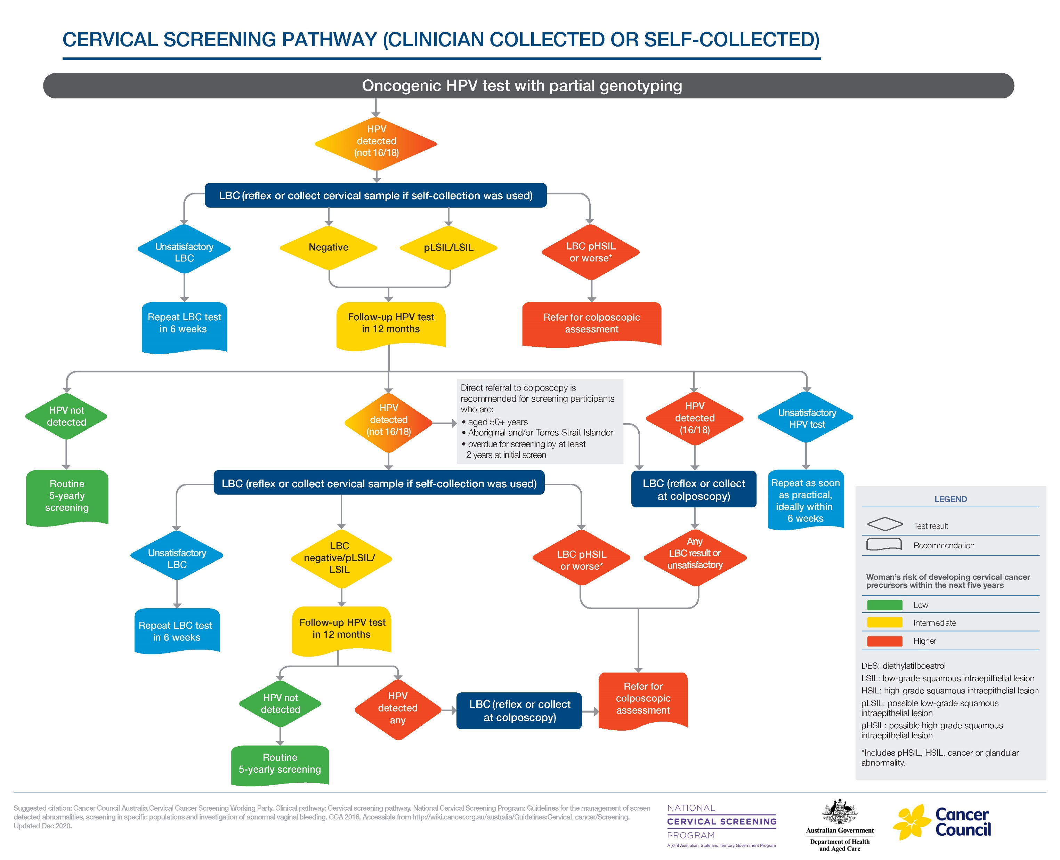
offer a follow-up self-collected HPV test, rather than LBC
For those who do not return until 9 months or more after the self-collected HPV test:
this will determine if the HPV infection has now been cleared and the person can return to routine screening
Cancer Council Australia Cervical Cancer Screening Working Party. Clinical pathway: Cervical screening pathway. National Cervical Screening Program Guidelines for the management of screen detected abnormalities, screening in specific populations and investigation of abnormal vaginal bleeding. Accessible from http://wiki.cancer.org.au/australia/GuidelinesCervical_cancer/Screening. Updated Dec 2020.

Slide 11
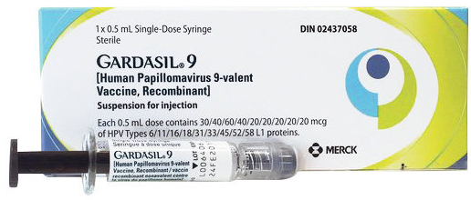
HPV VACCINATION REMINDER
Free catch-up program through primary care, up to age of 26. First cervical screen is a good opportunity
HPV
implicated in cervical oropharyngeal, anal and vulval/vaginal cancers
1 dose recommended between ages 9 – 25 if immunocompetent
*84% HPV VACCINATION COVERAGE IN 2023, A REDUCTION FROM 2022
3 doses recommended if ≥ 26 or severely immunosuppressed at any age
*Brotherton et al. 2024 Cervical Cancer Elimination Progress Report: Australia’s progress towards the elimination of cervical cancer as a public health problem. Published online 14/03/2025, Melbourne, Australia, at https://www.cervicalcancercontrol.org.au

Slide 12


THANK YOU!

