Slide 1

Victorian Long COVID Health survey
18/10/23
Dr Lance Emerson
CEO and Deputy Secretary – Victorian Agency for Health Information
Department of Health, Victoria

Slide 2
CONFIDENTIAL
Not to be distributed further
Please note that these data / results are not yet publicly available, and are not to be distributed further.
They are provided for the purpose of clinical care and quality & safety.
The full results will be published in an upcoming MJA supplement.
2

Slide 3



About the Long COVID Health Survey
Conducted to understand the impact of long COVID
on the Victorian population and health system
Random stratified sample of Victorians aged 18+,
sourced from the Department’s Transmission and
Response Epidemiology Victoria database
45 questions on health, quality of life and
health services accessed
3

Slide 4



Criteria for classifying long COVID adapted from
World Health Organisation (WHO) clinical definition
COVID infection
% classified as having long COVID
=
Not fully or mostly recovered at
3 months after their first infection
Reported still experiencing 1 or
more new persistent symptom/s
(>2 month duration) at time of survey
4

Slide 5
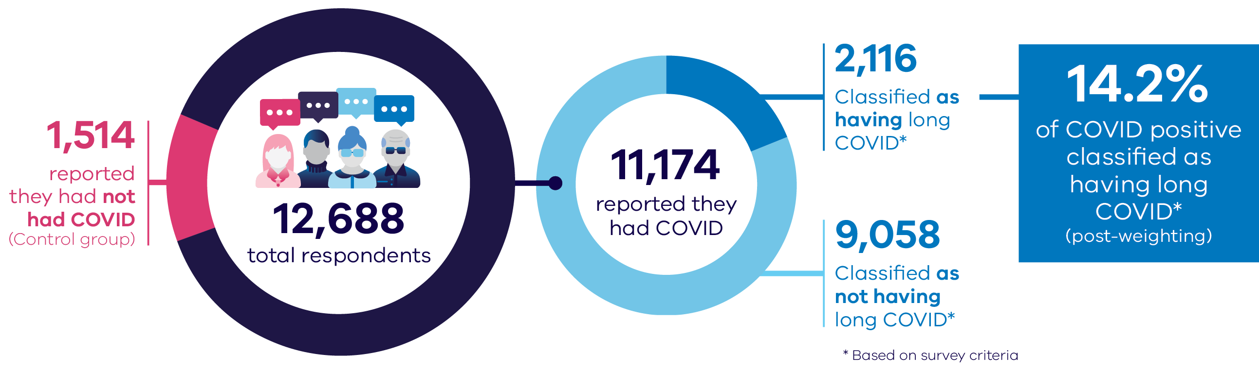
About the Long COVID Health Survey
Sample source:
COVID positive and close contacts aged 18+ from
the Transmission and Response Epidemiology Victoria (TREVI) database
Infection dates:
January 2020–October 2022
(Controls sourced from
close contact database:
January 2020–November 2021)
Data collection dates:
September 2022–April 2023
Data weighted by:
Age, gender, location
and education
5

Slide 6

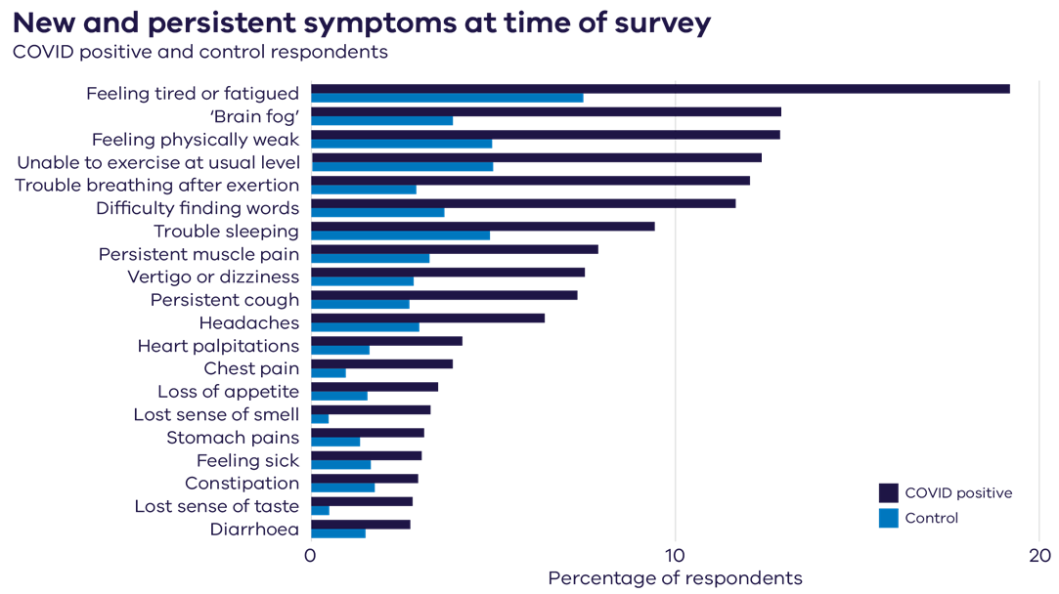
Fatigue, ‘brain fog’ and physical weakness were the most common persistent symptoms among COVID positive respondents
Note: Reference date for COVID positive was their infection date and for control groups, November 2021.
6

Slide 7

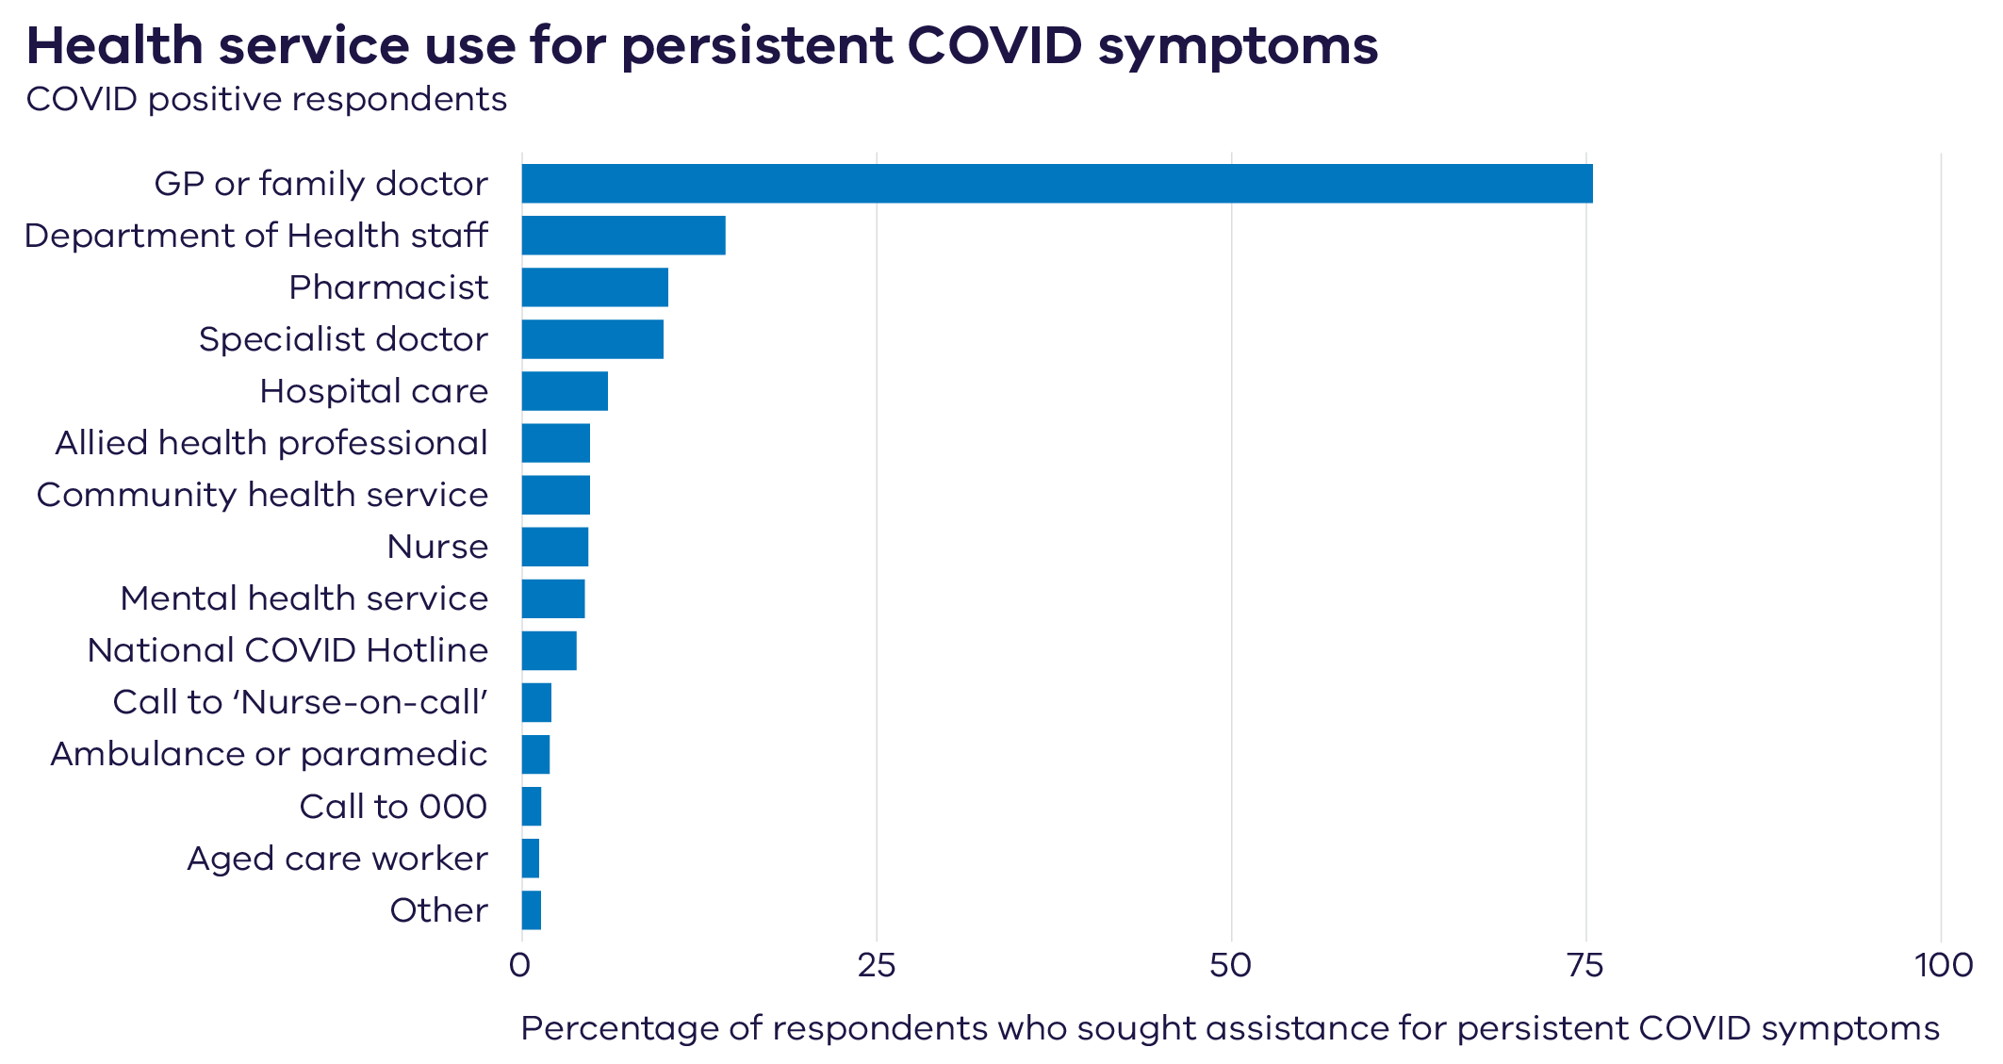
GPs were the most common health service used for persistent
COVID symptoms
Q13. Thinking about the time after you had COVID in (month), have you received medical assistance or treatment for ongoing or persistent COVID symptoms from any of the following?
This could include in-person, or by telephone or video call (telehealth).
Base: 3,063 (COVID positive respondents and received assistance)
Excludes 8,061 respondents who reported “None of the above” assistance or treatment”, “Not sure” (n = 44) or “Prefer not to say” (n = 9)
7

Slide 8

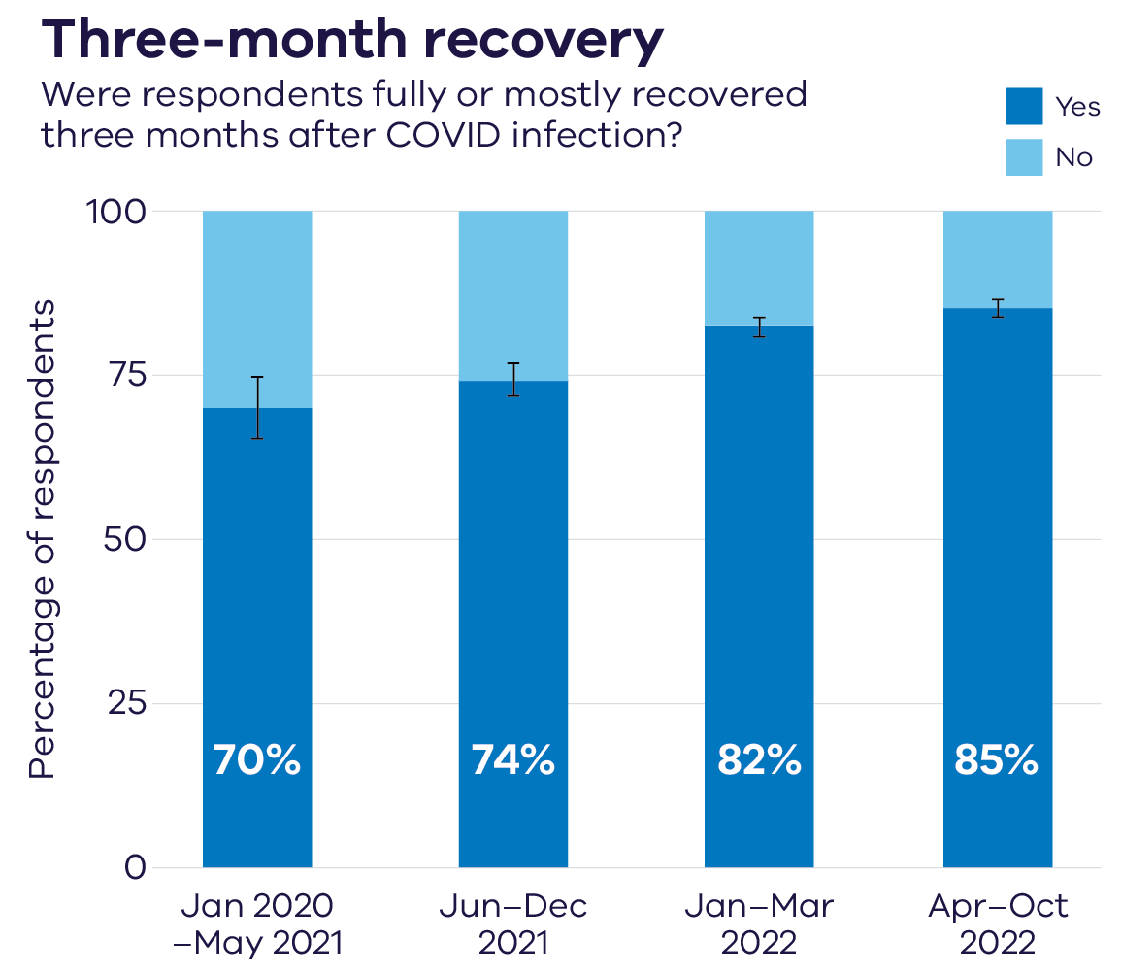
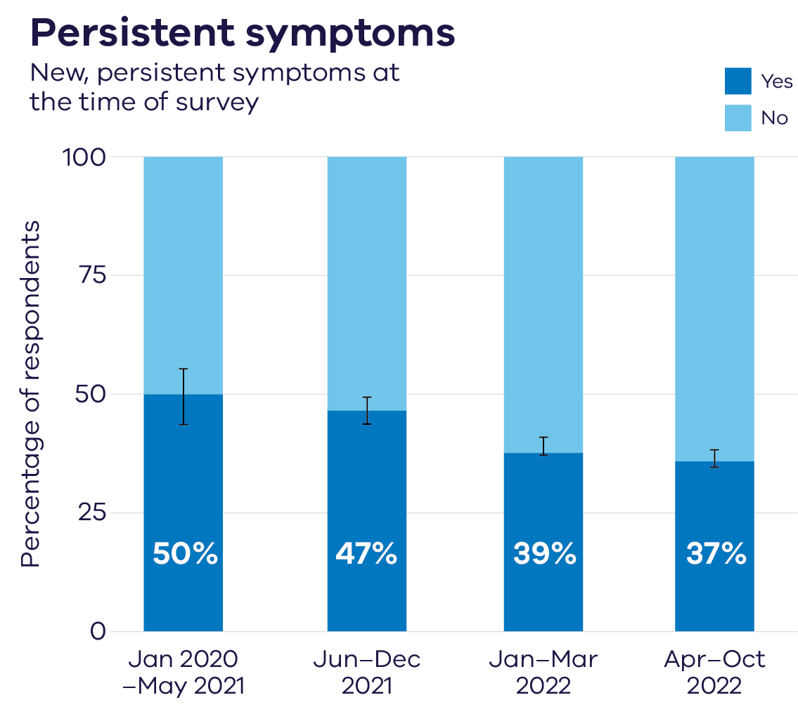
Recovery and outcomes were better for respondents with more recent COVID infections
Q32/33 “Before you got COVID” (COVID positive) have you experienced any of the following symptoms that lasted two months or more? Did you experience (condition from Q32) before you had COVID? Are you still experiencing (condition from Q32)?
Total base: 11,174 (COVID positive respondents)
Q12 Three months after the time you got COVID how recovered and back to normal did you feel? Fully or mostly recovered is defined as either Q12 value 1 or 2
Total base: 11,149 (COVID positive respondents)
8

Slide 9

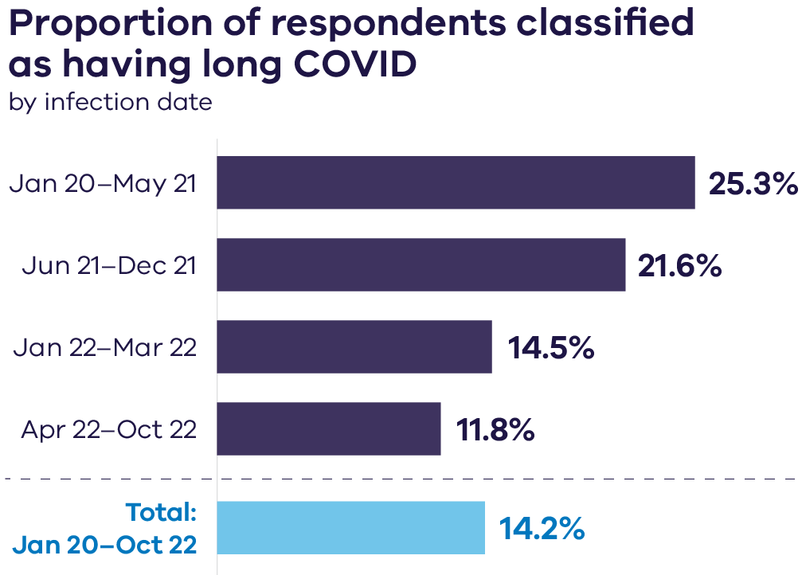
The proportion of long COVID respondents was lower for more recent infections
Total recorded Victorian COVID cases
20,599
811,719
735,797
1,062,193
2,630,308
Total base n = 11,174 – COVID positive sample
9

Slide 10

What does the survey tell us about respondents who were classified as having long COVID?
62%
40%
97%
Female gender
Aged 40-59
Symptomatic acute COVID
(50% for not long COVID)
(32% for not long COVID)
(90% for not long COVID)
8%
46%
Reported receiving
hospital care for
acute COVID
Recalled slight to extreme anxiety/depression before first infection
(2% for not long COVID)
(30% for not long COVID)
Base: 2,116 COVID positive respondents classified as having Long COVID;
9,058 COVID positive respondents not classified as Long COVID
10

Slide 11

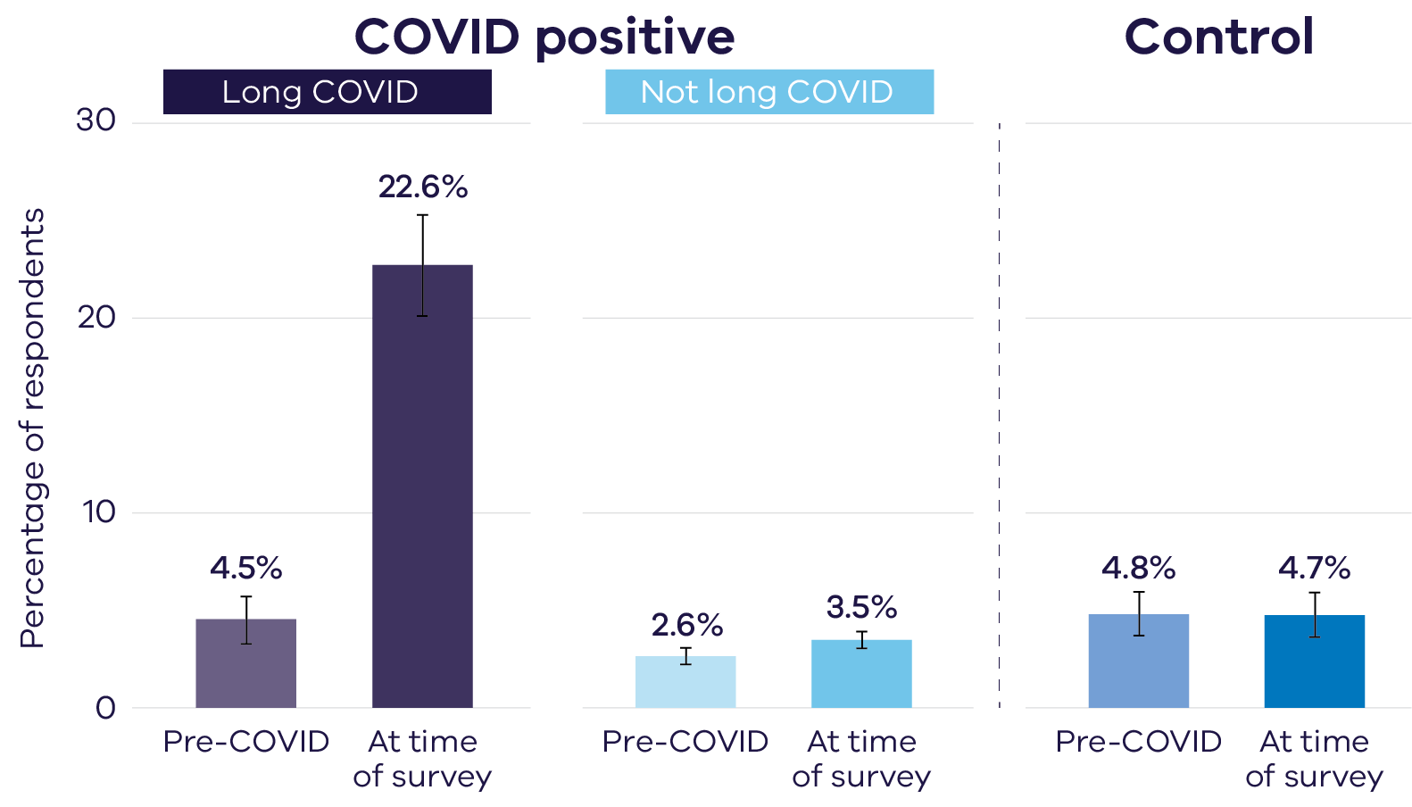
Respondents classified as having long COVID were more likely to report problems with their usual activities
At least moderate problems with usual activities
Q25 a/b. (Usual activities EQ-5D-5L question) How would you best describe your usual activities? (e.g. work, study, housework, family or leisure activities) a: Today, b: Before you got COVID (COVID positive)/In November 2021 Values: 1: No problems doing my usual activities, 2: Slight problems doing my usual activities, 3: Moderate problems doing my usual activities, 4: Severe problems doing my usual activities, 5: Unable to do my usual activities All respondents were asked Q25a/b. (Base: 12,673)
11

Slide 12






Other characteristics of respondents classified as having long COVID
20.3% reported a 20+ point decline on 0–100 scale of overall health
at time of survey, compared to before first COVID infection
22.9% reported new moderate or severe problems, or they were
unable to do their usual activities when reflecting on their usual activities before COVID
26.0% reported they had been told by a doctor they had long COVID*
10.5% reported receiving care from a specialist for persistent
COVID symptoms
Total base: 2042 (Long COVID classified respondents)
* New question only asked in Phase 2 data collection
12

Slide 13

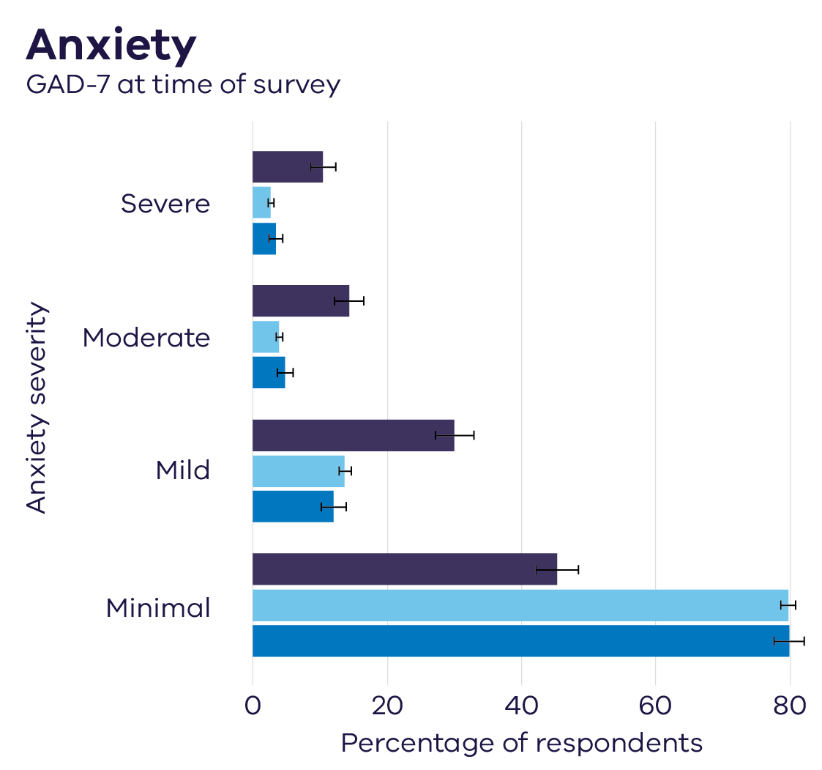
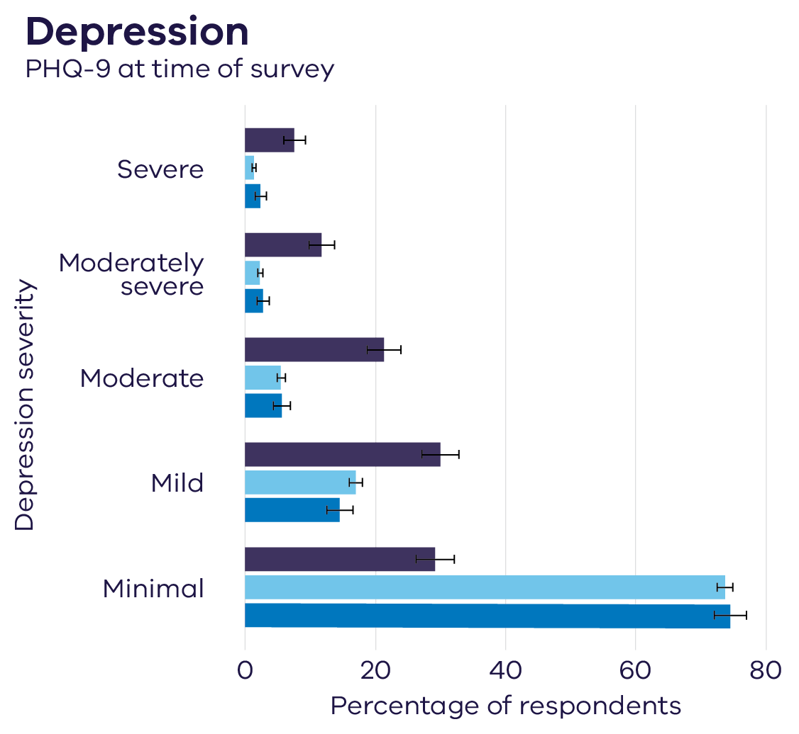

Respondents classified as having long COVID were more likely to report more anxiety, and depression at the time of the survey
GAD-7: Generalized anxiety disorder 7-item. Screening tool for generalised anxiety disorder, PHQ-9: Patient health questionnaire 9-item depression subscale. Scale for assessing depression
Q36 The following questions are about how you have been feeling recently. Over the last 2 weeks, how often, if at all, have you been bothered by any of the following problems? (GAD-7 and PHQ-9 standard statements) GAD7 Anxiety scale Base: 12,609, Depression PH9 base: 12,557 1. Mental Health and COVID-19: Early evidence of the pandemic’s impact: Scientific brief, 2 March 2022, https://www.who.int/publications/i/item/WHO-2019-nCoV-Sci_Brief-Mental_health-2022.1

Slide 14

In summary
14.2% of
COVID positive respondents with infections from
January 2020– October 2022 were classified as having long COVID.
Respondents who had COVID later in the pandemic generally reported better outcomes. However, many more Victorians were infected later in the pandemic.
General Practitioners/ family doctors experienced the greatest burden for treating persistent COVID symptoms.
A group of long COVID respondents appeared to be experiencing greater impact on their quality of life. Anxiety or depression was also more common among those with long COVID.
The Victorian Long COVID Health Survey findings on post-COVID symptoms and risk factors were consistent with international long COVID research.
14

Slide 15
Further research possibilities
77% of respondents consented for their survey data to be linked with DH datasets
Long COVID Health Survey
data
Administrative
data sets
MBS
PBS
Research opportunities:
Assessing the effect of vaccination and antiviral use on long COVID risk
AIR
TREVI
Examining long COVID patient service use and experience in the health system
Includes survey data on:
Health service use
Persistent symptoms
Acute COVID recovery
Mental health
Derived long COVID status
VAED
VEMD
Tracking health and mental health outcomes for long COVID cases
VINAH
CMI
67% of respondents consented to being re-contacted for follow-up surveys
AIR Australian Immunisation Register
CMI Client Management Interface (mental health)
MBS Medical Benefits Scheme
PBS Pharmaceutical Benefits Scheme
TREVI Transmission and Response Epidemiology Victoria database
VAED Victorian Admitted Episodes Dataset
VEMD Victorian Emergency Minimum Dataset
VINAH Victorian Integrated Non-Admitted Health dataset
15

Slide 16




Stay in touch
VAHI newsletter
https://vahi.vic.gov.au/about-victorian-agency-health-information/news/newsletter
Twitter
www.twitter.com/VAHI_Vic
LinkedIn
www.linkedin.com/company/vahi/
Email
vahi@vahi.vic.gov.au

