Slide 1
Long COVID Update
Dr Bernard Shiu
Director, Geelong Long Covid Clinic
RACGP Webinar
16/10/2023
Notes:
Speaker notes:
Acknowledgement of Country
Thanks event host (Gavin Halge, VRHN Program Coordinator) for the meeting invitation.
List of Content
Latest epi data of COVID (slide 2-3)
Current epidemiological update about accumulated and newly-diagnosed Long COVID cases in Australia and Victoria.
Long COVID symptoms (overview)
Long COVID clinic – care and services

Slide 2
Geelong Long Covid Clinic
Established in June 2022
First community Based Long Covid Clinic in Australia
Have seen overall 300+ patients
Funding from Medicare and patients co-payment
Based on a multidisciplinary model
Notes:
We were the first community based Long Covid Clinic in Australia.
We received no extra funding and solely relied on medical item numbers and patients paying by out of pockets. So far we have seen just over 300 patients.

Slide 3
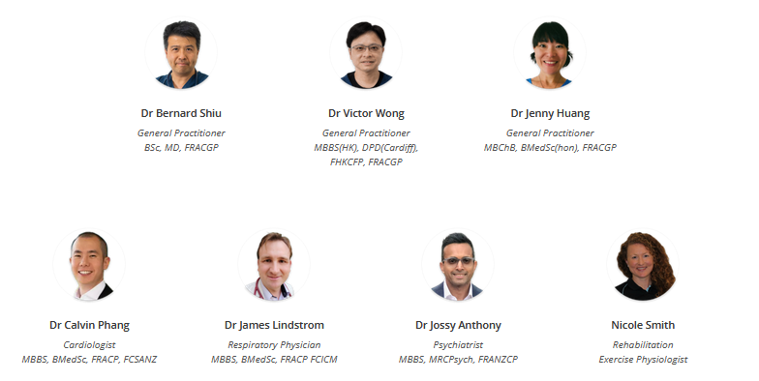
Geelong Long Covid Clinic in June 2022
Notes:
Geelong Long Covid Clinic was started by 7 clinicans in June 2022 who have a special interest in management of chronic conditions. We composed of 3 GP specialists, a cardiologist, a respiratory physician, a psychiatrist and an expercise physio focus on rehab.

Slide 4
Our current team
Hospital Specialists:
Rehab Physicians
Renal physician
Neurologist
Respiratory Physician
Cardiologist
Psychiatrist
Allied Health:
OTs
Social workers
Psychologists
Respiratory Physiotherapist
Play therapists / Art Therapists / Music Therapists
Exercise Physiologist
Notes:
Our team has grown significantly over time, and now we have rehab physician, neurologist, renal specisalists together with a team of allied health including 6 OTs. 3 psychologists, 1 resp physio and other therapists in the pipeline.

Slide 5
Gender and Age distribution

Slide 6
Referral sources

Slide 7
Distance Travel

Slide 8
Consultation model flow
Refer to Hospitalists for further workup if necessary
Initial Consultation our GP Specailist
Arrange Appropriate Investigation
Start Rehabilitation
by allied health
Continue to Monitor
Start necessary treatment

Slide 9
Symptoms presented

Slide 10
The course of progression
Persistent from initial infection
Initial symptoms, followed by a recovery phase then appears a few weeks later
Fluctuate or relapse over time

Slide 11
Possible clinical theories
1/ Multi-organs Microinflammation – fatigue, muscle pain, brain fog
2/ Coagulability imbalance – PE and other coagulation related problems
3/ Persistent Virus presence – Multi organ involvments
4/ Autonomic deregulations – POTS, tachycardia, dizziness, BP variation
5/ Mast Cell Degranulation – Persistent Cough and SOB
6/ Affecting microbiomes in the guts – gastro symptoms, SIM01
7/ Activation of other conditions via unknown pathway

Slide 12
Severe Co-mobilities
Respiratory disease,
Obesity,
Diabetes,
Hypertension,
Chronic cardiovascular disease,
Chronic kidney disease,
Post-organ transplantation,
Active cancer
Severe mental health conditions
living with disabilities or alone (lack of support)

Slide 13
Main contributing factors
Unvaccinated or not up-to-date vaccination
Initial severity e.g. admission to ICU, needing O2 or intubation
Virus variants eg Alpha to Delta Strain (hence the timing of infection between early 2020-late 2021)

Slide 14
What impacts we know so far
Most people recovers in time although timeline is different
Children and teenagers are less likely to have severe Long COVID
There is no single test to confirm a Long COVID diagnosis,
Affect patients’ Physical, Mental and Social wellness
Very similar to Chronic fatigue syndrome/ Fibromyalgia, because of the post viral sequalae
Symptoms also resemble POTS

Slide 15
CFS/ME vs POTS (taken from Cleveland clinic and Johns Hopkins Medical)
CFS/ME POTS
Disrupted sleep
Changes in blood pressure, feeling dizzy or pale
Palpitations, increased heart rate or shortness of breath with exertion or on standing
Problems with thinking, concentrating, memory loss, vision, clumsiness, muscle twitching or tingling (sometimes called ‘neurocognitive problems’)
Pain or aches, joints or head
Extreme Exhaustion/fatigue.
Disrupted sleep from chest pain, racing heart rate and excessive sweating during sleep.
Dizziness or lightheadedness, especially when standing up, during prolonged standing in one position or on long walks. Shortness of breath (dyspnea).
Chest pain. Heart palpitations
Forgetfulness and trouble focusing (brain fog).
Headaches and joint pain
Exhausion

Slide 16
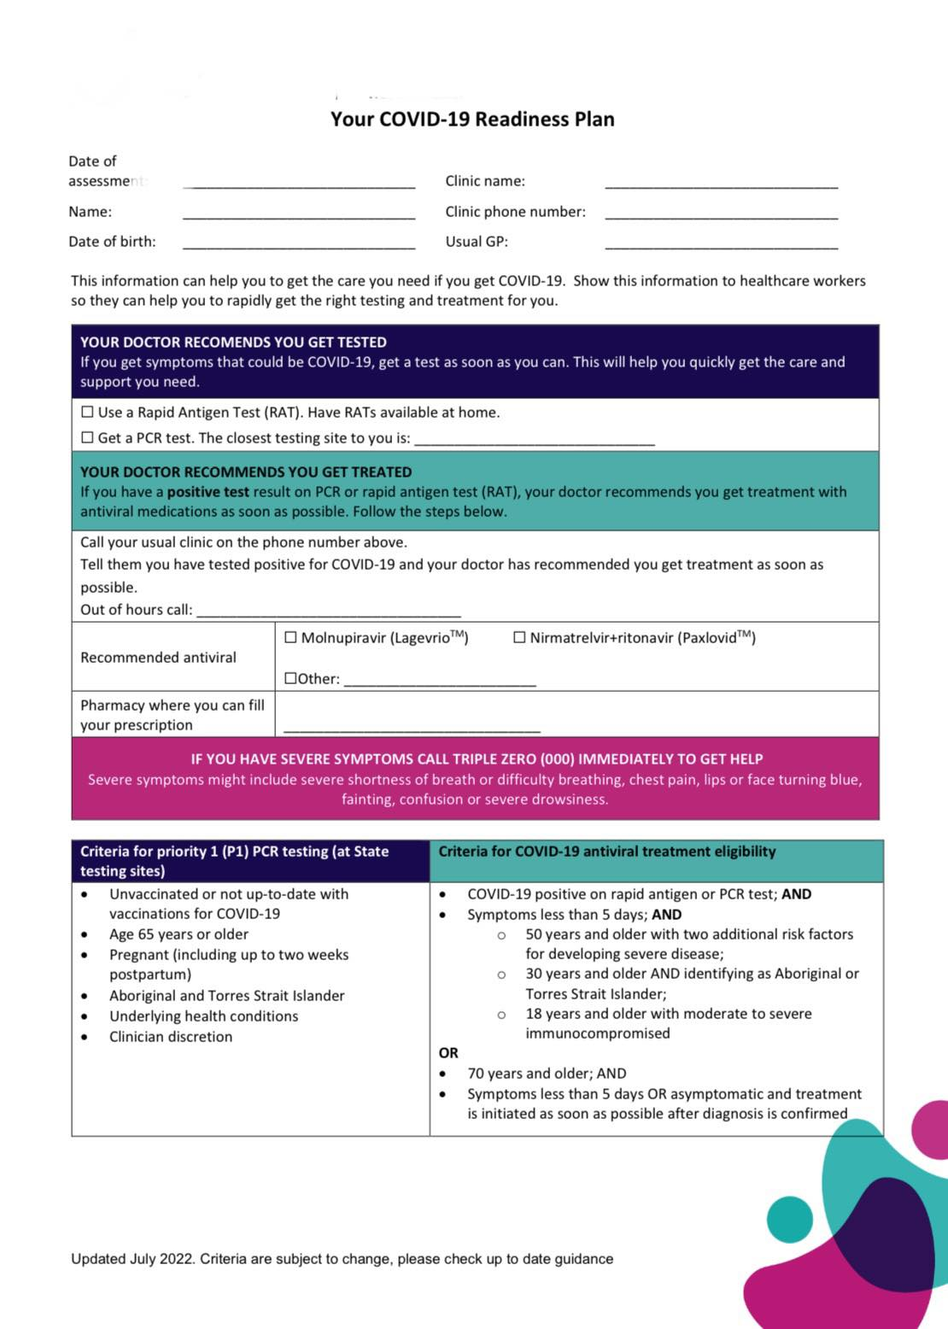
The best way to protect against Long COVID
NOT TO GET INFECTED
Get vaccination updated regularly
Get treatment (Anti-Viral) early
Have a COVID Positive action plan (who to call, where to get meds and support etc)
Speak to specialists early

Slide 17
Recommendations
- By Implementing evidence-based interventions in primary care settings working in a multidisciplinary team will improve the quality of life of those with Long Covid
- Most care will be given in General Practice
- Keep up to date as more evidence approaches are emerging

