Slide 1



Immune biology and multisystem impact of long covid
Prof David Watters
Deakin University and Barwon Health
Director of Surgery, Safer Care Victoria

Slide 2
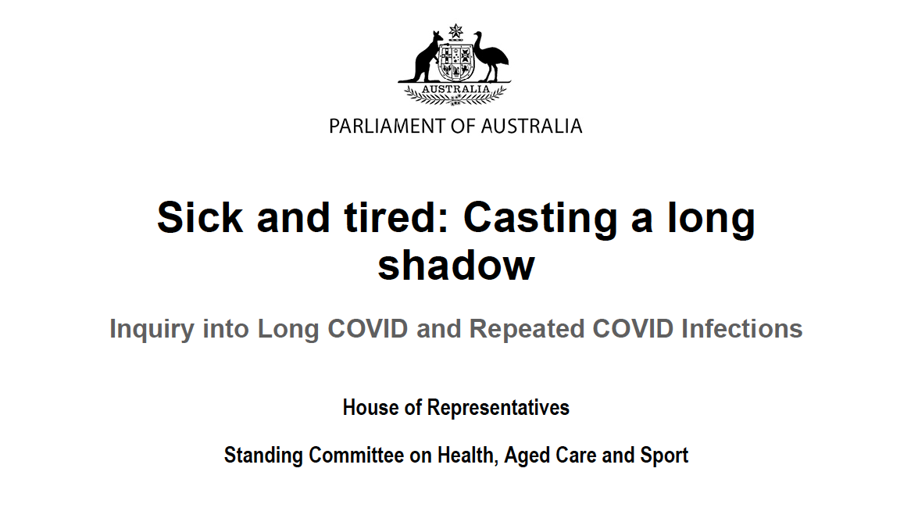
April 2023
Notes:
In August, 2022 the USA set up the National Research Action Plan on Long COVID, which led the US National Institutes of Health to allocate $1·15 billion to the Researching COVID to Enhance Recovery (RECOVER) project.

Slide 3
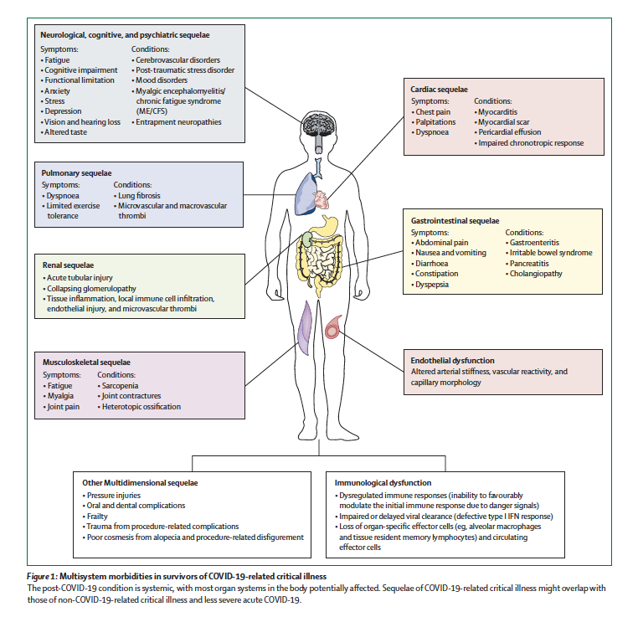
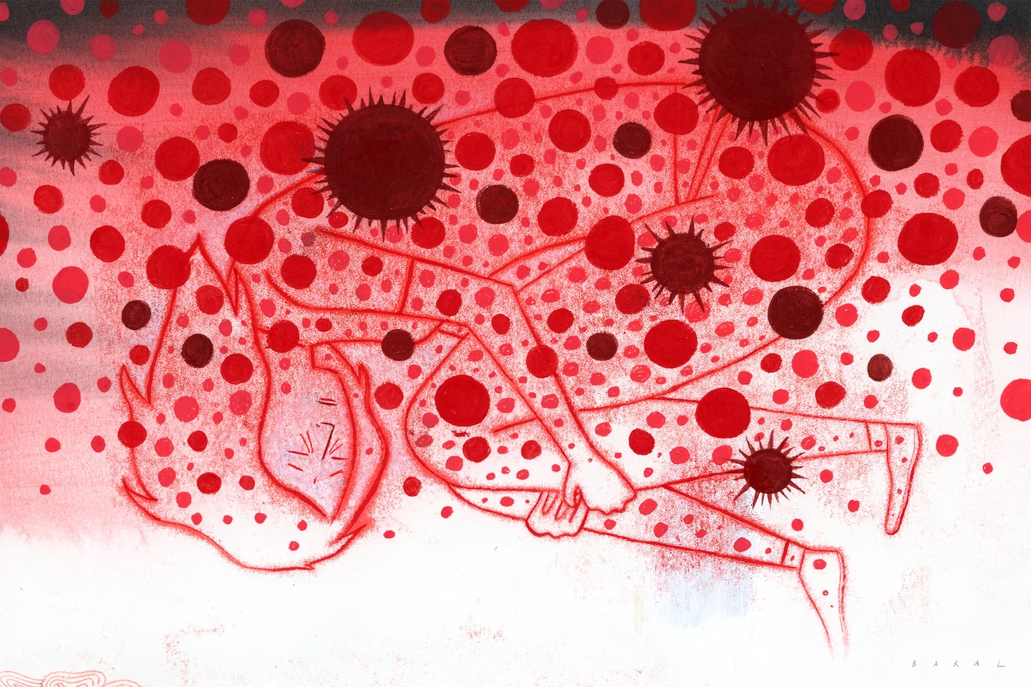
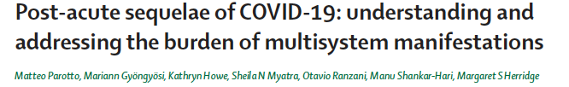
“Long covid has derailed my life…..”
Madeline Miller Washington Post, 9 August 2023

Slide 4
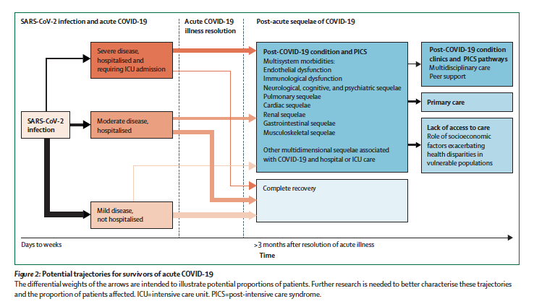

Slide 5
Long COVID Sequelae and Comorbidities
Autonomic Dysfunction (POTS) – orthostatic intolerance
Thrombotic stroke and TIA
Neurodegenerative disease
Cognitive impairment
Speech and language difficulties
Impaired lung function and scarring
New onset/exacerbation of asthma
New onset diabetes/ Deteriorating glycaemic control
Increased post COVID-19 mortality assoc with diabetes, HT and obesity
Impaired kidney function, deterioration of existing CKI and dialysis
Endothelial dysfunction and Thrombosis
Mental Health disorders
Fatigue and Impaired work/study capacity

Slide 6
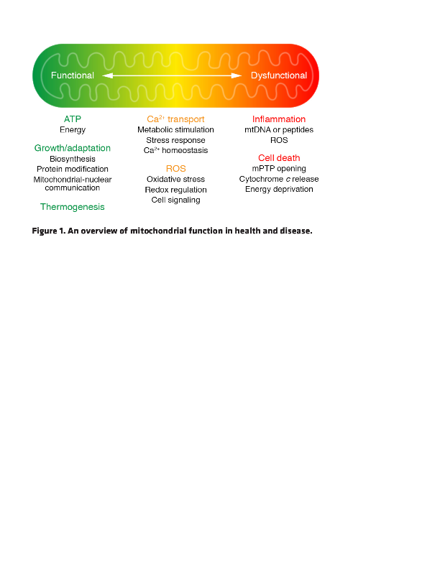
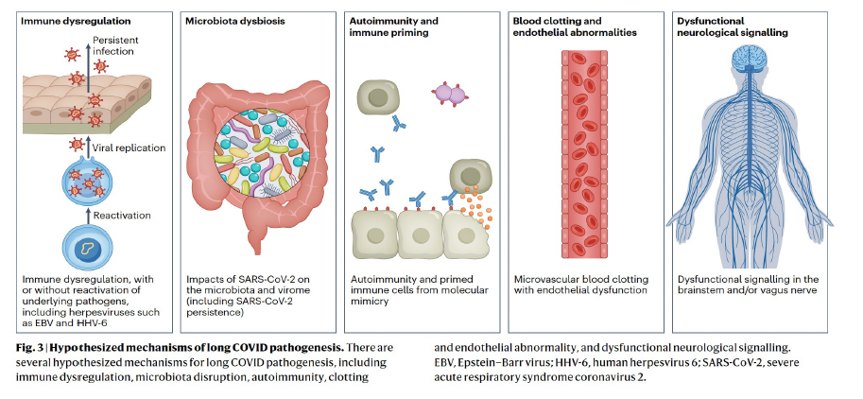
Possible Immunobiological Causes of Long Covid
and/or Direct interaction/inhibition of SARS-CoV2
with critical mitochondrial proteins

Slide 7
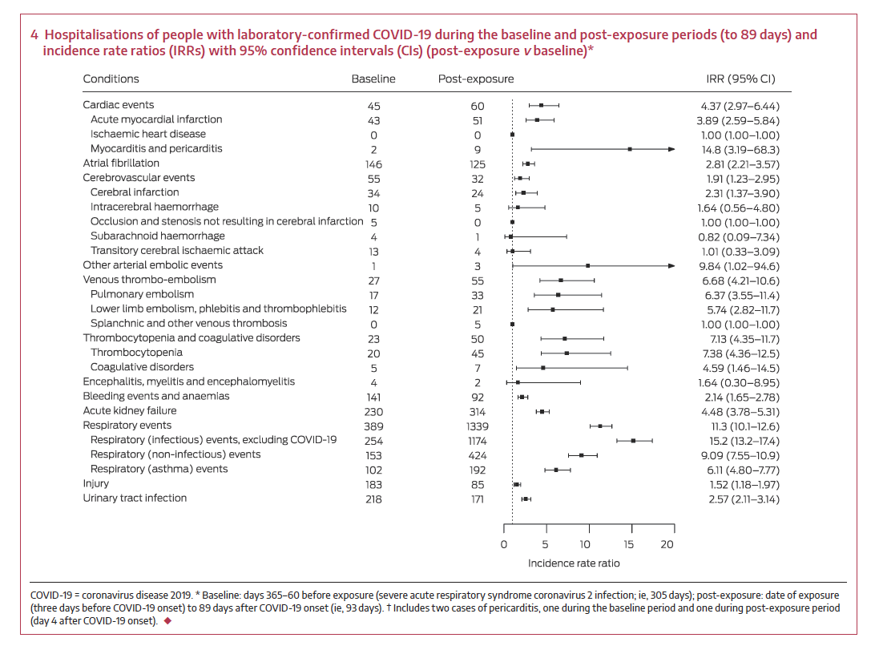
Post COVID hospital admissions in Victoria
Rowe SL, Leder K, Dyson K, Sundaresan L, Wollersheim D, Lynch B, Abdullahi I, Cowie BC, Stephens N, Nolan TM, Sullivan SG, Sutton B, Cheng AC. Associations between COVID-19 and hospitalisation with respiratory and non-respiratory conditions: a record linkage study. Med J Aust. 2023 Jan 16;218(1):33-39.

Slide 8
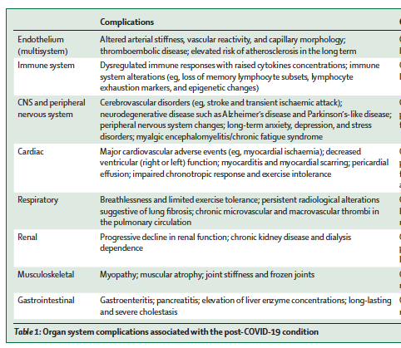
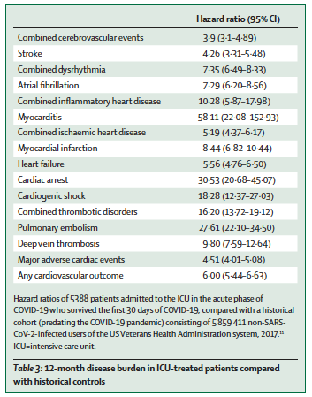
Major Medical Conditions within 12 months of COVID-19
ICU
Cohort
Pro-atherogenic inflammatory responses in plaques – infected with Covid-19
Notes:
Macrophages affected in coronary plaques.

Slide 9
Summary
Long Covid results in many different symptoms affecting every major body system
Fatigue, brain fog (cognitive impairment) and breathlessness are 3 of the most frequent symptoms
Mental health issues are frequent and previous mental health problems may be made worse
Impact on pre-existing comorbidities and onset of new comorbidities
There are markers of immune dysfunction that persist up to two years after COVID-19, especially in those with long covid symptoms
COVID-19 viral particles persist in lung, brain and gut long after COVID-19
Autoimmunity may play a role in long covid
Other (latent) dormant viruses may be re-activated including Epstein-Barr virus

