Slide 1

Addressing the Impact of COVID on Cancer Diagnoses
Sabine Ostrowski
Manager – Early Detection, Prevention Division
Cancer Council Victoria
Sabine.Ostrowski@cancervic.org.au

Slide 2
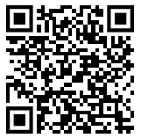
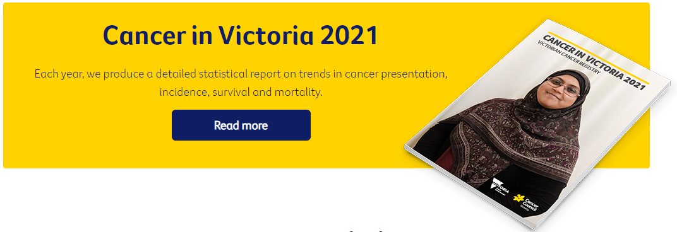
Victorian Cancer Registry
State-wide population-based registry since 1982
Receive data under the Improving Cancer Outcomes Act 2014
Provides a foundation for measuring and improving cancer outcomes
https://www.cancervic.org.au/research/vcr
Slides courtesy of A/Prof Luc te Marvelde, Head, Data Analytics Victorian Cancer Registry, Luc.teMarvelde@cancervic.org.au

Slide 3
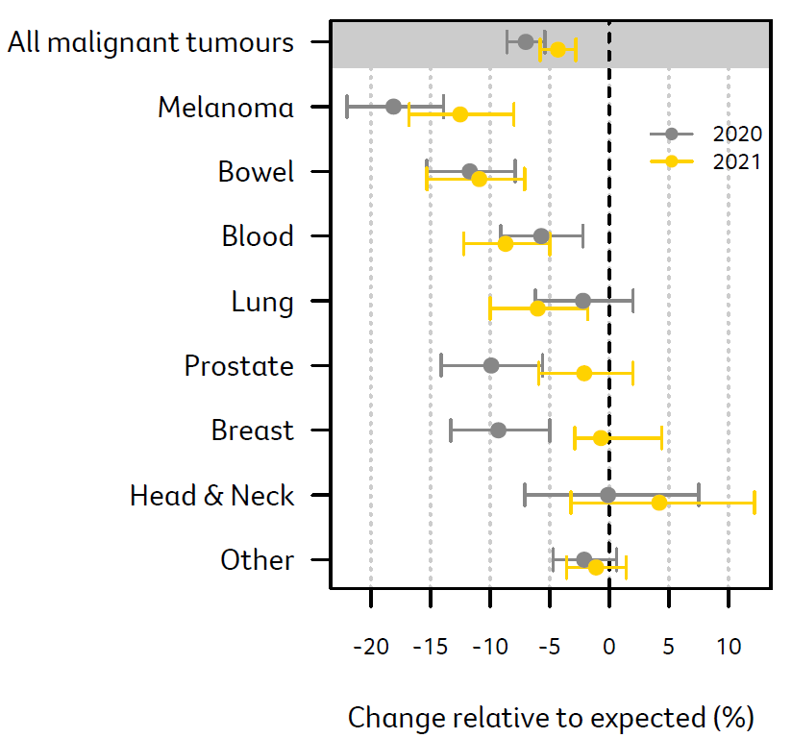
Fewer diagnoses than expected
Estimated decline in diagnoses
There were 7% fewer cancer diagnoses in Victoria in 2020 than expected.
There were 4.3% fewer cancer diagnoses in Victoria in 2021 than expected.
There remain approximately 3,800 fewer diagnoses than expected at the end of 2021.
The greatest decline was in bowel, prostate and blood cancers and melanoma. These accounted for 76% of all missed diagnoses in 2020 and 2021.
Source: Victorian Cancer Registry,. Cancer in Victoria 2021
Notes:
In the graph on the right, we see the dotted line which represents that the number of cancer diagnoses was as we would expect it to be, based on statistical modelling which used the trend over the 5 year period 2014-2019 to predict both 2020 and 2021 diagnoses. The lines either side of the point estimate provide 95% confidence intervals.
Overall we see that in 2020 there was a 75% decline in the observed cancer diagnoses, based on what we expected to see. In 2021 the decline was more modest. We saw a 4.3% decline in cancer diagnoses.
In total, at the end of 2021 we report an estimated 3,864 fewer diagnoses than expected.
The greatest decline was for melanoma where we saw an 18% decline in 2020 and a 12% decline in 2021. In total, we report an estimated 827 fewer diagnoses than expected.
We saw a 12% decline in bowel cancer diagnoses in 2020. Ths reduced only marginally to an 11% decline in 2021. At the end of 2021, we report 846 fewer diagnoses than expected.
We saw a significant increase in the number of prostate cancer diagnoses in 2021, with an overall decline of 2% at the end of 2021. However, adding those cases not diagnosed in 2020 to the smaller number of 2021, we see the cumulative number of undiagnosed prostate cancer cases reaches 625.
The most significant rebound occurred in the diagnoses of breast cancer. We saw an estimated 9% decline in 2020 and this reduced to a 1% decline in 2021 with confidence intervals crossing 0 to indicate that there may even have been more diagnoses than expected in 2021.
Overall, the estimated decline in bowel, prostate, blood cancers and melanoma accounted for 3 in 4 missed diagnoses at the end of 2021.

Slide 4
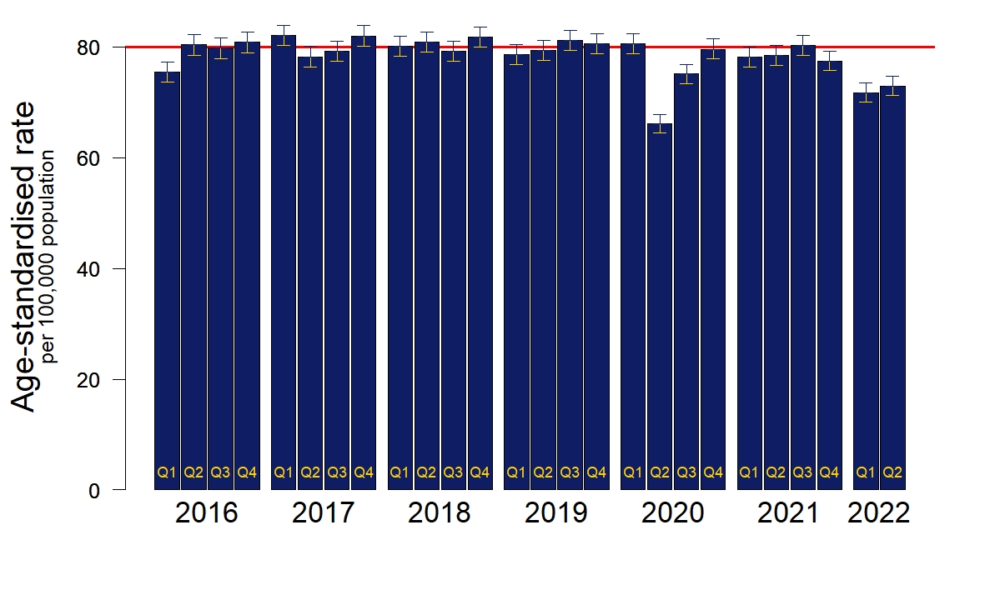
Victorian Cancer Registry 2023
Fewer diagnoses than expected
All cancer types combined
2022 Q1 and Q2 new cancer diagnoses processed
Reduction in diagnoses in Q1 and Q2 of 2022
Year of cancer diagnosis
Average rate 2016-2019
Analyses on malignant incidence cases, excluding DCOs; Bars represent 95% confidence intervals; Adjusted for changes in the Victorian population (ABS: Estimated Residential Population by quarter)
Notes:
Age-standardised cancer incidence rates are pretty stable over time
No signs of (overall) catch-up
It took two quarters to get back to ‘normal numbers’
Low number of new diagnoses in 2022… real or data issue?

Slide 5
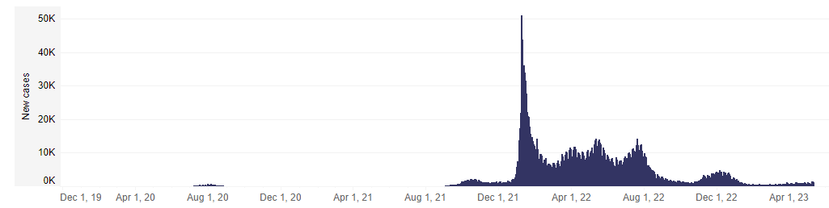
Victorian Cancer Registry 2023
Low number of new diagnoses in 2022?
Daily number of new COVID-19 diagnoses in Victoria
Reduction in diagnoses in 2022 coincides with the rapid increase in COVID cases
Death certificate data was removed from the analyses because it has not yet been incorporated into the Q1 and Q2 2022 data
All cancer types combined
Late notifications ~1% >1yr
Year of cancer diagnosis
Analyses on incidence cases, excluding DCOs; Bars represent 95% confidence intervals; Adjusted for changes in the Victorian population (ABS: Estimated Residential Population by quarter)
Notes:
Death certificate data was removed from the analyses because it hasn’t yet been incorporated into the Q1 and Q2 2022 data.’ There may be some additional diagnoses still to come in for Q1 and Q2 from hospitals, but these numbers are expected to be relatively low. While full QA check is not undertaken until we have finalised coding the entire 2022 year, we are concerned that the rates remain very low in 2022

Slide 6
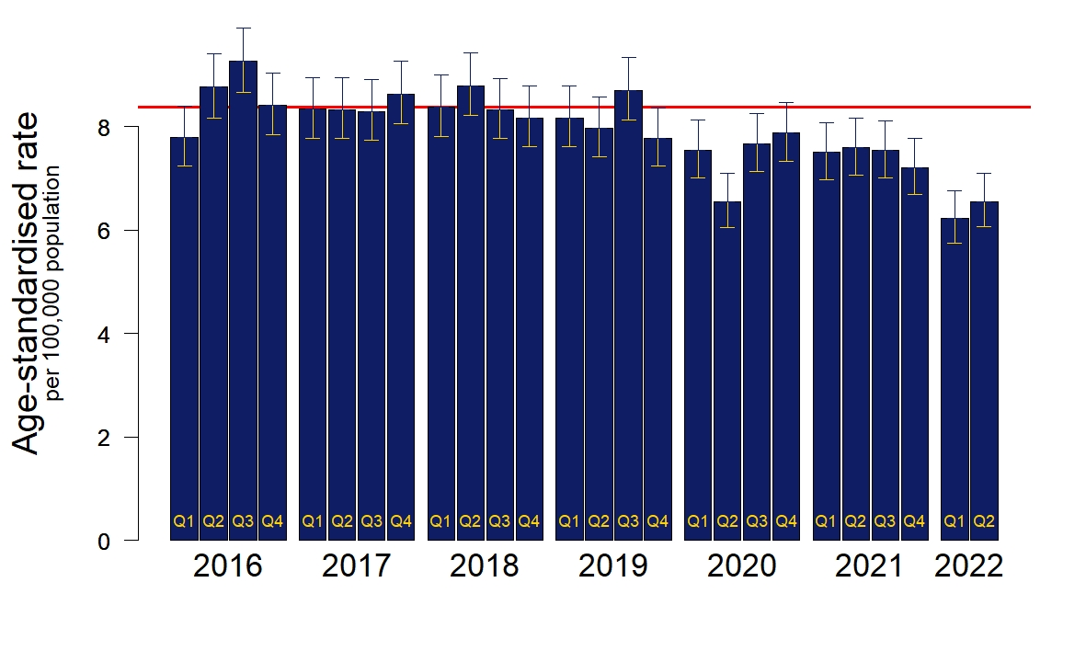
Victorian Cancer Registry 2023
Fewer diagnoses than expected
Colorectal cancer
Males and females combined
Many undiagnosed cancers, including colorectal cancers
Potential for more advanced disease when eventually diagnosed
Year of cancer diagnosis
Average rate 2016-2019
Analyses on incidence cases, excluding DCOs; Bars represent 95% confidence intervals
Adjusted for changes in the population (ABS: Estimated Residential Population)
Notes:
CRC reported the most overall % decline when reported on data to Dec 2021.
[CRC is the most interesting one and also perhaps the most concerning one, given that we did see a decline across all stage groups]

Slide 7
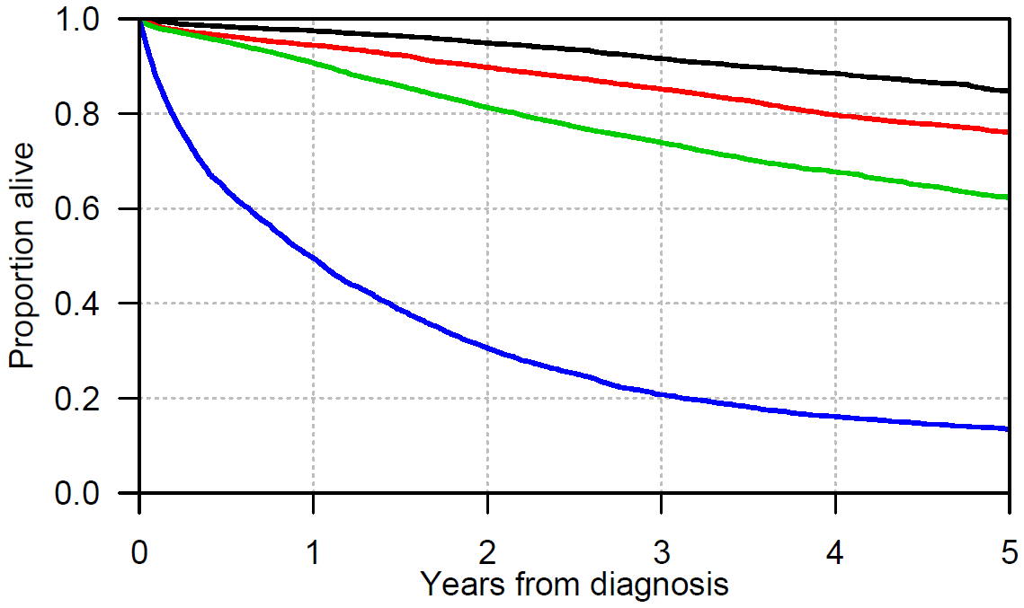
Victorian Cancer Registry 2023
Early detection saves lives
Survival following a diagnosis of colon cancer (2012-2021), by stage at diagnosis
5-year survival (95% CI)
Stage I 85% (84-86)
Stage II 76% (75-77)
Stage III 62% (61-64)
Stage IV 13% (12-15)
Survival = Absolute survival; CI = confidence interval
n=23,760 cases, excluding cases with missing stage (n=3,227), excluding cancer of the appendix
Notes:
Here is evidence that early detection saves lives…
I plotted survival curves for patients diagnosed with colon cancer between 2012 and 2021. Of the people diagnosed with stage I disease, 85% are still alive 5 years after diagnosis..
Compare that with those diagnosed with metastatic cancer (stage 4), of which 13% are still alive after 5 years.
Early detection saves lives!
I took colon cancer as an example, but you can replace this with any cancer. Cases with early stage cancer have better prognosis compared with people with more advanced stage at diagnosis.
Early detection is mainly up to the people as only they can initiate health seeking behaviour, but COVID certainly made it more difficult to do so…

Slide 8



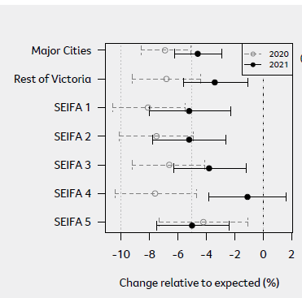
The challenge
Participation rates across all 3 cancer screening programs (2)
Melanoma, bowel, breast, blood and prostate cancer diagnoses (1)
Relatively evenly impacted (1)
~3800 missed cancers(1)
Vic wide, all SEIFA (1)
Cancer in Victoria, VCR, 2021
AIHW Cancer Screening Programs Quarterly Data 2022
Behavioural Insights Report, CCV, 2021
Health seeking behaviours (3)
Notes:
Our challenge is to find the estimated 3800 missed cancer diagnoses of 2020 and 2021, we also need to curb this declining trend in diagnoses that appears to have continued into 2022.
Early data from analysis of AIHW indicated reduced participation across all 3 screening programs
greatest decline occurred in bowel cancer, melanoma, blood cancer and prostate cancer diagnoses- not just cancers we have National screening programs for
relatively evenly distributed across men and women
- VCR data indicated major cities and regional Victoria were equally impacted, and across all socio economic groups
-There was also qualitative evidence to demonstrate that the was a change in health seeking behaviours during this time, COVID changed how people prioritise their health-> perception screening and health checks can be put off

Slide 9
The mission
Aim
Increase awareness of and participation in early detection health behaviours, attending health checks and participation in cancer screening to ensure cancer diagnosis is at its earliest stage
Primary Audiences
All Victorians aged 35-74
Secondary Audiences
Clinicians and healthcare workers
Notes:
Primary Audience: Rationale for this audience choice = 2/3 of decline in cancer diagnoses occured in this group
With a focus on Men 50-74 as the Majority of “missing cancers” are among men (due to melanoma and prostate) , Mean age for melanoma diagnosis was 66 years among men (AIHW 2022)
And women 35-60 All cancer screening programs target women in this range, additionally the Behavioural insights study found that women are disproportionately burdened by covid and are health communicators at home
Mandarin and Arabic speaking chosen as a priority audience on basis of Languages spoken based on large populations in target age ranges, lower english proficiency
Health Professionals Objective To build capacity for health professionals to engage with patients around early detection and screening

Slide 10
The campaign
Insights that guided concept selection and creative development
Barriers primarily related to experiences and perceptions about health services rather than being directly related to individuals’ health attitudes
Limited value in addressing individual attitudes without also addressing perceptions of the limitations of the system
Need to know that doctors want to see them, that GPs and allied health professionals are available and that if they make a booking to get an unusual symptom checked, they aren’t being a burden
Notes:
The formative research and concept testing of the creative concepts :
The takeaway from this work was that experiences and perceptions about the health services are the barrier we need to address, as these are impacting attitudes and health seeking behaviours
Essentially the community needs to know Doctors want to see them, health professionals are available and that making an appointment to have an unusual symptom checked is not being a burden.
Based on these learnings, one creative concept really fit the brief and after wide consultation with key stakeholders such as GPs, RACGP - to ensure that we were developing a campaign that accounted for the current challenges in primary care. and CALD community leaders - to ensure the language would be effective and appropriate in different contexts and settings we arrived here……..

Slide 11
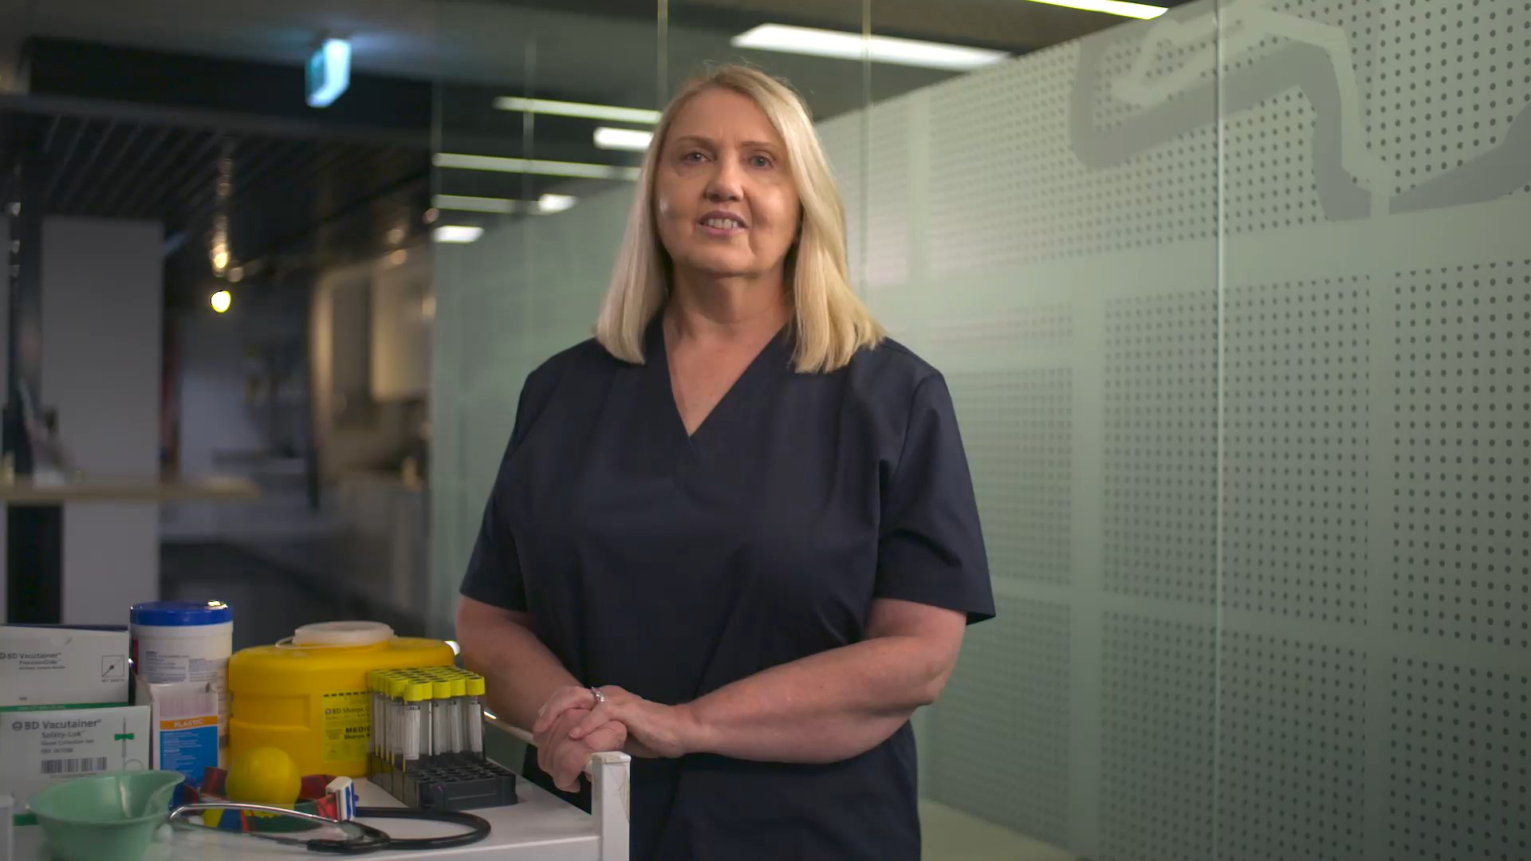
Campaign Creative
Notes:
The takeaway from this work was that experiences and perceptions about the health services are the barrier we need to address, as these are impacting attitudes and health seeking behaviours
Essentially the community needs to know Docotors want to see them, health professionals are available and that making an appointment to have an unusual symptom checked is not being a burden.
Based on these learnings, one creative concept really fit the brief and after wide consultation with key stakeholders such as GPs, RACGP - to ensure that we were developing a campaign that accounted for the current challenges in primary care. and CALD community leaders - to ensure the language would be effective and appropriate in different contexts and settings we arrived here……..

Slide 12











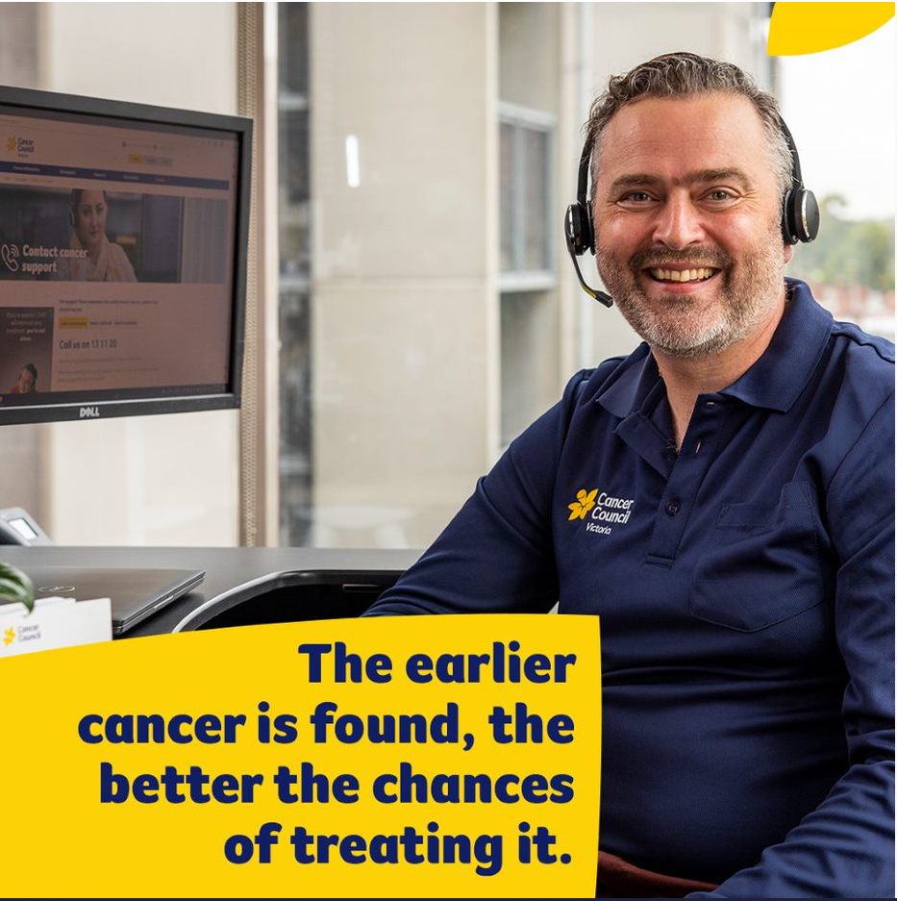



Early Detection Saves Lives Campaign
Burst 1
22nd May to 30th June
Paid
Targeting men 50-74 across VIC
Burst 2
13th Aug to 9th Sept..
Targeting all 35-60 across VIC
Radio
Online Video
Social Media
Digital Display
Search
CALD Media
Encouraging early cancer detection behaviours such as seeing a doctor if you notice any unexplained changes to your body or skin and keeping up to date with cancer screening
Owned
Website:
earlydetection.org.au
Stakeholder kit: cancervic.org.au/cancer-information/screening/early-detection/stakeholder-toolkit
Earned
PR
Launch Event
Notes:
Burst 1 aligns with the National Bowel Campaign and Regional VIC skin
Burst 2 aligns with State Bowel and Regional Cervical Campaign
Primes the audience for the other CCV cancer specific screening campaigns in market

Slide 13
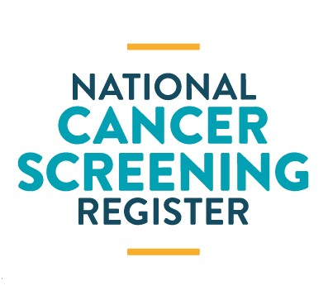


We need your help.
1800 627 701 (ncsr.gov.au)
https://www.cancervic.org.au/cancer-information/screening/early-detection/stakeholder-toolkit
Sabine.Ostrowski@cancervic.org.au
www.earlydetection.org.au
Requests for access to VCR data - Cancer Council Victoria (cancervic.org.au)
Notes:
continue to encourage opportunistic conversations around new unexplained symptoms
ask every patient if they are up to date with cancer screening, check their screening status via the National Cancer Screening Register or contacting Breastscreen
amplify the campaign message through your own channels- stakeholder kit provided
We all need to work together to curb this concerning trend of declining cancer diagnoses and encourage all Victorians to get back to health seeking behaviours and keep up to date with cancer screening. Its clear we have work to do to change people's perceptions and behaviours and that sustained messaging is needed from the health sector and government. We thank the Victorian government Department of Health for their support of this campaign, its investments like these that will improve cancer outcomes and save lives.

