Slide 1
Context and policy settings
Adj Professor Kathryn Whitfield
A/Executive Director Community Based Health Services
Department of Health
Notes:
Overview
Some epi on cancer and its burden on the Victorian community (incidence, mortality and survival)
Policy context for Improving Cancer Outcomes in Victoria
Saving lives / moderating the negative impacts of cancer
Screening saves lives
Early detection saves lives
Resources to improve outcomes – based on the Optimal Care Pathways incl. specific resources to support those in general practice.

Slide 2
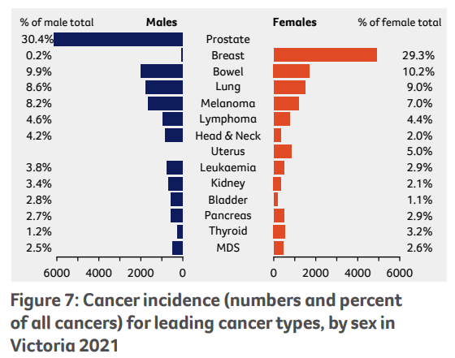
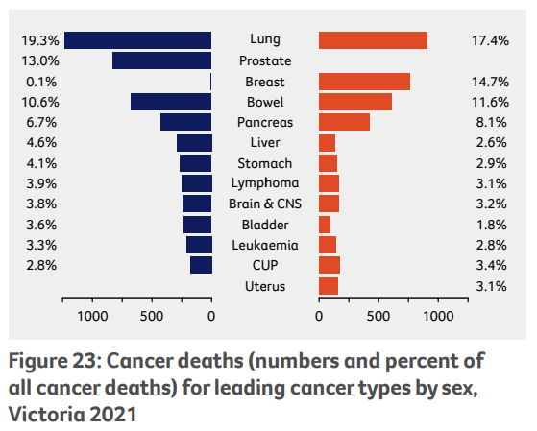
Cancer burden – approx. 1 in 3 Victorians will develop a cancer by the age of 75
5-year survival rates: 71%
(↑ from 46% in 1982)
36,974 Victorians diagnosed with cancer
Cancer is the greatest single cause of death in Victoria (~30%)
11,581 Victorians died of cancer
Source: Cancer in Victoria: Statistics & Trends 2021

Slide 3
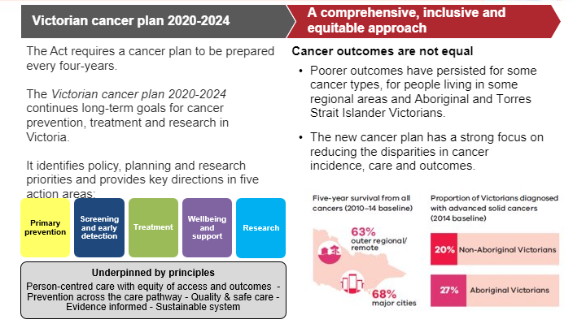
The Improving Cancer Outcomes Act 2014 enshrines Vic government’s commitment to improving cancer outcomes
Notes:
New VCP under development – for delivery ~ Sept/Aug 2024
Nationally an inaugural Aust Cancer Plan is expected to be released in the very near future
Intent of these plans in to outline/describe goals, strategic intent of policy and support all players across cancer control to contribute their efforts to the strategic intent

Slide 4
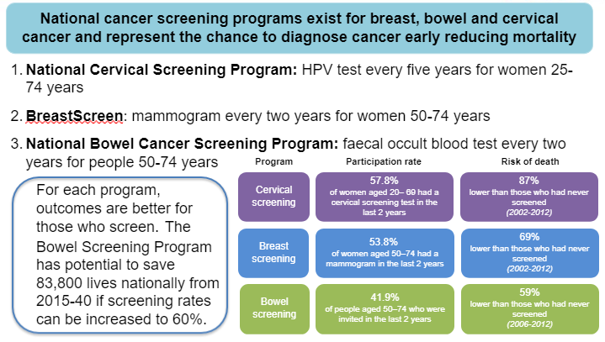
Cancer screening saves lives
Notes:
Of course you all know this…..

Slide 5
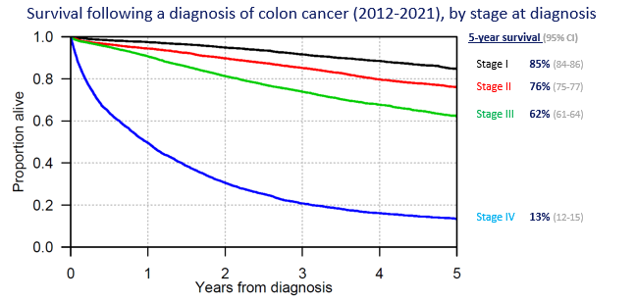
Early detection saves lives
Source: VCR, 2023
Notes:
You probably also know this……that the stage of the cancer at diagnosis makes a significant difference to outcomes
Diagnosing cancer as early as possible makes all the difference wrt 5-year survival

Slide 6
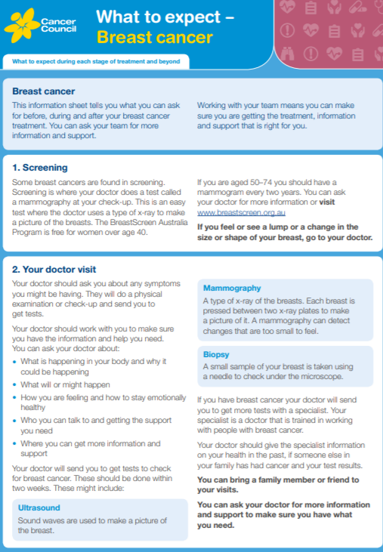
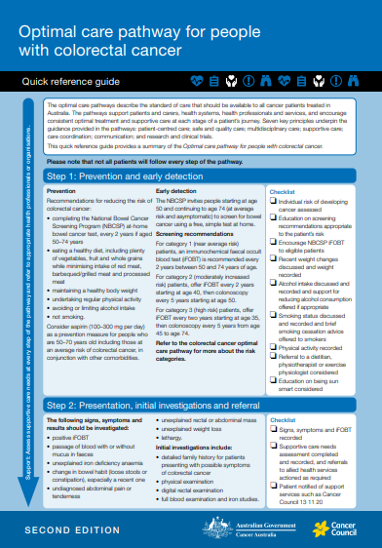
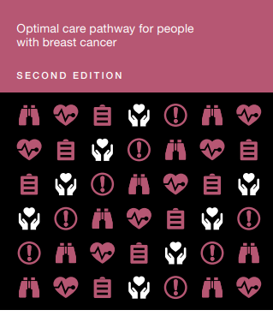
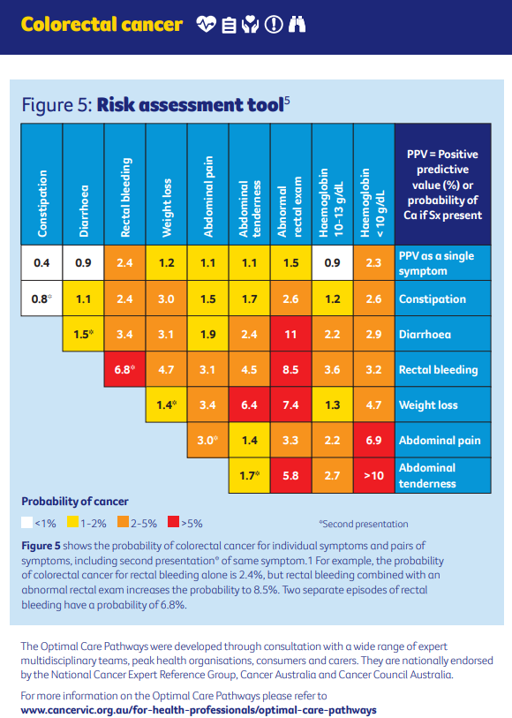
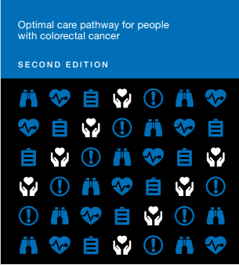
Optimal care pathways
Victorian developed National Optimal Care Pathways (OCPs) for people with cancer guide the steps and system of care for best outcomes
There are OCPs for 26 cancers
Full guides
Quick reference guides (for GPs)
Consumer ‘What to expect guides’
Available as a Web App
Incorporated into HealthPathways
iPaced resources for GPs
Optimal Care Pathways - Cancer Council Victoria (cancervic.org.au)
Notes:
There has been a lot of work undertaken over the past decade to create resources to guide the delivery of optimal care for those diagnosed with cancer
These follow the pathway from prevention through to survival, living with advanced disease and/or EOL
They have been developed based on best evidence and consensus opinion and are freely available via the CCV website
Along with the full guides – there have been associated Quick Reference Guides, a Web App
Plus specifically to support GPs, the OCPs have been incorporated into HealthPathways and in collaboration with Uni Melb a series of iPaced tools have been produced – these provide eg demographic risk profiles and a risk assessment tool to assist with determining if a cancer diagnosis is likely.

