Slide 1
Advancing women’s health in primary care
Professor Danielle Mazza AM
MD, MBBS, FRACGP, DRANZCOG, Grad Dip Women’s Health, GAICD, CF
Head, Department of General Practice, Monash University
Director, NHMRC SPHERE Centre of Research Excellence

Slide 2

Accessible high quality comprehensive women’s sexual and reproductive health services delivered in primary care
5.57 million women of reproductive age in Australia
General practice and primary care
Preconception Care
Contraception
Abortion

Slide 3
Outline
Current status of women’s health in primary care
New strategies to support women’s health in primary care
Telehealth S&R Health MBS item numbers
Deregulation of medical abortion
National endometriosis clinics & Endo and chronic pelvic pain management plan
Community pharmacy and contraception
AusCAPPS – an online community of practice to support LARC and EMA provision in primary care
Improving health literacy, navigation and access – local resources

Slide 4
Where are we at currently?

Slide 5
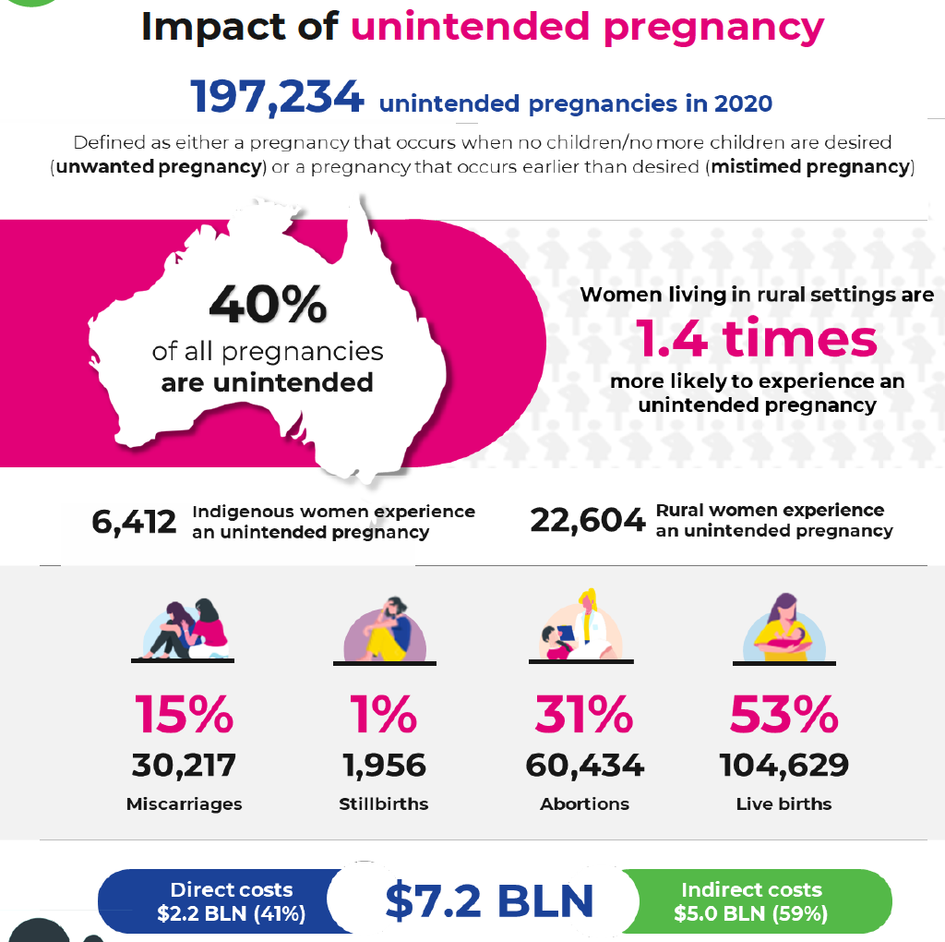
The burden of unintended pregnancy in Australia
Organon Report into Unintended Pregnancy in Australia Sept 2022.
Rowe H, Holton S, Kirkman M, Bayly C, Jordan L, McNamee K, McBain J, Sinnott V, Fisher J. Prevalence and distribution of unintended pregnancy: the Understanding Fertility Management in Australia National Survey. Aust N Z J Public Health. 2016 Apr;40(2):104-9.

Slide 6
What do we need to do to reduce unintended pregnancy?
Improve access to effective forms of contraception to prevent pregnancy
Improve access to safe abortion when required for unintended pregnancy

Slide 7
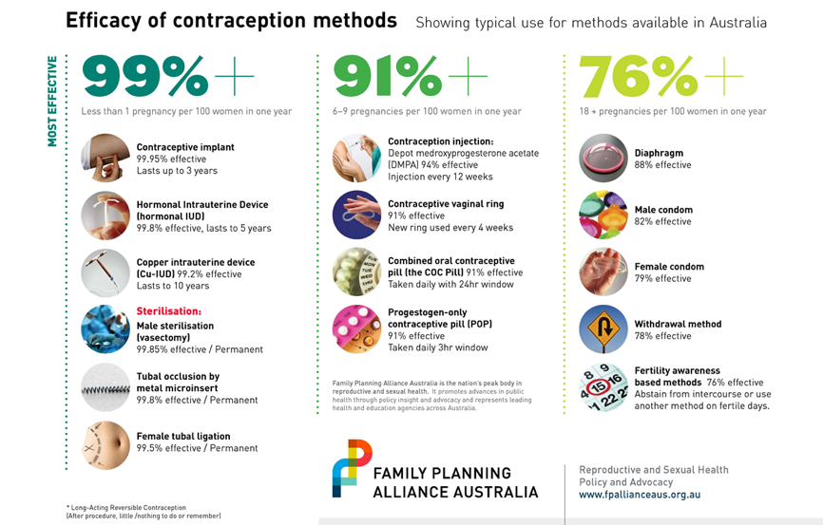

Slide 8
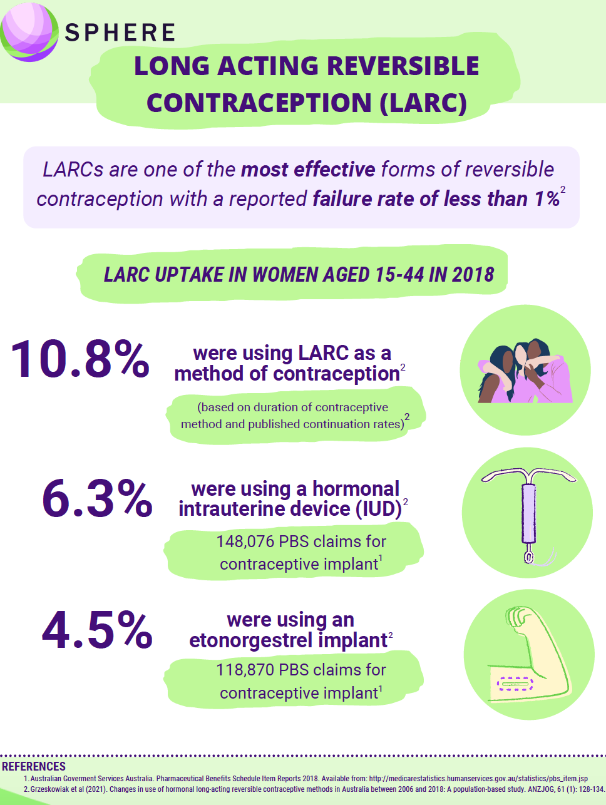
International benchmark:
20-25%
LARC use
Sweden = 31% in 2019 majority IUDs

Slide 9
What is our current workforce?
10% of GPs nationally
No formal GP trainee training
70-80% of GPs nationally
All GP trainees are being trained
Unknown number of GPs nationally
No formal GP trainees training
Following training low number commence and not all sustain practice

Slide 10
Where can practitioners train?
Very limited number of locations for GPs and nurses to train in EMA and IUD insertion
Few public hospitals provide so no opportunity for training during residency
In the community IUD training is expensive (?$1600) and GPs need to take time out (about a week) to get clinical experience and lose income doing so = total cost is great
Long wait time for IUD training (months)

Slide 11
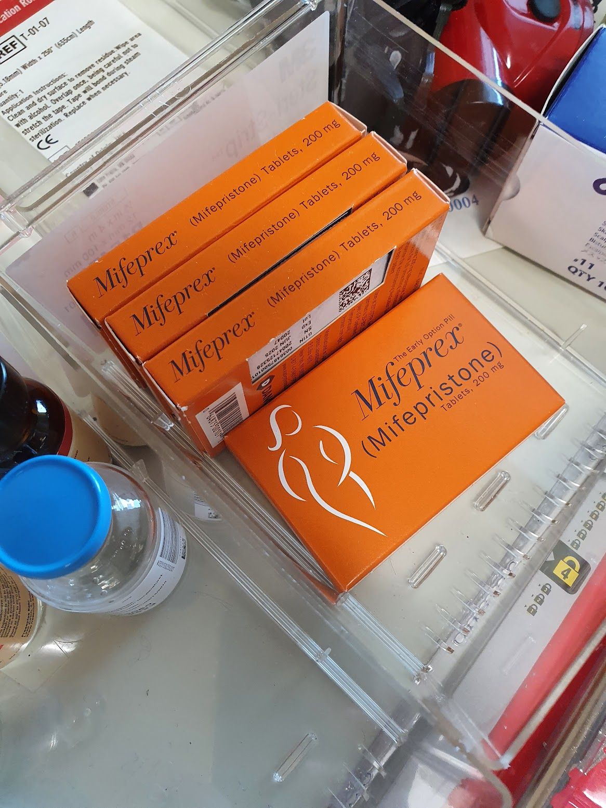
Ensuring local access and choice of abortion method
There is an assumption that EMA is enabling
Choices are being made because of constraints in women’s lives e.g. kids/work/local accessibility
Broad range of experience of medical abortion:
75% its fine or can cope
25% wouldn’t do it again
But what about:
Young people <16 years – it’s a big ask
Women who are unsupported
Cheaper for health services to deliver medical abortion not surgical

Slide 12

Aim: to describe abortion referral pathways for each Health Pathways portal (these are generally aligned with PHN boundaries) in Australia.
17 out of 34 Australian HealthPathways consented to be included.
Results:
Nearly half (47%) had no public services listed for surgical abortion
35% had no public services for medical abortion
The majority (64% for surgical abortion, 67% for medical abortion) emphasised that public services should be considered only as a last resort.
No consistency in information regarding gestation-speciﬁc options, the time-critical nature of referrals, and the importance of women’s own preference when deciding between medical or surgical abortion.

Slide 13
Abortion “deserts” in Australia
about 30% of women in Australia lived in SA3s in which MS-2 Step had not been prescribed by a GP during 2019, including about 50% of those in remote Australia
MS-2 Step prescribing and dispensing during 2019, by level 3 statistical area (SA3)
Subasinghe AK, McGeechan K, Moulton JE, Grzeskowiak LE, Mazza D. Early medical abortion services provided in Australian primary care. Med J Aust. 2021 Oct 18;215(8):366-370. doi: 10.5694/mja2.51275. Epub 2021 Sep 22. PMID: 34553385.

Slide 14
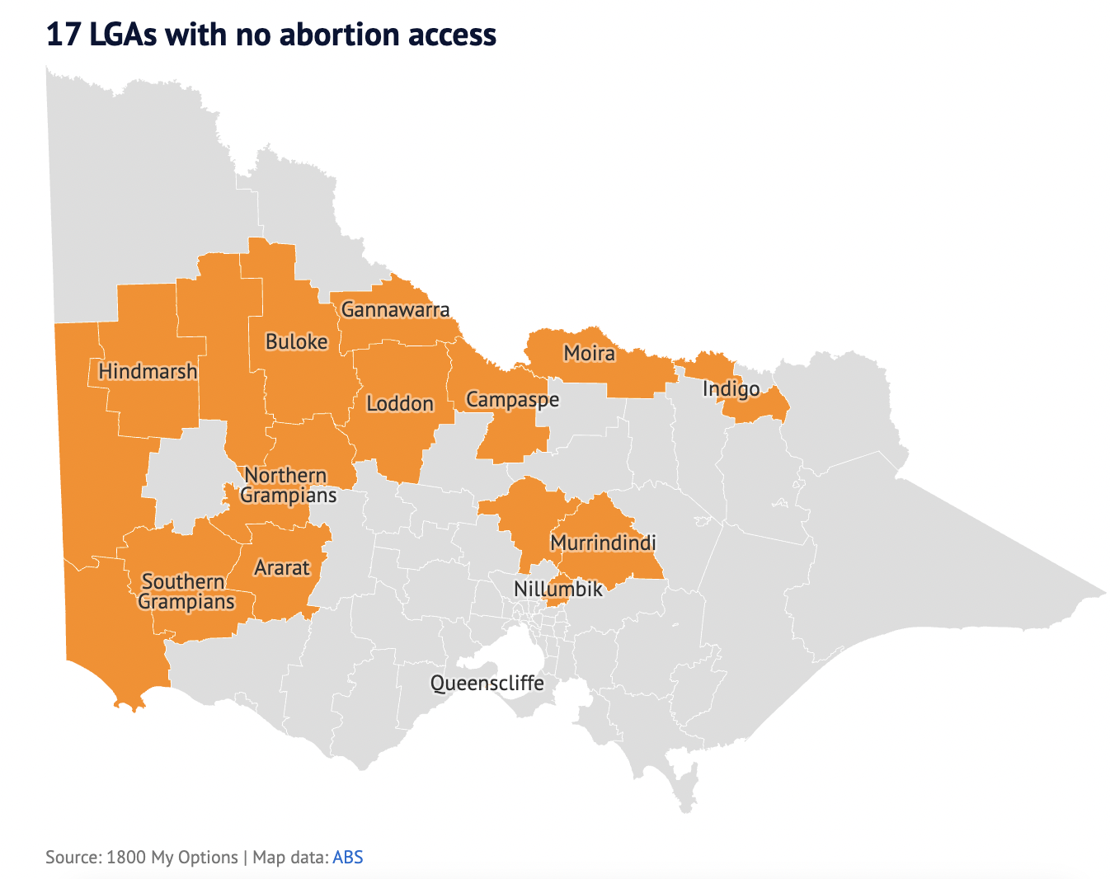

Slide 15
Critical points
GPs who provide EMA are also the ones providing LARC and menopause and endometriosis and PCOS and other forms of womens health care
Victorian Regions that have low EMA also have low LARC and high teenage pregnancy

Slide 16
Reminder of the Australian Context
3. Consumer barriers
1.Abortion and LARC Deserts
2. Decreasing workforce capability
Lack of exposure to and training in abortion and contraception for medical, nursing and pharmacy trainees prior to entering the workforce
Lack of opportunity for existing practitioners to upskill
Difficulty navigating to services
Poor health literacy
Cost
about 30% of women in Australia lived in SA3s in which MS-2 Step had not been prescribed by a GP during 2019, including about 50% of those in remote Australia
Subasinghe AK, McGeechan K, Moulton JE, Grzeskowiak LE, Mazza D. Early medical abortion services provided in Australian primary care. Med J Aust. 2021 Oct 18;215(8):366-370. doi: 10.5694/mja2.51275. Epub 2021 Sep 22. PMID: 34553385.

Slide 17
System approaches

Slide 18
MBS Item Numbers for Telehealth Sexual and Reproductive Health Care Consultations
Introduced July 1st 2021
No patient restrictions
Time based phone and video consultations
Cover any aspect of Sexual and Reproductive Health and Blood Borne Virus care eg contraception, abortion, menopause
Service | Telehealth items via video-conference | Telephone items
Professional attendance for the provision of services related to blood borne viruses, sexual or reproductive health by a general practitioner of not more than 5 minutes | 92715 | 92731
Professional attendance for the provision of services related to blood borne viruses, sexual or reproductive health by a general practitioner of more than 5 minutes in duration but not more than 20 minutes | 92718 | 92734
Professional attendance for the provision of services related to blood borne viruses, sexual or reproductive health by a general practitioner of more than 20 minutes in duration but not more than 40 minutes | 92721 | 92737
Professional attendance for the provision of services related to blood borne viruses, sexual or reproductive health by a general practitioner lasting at least 40 minutes in duration | 92724 | 92740

Slide 19
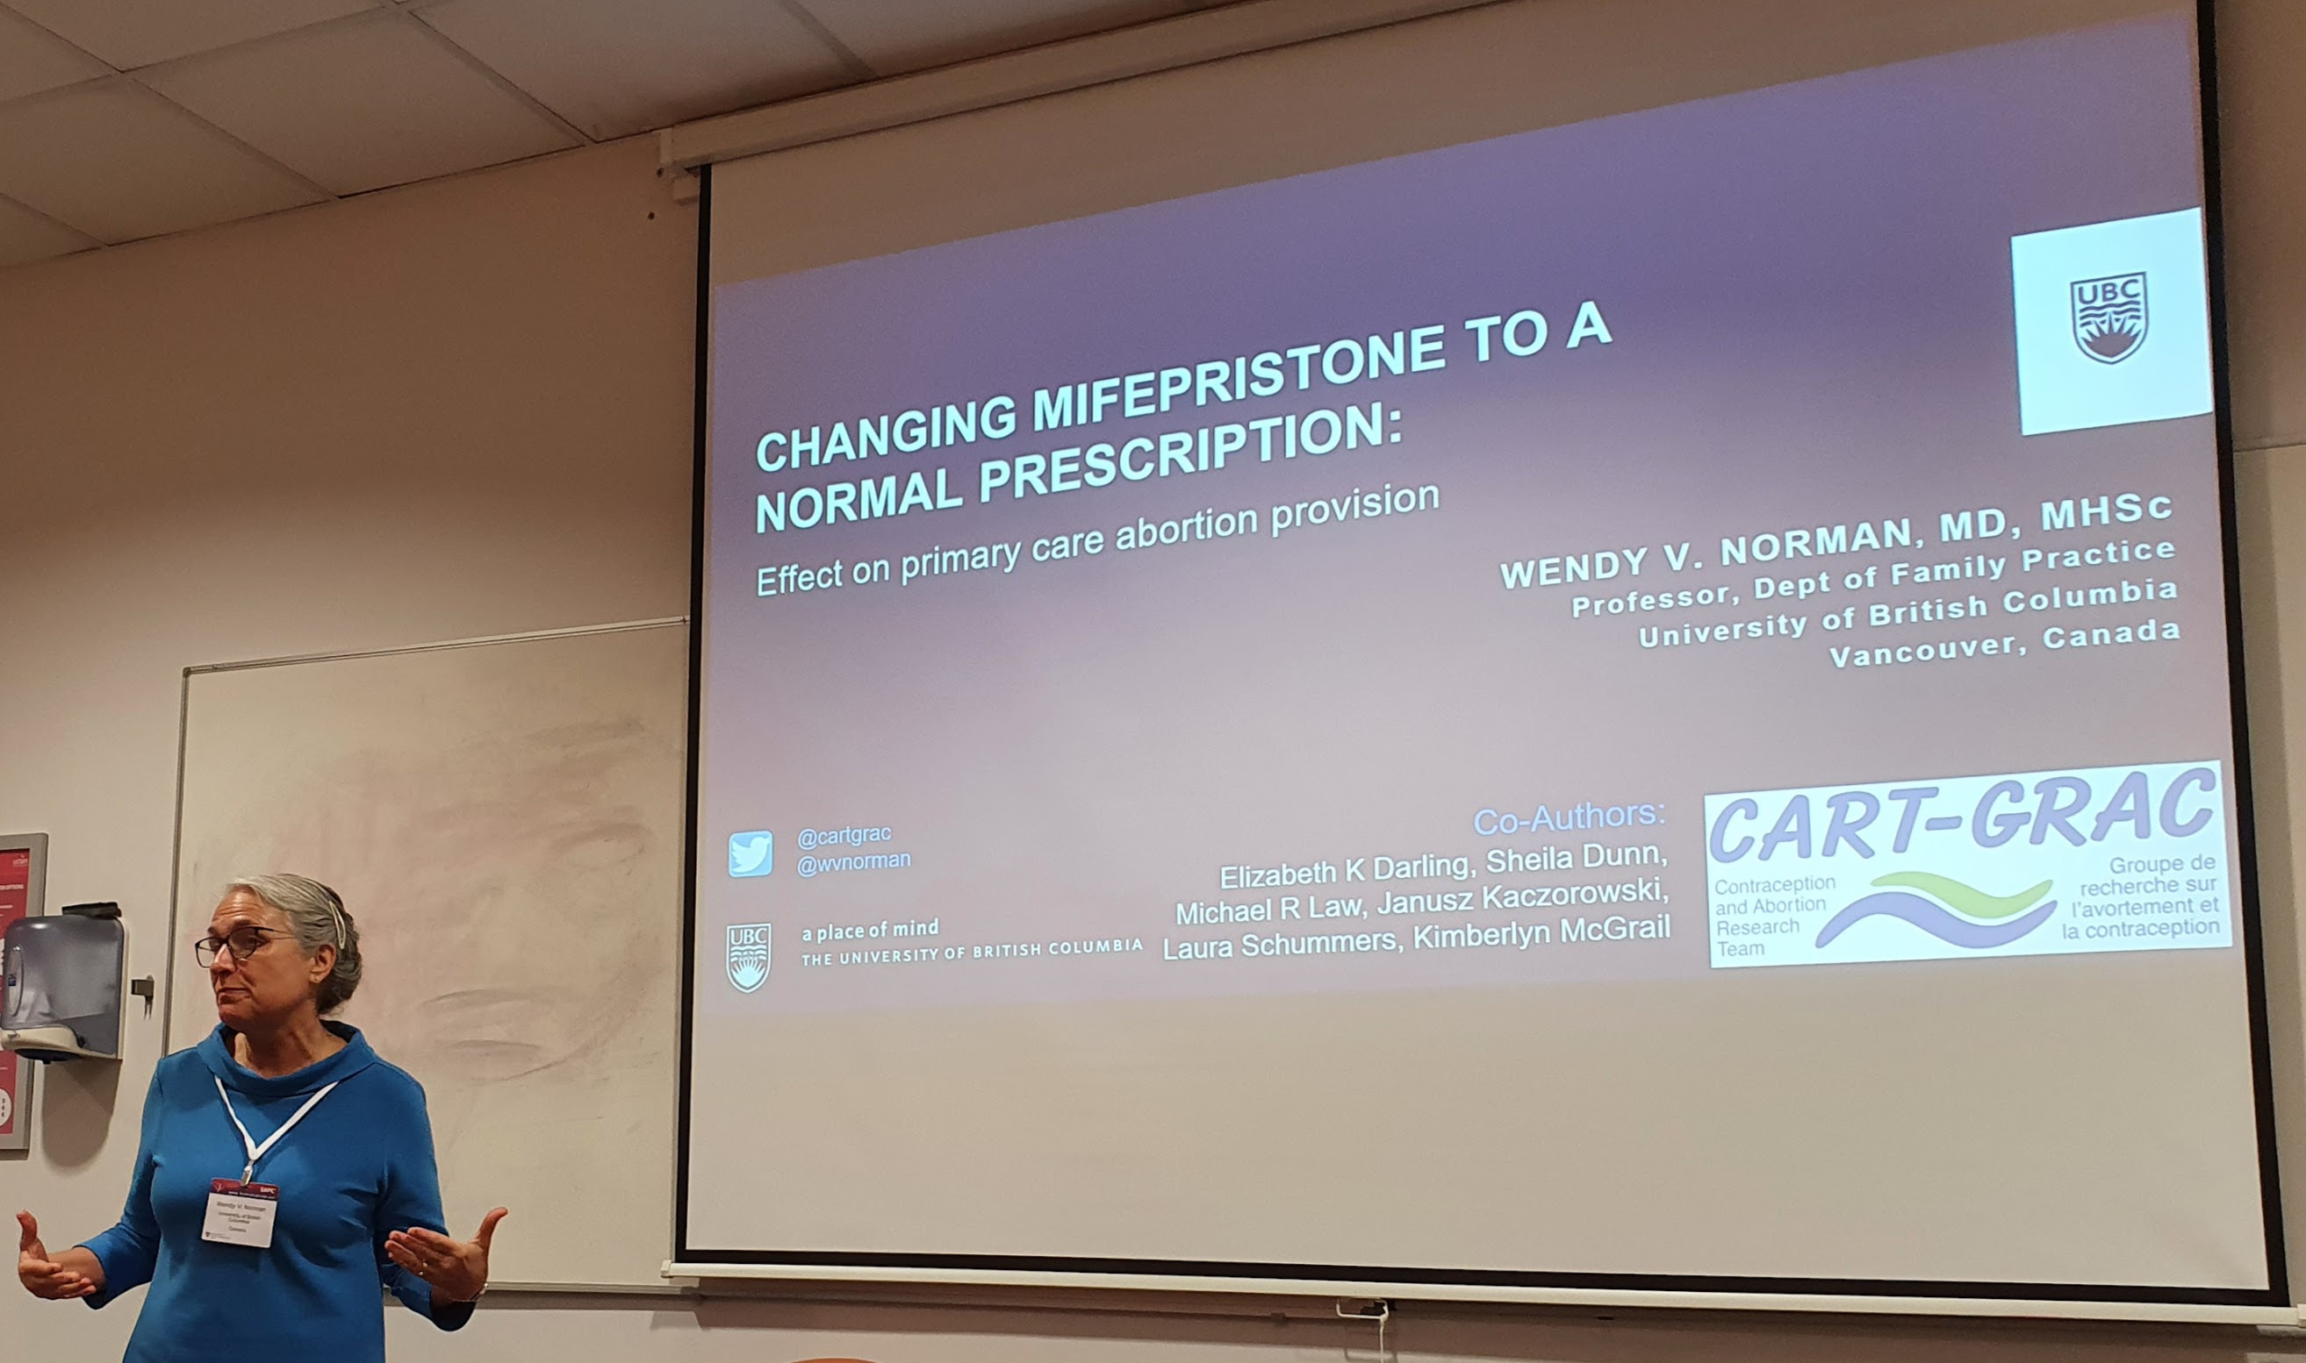

When medical abortion is available as a normal prescription:
abortion rate & safety did not change
The number of providers of abortion tripled
Rural areas had a twelve-fold increase in providers
Nine percent of abortions providers are Nurse Practitioners (providing nearly 1% of abortions)
New England Journal of Medicine. 2022;386(1):57-67.
@wvnorman @cartgrac @ubc
Notes:
Here, we se the abortion rate
Where see a pre-mifepristone decline in the abortion rate, followed by a small increase in the number of abortions per 1,000 reproductive aged females after mifepristone was available and unrestricted

Slide 20
TGA and PBAC regulatory reform re MS2Step
Up till August 1st | From August 1st
GPs had to undertake mandatory training in order to register to prescribe | No requirement for mandatory training or certification
GP prescribers had to reregister every 3 years
Individual pharmacists needed to register to dispense MS2Step | All pharmacies can dispense
Prescription restricted to medical practitioners | Nurse practitioners and endorsed midwives can prescribe (subject to state legislation)
MS Health needed to provide a 24/24 helpline for patients | Patients can utilize healthdirect
Gestational limit of 9 weeks | Gestational limit of 9 weeks continues

Slide 21
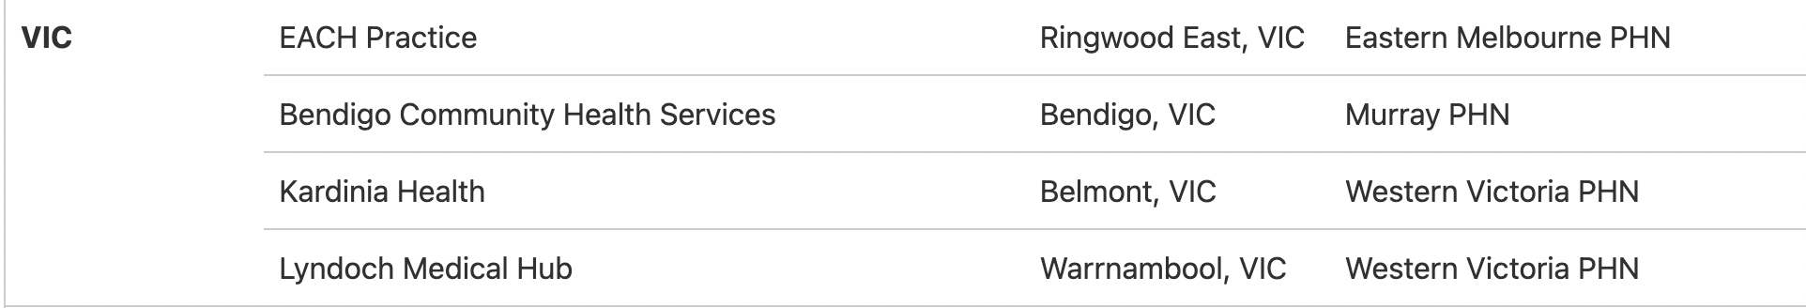
National Endometriosis and Pelvic Pain Clinics
20 clinics around Australia commissioned by PHNs
Aim to reduce diagnostic delays, promote early access to multi-disciplinary intervention, care and treatment, raise awareness of endometriosis and pelvic pain, build professional knowledge and skills and improve access to information and care pathways.
Each receive $700K over 4 years to support:
hiring specialised staff (including nurse practitioners and allied health professionals),
investment in equipment or fit-outs such as pelvic physiotherapy areas, as well as resources, training and development.

Slide 22

Endo MP Project
Partnership between SPHERE and RACGP
Aims to develop, pilot and implement a GP Management plan to improve diagnosis and management of endometriosis and chronic pelvic pain in primary care
Will be ready for implementation at the end of 2025

Slide 23



Community pharmacy and contraception
Progesterone only pill available OTC in Scotland and now in USA
Pilot in Vic to commence in Oct 2023 of pharmacy provision of limited amount of repeat COCP
involves training pharmacists to deliver contraceptive counselling and refer on to provider for hormonal contraception if required

Slide 24
Workforce Capacity Buiding

Slide 25


Slide 26

Funding and Partners
This project is funded through an NHMRC Partnership Grant
Notes:
Sharon
We would like to acknowledge that this research is funded by an NHMRC partnership grant and the role of our partners in the development of the AusCAPPS network.

Slide 27
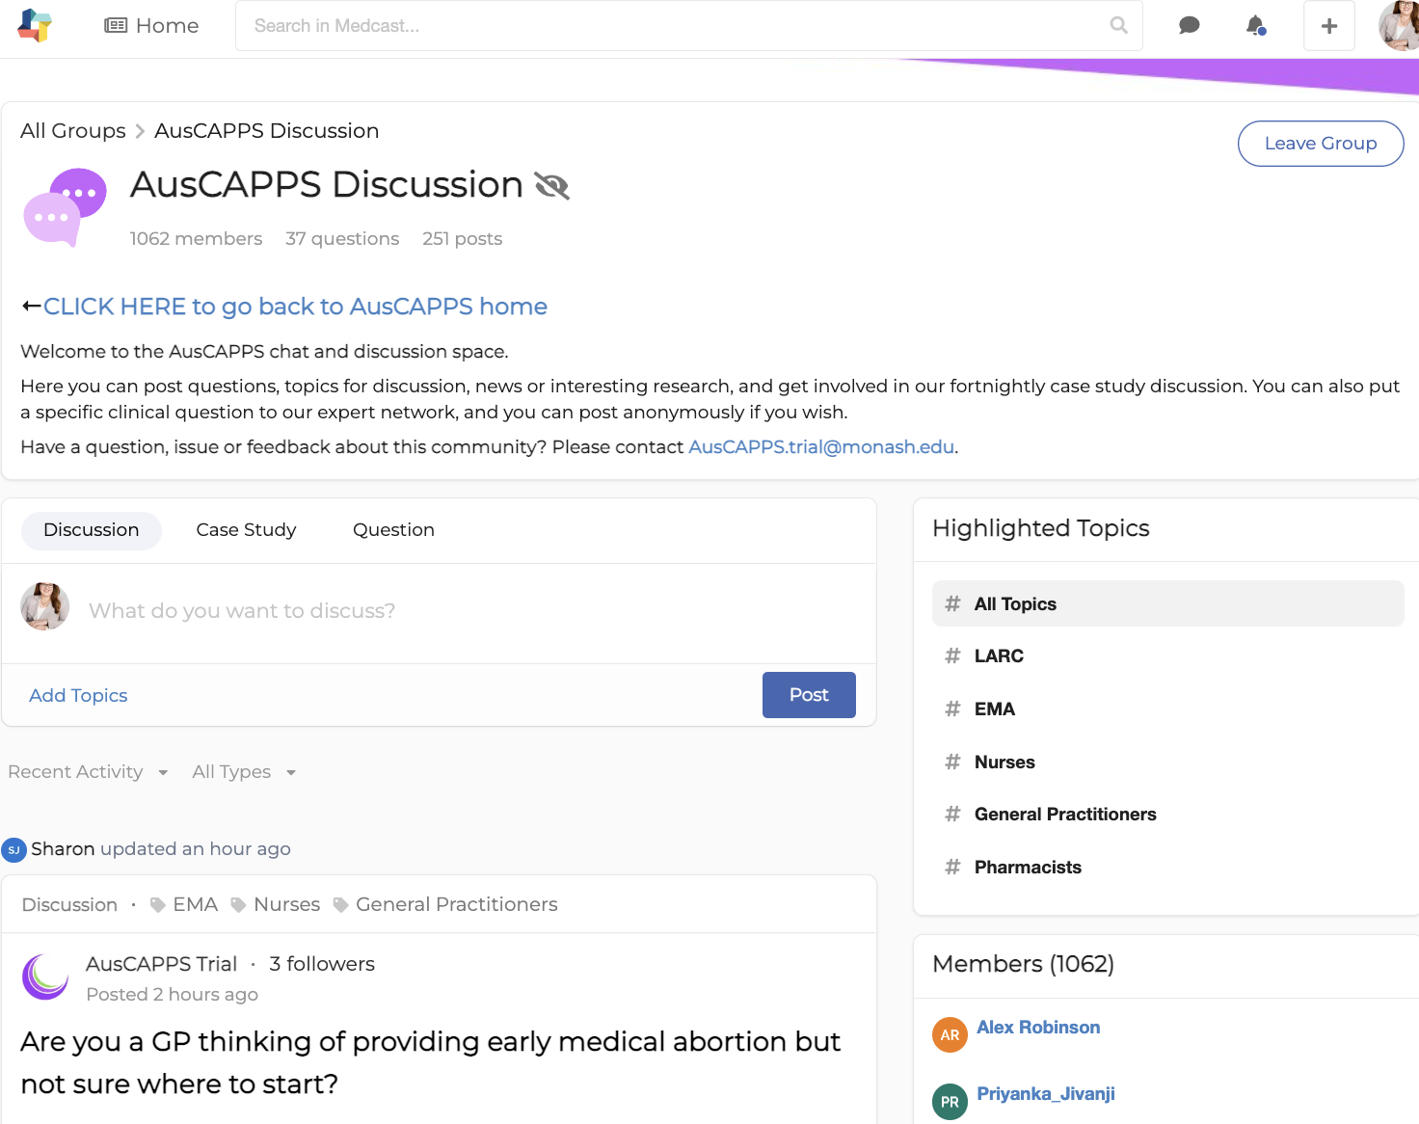
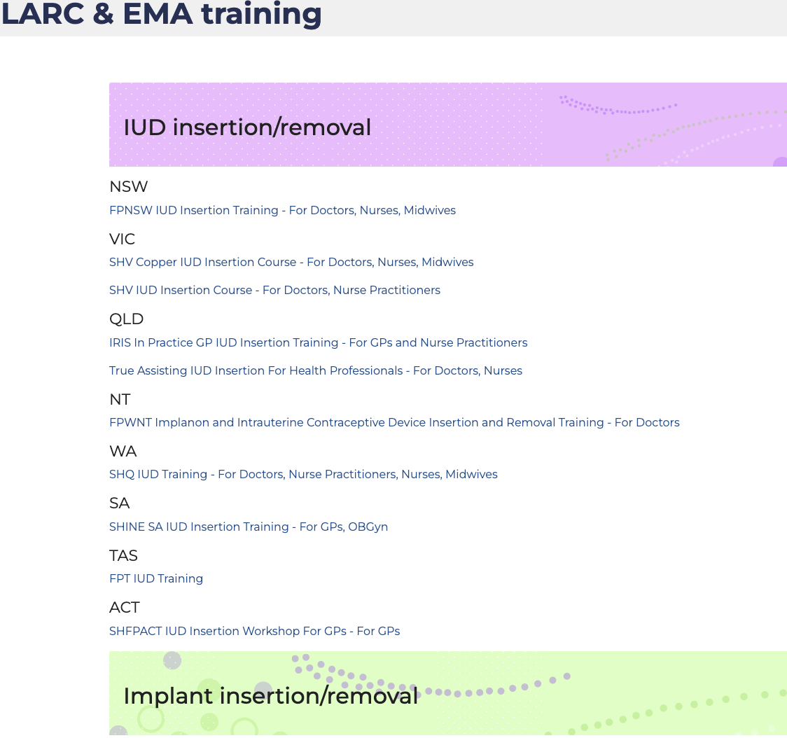
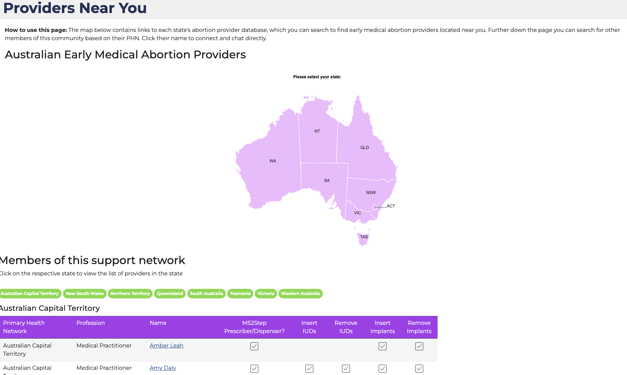
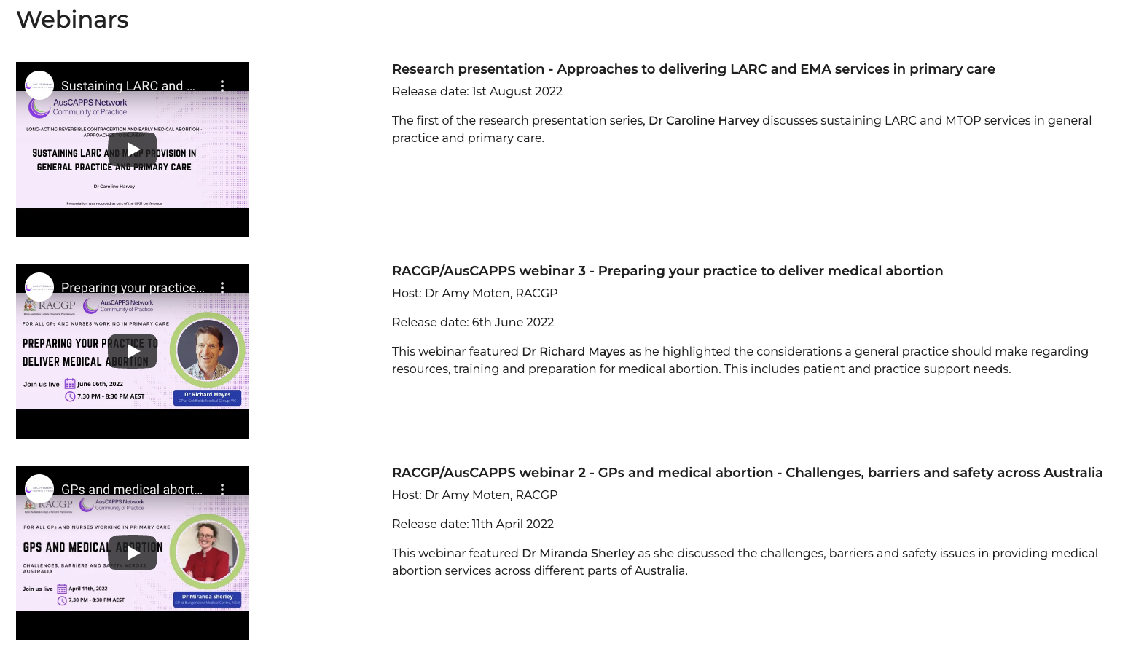
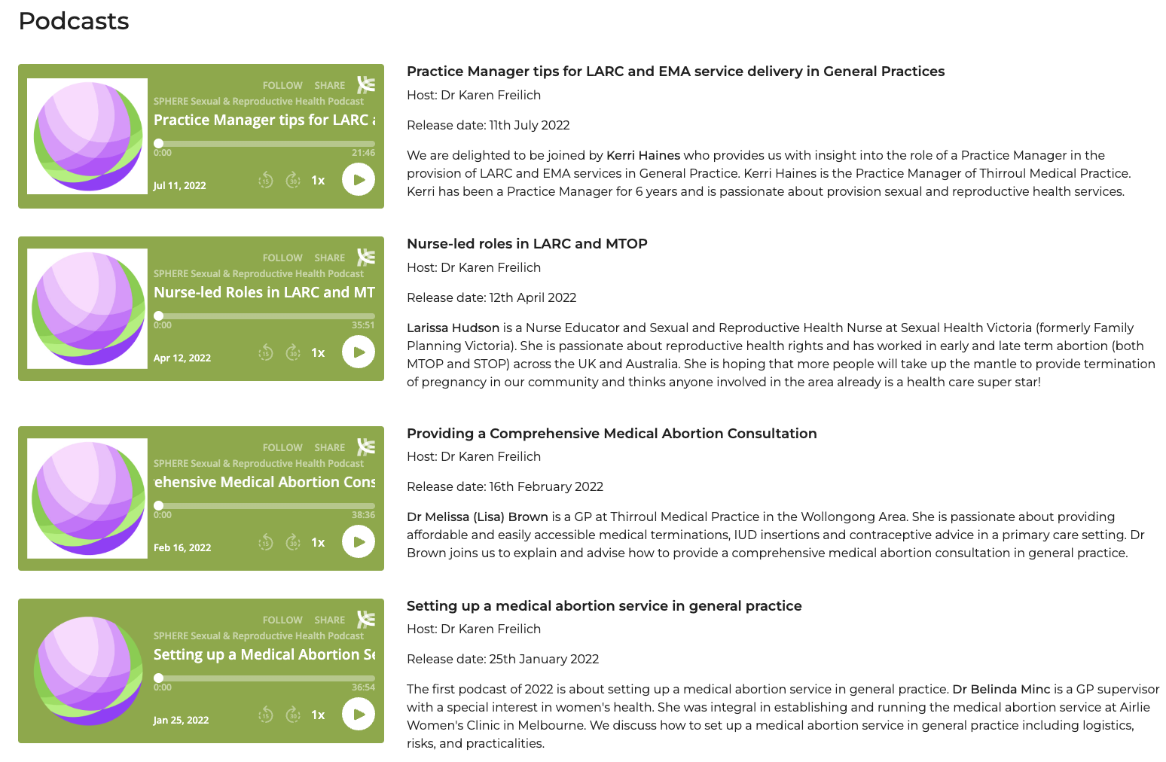
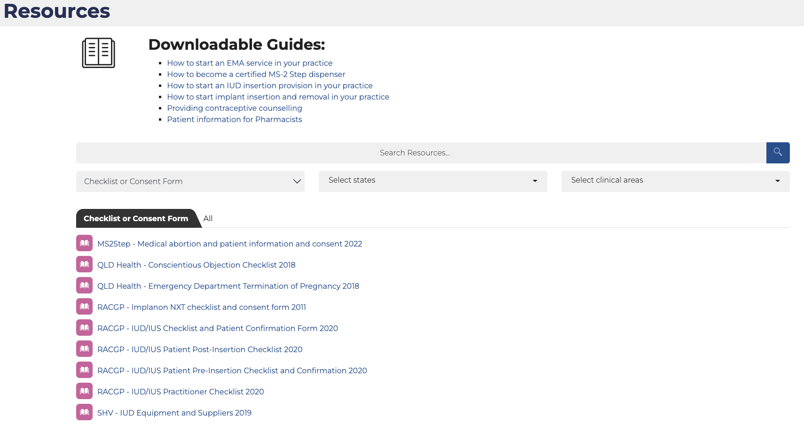

Slide 28


Slide 29
Supporting consumers

Slide 30
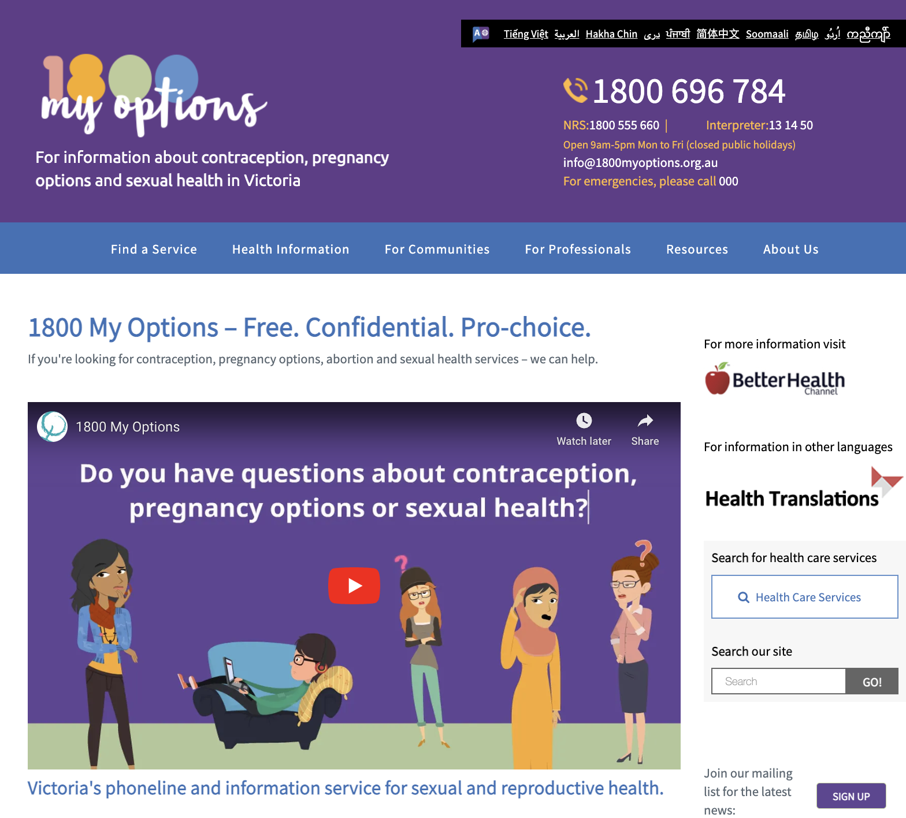
Navigation to Services

Slide 31




Slide 32
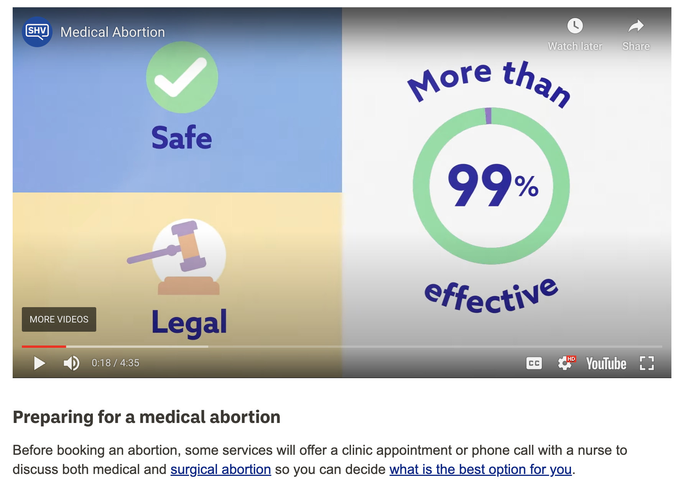

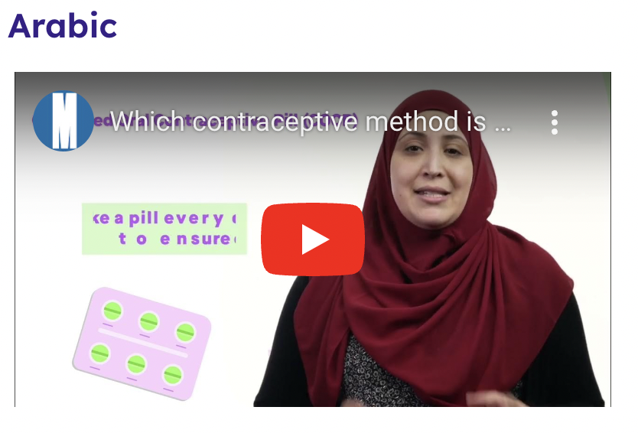
Resources for patients
Jean Hailes
Sexual Health Victoria
https://www.spherecre.org/resources/for-consumers/which-contraceptive-method-is-right-for-you

Slide 33
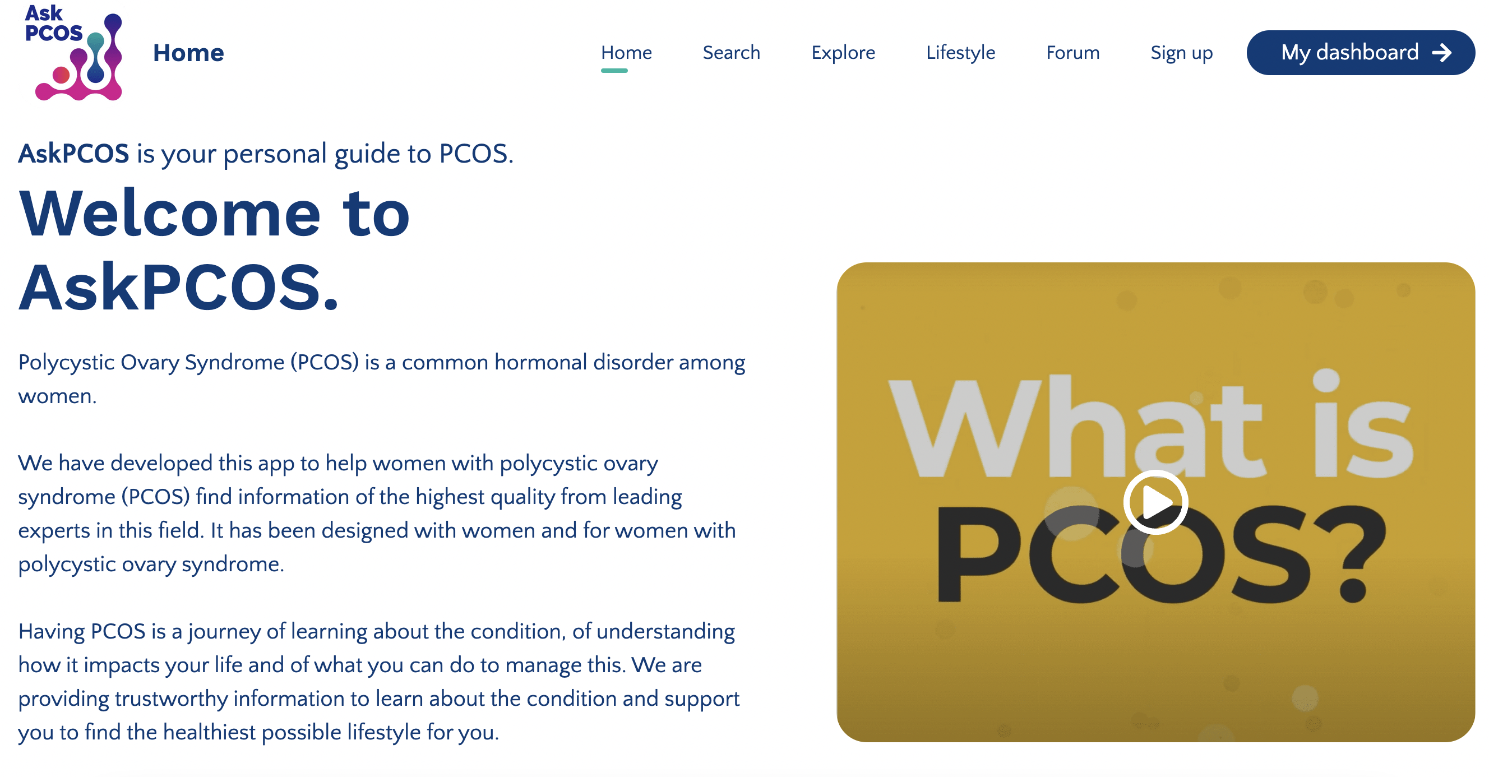

Resources

Slide 34
Conclusion
Awaiting federal government response to the recommendations of the Senate Inquiry into Universal Access to Reproductive Health Care for Women
Consider becoming a MS2Step and LARC provider if you are not already
Join AusCAPPs for support in LARC and EMA provision

