Slide 1
Disparities in Women’s Health Outcomes
Prof. Zoe Wainer BMBS, PhD, MPH, FCHSM, AFRACMA, GAICD Deputy Secretary, Public Health, Department of Health Enterprise Professor (Hon), The University of Melbourne
16 August 2023

Slide 2
Defining sex and gender
Sex and gender are not synonymous and should not be used interchangeably.
WHO defines these concepts as follows:
Sex ‘refers to the different biological and physiological characteristics of females, males and intersex persons, such as chromosomes, hormones and reproductive organs’.
Gender ‘refers to the characteristics of women, men, girls and boys that are socially constructed. This includes norms, behaviours and roles associated with being a woman, man, girl or boy, as well as relationships with each other. As a social construct, gender varies from society to society and can change over time’.

Slide 3
Defining women’s health
Conditions that pertain to females
maternal health
Conditions that affect women and females differently
cardiovascular diseases
Conditions that affect women and females disproportionately
Conditions characterised by gender-based discrepancies in care
autoimmune diseases
chronic gynaecological conditions e.g. endometriosis
gynaecological infections
menopause
women’s oncology
migraines
osteoporosis
pain management
mental health

Slide 4
Intersectionality
Sex and gender interact with each other and with other factors such as age, religion, ethnicity – also referred to as intersectionality.
Age
Gender
Disability
Nationality
Religion
Ethnicity
Socio-economic status
LGBTIQ+

Slide 5
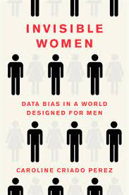
Invisible women
“The bodies, symptoms and diseases that affect half the world’s population are being dismissed, disbelieved and ignored. And it’s all a result of the data gap, combined with the still prevalent belief, in the face of all the evidence that we do have, that men are the default humans.”
(Perez 2019)

Slide 6
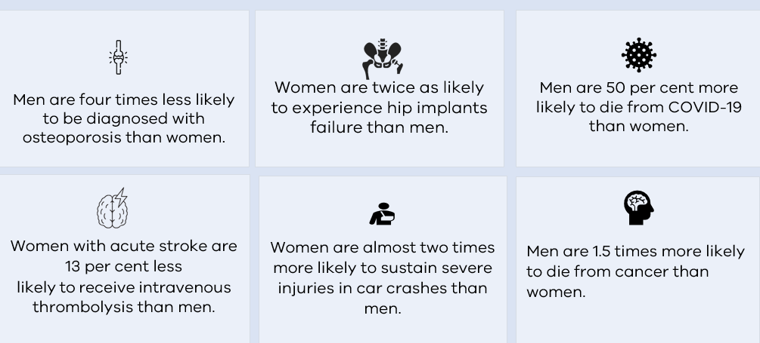
Why sex and gender matter

Slide 7
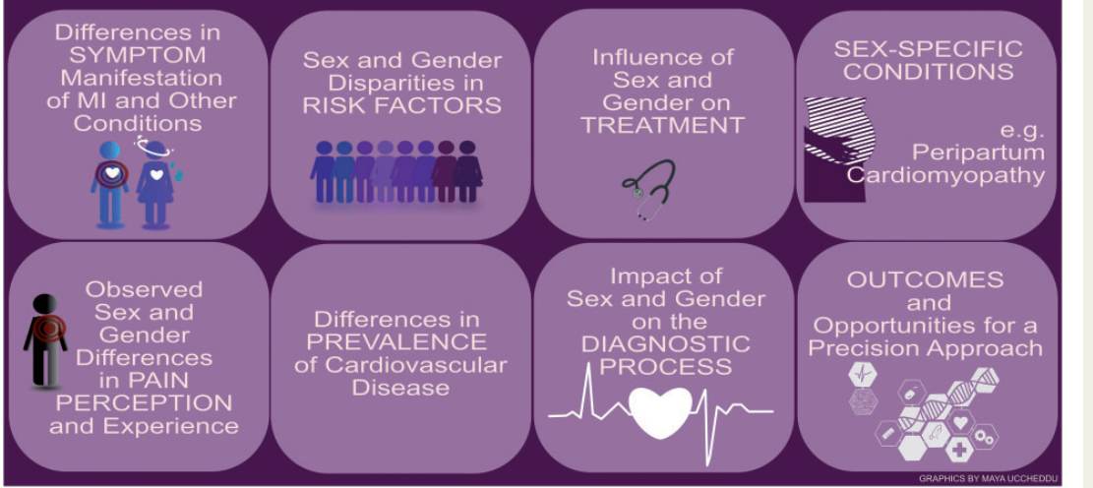
Sex and gender differences in cardiovascular disease
Schumacher et al 2021. European Heart Journal

Slide 8
Differential outcomes: hip implants

Slide 9
What are we doing to improve women’s health?
Kym Arthur, Executive Director, Women’s Health

Slide 10
Current programs and initiatives
Maternity and newborn services
1800 MyOptions
Free sanitary products in schools
Education in schools
Breast, cervical and bowel screening
Health promotion in women’s health organisations
Public IVF services
Gynaecology clinics
Sexual and reproductive health hubs

Slide 11





Election Commitment Aims
Promote the health of women and girls, including protection their basic rights to health care that is safe and high quality
Improve access to health services women require across their life course.
Support women to access culturally safe mental health and wellbeing services.
Promote best practice prevention, diagnosis, early intervention, treatment and/or management.
Use data and evidence to design programs and services to address a broad range of women’s health issues.
Expand and improve capability of the workforce providing women’s health clinical services.

Slide 12

Vision, Principles and Reform Enablers
VISION: A future where women of all ages, cultures and communities have the best possible health outcomes
VISION: A future where women of all ages, cultures and communities have the best possible health outcomes
Women’s Health Reform Enablers
Health Needs Assessment for a data-driven and equity-led approach
Stakeholder and Community Engagement, including lived experience and codesign
System design processes including service mapping, model of care, and referral pathways
Quality Assurance and Continuous Quality Improvement (CQI) processes
Outcomes & Evaluation Framework
Gender Impact Assessment
Governance structures – working group, steering committee, and taskforce
Knowledge translation – from research & data into action

Slide 13
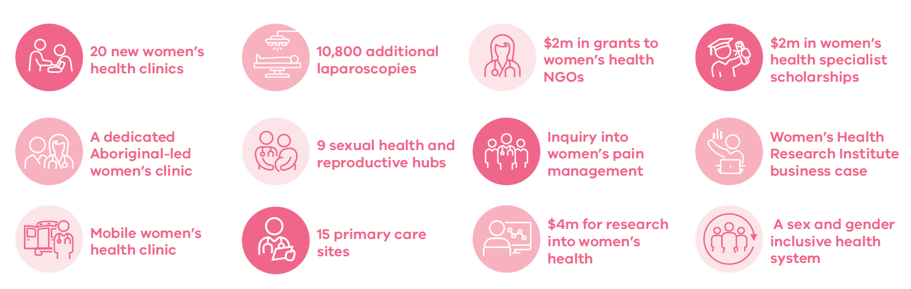
Women’s Health Reform Commitments

Slide 14
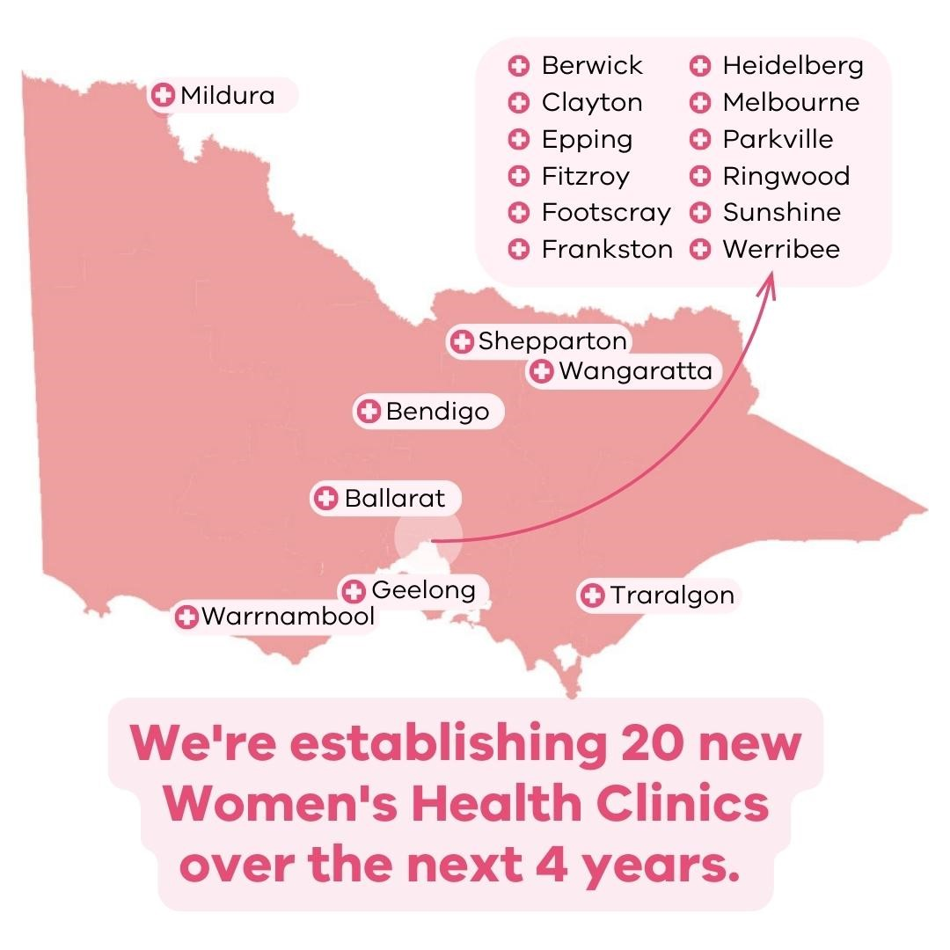
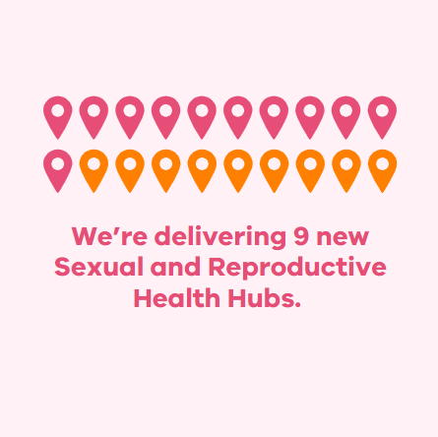
New Hubs and Clinics

Slide 15

Thank you! Any questions?

