Slide 1
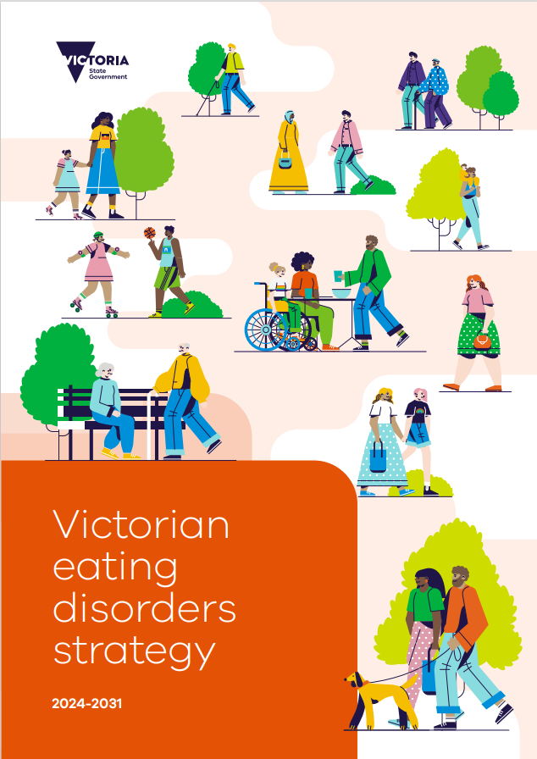
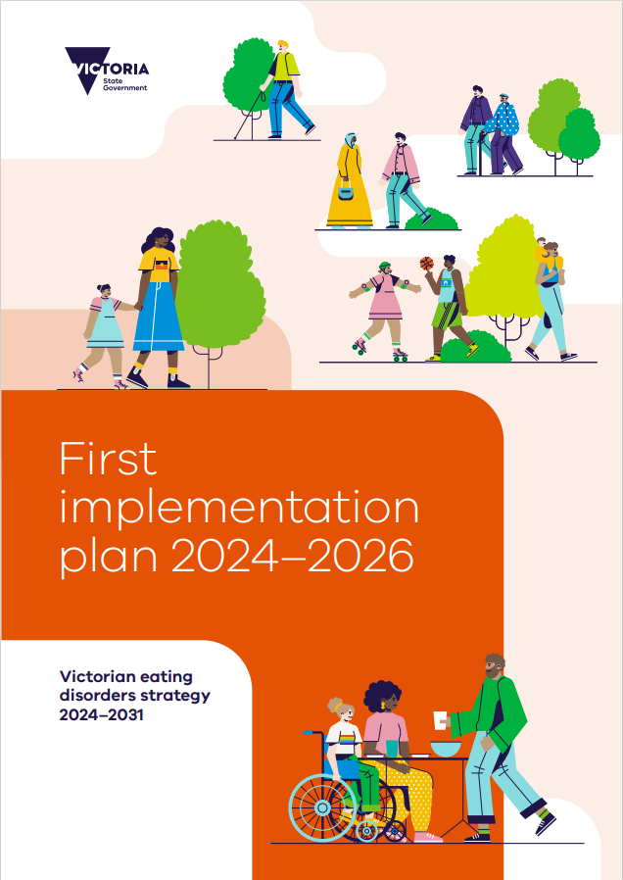
Victorian Eating Disorders Strategy 2024-2031
Notes:
Launch of the Strategy and the First Implementation Plan- October 6.

Slide 2











Context to this work
Background
Key challenges and issues
Current opportunity
The Royal Commission’s interim report noted an 11.1 per cent annual increase in number of reported eating disorders by public specialist mental health services (2008-09 to 2017-18).
COVID-19 pandemic caused sudden and unprecedented increase in service use for eating disorders.
Impact of pandemic on incidence and severity of eating disorders in Victoria yet to be fully realised, with an average delay of more than five years from symptom onset to diagnosis, and recovery ~ 1 to 6 years.
Historically, eating disorder care in Victoria limited, fragmented and underfunded, with investment skewed towards most acutely unwell.
No one pathway into and through eating disorders service system posing challenges for consumers, families, carers.
Significant gaps in eating disorder research, prevention, early intervention and community services.
Barriers to care include lack of clinical knowledge, inadequate focus on early intervention, stigma and lack of accessible services, including outreach support.
Significant changes since Victorian Eating Disorder Strategy (2014) including changes to DSM-5 diagnostic criteria, and impact of pandemic.
Recognising current gaps and challenges, the Victorian Budget 2022/23 provided funding to develop new statewide eating disorders strategy
Aligns with development of the National Eating Disorder Strategy 2023-2033, presenting opportunities for collaboration and alignment between state and national agendas
In 2021, Australian Eating Disorder Research and Translation Strategy 2021–2031 launched, providing further opportunities for alignment
Notes:
This new strategy is significant for a number of reasons:
Eating disorder presentations and severity have increased in Victoria over the past decade- the RCVMS highlighted this trend and its impact.
Historically, eating disorder prevention and care in Victoria has been limited, fragmented and underfunded. Navigating the service system has been a challenge for consumers, families and carers.
Funding in the 2022-23 budget provided the opportunity to develop the new strategy, (and more recent funding has supported the delivery of actions in the strategy)
The strategy provides a significant opportunity to consider the eating disorders system in the context of the transformation underway to implement a new mental health and wellbeing system architecture in Victoria.

Slide 3




Strategy scope
The strategy aims to achieve high-quality, safe and evidence-informed practice in the promotion, prevention, early intervention, treatment and recovery for Victorians with or at risk of developing an eating disorder, and their families, carers and supporters.
Continuum of care
Considers actions across continuum of health promotion, prevention, early intervention, treatment and recovery for people with or at risk of developing eating disorders (including those experiencing severe and enduring eating disorders)
Recognises person's journey of care is not linear
Types of eating disorders
Consider actions to support people with or at risk of developing eating disorders
Includes people who meet diagnostic criteria in DSM-5; people with broader feeding or eating disorders (e.g. orthorexia, disordered eating); as well as people experiencing distress related to body image, shape, size or weight (e.g. body dysmorphia).
Lifespan
Cover all age groups - system needs to be able to prevent, and where necessary identify, assess and treat people with eating disorders in a developmentally appropriate way
Diversity of experiences
Consider how all aspects of a person’s identity – such as Aboriginality, gender, gender identity, sex, sexual identity, cultural and linguistic background, trauma experience, ability, age, geographic location, mental health, physical health – can interact with attitudes, systems and structures in society to influence risk of developing and/or a person’s experience of an eating disorder.
Notes:
The strategy aims to achieve high-quality, safe and evidence-informed practice in the promotion, prevention, early intervention, treatment and recovery for Victorians with or at risk of developing an eating disorder, and their families, carers and supporters.

Slide 4









Engagement approach
The strategy has been developed in partnership with people with lived and living experience of eating disorders, their families, carers and supporters. It draws on the unique perspectives and experiences from a range of backgrounds.
Advisory group
Key stakeholders and partner orgs
Representatives from Victorian government departments including:
Mental Health and Wellbeing Division
Public Health Division
Commissioning and System Improvement
Safer Care Victoria
Department of Education
Department of Justice and Community Safety
Office of the Chief Psychiatrist
Consulted with….
100+ individuals with lived and living experience of eating disorders, families, carers and supporters
50+ organisational representatives across health services and clinical peaks
40+ organisational representatives across community, research and advocacy settings
Consultation: Round 1
Consultation: Round 2
Consultation: Round 3
Workshops and a public consultation focused on vision, current issues, gaps and opportunities within the eating disorder continuum of care in Victoria
Explored design considerations as part of defining the future state system for eating disorders care in Victoria
Targeted workshops gathered final feedback on the strategy and its implementation considerations
Notes:
Significantly- the strategy was developed in genuine partnership with people with lived and living experience of eating disorders and their families, carers and supporters. As well as health services, clinical peak bodies and community, research and advocacy organisations.
Eating Disorders Victoria and the Victorian Centre of Excellence in Eating Disorders (or CEED) have been key partners in the development of the new strategy and will continue to work in partnership with the Department of Health as we move into implementation.
These are people and organisations who deeply understand the problems and gaps in our current system and know what we need to improve.

Slide 5

Vision and ‘how to’ statement
A bold vision for reform
By 2031, people in Victoria feel supported to have a safe and empowered relationship with body, food, and movement, free of stigma or weight discrimination, enabling them to build a meaningful life underpinned by their own physical and mental wellbeing.
How this will be achieved
By enabling a person, family and supporter-centred, accessible, interconnected and evidence-informed continuum of care that promotes prevention and early intervention, co-designed and delivered with lived experience across intersectionalities, leading to the best outcomes for all people in Victoria at risk of or impacted by eating disorders.
Notes:
Co-designed vision statement

Slide 6
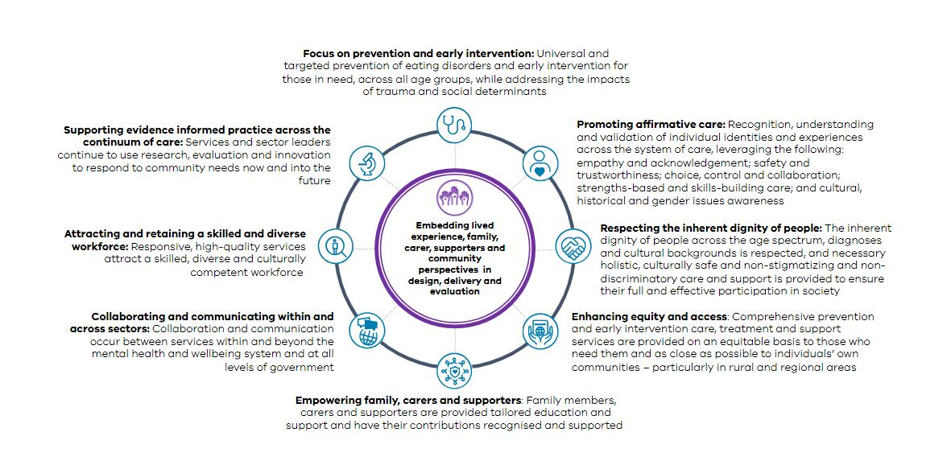
Guiding principles
Nine guiding principles support the roll out of the strategy, including;
Notes:
The strategy proposes a range of guiding principles and a framework to deliver actions that collectively represent a fundamental, structural and cultural shift in the way we think about eating disorders.

Slide 7
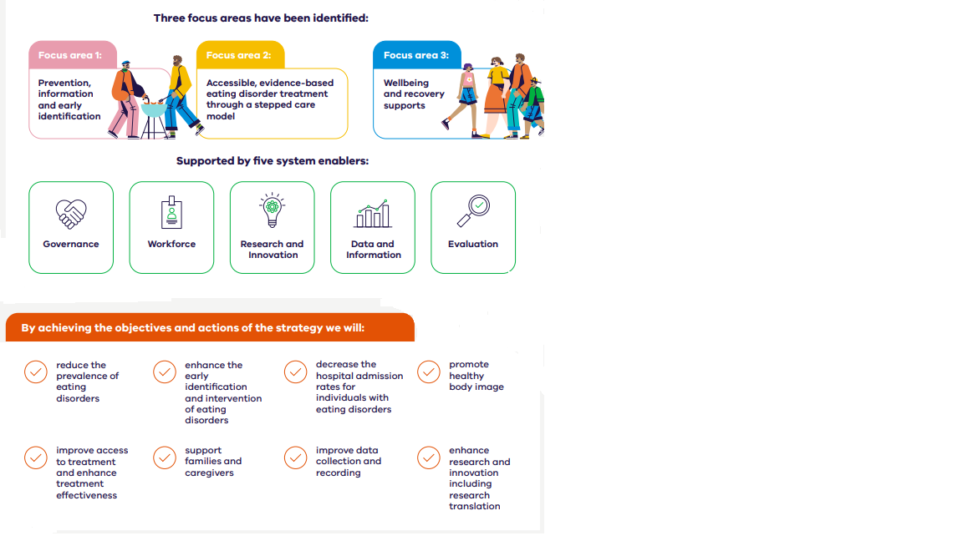
Strategic framework
In addition to the guiding principles, a framework with three focus areas and five system enablers has been developed to deliver the strategy.
Objectives to deliver the strategy’s vision have been allocated across the three focus areas, aligned with the stepped system of care for eating disorders.

Slide 8
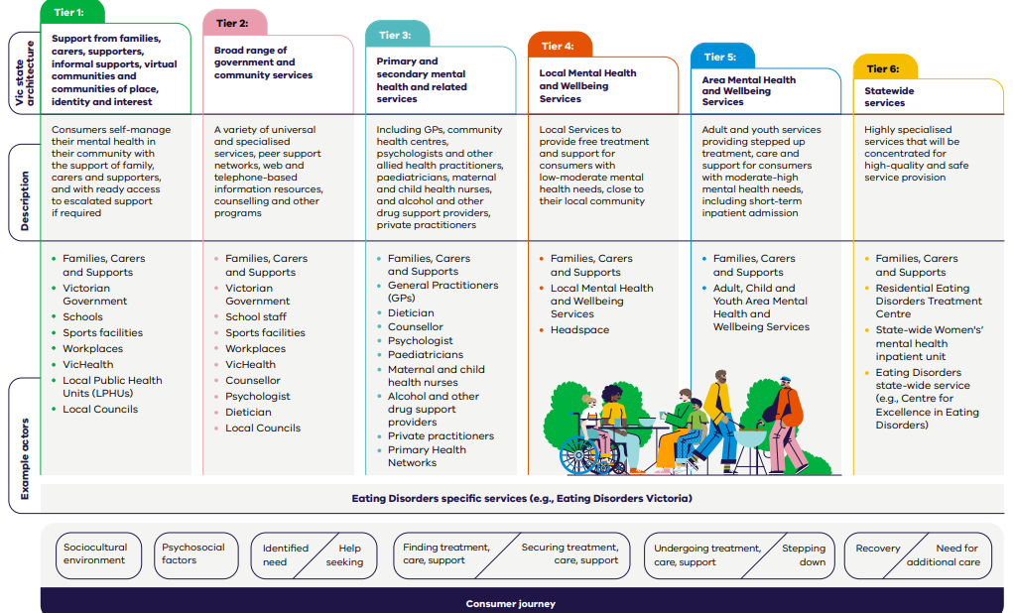
Victorian eating disorders stepped system of care
Notes:
The strategy aims to embed the national stepped model of care across Victoria’s mental health and wellbeing system.
This figure shows the stepped system of care mapped to the Victorian health and reformed mental health systems.

Slide 9

Statewide program of Victorian public mental health focussed on:
Building the ED clinical capability of the Area MHWS & health sector workforce
Support building the stepped system of care for eating disorders in Victoria

Slide 10





About CEED
Strengthening the system of care to provide excellence in eating disorders treatment for Victorians
Service Development partnership
Training & Education
Clinical case
Consultation
Resource Development
Adjunctive Clinical Programs at AMHS
Notes:
So, a little bit about CEED. CEED is a state-wide service in the Victorian Government's commitment to the provision of quality services to those with eating disorders and their supports.
CEED provides leadership and support to clinicians and services through:
Clinical consultation
Training
Service development
And resource development

Slide 11

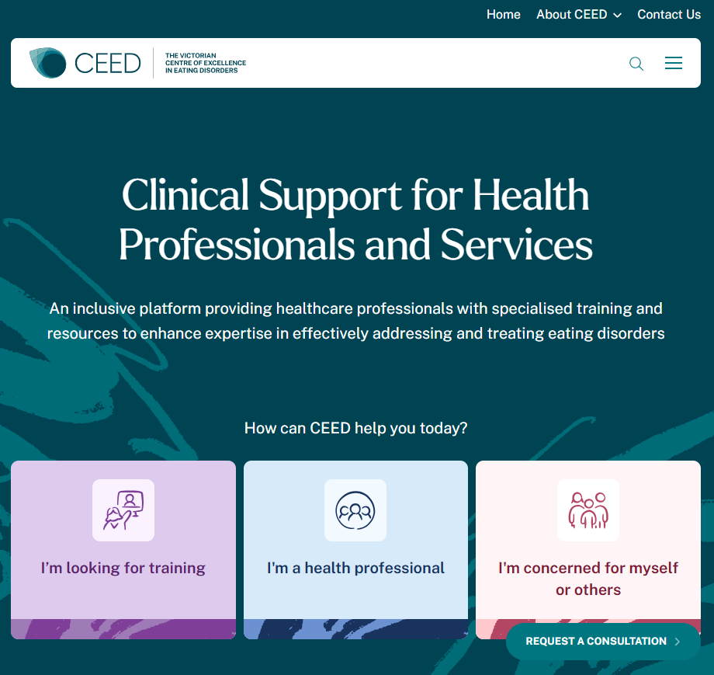

Slide 12
Victorian eating disorders stepped system of care
Notes:
The strategy aims to embed the national stepped model of care across Victoria’s mental health and wellbeing system.
This figure shows the stepped system of care mapped to the Victorian health and reformed mental health systems.

Slide 13
Victorian eating disorders stepped system of care
BN or BED
12-25yo
25yo+
Headspace
ED Credentialed PP (EDP)
ED Credentialed PP (EDP)
Wellbeing Locals / Head2Health
AN & AN like / ARFID & complex ED
0- 25yo
25yo+
CYMHWS
ED Credentialed PP (EDP)
Local AMHWS
RMH / BETRS / Monash WRC / Wren ED Programs
ED Credentialed PP (EDP)
Notes:
The strategy aims to embed the national stepped model of care across Victoria’s mental health and wellbeing system.
This figure shows the stepped system of care mapped to the Victorian health and reformed mental health systems.

