Slide 1
The role of Early Parenting Centres
August 2025
OFFICIAL

Slide 2
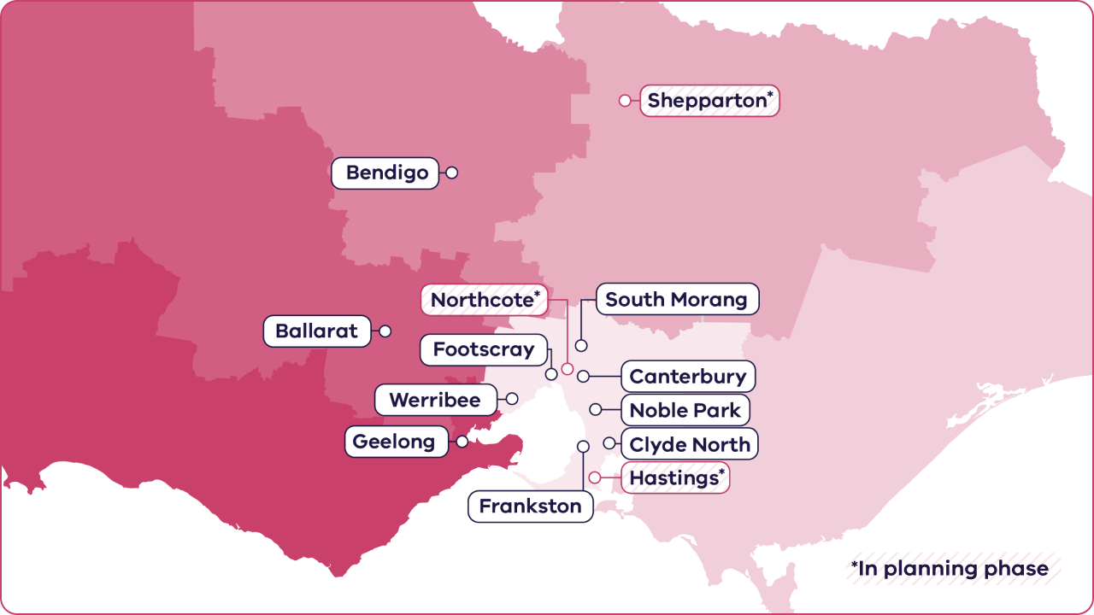
Currently 10 EPCs across the state, growing to 13 by 2028
Free health service for families with children from birth and up to 4yo, offering:
residential stays
day stays
telehealth
group programs.
No Medicare card is required to access an EPC service.

Slide 3
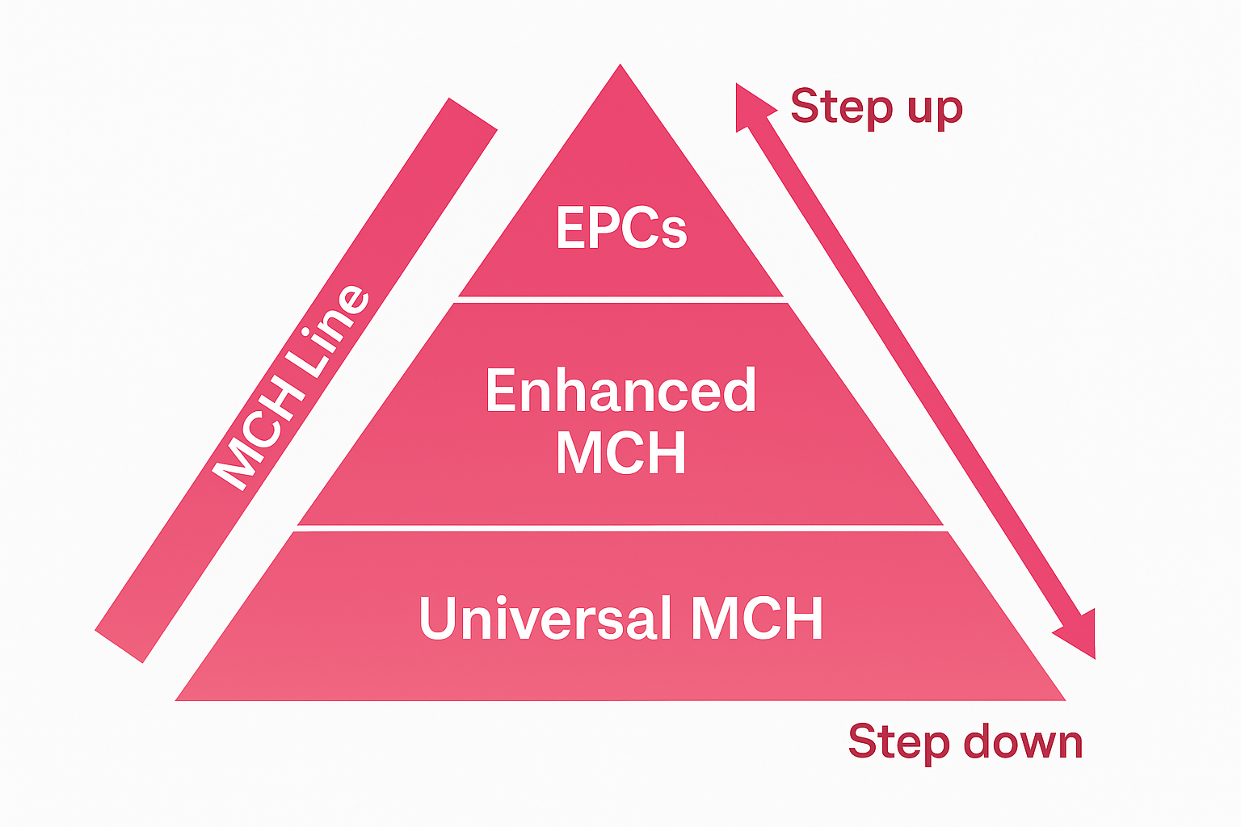

The role of Early Parenting Centres within Victoria’s Maternal and Child Health system
Murrumbek Casey EPC, image courtesy Monash Health

Slide 4

Service offerings
    MCH service
Health promotion – breastfeeding, nutrition, immunisation, home safety, first aid.
Population based screening – i.e. postnatal depression, infant/child development.
Identification of needs – connecting early with appropriate support and information.
Anticipatory guidance – e.g. talk with parents about next stages of child development.
Referral – to professionals or key services (including EPCs) for specialist support.
    EPCs
Intake and assessment – identification of presenting and underlying needs, and goals
Targeted interventions - to address parenting goals through residential stay program (5 days/4 nights), day stay program, and/or home-based programs.
Clinical interventions - individual or group therapy sessions, workshops on parenting skills, and practical assistance with issues such as sleep and feeding problems.
Referral – reconnection with local services

Slide 5

Workforce
    MCH service
    MCH Nurse-led
  Universal MCH is delivered by qualified MCH Nurses across:
    81 local government based MCH services
    17 Aboriginal MCH service locations, including Aboriginal health workers
    Statewide 24/7 MCH Phone Line.
  Multidisciplinary care is delivered in elements of the MCH program, under MCH nurse leadership.
EPCs
Nurse-led multidisciplinary care team
Comprised of various nursing roles (registered nurses, registered midwives, enrolled nurses and MCH nurses), allied health professionals, psychologists, social workers, play therapists and early parenting practitioners.
Use a multidisciplinary care team approach that:
    brings a holistic view of family and community to address underlying causes
    provides team-based care planning and care coordination.
    MCH nurses are a critical part of the multidisciplinary team. They provide clinical guidance and support to nursing staff and lead clinical governance and clinical policy development across the EPC.

Slide 6
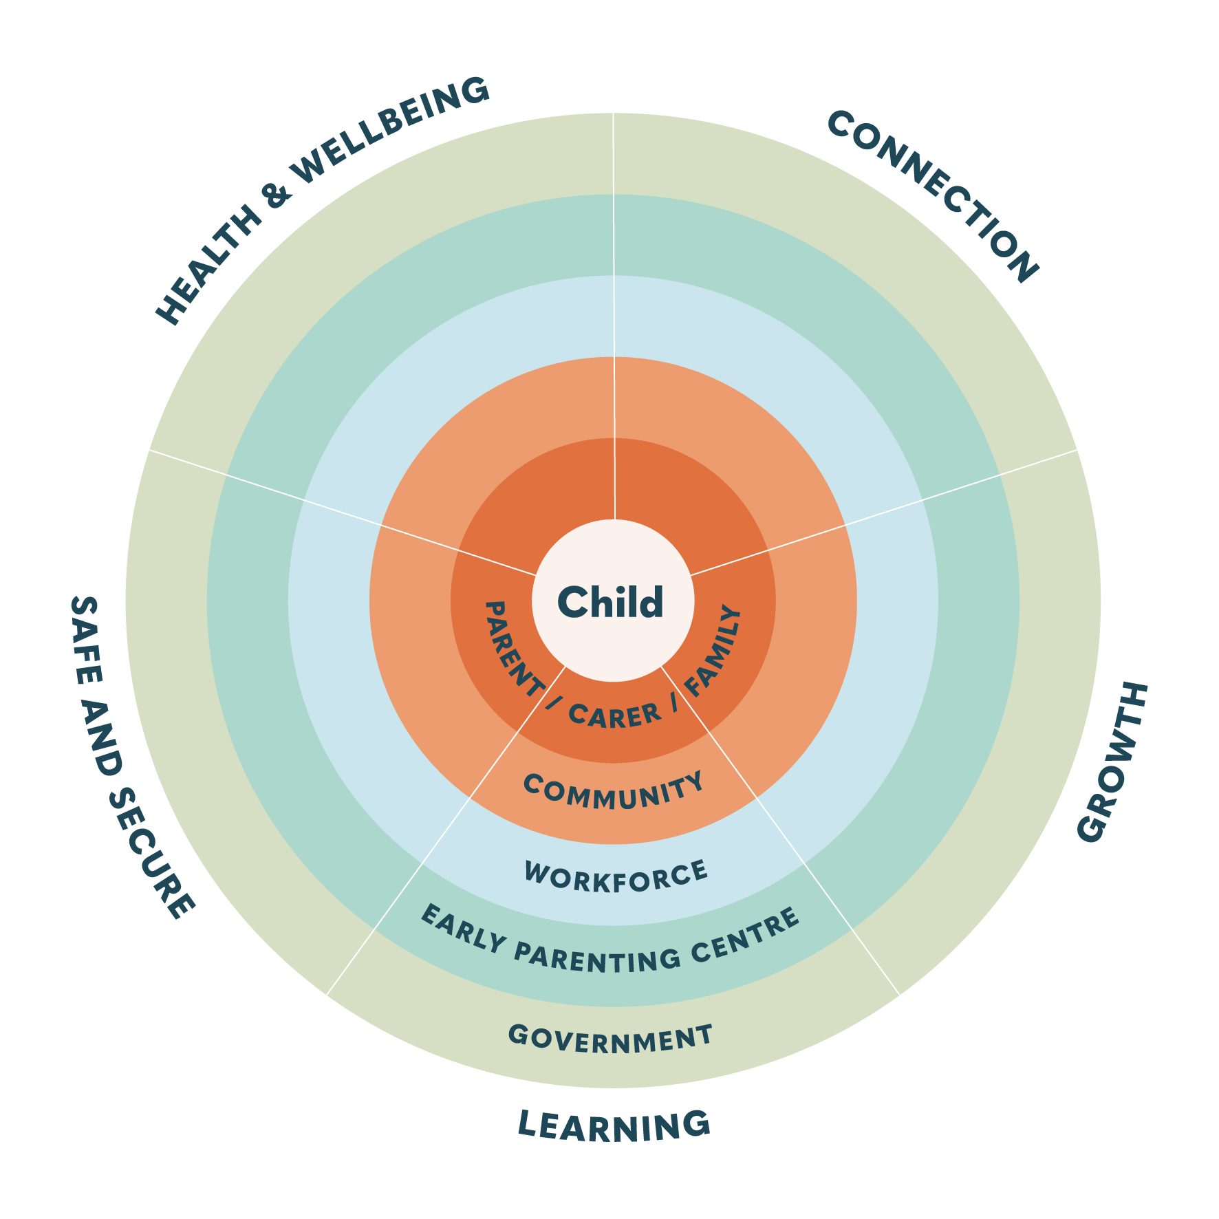

Evidence-based outcomes of EPC participation

Slide 7
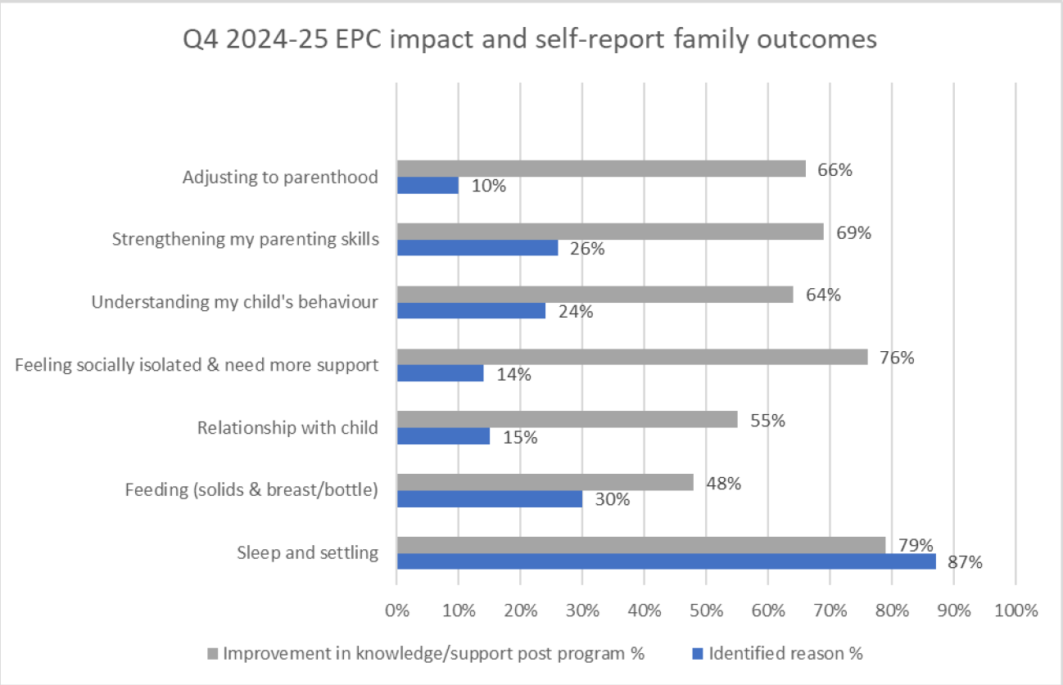
Outcomes for parents and carers

Slide 8


Referrals to EPCs
A list of all EPCs is available at: www.health.vic.gov.au/maternal-child-health/early-parenting-centres
Each EPC has an online referral form on their homepage

