Slide 1
Syphilis Update – Victoria
RACGP webinar, 27 November 2025 Dr. Dilanka Hettiarachchi (Public Health Medical Officer / GP) Office of the Chief Health Officer Victorian Department of Health​
OFFICIAL

Slide 2
Learning objectives
Apply best practice principles for timely diagnosis, management and contact follow-up
Understand local syphilis epidemiological trends
Understand and implement the updated syphilis in pregnancy testing recommendations
Identify professional development opportunities and support sources

Slide 3
Syphilis Overview
Syphilis is a common STI caused by Treponema pallidum bacteria
It is easily treated if diagnosed early but can be undetected and if untreated, may lead to serious complications.
A substantial proportion will have no symptoms and will only be diagnosed by screening or serological testing.
Mode of transmission
direct skin or mucous membrane contact during vaginal, anal or oral sex
vertical transmission during pregnancy through placenta or during delivery
less commonly via infected blood, non-sexual contact with infectious lesions or needle-stick injury / sharing injecting equipment.

Slide 4
Stages of Infection
Infectious syphilis (<2 years)​ | Primary syphilis​ | Painless chancre (may appear 10-90 days after inoculation) Genital or non-genital sites Spontaneously heals over a few weeks Lymphadenopathy may be present
 | Secondary syphilis​ | Non-specific systemic symptoms: Headache, fatigue, lymphadenopathy, fever, sore throat, rash. Develop 4-10 weeks after onset of primary lesion Condylomata lata, neurological and ocular symptoms may be present Symptoms may persist for 3-12 weeks and relapse if untreated​
 | Early latent syphilis​ | No clinical symptoms or signs Positive syphilis serology without evidence of adequate past treatment Previously negative test or a 4-fold increase in RPR within past 2 years(if previously treated).​
Non-infectious syphilis (>2 years)​ | Late latent syphilis ​ | No clinical symptoms or signs Positive syphilis serology No evidence of adequate past treatment. No negative test within 2 years.​
 | Tertiary syphilis​ | Syphilis of greater than 2 years duration with destructive skin, cardiovascular or neurological disease​

Slide 5
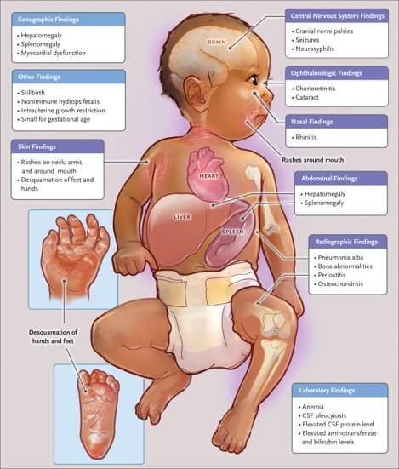
Congenital Syphilis
Pathophysiology
Transplacental transmission can occur at any stage of pregnancy
Highest risk in untreated early syphilis
Infant outcomes
Miscarriage, stillbirth and death
Lifelong disability
Clinical manifestations
Early (<2yrs): hepatosplenomegaly, rash, anaemia, rhinitis, bone lesions
Late (>2yrs): dental abnormalities, hearing loss, interstitial keratitis, skeletal deformities
Source: DOI: 10.1056/NEJMra2202762

Slide 6
Groups at Higher Risk
Any person can get syphilis through unprotected sex with an infectious person.
Groups at higher risk of syphilis
Risk factors for congenital syphilis
gay, bisexual and other men who have sex with men (GBMSM), and their female partners
heterosexual people with multiple partners
sex workers
people who inject drugs that lead to disinhibiting sexual behaviour
Aboriginal and Torres Strait Islander peoples
socio-economic disadvantage or homelessness
people from CALD backgrounds
pregnant people not engaged in antenatal care
pregnant people with one or more risk factors:
drug and alcohol misuse
homelessness or unstable accommodation
mental health issues
family violence
new infection or re-infection in pregnancy
Aboriginal and Torres Strait Islander people

Slide 7
Management Principles
Treatment: recommended antibiotics
Partner management: contact tracing, testing and treatment
Follow up: repeat testing and treatment response check
Testing: standard STI check up, testing in pregnancy and compatible illness

Slide 8
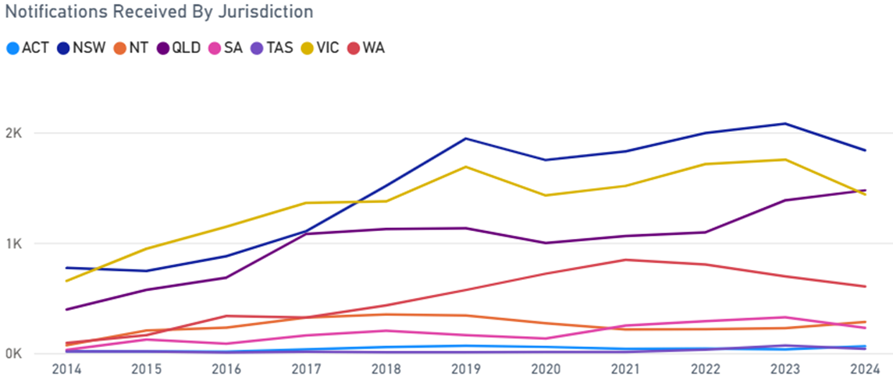
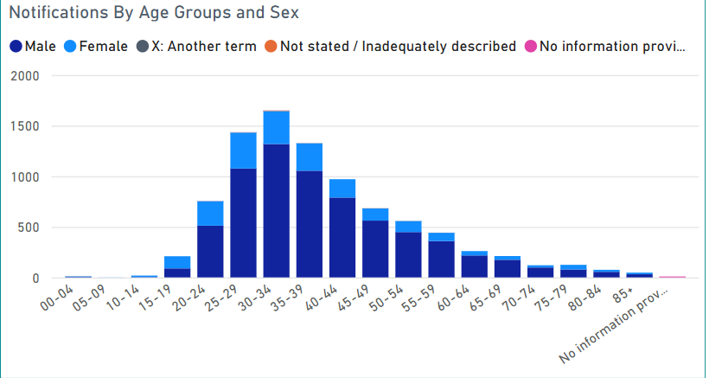
Syphilis – A Public Health Priority in Australia
Syphilis notifications in Australia (2024)
Infectious syphilis
 | 2023 | 2024 | 2025 (as 6 Aug)
Infectious syphilis | 6,566 | 5,968 | 3,546
Congenital syphilis | 20 | 11 | 11
Infant deaths | 10 | 4 | 4
Source Australian Centre for Disease Control Dashboard · NNDSS Portal

Slide 9
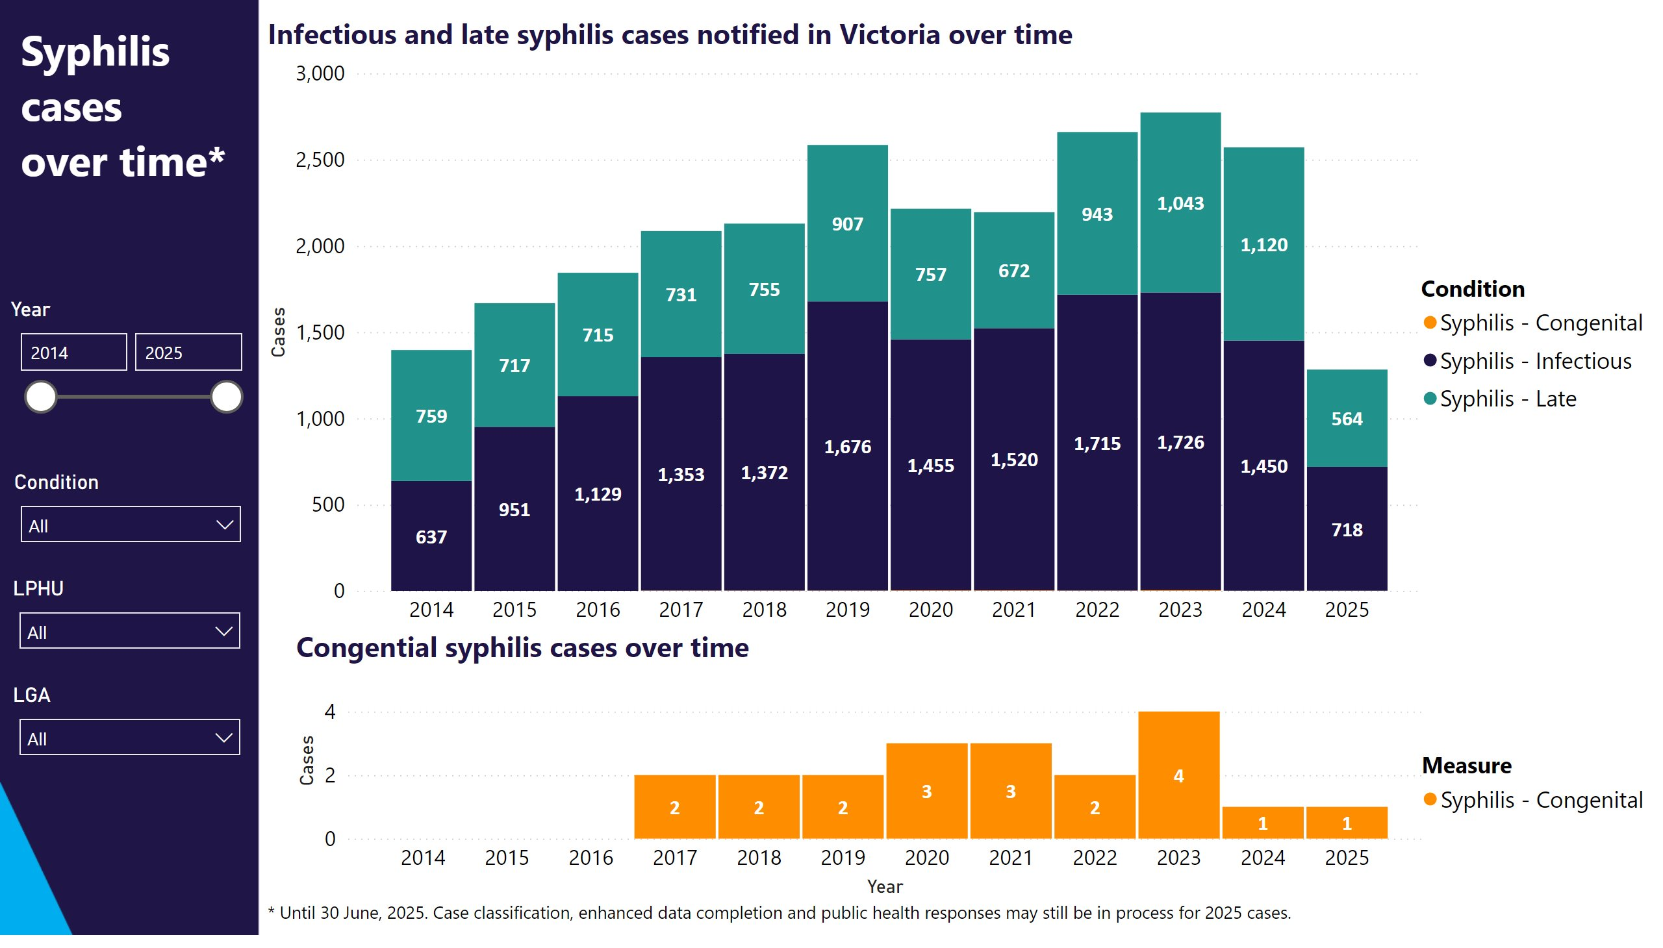
Victorian Syphilis Epidemiology
Source Victorian Department of Health – Public Health Event Surveillance System (internal data, 2025)

Slide 10
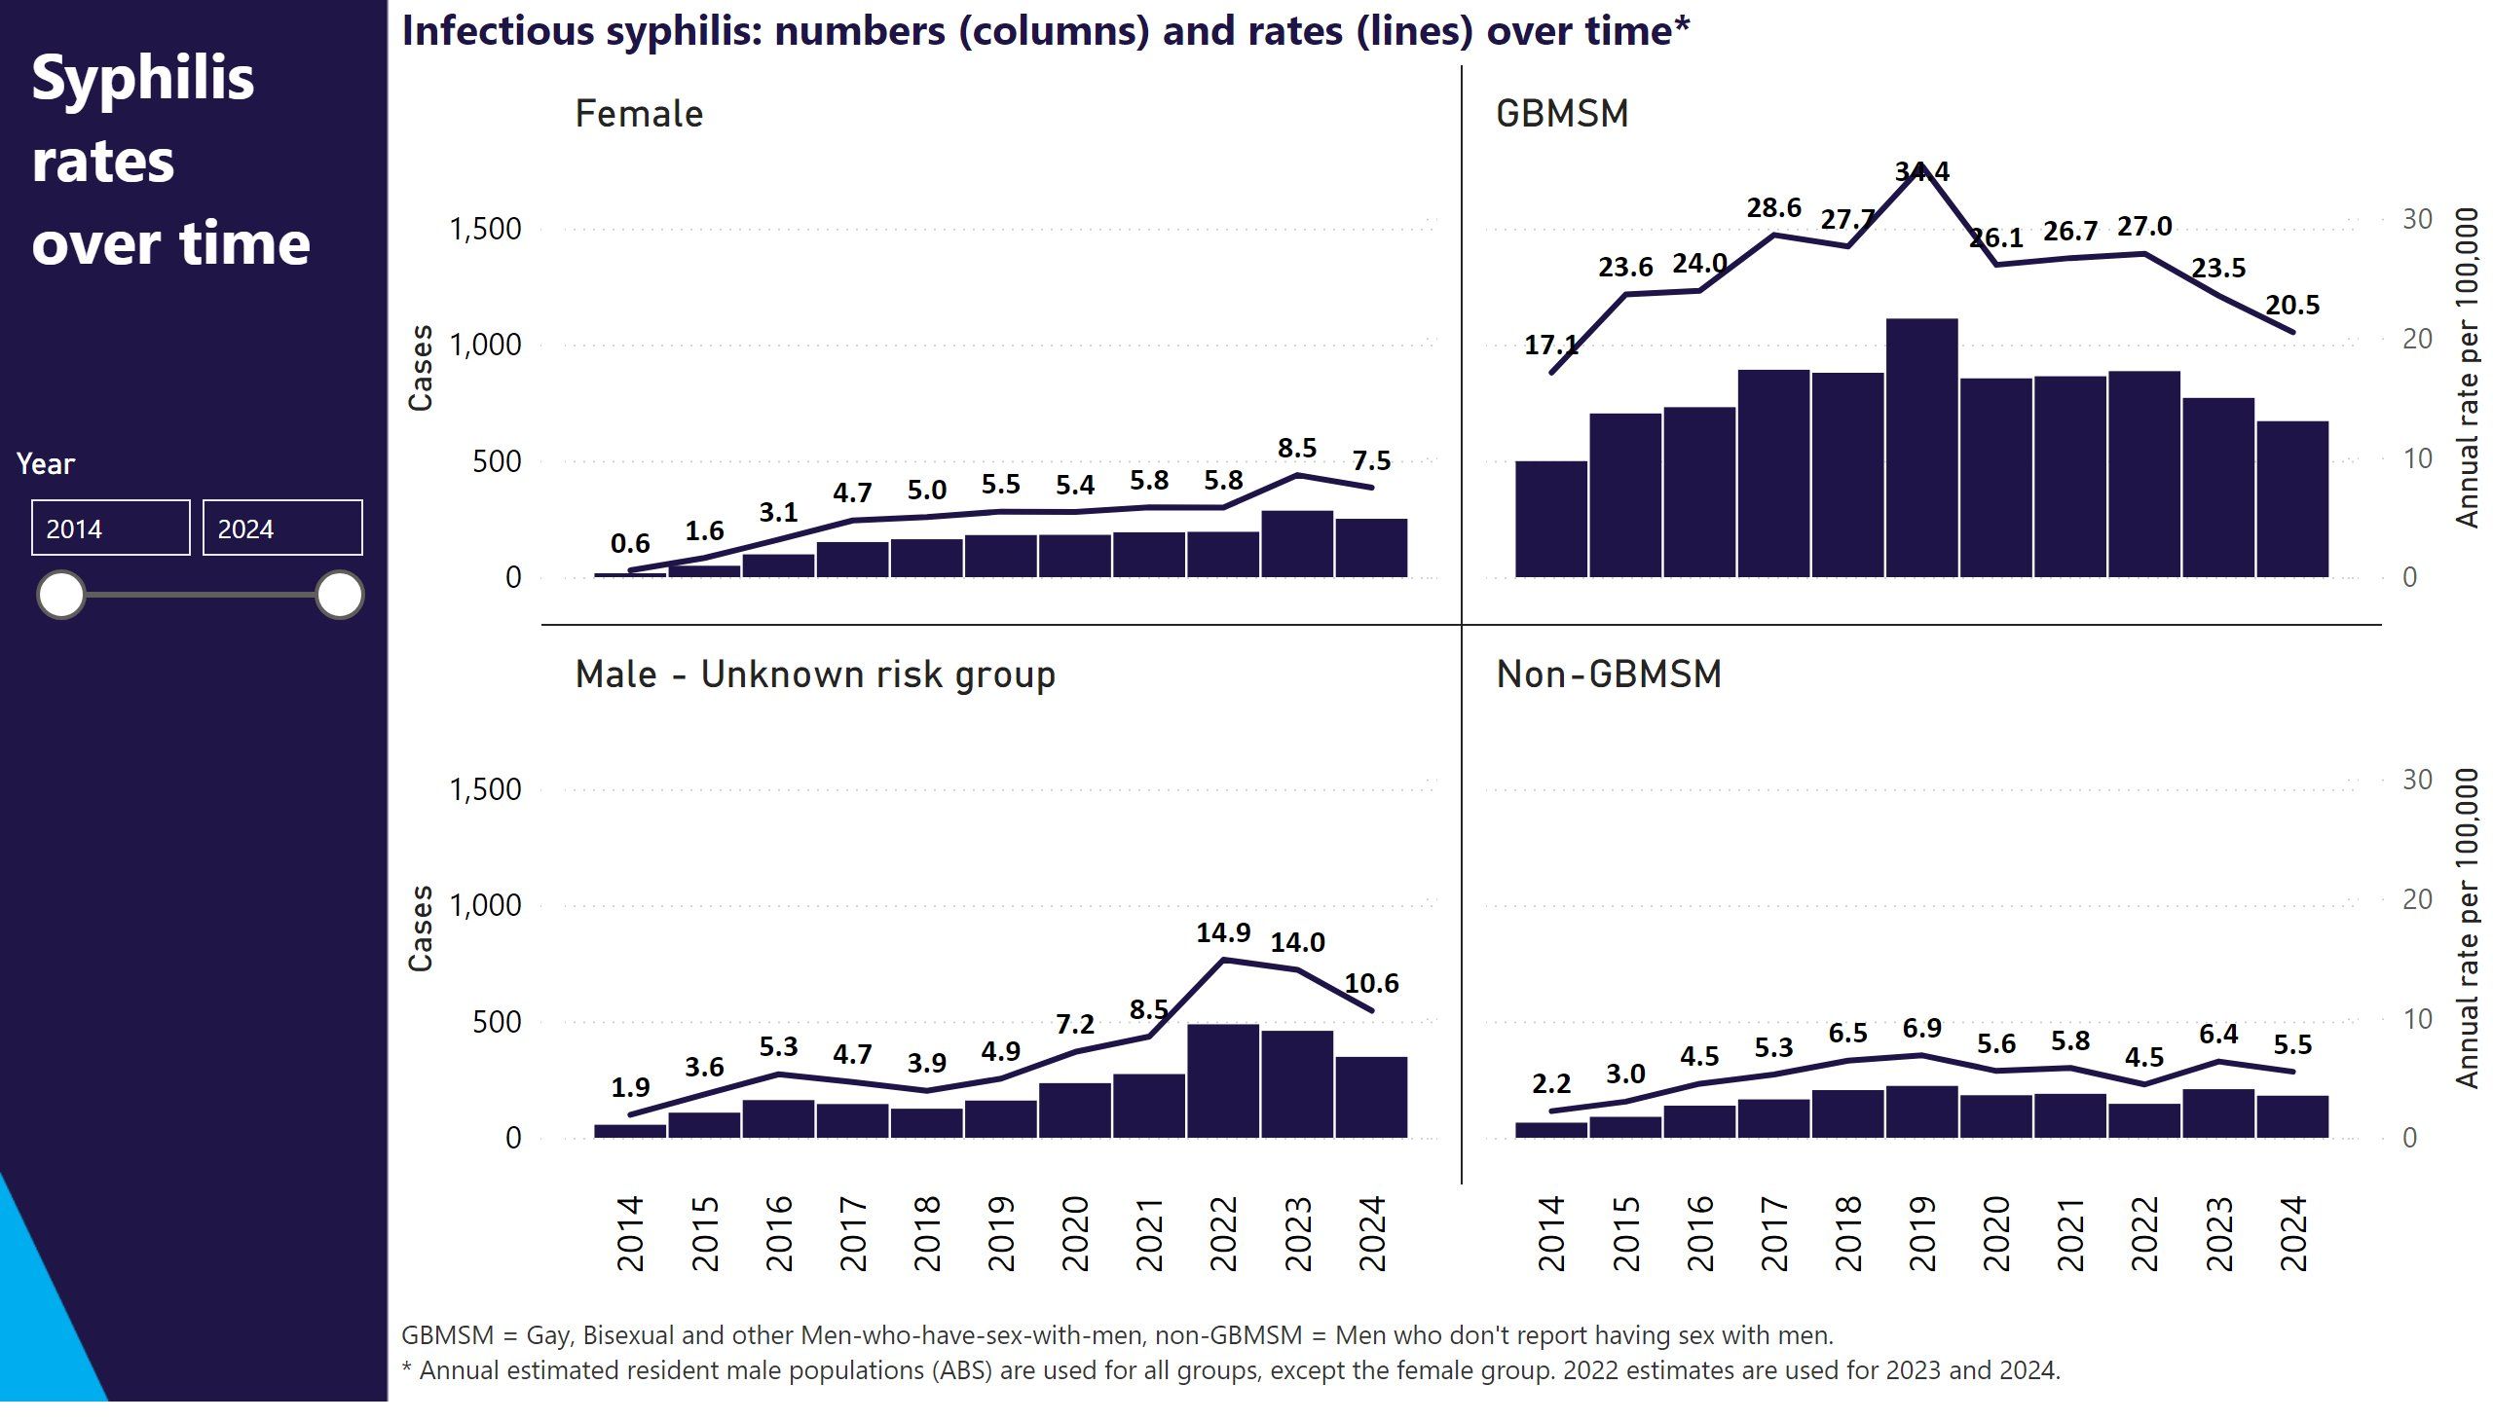
Victorian Syphilis Epidemiology: Demographic Groups
Source Victorian Department of Health – Public Health Event Surveillance System (internal data, 2025)

Slide 11
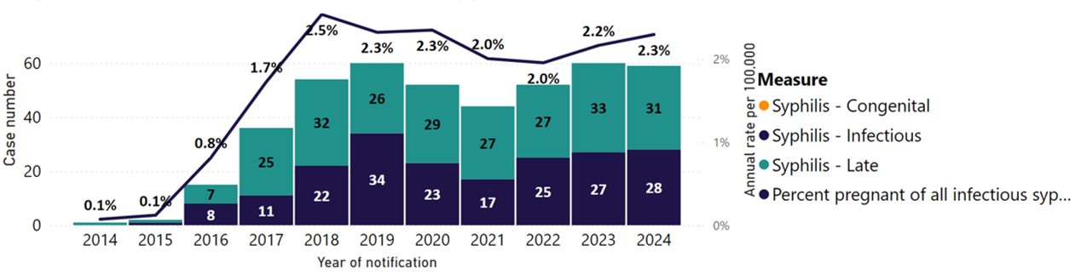
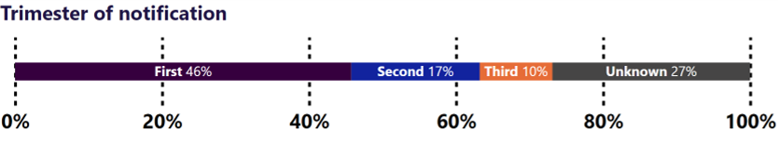
Victorian Syphilis Epidemiology: Notifications during pregnancy
Source Victorian Department of Health – Public Health Event Surveillance System (internal data, 2025)

Slide 12
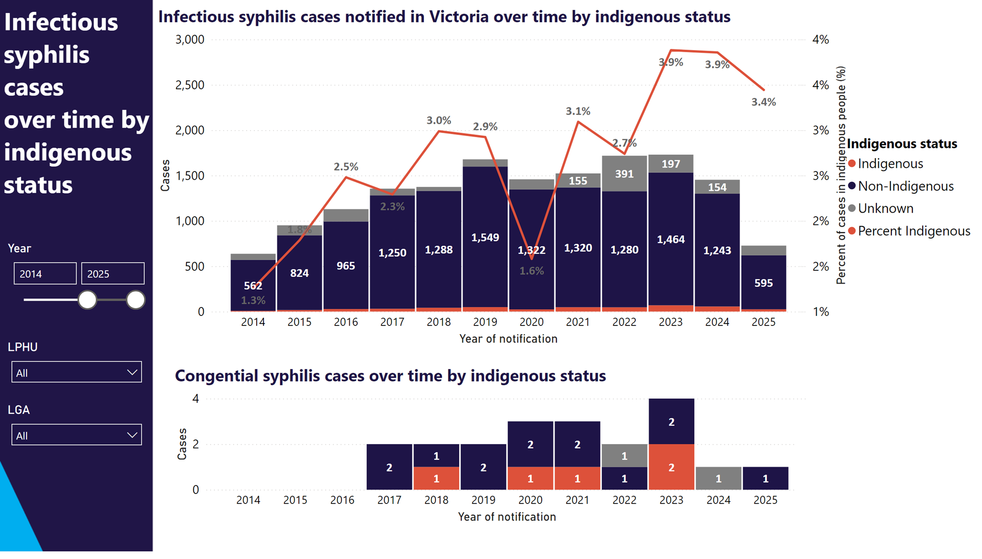
Victorian Syphilis Epidemiology: First Nations
*Record Indigenous status on notification form if possible
Source Victorian Department of Health – Public Health Event Surveillance System (internal data, 2025)

Slide 13

National Syphilis Response Plan
Goals by 2030:
Strengthen prevention and testing strategies for syphilis in priority populations and settings, targeting high-burden areas
Reduce ongoing transmission and incidence of syphilis across priority populations
Reduce morbidity and mortality associated with syphilis.
Eliminate congenital syphilis (defined as sustained zero congenital syphilis cases)
National Syphilis Response Plan 2023–2030 | Australian Centre for Disease Control

Slide 14

Victorian Sexual and Reproductive Health and Viral Hepatitis Strategy 2022-30

Slide 15
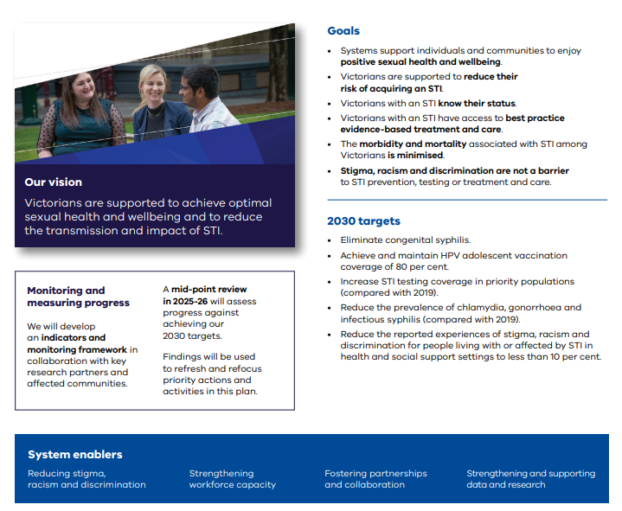
Victorian STI Plan 2022-30 and Syphilis Response

Slide 16
Syphilis Testing Recommendations during Pregnancy
All pregnant people should be tested for syphilis at least three times:
+
Any pregnant people should also be tested for syphilis if:
A.
At first antenatal visit
B.
26 to 28 weeks
C.
36 weeks or birth (whichever is earlier)
presenting with symptoms or signs of an STI
exposed to an STI
In addition, newborn infants should not be discharged without confirming that the mother’s syphilis status has been documented at least once during pregnancy.

Slide 17






Syphilis in Pregnancy
Coordination of Care
GP, laboratories and specialist clinics work together to ensure timely treatment
Active Follow-up
Follow-up pregnant people who miss follow-up
Local Public Health Units and the Department's Partner Notification Officers can assist
Counselling & Engagement
Reinforce importance of treatment and ongoing follow-up
Timely Treatment
Provide prompt treatment with recommended antibiotics
Further Advice
Reinforce importance of treatment and ongoing follow-up
Infant Follow-up
Babies born to mothers with syphilis in pregnancy require specialist paediatric follow-up

Slide 18
Partner Management of Syphilis in Pregnancy
Sexual partners of those diagnosed with syphilis during pregnancy should be tested and treated without waiting for test results, to prevent reinfection during pregnancy.
Local Public Health Units and the Department’s Partner Notification Officers can assist in contacting sexual partners of any patient diagnosed with an STI, including syphilis.
This is a confidential service.
Parter Notification Officers can be reached on (03) 9096 3367 or by email at contact.tracers@dhhs.vic.gov.au.
Partner notification tools are also available for individuals to inform their sexual partners anonymously at Let Them Know, Better To Know, Drama Down Under

Slide 19
Key Messages
Early diagnosis and treatment
Testing and treatment in higher risk groups
Test all pregnant people for syphilis at least three times during pregnancy, and if presenting with or exposed to an STI
Test and treat sexual partners of pregnant people without waiting for test results
Babies born to mothers diagnosed with syphilis during pregnancy require specialist follow-up
Syphilis is a notifiable condition that must be notified in writing within 5 business days

Slide 20



Information Resources
ASHM Syphilis Resources https://ashm.org.au/learning-hubs/syphilis
Could It Be Syphilis? Clinical Indicator Tool | ASHM Health
Decision Making In Syphilis | ASHM Health
STI Guidelines Australia | Australian STI Guidelines website
Victorian Department of Health
Syphilis information and advice
Victorian sexual and reproductive health and viral hepatitis strategy 2022-30
Chief Health Officer Advisory (17 Feb 2025) on changes to syphilis testing during pregnancy
Partner Notification Tools: Let Them Know, Better To Know, Drama Down Under

Slide 21

Questions?

