Slide 1
Syphilis – a public health priority
Dr Christian McGrath
RACGP webinar – February 2024

Slide 2
Outline
Syphilis - a public health priority
Public health response and the role of GPs
Syphilis management in general practice
Key learnings

Slide 3
Syphilis - a global public health priority
Syphilis, one of the oldest known sexually transmissible infections is now resurging at an alarming rate.
7.1 million new cases of syphilis globally in 2020
US : In 2022 - 203,500 cases, the highest levels in more than a decade, and nearly double than in 2018. Over 3,750 congenital syphilis cases, a 30% increase compared to 2021.
UK : In 2022 - syphilis cases reached their highest level since 1948.
Canada: 389% increase in infectious syphilis, between 2011 and 2019.

Slide 4
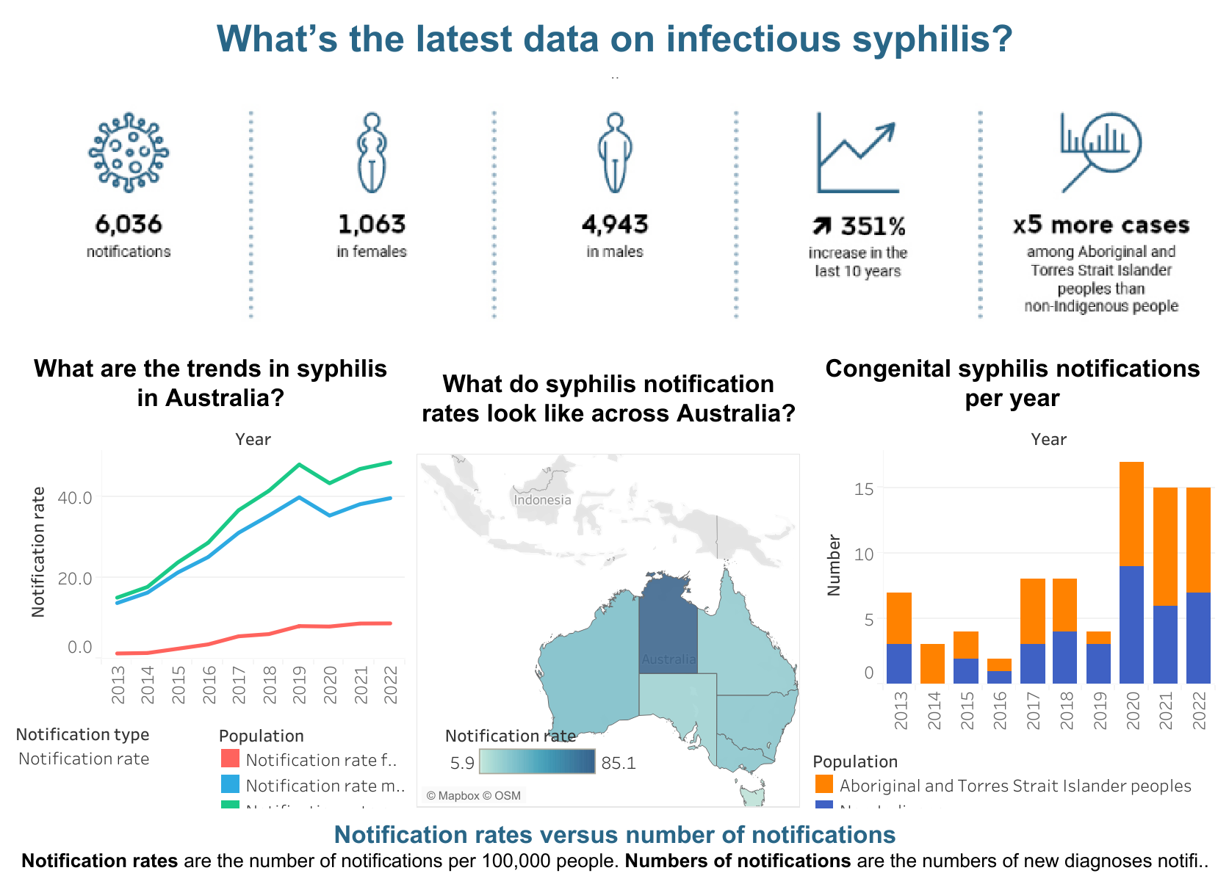
Syphilis - a public health priority in Australia
Syphilis notifications in Australia (2022)
Source Kirby Institute https://www.data.kirby.unsw.edu.au/syphilis

Slide 5
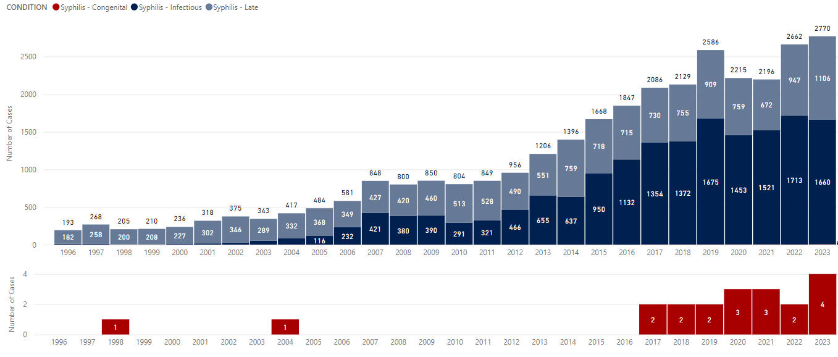
Syphilis – a public health priority in Victoria
Syphilis notifications in Victoria (1996–2023)

Slide 6
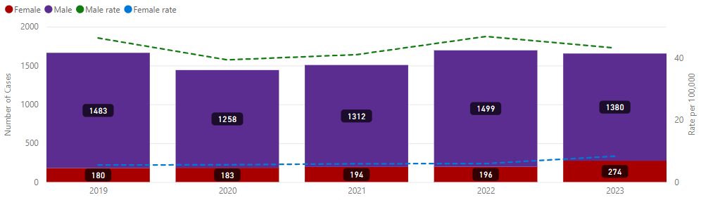
Syphilis - a public health priority

Slide 7

Public health response in Victoria
TARGETS FOR 2030
Eliminate congenital syphilis
Increase testing and treatment in priority populations
Reduce prevalence
Reduce the experience of stigma
OUR RESPONSE
COORDINATED
PATIENT-CENTERED
COMMUNITY-FOCUSSED
State-wide actions
Local tailored actions
Partnership approach
Victorian sexually transmissible infections (STI) plan 2022–30 | health.vic.gov.au

Slide 8
What can GPs do?
Test test test
Treat
Educate
Chief Medical Officer Call to Action
https://ashm.org.au/about/news/chief-medical-officer-syphilis-calls-for-action/

Slide 9
What can GPs do?
Routinely screen ALL sexually active people
Refer to relevant sexual health guidelines:
Australian STI Management Guidelines for Use in Primary Care www.sti.guidelines.org.au
Screen all pregnant women for syphilis at the start of each pregnancy
If at high risk of syphilis infection, repeat screening later in pregnancy . Screen if unsure of the level of risk.
E.g. in Mildura region, recommendations are: Repeat screening at 28 to 32 weeks, and again at delivery for all pregnant women (i.e., screen 3x during pregnancy)
There is ongoing discussion and increasing support nationally for universal screening later in pregnancy

Slide 10
Serology tests
Specific serology tests: TPHA TPPA, FTA Ab, EIA
Used in screening
Non-Specific tests: RPR VDRL
Used in monitoring treatment
If uncertain how to interpret results – MSHC can provide advice on diagnosis and management: 1800 009 903 or www.mshc.org.au
If positive results in pregnant women and/or babies - discuss with a health professional with expertise in the area

Slide 11
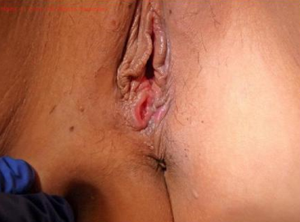
Primary syphilis
Clinical presentation - Chancre
Often painless (but can be painful)
Indurated lesion
May not be noticed if in the mouth, anus, vagina, or cervix
Diagnosis
PCR swab of the ulcer for syphilis + HSV multiplex
Serology but it may be negative in early cases, so repeat
MSHC have dark field microscopy available

Slide 12
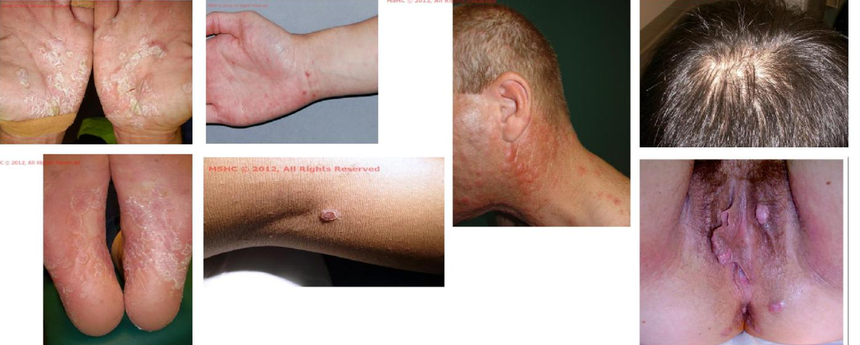
Secondary syphilis
Not always typical - a myriad of dermatological presentations
Source: Melbourne Sexual Health Centre

Slide 13
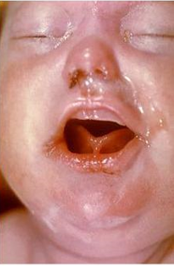
Untreated syphilis in pregnancy
Risk of maternal damage
One third of untreated patients with latent infection will develop symptomatic late syphilis
Risk of congenital syphilis - foetal damage, including stillbirth
Infection can occur at any gestation
Primary and secondary syphilis infection results in 100% risk of transmission to the foetus.
Foetal damage may include:
Hepato-splenomegaly, osteochondritis, periostitis,
Jaundice, purpura, lymphadenopathy,
Hydrops, myocarditis, rhinitis, pneumonia
Stillbirth

Slide 14
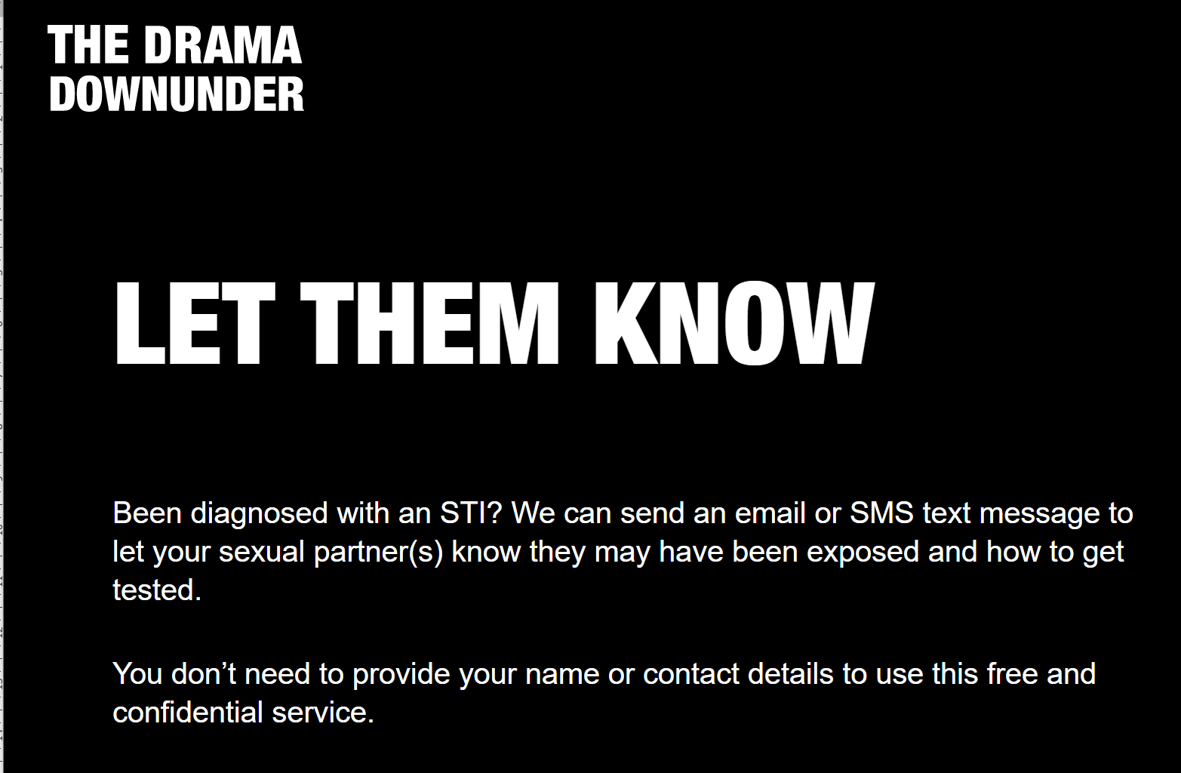
What to do if you have a positive result
Treat
2. Notify the Department of Health
https://www2.health.vic.gov.au/public-health/infectious-diseases/notify-condition-now
3. Notify, test and treat contacts of the index case
For positive cases, you must test AND treat (don't wait for results) their sexual partners
For assistance with partner notification, contact LPHUs or DH Partner Notification Officers (PNOs) on 03 9096 3367 or contact.tracers@health.vic.gov.au
Partner notification tools are also available at:
Let Them Know: https://letthemknow.org.au/
The Drama Downunder: https://www.thedramadownunder.info/let-them-know/
4. Full STI screen

Slide 15

Treatment
Refer to treatment guidelines (https://www.mshc.org.au/health-professionals/treatment-guidelines/syphilis-treatment-guidelines)
Give benzathine penicillin not benzylpenicillin (this is ineffective against syphilis)
Abstain from sex until seven days after patient and partner(s) have both received treatment
For non-pregnant adults
Available in doctors' bag:
Primary and secondary (early) syphilis: 1.8 gm = 2.4 million units IMI stat
Late latent syphilis: 1.8 gm = 2.4 million units IMI weekly for 3 weeks
In pregnancy
Call the MSHC Clinicians Advice Line: 1800 009 903
Congenital syphilis
Seek specialist advice

Slide 16
Beware of reinfection
Reinfection may occur from a sexual partner
Can occur if partner(s) are given inadequate treatment e.g. given the incorrect type of penicillin
Monitor RPR (should fall fourfold = 2 dilutions over 6 months)
Titres fall with treatment
Retest in pregnancy
Consider repeating serology at 26-28 weeks (when they are having their oral glucose tolerance test)
Beware a rising titre following treatment = probable reinfection.

Slide 17
Summary of learnings
Syphilis is increasing in our community. All sexually active people are at risk.
Screen all sexually active people
Screen all pregnant persons at the first antenatal visit; repeat screening later in pregnancy and at birth for those at risk
Consider primary and secondary syphilis presentations.
Do not delay treatment - Benzathine Penicillin in Doctors bag
Contact trace and treat partners
Look for other BBV/STI and treat
Repeat serology
Beware of reinfection
Liaise with colleagues and ask for help to enable effective management of syphilis cases
Fill out DH syphilis notification form

Slide 18



Additional resources - workforce development
VHHITAL training program
https://nwmphn.org.au/about/partnerships-collaborations/vhhital/
Syphilis HealthPathways
https://vtphna.org.au/care-pathways-and-referral/
Centre for Excellence in Rural Sexual Health
https://medicine.unimelb.edu.au/cersh#online-learning-modules
ASHM
https://ashm.org.au/learning-hub/syphilis/

Slide 19
Additional resources – relevant links
Clinician advice and assistance:
MSHC diagnosis and management advice: 1800 009 903 or www.mshc.org.au
Department of Health partner notification and syphilis in pregnancy assistance: 03 9096 3367 or contact.tracers@health.vic.gov.au
Online partner notification tools: https://letthemknow.org.au/ & https://www.thedramadownunder.info/let-them-know/
Information for clinicians:
Congenital Syphilis in Victoria Chief Health Officer Advisory : https://www.health.vic.gov.au/health-advisories/congenital-syphilis-in-victoria
Syphilis information for health professionals: https://www.health.vic.gov.au/infectious-diseases/syphilis
Department of Health syphilis notification form (fill out if your patient tests positive): https://www2.health.vic.gov.au/public-health/infectious-diseases/notify-condition-now
Clinical guidelines:
Australian STI management guidelines for use in primary care: www.sti.guidelines.org.au/
Melbourne Sexual Health Centre (MSHC) guidelines: www.mshc.org.au/health-professionals
Pregnancy Care Guidelines: Syphilis: https://www.health.gov.au/resources/pregnancy-care-guidelines/part-f-routine-maternal-health-tests/syphilis#362-syphilis-testing
Patient information:
Better Health Channel – Information on Syphilis: www.betterhealth.vic.gov.au/health/ConditionsAndTreatments/syphilis

Slide 20
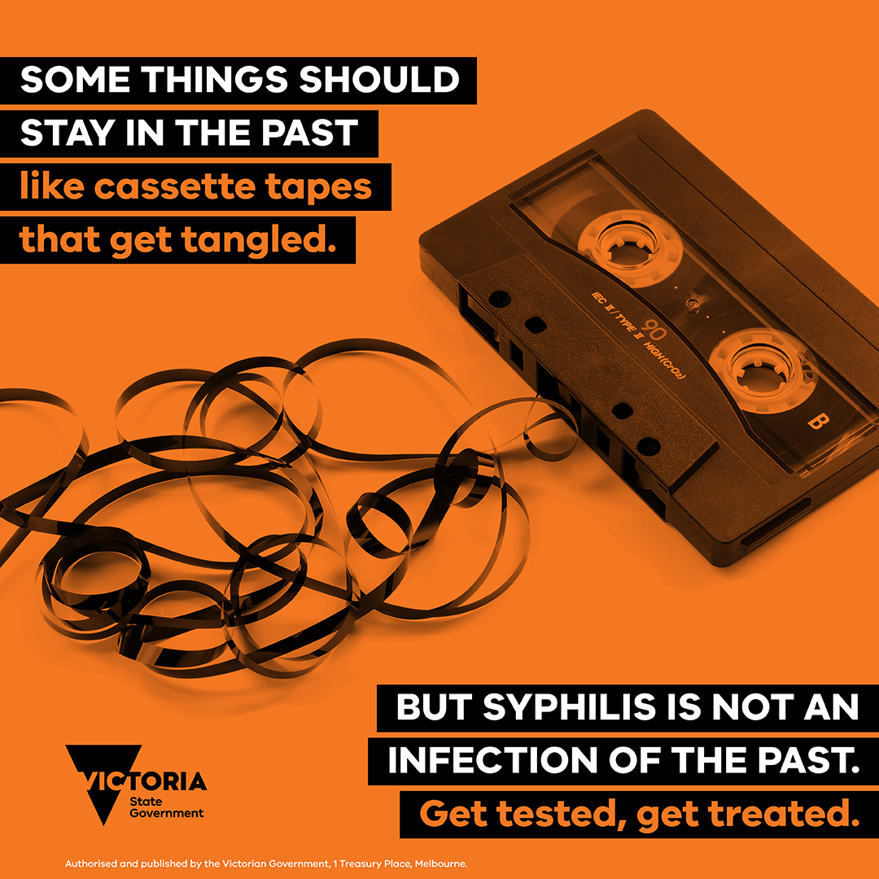
Questions ?

