Slide 1
COVID-19 update
Dr David Lister
Deputy Chief Health Officer
29th February 2024

Slide 2
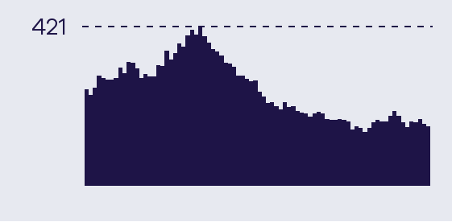
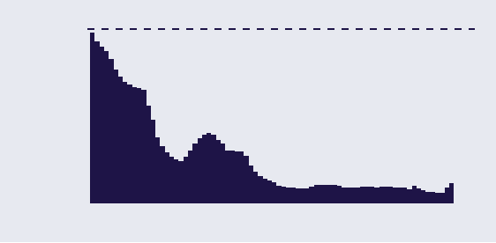
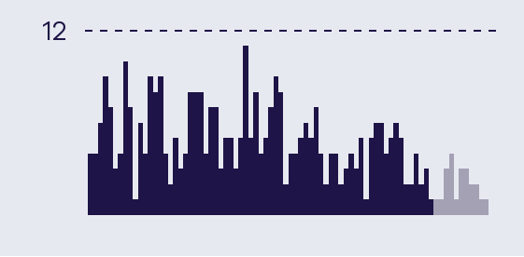

Epidemiological Summary
Current indicators show low levels of COVID-19 activity in Victoria.
 | The number of people in hospital with COVID-19 has decreased this week. The 7-day average is 164, compared to 178 last week. The 7-day average of ICU patients has increased this week (7 to 8).
 | The latest quantitative wastewater measures indicate there are low COVID-19 viral loads in Victorian wastewater in both metropolitan and regional catchments. Higher levels of SARS-CoV-2 in wastewater suggest higher prevalence of COVID-19 infections in the community. (Plot shows metropolitan median relative quantitative levels of SARS-CoV-2 in wastewater)
 | Deaths in the most recent 28-day period (24/01/2024 – 13/02/2024) have declined compared to the prior 28-day period (03/01/2023 – 23/01/2024), with a current 28-day total of 110. Increases and decreases in the reporting of deaths attributable to COVID-19 tend to lag waves of infections and hospitalisations by several weeks. (Note that reporting periods for deaths are lagged by 2 weeks to allow for delays in data collection)
 | Following rapid growth in early December, JN.1 (a sublineage of BA.2.86) is the dominant variant in Victorian wastewater samples at approximately 94% in the most recent week. This is the first time a single subvariant has been dominant in Victoria since BA.5 in 2022. JN.1 is also the dominant variant globally.
Daily numbers last 12 weeks

Slide 3
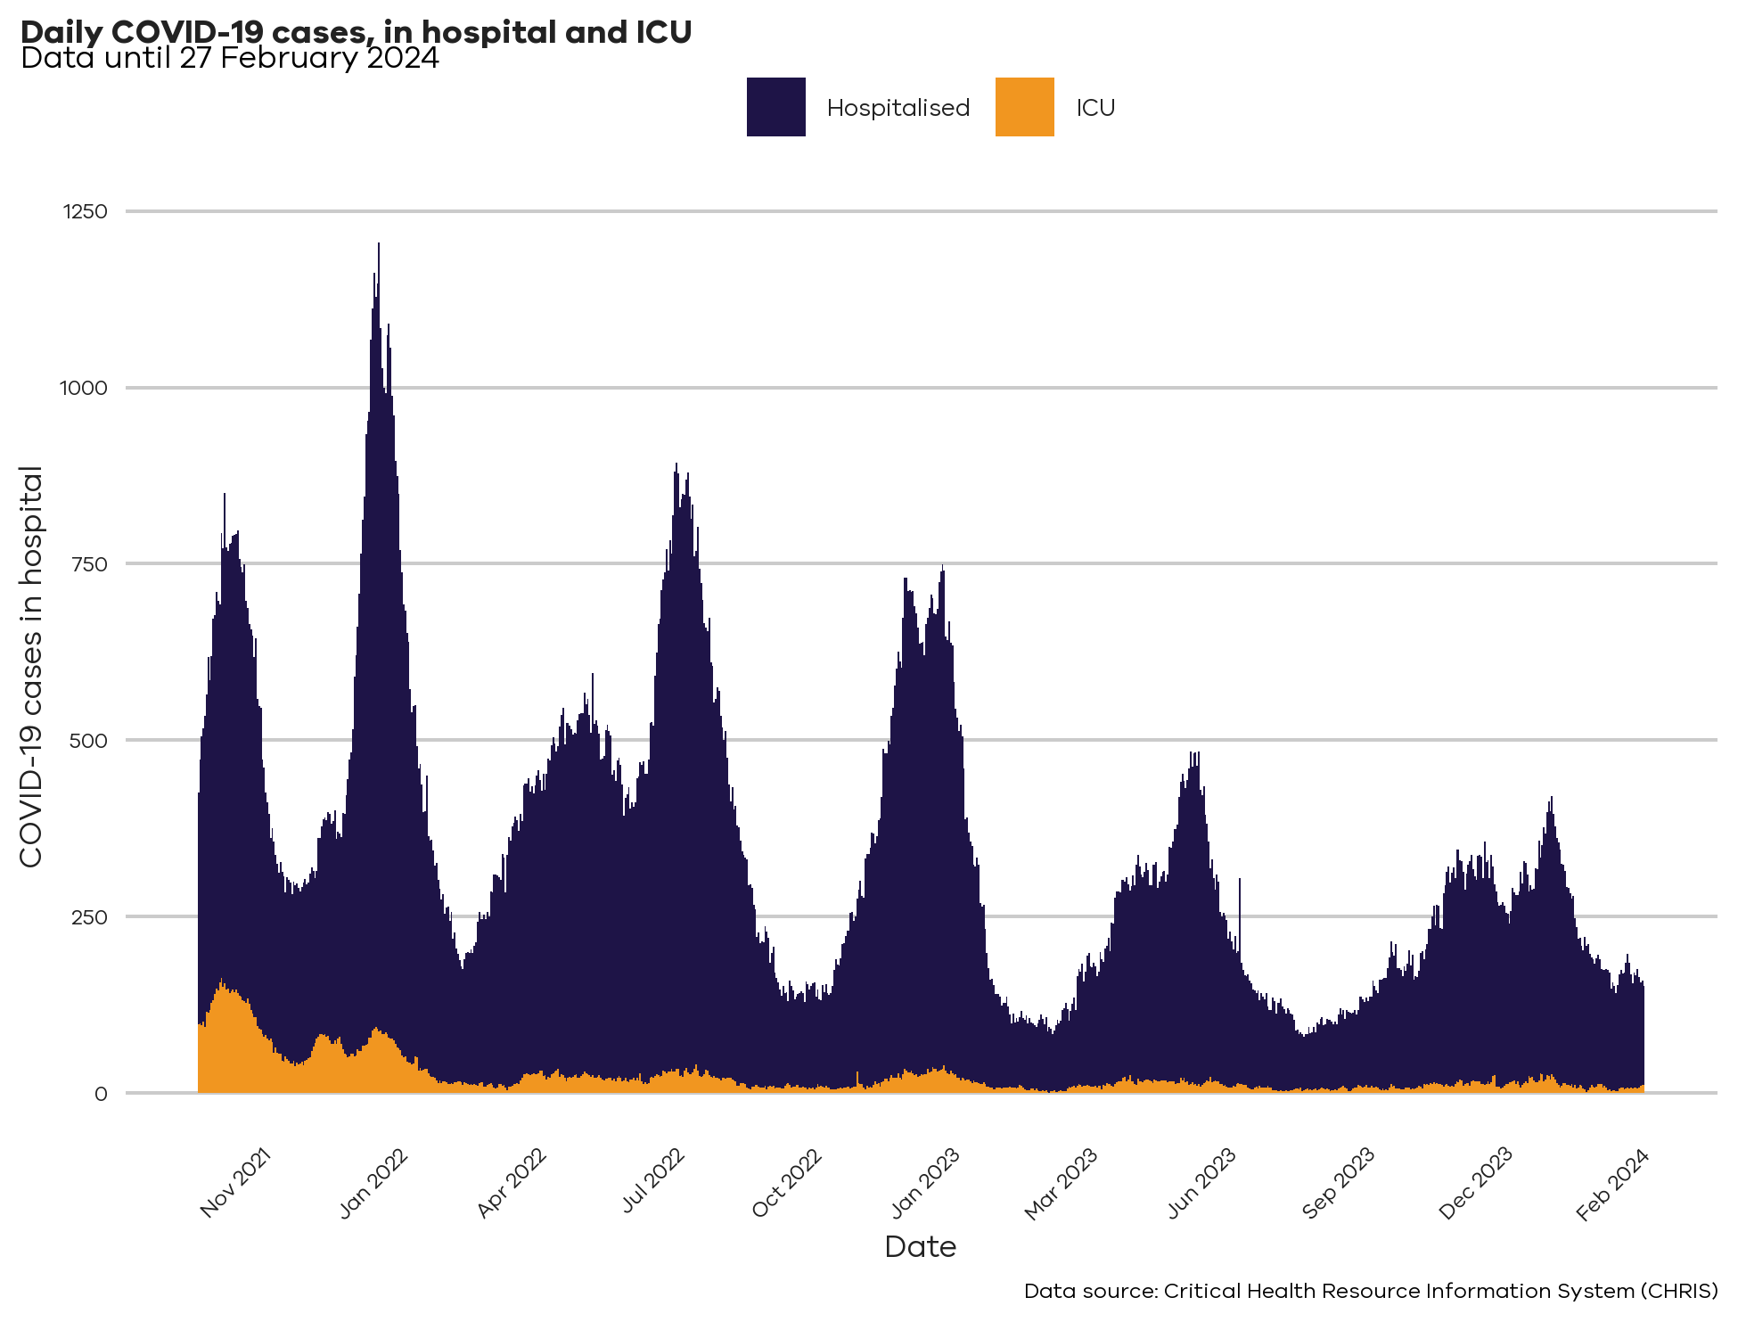
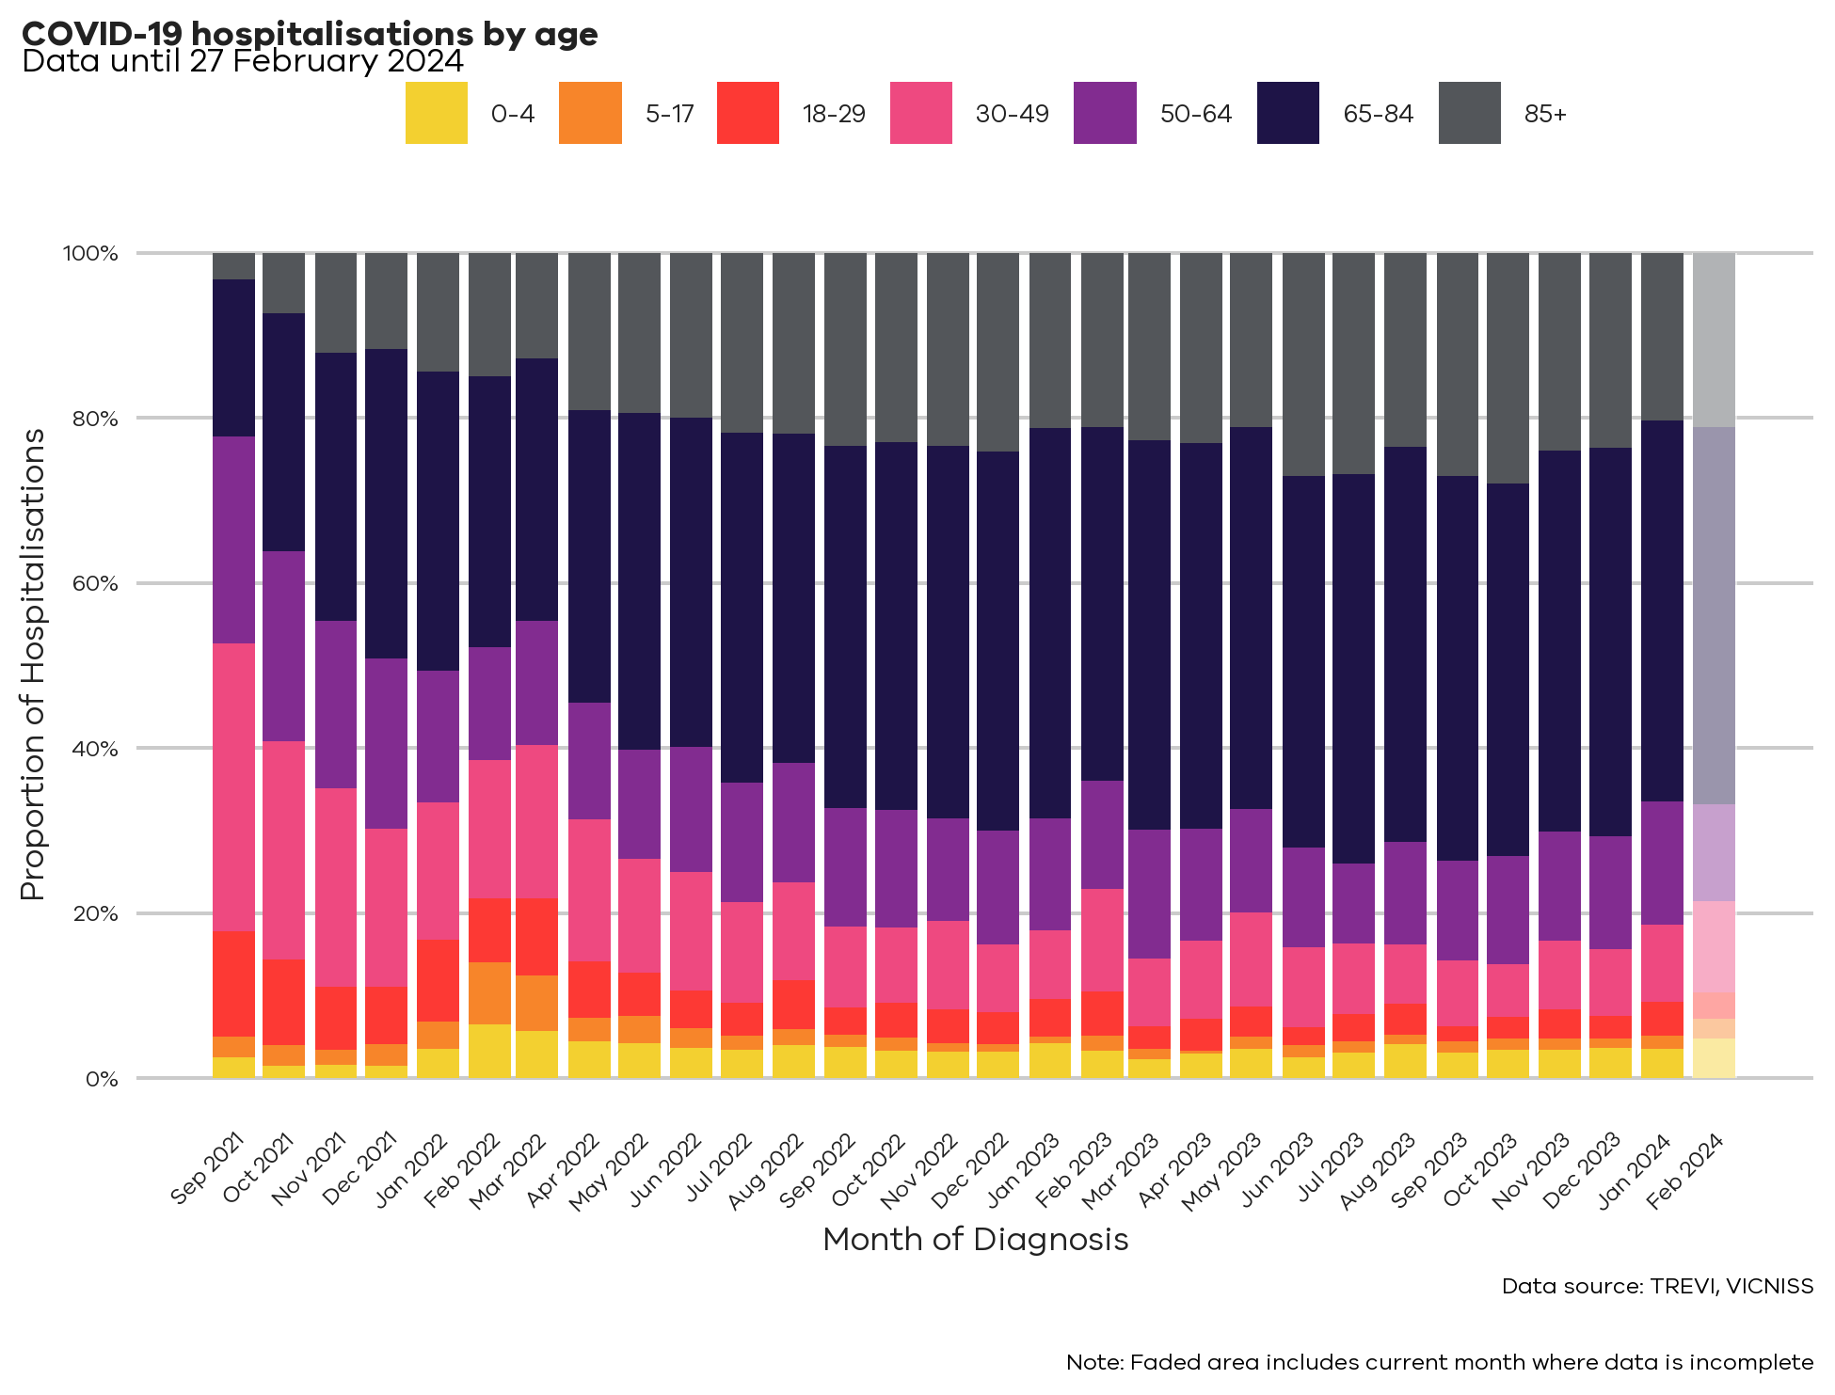
COVID Hospitalisations

Slide 4
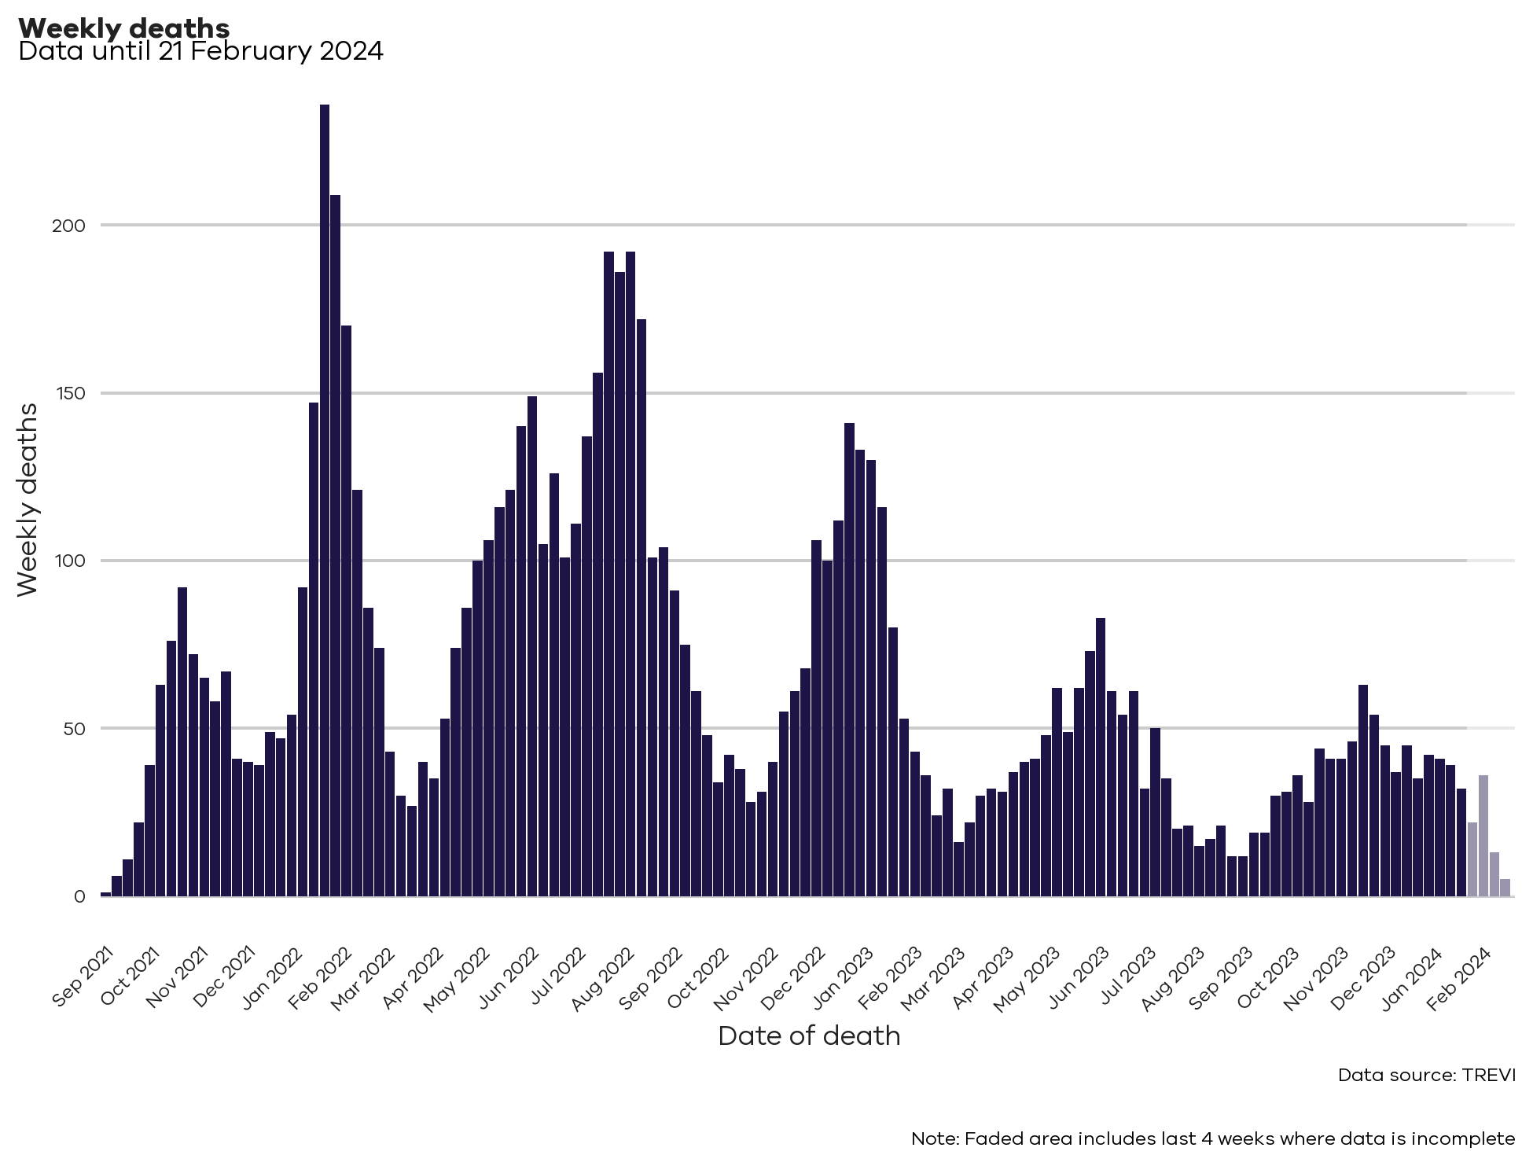
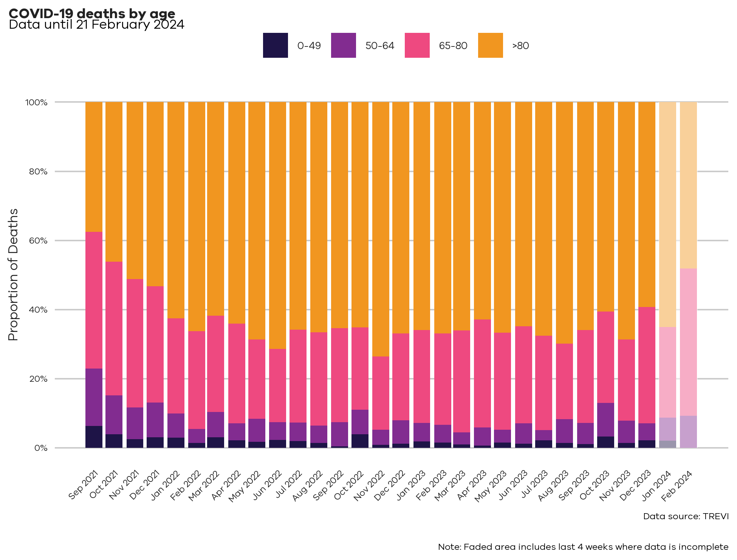
COVID Mortality

Slide 5
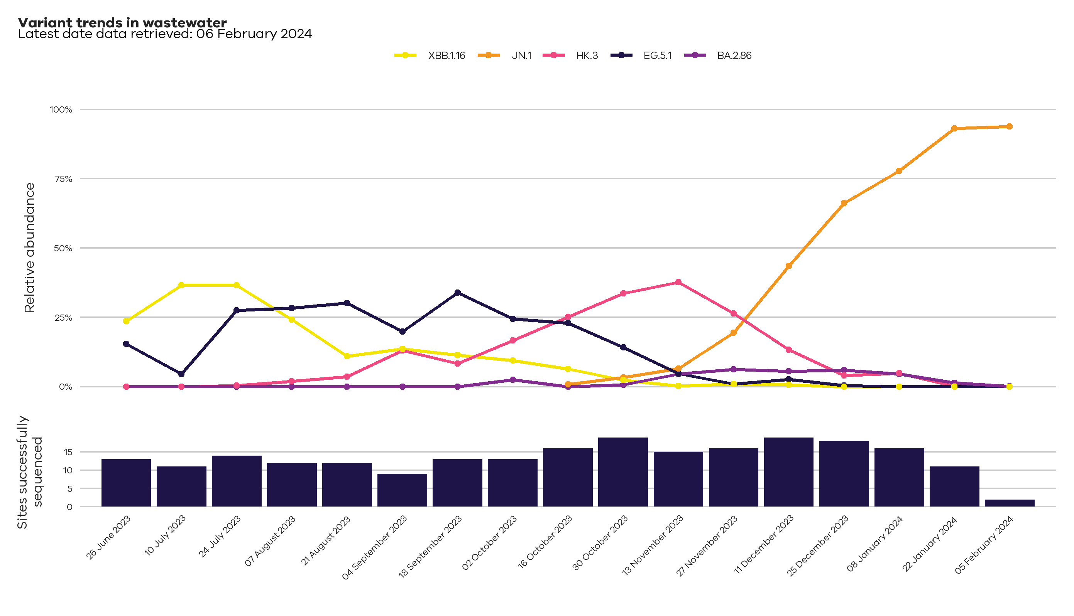
Wastewater surveillance: variant trends in Victoria
Analysis of wastewater samples can help us understand which SARS-CoV-2 variants are currently circulating in Victoria.
In the past there have been waves of infections and hospitalisations when a new variant or subvariant has spread quickly relative to the others. There are a number of closely related sublineages circulating in Victoria. Only the most detected variants have been displayed here.
JN.1 is the most dominant variant in Victoria, and globally
Declared VOI in Dec by WHO
No evidence to suggest it causes more severe disease
New vaccine (monovalent XBB 1.5) works well against this variant

Slide 6
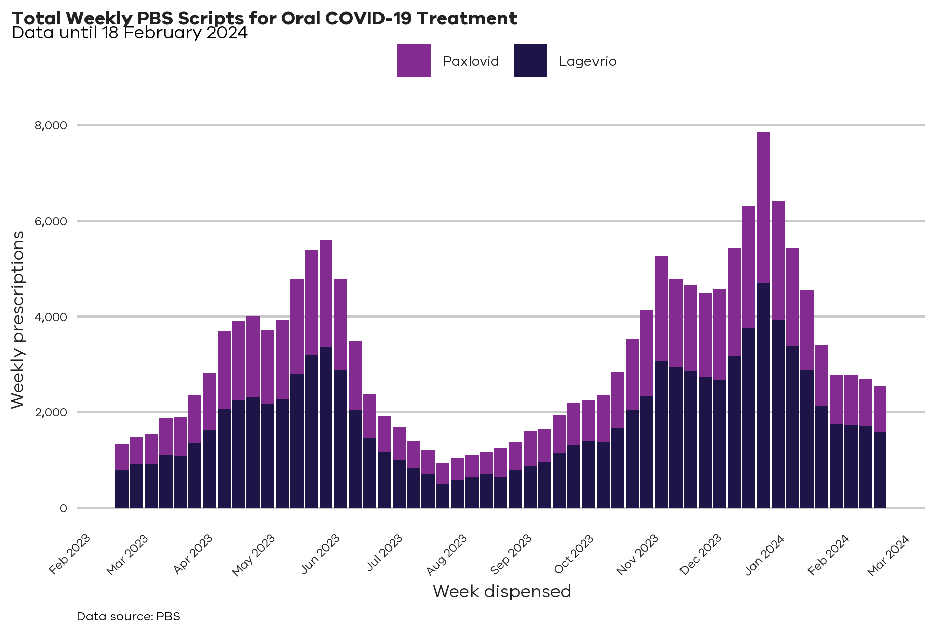
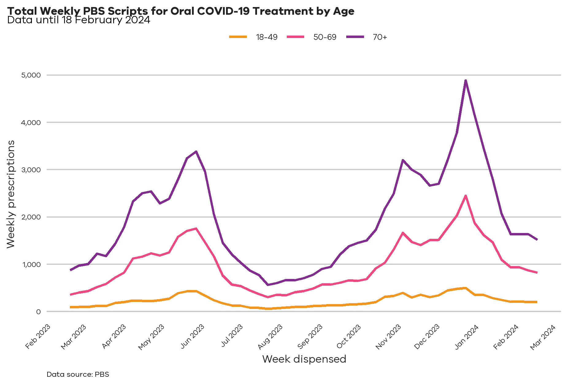
Treatments
PBS prescriptions dispensed within Victoria for PBS eligible oral COVID-19 treatments. Reporting week is Monday to Sunday. Note that totals may change week to week as more data is submitted, and totals may differ from other sources due to exclusions and/or differing dates from which the data is taken.

Slide 7

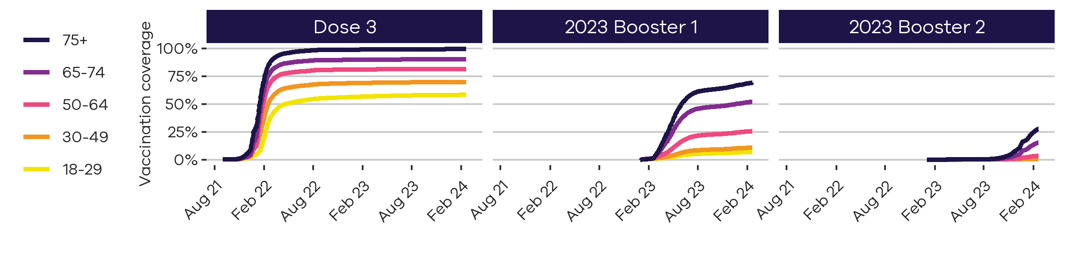
Vaccination
Age group | Dose 3 | 2023 Booster 1 | 2023 Booster 2 | Vaccinated last 6 months* | Doses last 7 days# | Doses last 12 weeks
00-04 |  |  |  |  | <10
05-11 |  | Low eligibility |  |  | 34
12-15 |  |  |  |  | 21
16-17 | 48% |  |  |  | 21
18-29 | 58% | 7% |  | 2% | 599
30-49 | 70% | 11% |  | 3% | 1,308
50-64 | 82% | 26% |  | 7% | 2,343
65-74 | 90% | 52% | 15% | 20% | 4,194
75+ | >95% | 69% | 28% | 28% | 5,350
Total | 74% (16+ years) | 59% (65+ years) | 21% (65+ years) | 8% (18+ years) | 13,871

Slide 8
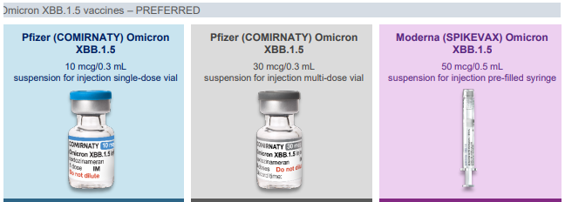
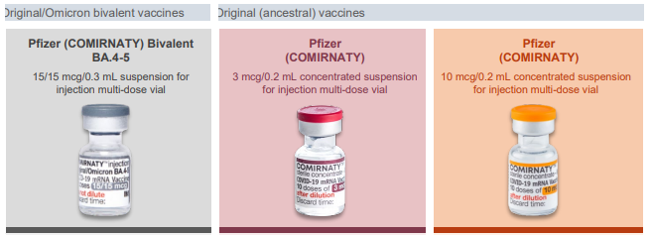
New ATAGI recommendations – 29th February
COVID-19 continues to have a significant impact across the community. The best protection against severe disease, is to keep up to date with vaccinations.
Adults 65 years and over, or aged 18-64 who are severely immunocompromised, are eligible to receive a booster dose every 6 months.
All other adults are eligible to get a booster dose every 12 months.

Slide 9
Other Key issues
Long COVID
Transmission
Antivirals
Questions?

