Slide 1
Mpox
RACGP Webinar 3rd July 2024
Dr Christian McGrath, Infectious Diseases Physician
Deputy Chief Health Officer (Communicable Diseases) Department of Health, Victoria
OFFICIAL

Slide 2
Contents
Mpox
What is mpox?
Epidemiology – global and national update
2024 Victorian outbreak
Clinical presentation
Testing
Treatment
Vaccination

Slide 3
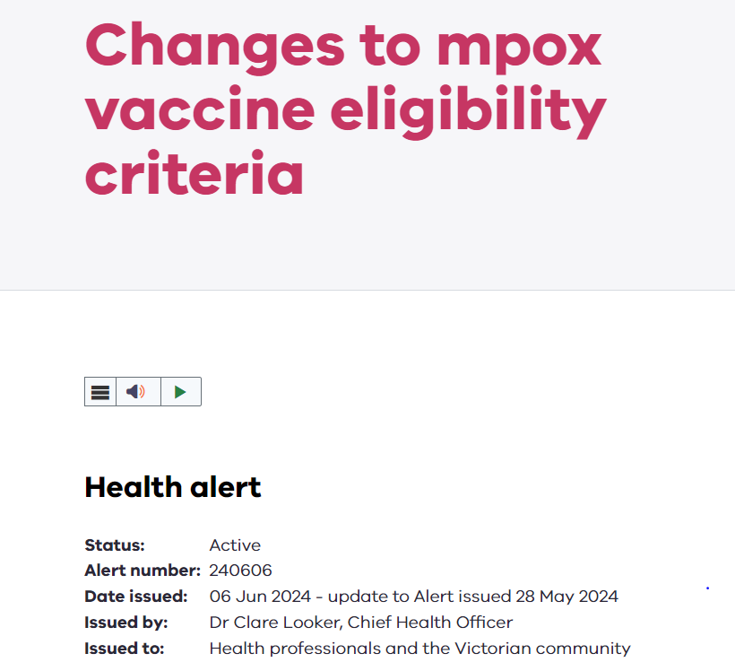
Subscribing to Chief Health Officer Alerts
Keep up to date with the latest alerts from the Department of Health
Follow the link and enter your email address to subscribe at: https://www.health.vic.gov.au/subscribe

Slide 4
What is mpox?
Mpox is an infectious disease caused by the monkeypox virus, a poxvirus of the Orthopoxvirus genus of the Poxviridae family (which includes cowpox, variola, vaccinia and others)
There are 2 genetic clades of the virus:
Clade I (previously known as the Congo Basin or central African clade)
Clade II (the former west African clade)
Mpox is a zoonosis, a disease transmitted from animals to humans
It is unknown what the natural reservoir of the virus is; various small mammals, including monkeys, squirrels, dormice, Gambian pouched rats are susceptible

Slide 5
What is mpox?
The virus was first detected in Denmark in 1958 in monkeys and kept for research
The first human case of mpox was detected in the Democratic Republic of Congo in 1970
Following eradication of smallpox in 1980 and the end of smallpox vaccination worldwide, mpox emerged steadily in East, Central and West Africa
A global outbreak occurred in 2022-2023 (Clade IIb)

Slide 6
What is mpox?
Mpox presents with symptoms similar to smallpox (but less severe)
It typically causes a painful rash, fever and lymphadenopathy
For most people it is a self-limiting illness, but it can cause severe disease, particularly in certain cohorts (such as those living with HIV or other immunocompromise)
It is spread person-to-person through contact with bodily fluids, internal mucosal surfaces (like the mouth and throat), lesions on the skin, respiratory droplets, contaminated objects, and via vertical transmission (mother-to-child)

Slide 7
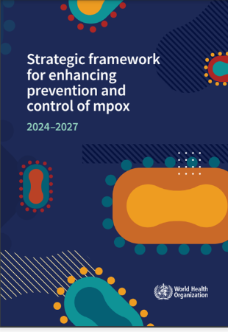
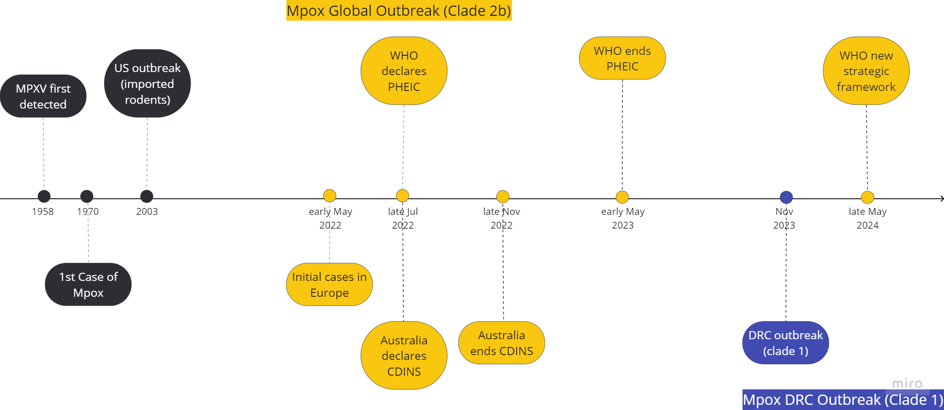
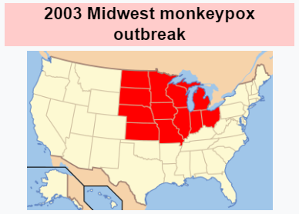
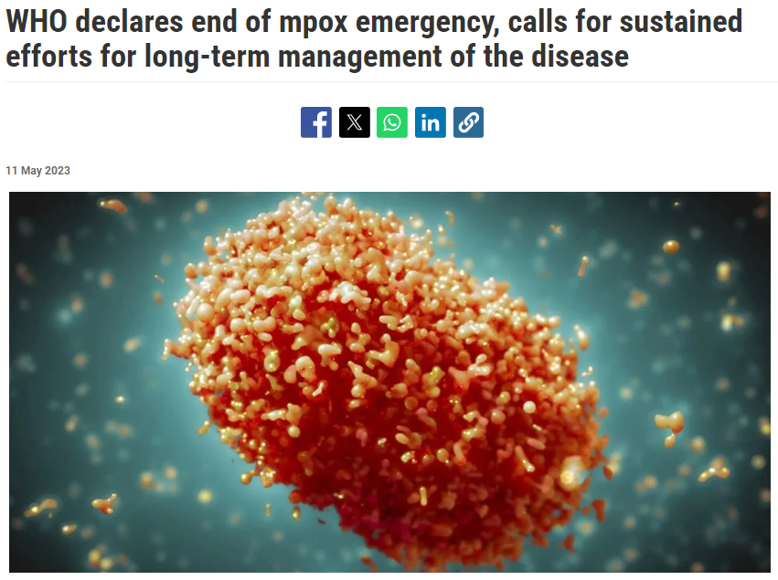
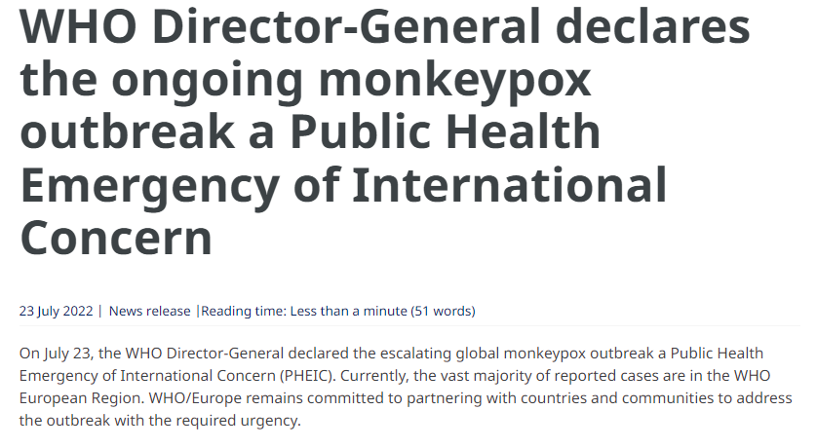
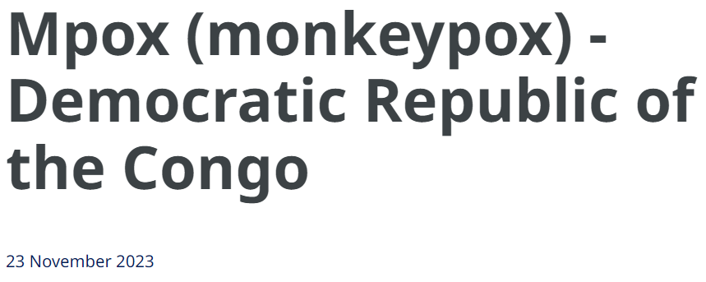
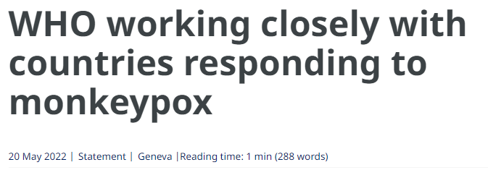
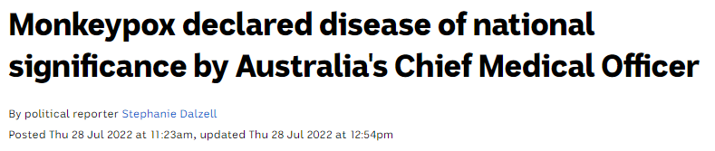
Mpox Global Outbreak: Timeline
Credit: Dr Min-Ho Jung, Department of Health, Victoria
Notes:
Sporadic imported cases with overseas travel
Outbreaks endemic to Congo (Clade 1) and West Africa (Clade 2)
May 2003 onwards – 71 human cases linked to imported exotic pet rodents from Ghana, then infected prairie dogs

Slide 8
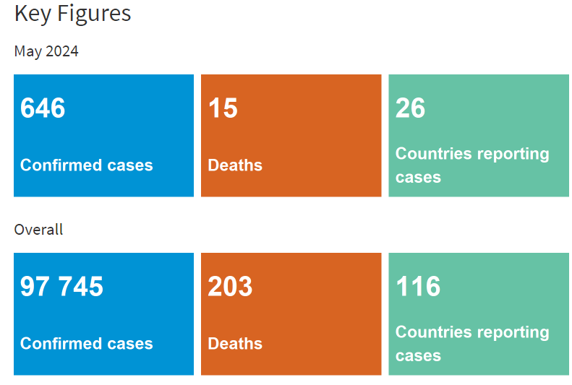
Epidemiology – World Health Organisation (WHO) Global Update
As of 31 May 2024, a total of 97,745 laboratory confirmed cases and 535 probable cases, including 203 deaths have been reported to WHO
The number of monthly reported new cases had decreased by 2.3% compared to the previous month
The majority of cases were notified from the African Region (43.5%) and the European Region (21.8%)
Except for countries in West and Central Africa, the ongoing mpox outbreak continues to primarily affect gay, bisexual and other men who have sex with men (GBMSM)

Slide 9
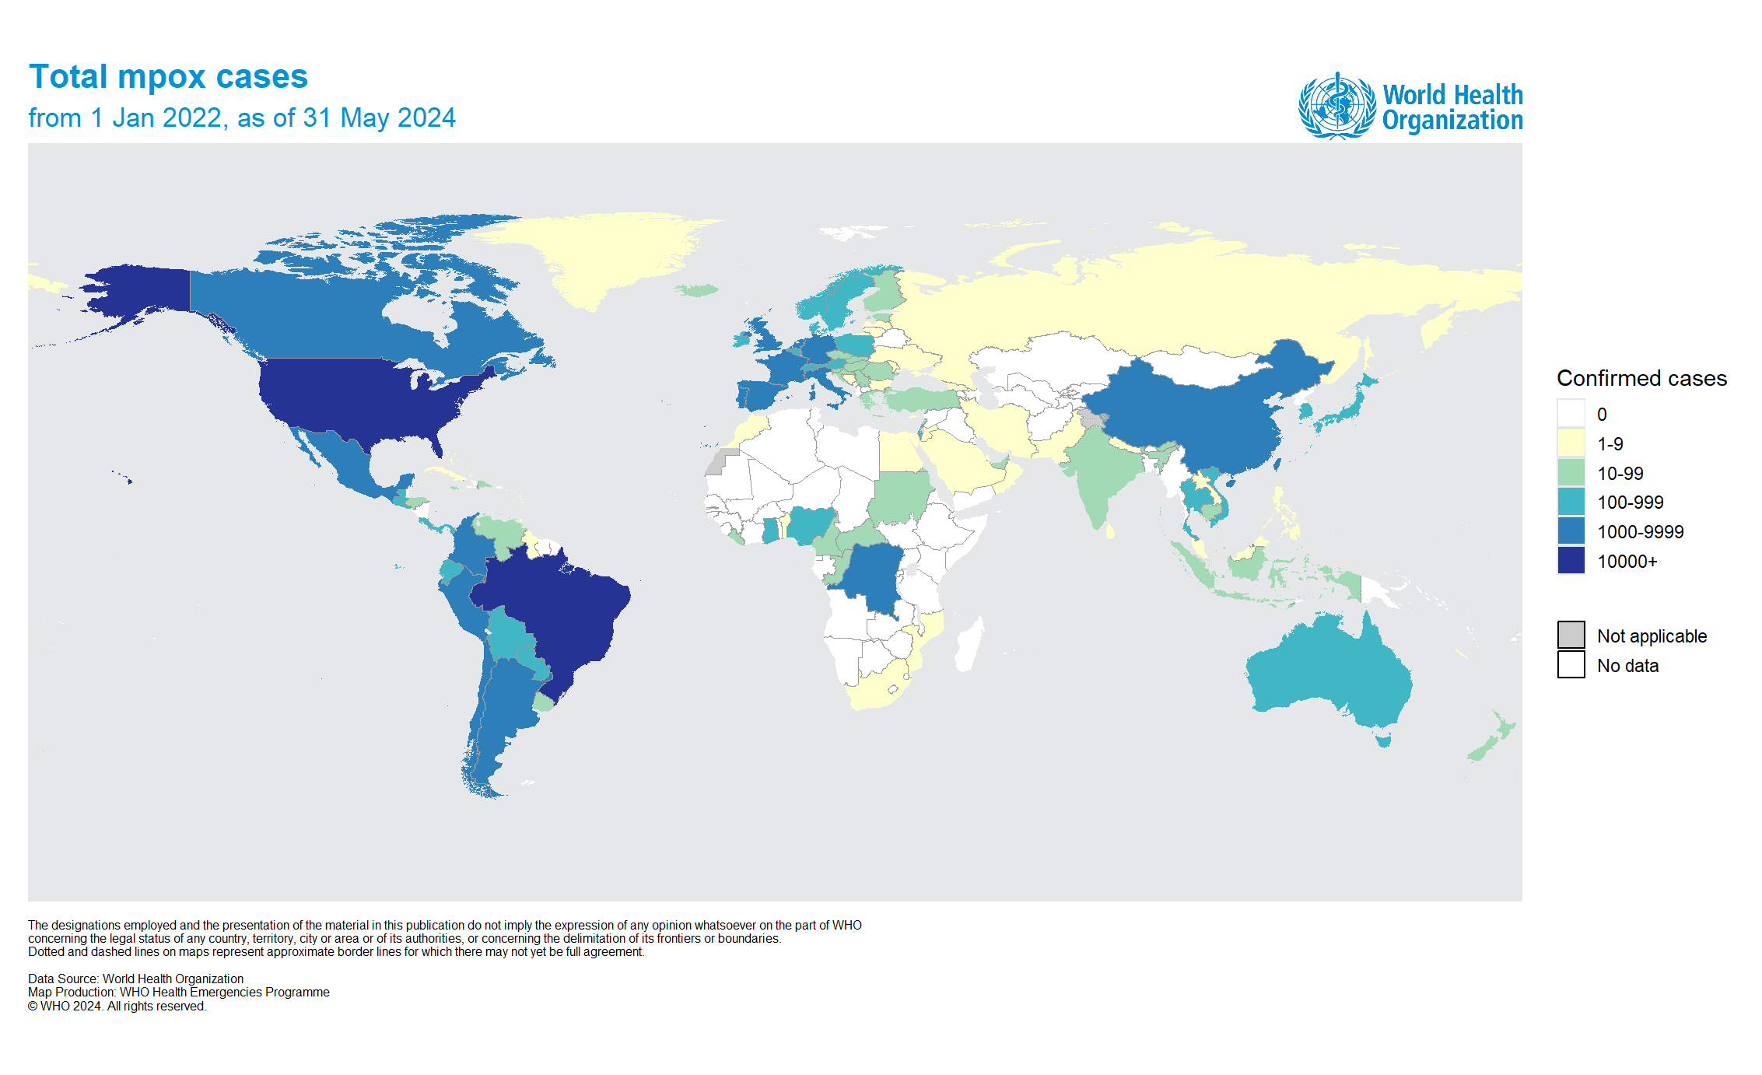
Epidemiology – WHO Global Update

Slide 10
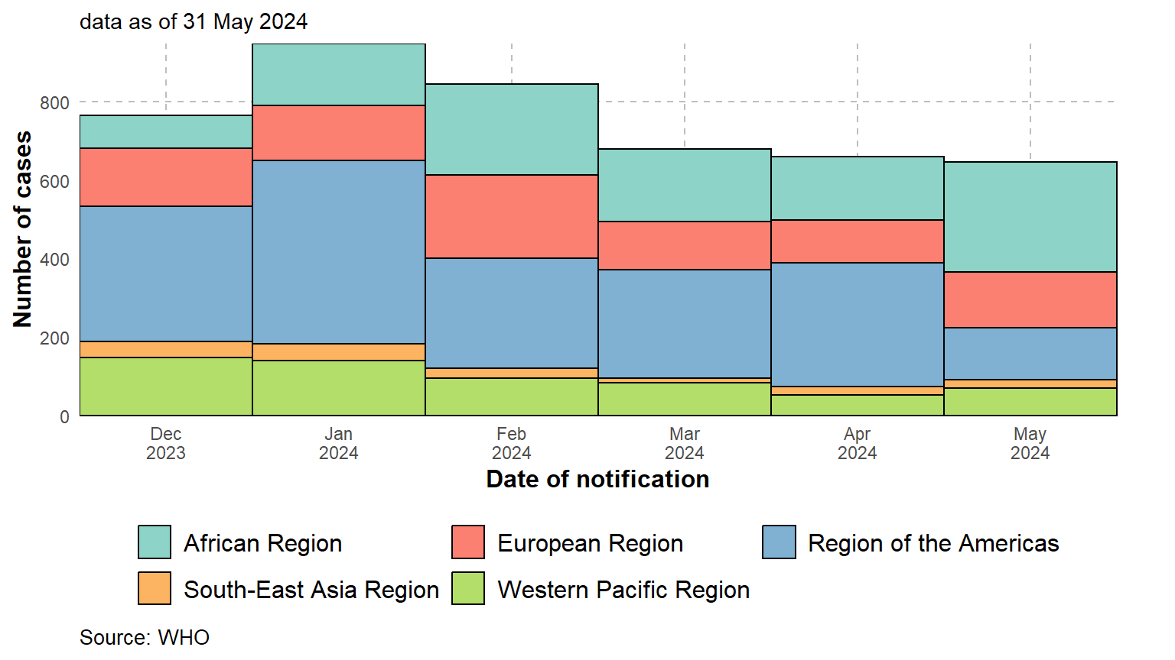
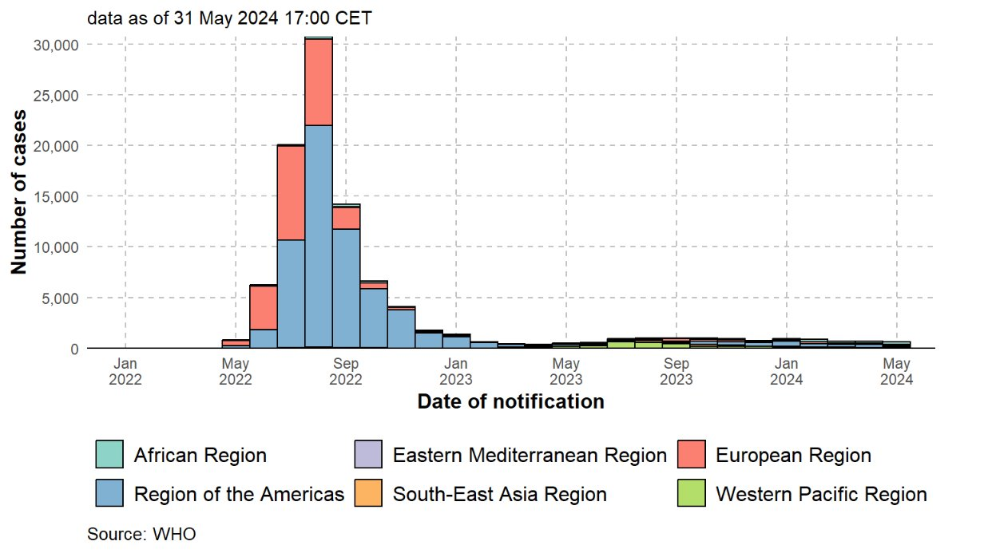
Epidemiology – WHO Global Update

Slide 11
WHO Risk Assessment
Per WHO, confirmation of one case of mpox, in a country, is considered an outbreak
WHO mpox long-term risk assessment (Dec 2023)
For the general population in countries not affected by mpox prior to the 2022-24 outbreak, the risk is assessed as low
For the general population in countries with historical transmission and their neighbouring countries, mpox risk is assessed as moderate
The overall global risk for MSM and sex workers is assessed as moderate
The risk for the general population in the Democratic Republic of Congo is assessed as high

Slide 12
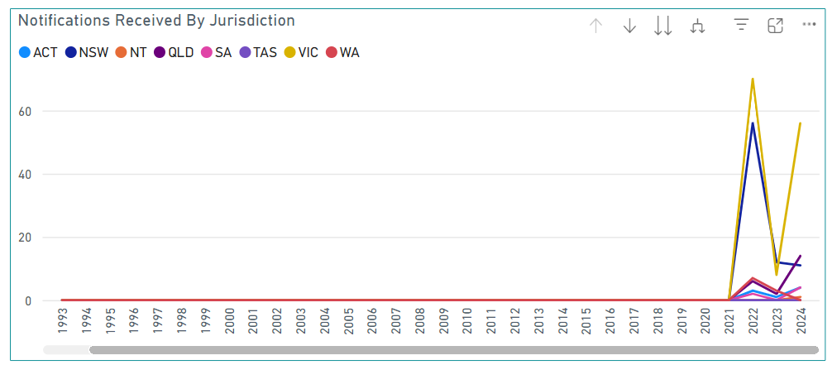
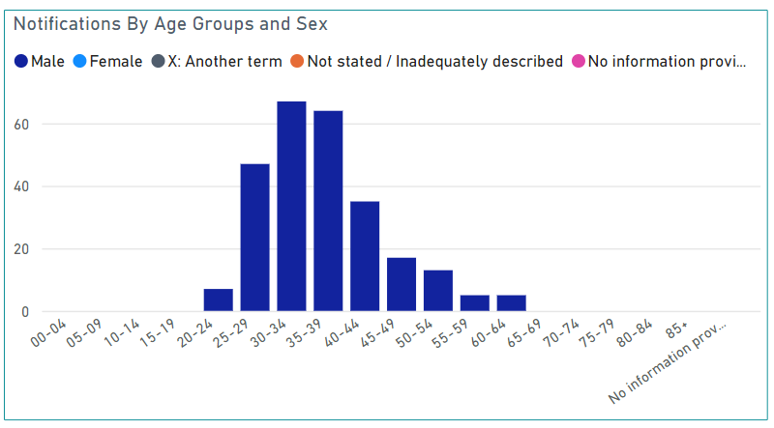
Epidemiology - National Update
In 2022 there were 144 mpox cases Australia wide; 70 in VIC, 56 in NSW, 7 in WA, 6 in QLD, 3 in ACT, 2 in SA, 0 in NT and TAS
In 2023 there were 26 mpox cases Australia wide; 12 in NSW, 8 in VIC, 3 in WA, 2 in QLD, 1 in ACT, 0 in NT, SA, and TAS
In 2024 (as of 28/06/2024) there have been 90 mpox cases Australia wide; 56 in VIC, 14 in QLD, 11 in NSW, 4 in ACT, 4 in SA, 1 in NT, 0 in WA and TAS

Slide 13
2024 Victorian mpox outbreak (28/06/2024)
56 cases have been notified in Victoria in 2024
1 case was identified in January 2024
The remaining 55 cases have been notified since 18 April 2024
Acquisition
Likely locally acquired: 48/55 (87%)
Likely overseas acquired: 3/55 (5%)
Still under investigation: 4/55 (7%)
Most cases within the current outbreak have been identified within metropolitan Melbourne

Slide 14
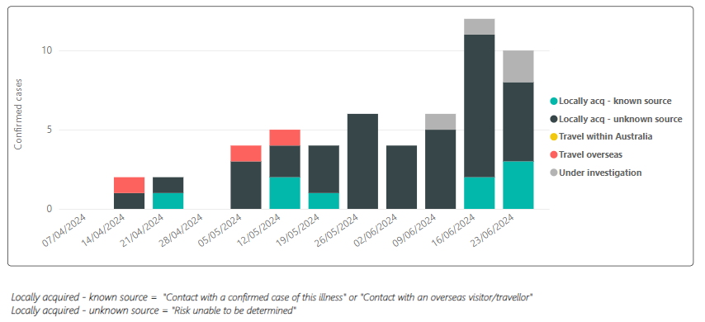
2024 Victorian mpox outbreak (28/06/2024)

Slide 15
2024 Victorian mpox outbreak (28/06/2024)
Demographics
Assigned male at birth: 55/55 (100%)
Age range: 23-64 years (median age 34 years)
Recent MSM contact: 55/55 (100%)
Aboriginal or Torres Strait Islander status: 2/55 (4%)
Country of Birth other than Australia: 22/55 (40%)
Vaccination status
Fully vaccinated (2 doses): 25/55 (45%)
Partially vaccinated (1 dose): 12/55 (22%)
Unvaccinated: 18/55 (33%)
12/55 (22%) of cases were HIV positive. Of these, 4 were fully vaccinated, 2 partially vaccinated, and 6 unvaccinated
There have been 3 hospitals admissions and 5 ED presentations

Slide 16
Clinical presentation of mpox - mpox symptoms
A rash may be located on the feet, hands, chest, face, mouth, or genitals, including penis, testicles, labia, vagina and anus
The rash will go through various stages, including scabs until healing
The rash can look initially like pimples or blisters and may be painful or itchy
The rash may be preceded or accompanied by non-rash symptoms (as below)
Other symptoms can include
Fever
Exhaustion
Chills
Headache
Back pain
Lymphadenopathy
Myalgia
Arthralgia
Respiratory symptoms (cough, sore throat, nasal congestion)
Proctitis (anal or rectal pain, blood stools, diarrhoea)
Urethritis
Atypical and attenuated clinical presentations can occur in partially and fully vaccinated people

Slide 17
Clinical presentation of mpox - mpox symptoms
Mpox is generally characterised by an incubation period, prodrome and rash
Incubation period: roughly 7-14 days, can be up to 21 days. A person is not infectious during this period, does not have symptoms and may feel fine
Prodrome: a person might develop symptoms including fever, malaise, sore throat, headache, lymphadenopathy. A person is infectious in this period
Rash: in some (more recent) cases, people have presented with a rash without prodrome. Lesions typically progress from papules, macules, vesicles, pustules, and then scabs. A person is infectious until after all the scabs have fallen off and and fresh layer of intact skin has formed underneath
Symptoms typically last 2-4 weeks and can depend on route of exposure, health of the individual and clade. Note that the West African clade (associated with the current outbreak) is associated with less severe disease and fewer deaths than the Congo Basin clade

Slide 18
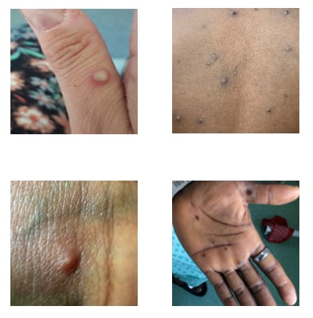
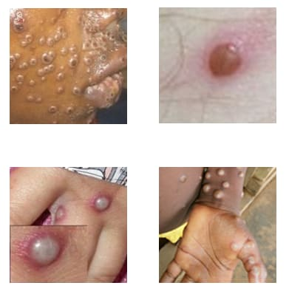
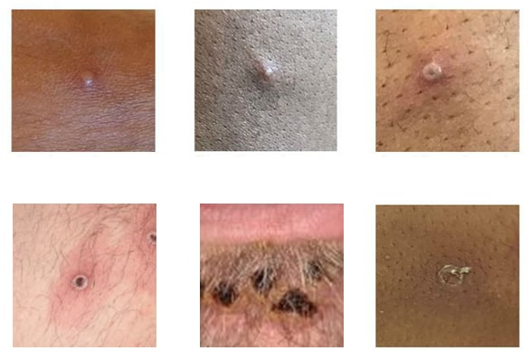
Clinical presentation of mpox - mpox lesions

Slide 19
Table 1: reported mpox symptoms, ALL mpox cases (N=55)
Symptom | n (% cohort)
Lesions or rash | 53 (96)
Fever | 23 (42)
Generalised weakness | 23 (42)
Lymphadenopathy | 20 (36)
Headache | 19 (35)
Myalgia | 18 (33)
Sore throat | 17 (31)
Proctitis | 15 (27)
Back pain | 11 (20)
Arthralgia | 5 (9)
Urethritis | 4 (7)

Slide 20
Table 2: Symptoms in fully, partially and unvaccinated mpox cases (N=55)
Symptom | Fully vaccinated (% cohort) n=25 | Partially vaccinated (% cohort) n=12 | Unvaccinated (% cohort) n=18
Lesions or rash | 24 (96) | 12 (100) | 17 (94)
Fever | 7 (28) | 6 (50) | 10 (56)
Generalised weakness | 9 (36) | 3 (25) | 11 (61)
Lymphadenopathy | 10 (40) | 3 (25) | 7 (39)
Headache | 5 (20) | 4 (33) | 10 (56)
Myalgia | 4 (16) | 4 (33) | 10 (56)
Sore throat | 7 (28) | 3 (25) | 7 (39)
Proctitis | 8 (32) | 0 (0) | 7 (39)
Back pain | 4 (16) | 2 (17) | 5 (28)
Arthralgia | 1 (4) | 1 (8) | 3 (17)
Urethritis | 3 (12) | 0 (0) | 1 (6)
Table 1: reported symptoms in 2024 Victorian mpox outbreak

Slide 21
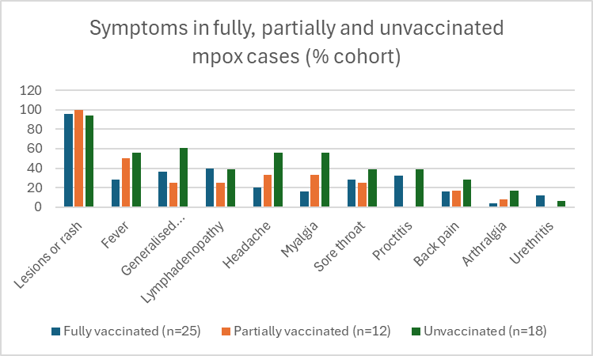
Figure 1: Symptoms in fully, partially and unvaccinated mpox cases (N=55)
Although in a small sample of 55 cases, there appears to be less systemic symptoms in the partially and fully vaccinated groups

Slide 22
Testing
Diagnosis of mpox is confirmed by polymerase chain reaction (PCR)
Suitable samples include a swab or other specimen of rash lesion material (fluid or base of lesion)
Other samples can include an anorectal swab for patients presenting with proctitis, or pharyngeal swabs
It is important to ensure that clinicians wear appropriate Personal Protective Equipment (PPE) when collecting samples (gloves, mask, gown, eye protection), see ICEG interim guidance on Monkeypox for health workers | Australian Government Department of Health and Aged Care
Always consider the possibility of mpox including other alternative diagnoses e.g., molluscum contagiosum. As symptoms resemble other sexually transmitted infections (STIs), testing should be considered as part of investigation of differential diagnoses based on individual risk assessment

Slide 23
Notification to the Department of Health (Victoria)
Mpox is an urgent notifiable condition
Clinicians should notify any suspected or confirmed case to the Department of Health by telephone as soon as practicable and within 24 hours by calling 1300 651 160 (24/7)
Clinicians do not require approval from the Department of Health prior to testing for mpox

Slide 24
Treatment - Tecovirimat (TPOXX)
Mpox typically results in a mild illness and most cases recover in a few weeks
Most cases do not need specific treatment other than supportive management or treatment of complications (e.g., antibiotics for secondary cellulitis)
Antivirals may be indicated for severe disease and Tecovirimat (TPOXX) is the preferred treatment option for severe mpox infection
Advice on clinical management, including viral treatment should always be sought from an ID physician
Approval is required from the Deputy Chief Health Officer (in Victoria) to access TPOXX from the National Medical Stockpile

Slide 25
Vaccination
Vaccination (JYNNEOS ®) is available free-of-charge for eligible people in Victoria
Two doses are required for optimal protection and are provided subcutaneously 28 days apart
The mpox vaccine takes about 14 days before it is effective
For more information: Victorian mpox (monkeypox) vaccination program guidelines and the Australian Immunisation Handbook – mpox

Slide 26
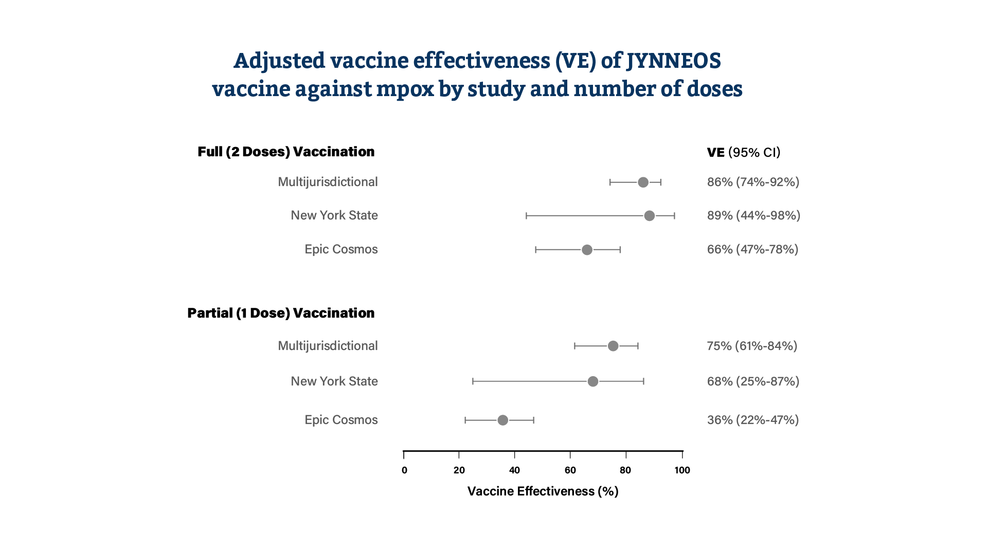
Vaccination - effectiveness
Studies show that JYNNEOS can reduce the risk of mpox illness, with 2 doses providing the best protection
However, no vaccine is 100% effective
People who have been vaccinated can still get mpox
Figure 1: Adjusted vaccine effectiveness (VE) of JYNNEOS vaccine against mpox by study and number of doses. Source: Mpox Vaccine Administration and Effectiveness | Mpox | Poxvirus | CDC

Slide 27
Vaccination – eligibility (PEPV)
Post-exposure preventative vaccination (PEPV) preferably in 4 days, in accordance with clinical guidance from the Australian Technical Advisory Group on Immunisation for:
High-risk contacts of mpox cases.
Attendees of SOPVs and public or private events (particularly where sexual or intimate contact may occur) in areas where local transmission of mpox is occurring.

Slide 28
Vaccination – eligibility (PPV)
Eligible people for primary preventative vaccination (PPV) include:
Sexually active gay, bisexual or other men who have sex with men.
Sexually active transgender and gender diverse people, if at risk of mpox exposure.
Sex workers, particularly those whose clients are at risk of mpox exposure.
Sexual partners (including anonymous or intimate contacts) of the above groups.
Sex-on-premises venue staff and attendees.
People living with HIV, if at risk of mpox exposure, and their partners.
Laboratory personnel working with orthopoxviruses.
Vaccination may also be considered for healthcare workers at risk of exposure to patients with mpox, based on local risk assessments. This may include primary care, sexual health clinics, hospital staff and others.

Slide 29
How do I access the mpox vaccine?
Immunisation providers can order mpox vaccine through Onelink online
Alternatively, GPs can refer patients to other mpox immunisation providers in their area
Contact your Local Public Health Unit for a list of mpox immunisation providers in your local area, or refer them to the following clinics here
If requiring additional support with access, contact the Immunisation Program at the Department of Health: immunisation@health.vic.gov.au

Slide 30
How to best approach an mpox outbreak? International Evidence
Research conducted in the US suggests the combination of vaccination (including addressing inequities in vaccine availability and coverage) and behavioural change due to high-risk group awareness in GBMSM are key strategies in controlling an mpox outbreak (Delaney, 2022).
Model fitting shows that both actions work synergistically, and could prevent 64% of cases when combined, compared to a sole two-dose vaccination campaign (21.1%), or behavioural changes due to high-risk group awareness alone (15.4%) (Lin, 2024).

Slide 31
Current Public Health actions
Comprehensive public health response
Coordinated by the Department of Health
Working collaboratively with key stakeholders (e.g. LPHUs, community organisations, clinicians)
Key elements
Case and contact follow-up
Immunisation program
Communication and engagement with key stakeholders and the community
Increase awareness
Promote vaccination including second vaccine dose
Prevent mpox transmission in the community
Notes:
Victorian Department of Health
Development of an Incident Management Team (IMT); weekly meetings involving Department of Health (DoH), Local Public Health Units (LPHUs), and other stakeholders including Thorn Harbour Health (THH), Victorian Infectious Diseases Reference Laboratory (VIDRL)
Release of Chief Health Officer (CHO) Alerts and media releases; ABC interview with the CHO
Mpox alert to General Practitioners
Letter to S100 prescribers
Health promotion communications (awareness around mpox outbreak, promoting vaccination)
Meetings with other stakeholders (e.g., Sex on Premises Venues [SOPV] managers, healthcare professionals)
Assisting LPHUs with conducting case and contact management, including VICS
Compiling epidemiological data from cases to create risk assessment into current outbreak
Funding pop-up/ walk-in vaccination clinics via THH
Local Public Health Units
LPHUs perform the bulk of case and contact management, supported by DoH
Health promotion communications (awareness around mpox outbreak, promoting vaccination)
Thorn Harbour Health
Engaging community and other stakeholders (including SOPVs and party organisers) via multiple avenues (including social media, apps- Grindr/Squirt, radio outlets- Joy FM, face to face/ on premises) to promote mpox awareness and vaccination
THH facilitated walk-in/pop up vaccination clinics
Victorian Infectious Diseases Reference Laboratory
VIDRL perform testing and genomic analysis to inform IMT risk assessment

Slide 32
THH pop-up/walk-in vaccination clinics
Thorn Harbour Health (THH) in Melbourne Victoria are currently running DoH funded pop-up/walk-in vaccination clinics on Fridays (The Centre Clinic, St Kilda) and Saturdays (THH, Abbotsford)
Eligible people can either book in online, or walk-in on these days to get vaccinated
Link to online THH booking: https://thorneharbour.org/sexual-health/mpox/

Slide 33
Key messages
Consider mpox as a differential diagnosis, particularly in patients with risk factors
Take a detailed sexual history, ask about attendance at SOPVs, beats, and group sex activities
Patients can present with atypical or attenuated infections
Remember those who are partially or fully vaccinated can still get mpox

Slide 34
Key messages continued
Vaccination is a key strategy to combat the current outbreak in Victoria, reducing severity of disease and transmission
Encourage eligible people to get vaccinated
If you have patients that are due or overdue for their second vaccination – consider reminding them via SMS or phone call. Alternatively, consider booking both the first and second vaccination appointments together

Slide 35
Questions?

Slide 36
References
Delaney, K. P. (2022). Strategies adopted by gay, bisexual, and other men who have sex with men to prevent monkeypox virus transmission—United States, August 2022. MMWR. Morbidity and mortality weekly report, 71.
https://immunisationhandbook.health.gov.au/contents/vaccine-preventable-diseases/mpox-previously-known-as-monkeypox Accessed 28th June 2024
https://thorneharbour.org/sexual-health/mpox/ Accessed 27th June 2024
https://www.cdc.gov/poxvirus/mpox/response/2022/vaccine-admin.html Accessed 4th June 2024
https://www.cdc.gov/poxvirus/mpox/symptoms/index.html Accessed 27th June 2024
https://www.health.vic.gov.au/infectious-diseases/mpox-monkeypox#resources-for-health-professionals Accessed 28th June 2024
https://www.health.gov.au/resources/publications/iceg-interim-guidance-on-monkeypox-for-health-workers Accessed 28th June 2024
https://nindss.health.gov.au/pbi-dashboard/ Accessed 28th June 2024
https://worldhealthorg.shinyapps.io/mpx_global/#2_Global_situation_update Accessed 27th June 2024
https://www.who.int/health-topics/monkeypox/#tab=tab_1 Accessed on 28th July 2024
https://www.who.int/news-room/fact-sheets/detail/monkeypox#:~:text=Mpox%20%28monkeypox%29%20is%20a%20viral%20illness%20caused%20by,back%20pain%2C%20low%20energy%2C%20and%20swollen%20lymph%20nodes Accessed 27th June 2024
Lin, Y. C., Wen, T. H., Shih, W. L., Vermund, S. H., & Fang, C. T. (2024). Impact of vaccination and high-risk group awareness on the mpox epidemic in the United States, 2022–2023: a modelling study. Eclinicalmedicine, 68.
Low, N., Bachmann L.H., Ogoina, D., McDonald, R., Ipekci A.M., Quilter, L.A.S., Cevik, M. (2023). Mpox virus and transmission through sexual contact: Defining the research agenda. PLoS Med, 20(1), e1004163.

Slide 37
Respiratory Viral updates
RACGP Webinar 3rd July 2024
Dr David Lister, Infectious Diseases Physician
Deputy Chief Health Officer (Prevention and Population Health) Department of Health, Victoria
OFFICIAL

Slide 38
Contents
Respiratory viral updates
COVID-19
Influenza/RSV
RSV prevention – AREXVY, ABRYSVO, Beyfortus (nirsevimab)

Slide 39

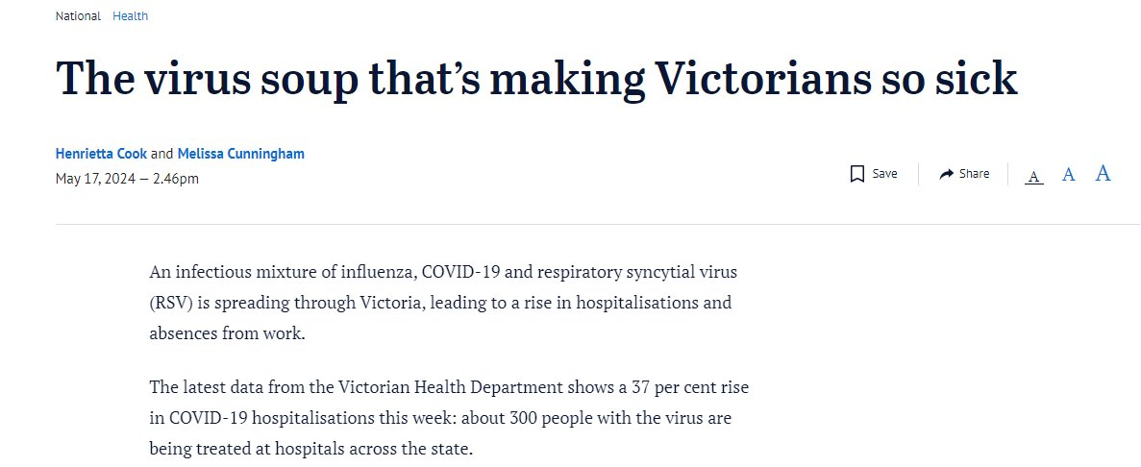
COVID-19/Influenza/RSV

Slide 40
COVID-19 update (10 - 21 June 2024)
Current trends indicate high but decreasing levels of COVID-19 in Victoria
COVID-19 hospitalisations have decreased for the second consecutive week
COVID-19 antiviral prescriptions have decreased
JN.1 continues to be the dominant variant of interest in Victoria and globally, with sublineage KP.3 increasing in abundance

Slide 41
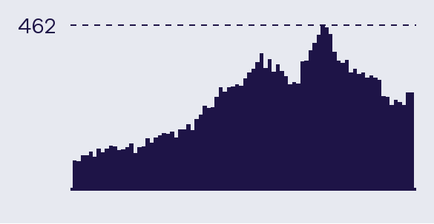
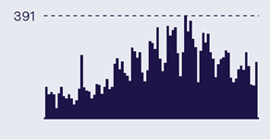
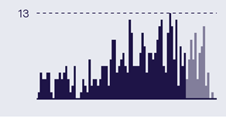

Epidemiological Summary
Current trends indicate decreasing levels of COVID-19 activity in Victoria.
Daily counts last 12 weeks
 | The number of people in hospital with COVID-19 has decreased this week. The 7-day average is 254 (week ending 25 June), compared to 311 last week.
 | COVID-19 notifications remained stable this week. A total of 1,310 cases (PCR-confirmed) were notified in the most recent week (ending 25 June), compared to 1,375 the week prior. 21,223 PCR tests were completed last week, similar to the week prior with 20,717 tests. 7% of tests returned a positive SARS-CoV-2 result, a decrease from 7.7% the previous week.
 | Deaths have increased. In the most recent 28-day period (15 May 2024 - 11 Jun 2024) there were 212 COVID-19 associated deaths. Increases and decreases in the reporting of deaths attributable to COVID-19 tend to lag waves of infections and hospitalisations by several weeks.
 | Globally, JN.1 is the most prevalent variant. KP.3 and KP.2 are the fastest growing JN.1 sublineages. They were declared Variants Under Monitoring by WHO on 3 May 2024. KP.3 has been the most prevalent JN.1 sublineage in Victoria to date.

Slide 42
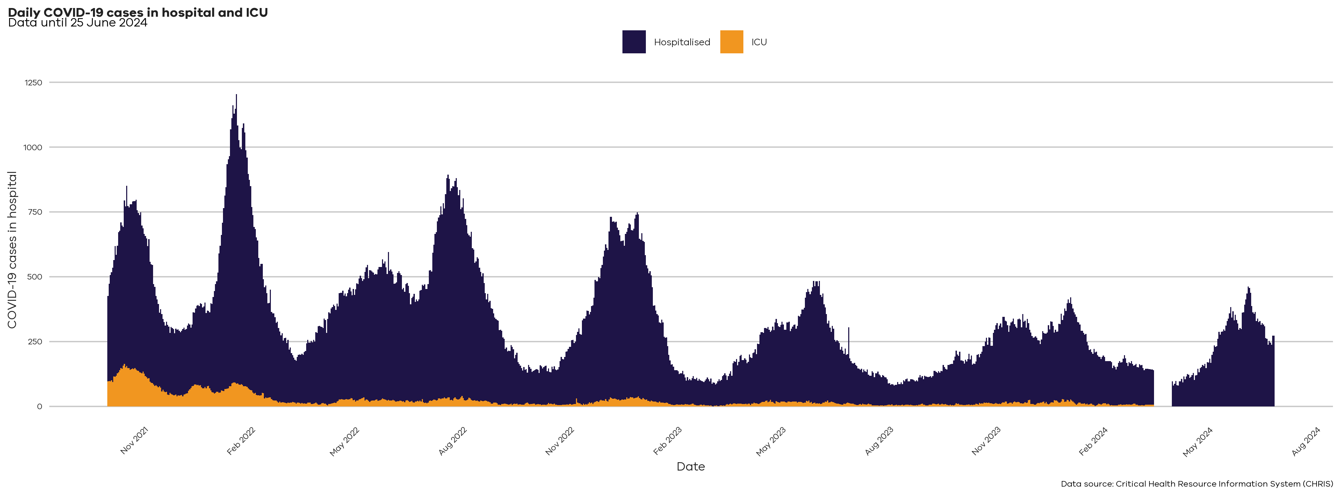
COVID-19 Hospitalisations
This graph shows data back to September 2021 when hospitalisations were increasing during the Delta variant wave. Hospitalisations represent the number of COVID-19 positive patients in hospital on a given day. Please note that COVID-19 hospitalisation data from CHRIS is unavailable for dates between 15 March 2024 and 30 March 2024

Slide 43
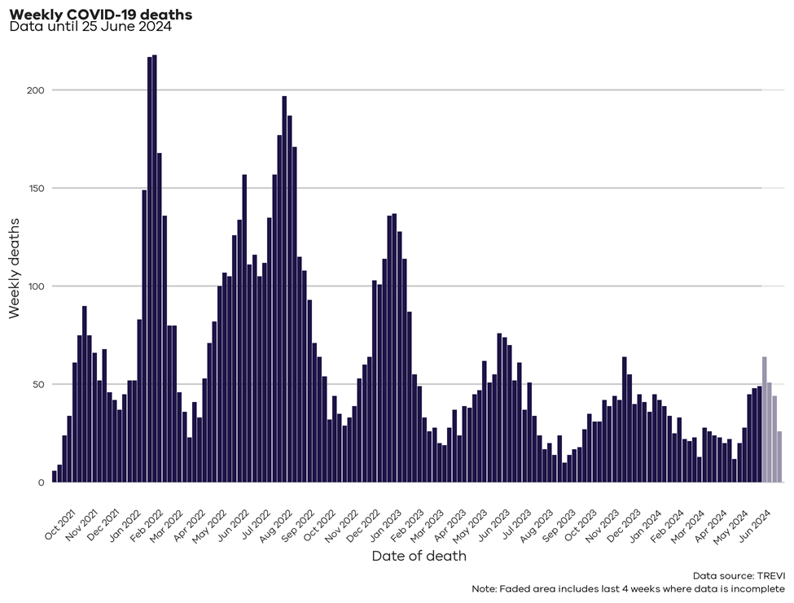
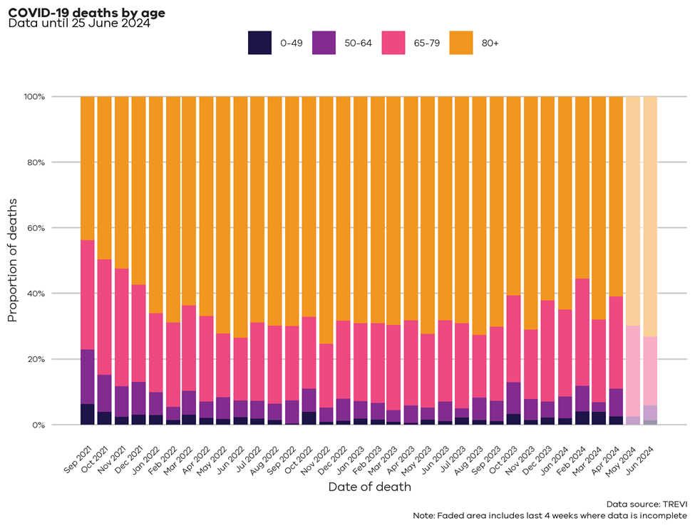
COVID-19 Mortality
Date is based on date of death, not the date of when each death was reported.

Slide 44
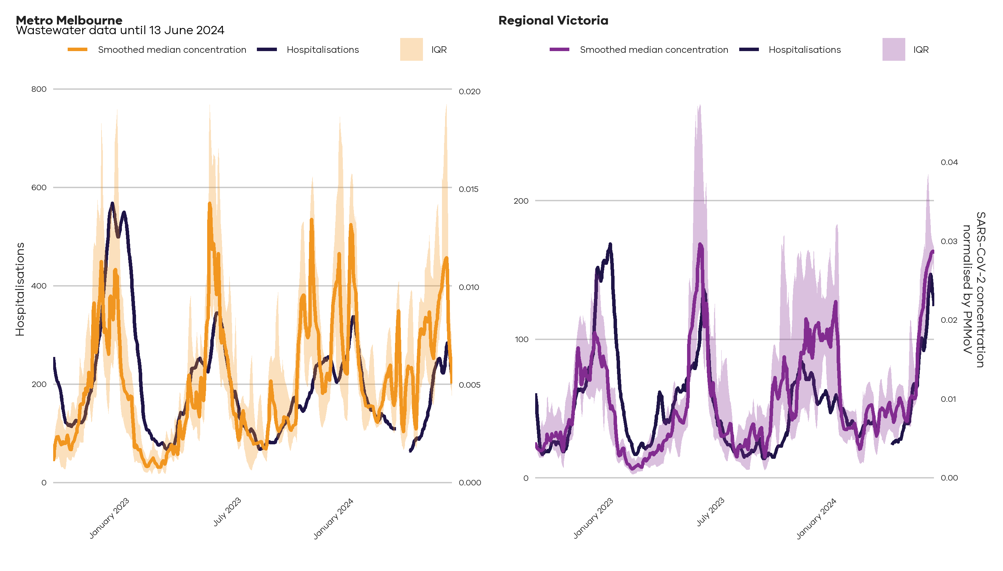
COVID-19 update – Quantitative Wastewater levels (10 - 21 June 2024)
Quantitative wastewater sampling and 7-day average hospitalisations provide insights into changes in prevalence and COVID-19 wave detection. These charts show the median SARS-CoV-2 wastewater viral loads with hospitalisations over time, which show a close relationship. Quantitative SARS-CoV-2 levels are normalised by PMMoV (a non-pathogenic virus that is shed consistently by the population) and smoothed over the read period to account for rainfall, population movements and catchment size.
Please note that COVID-19 hospitalisation data from CHRIS is unavailable for dates between 15 and 30 March 2024

Slide 45
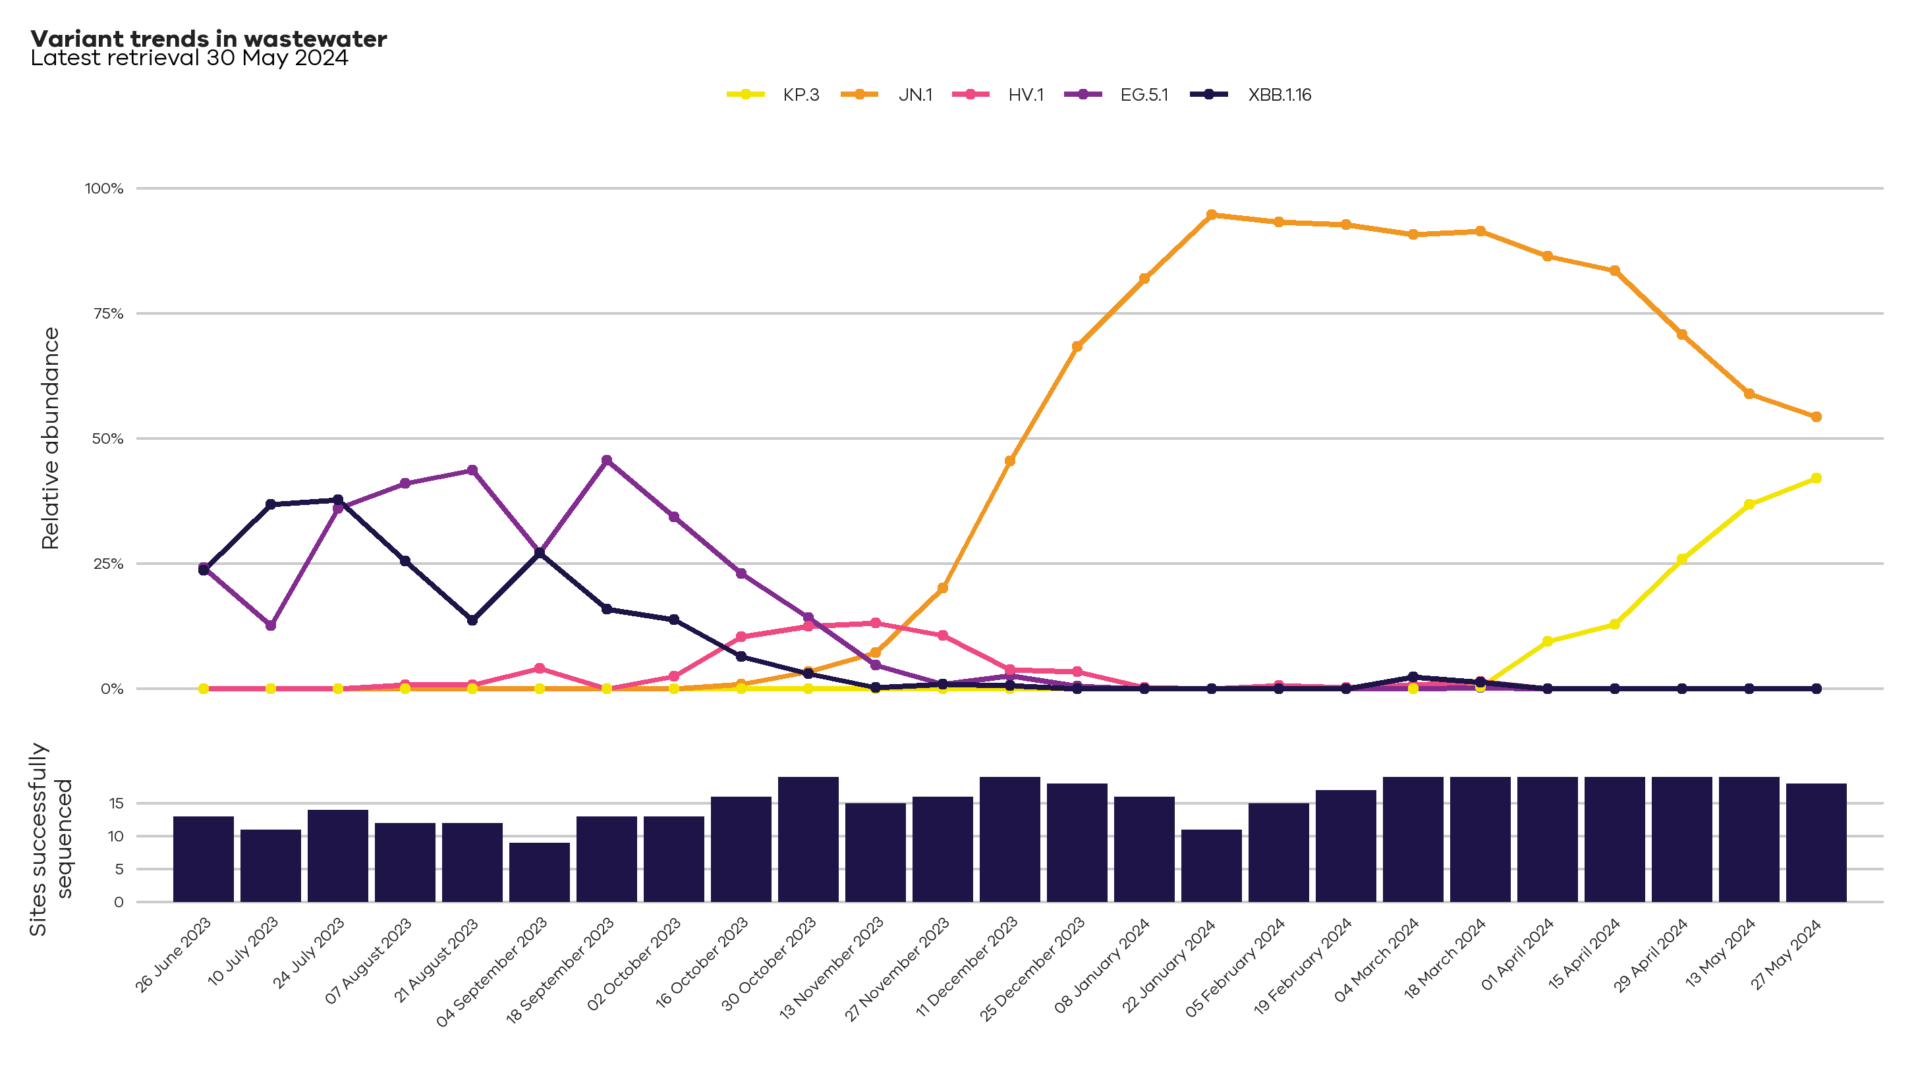
COVID-19 update – Quantitative Wastewater: variant trends in Victoria (10 - 21 June 2024)
Analysis of wastewater samples can help us understand which SARS-CoV-2 variants are currently circulating in Victoria. In the past there have been waves of infections and hospitalisations when a new variant or subvariant has spread quickly relative to the others. There are a number of closely related sublineages circulating in Victoria. Only the most detected variants have been displayed here.

Slide 46
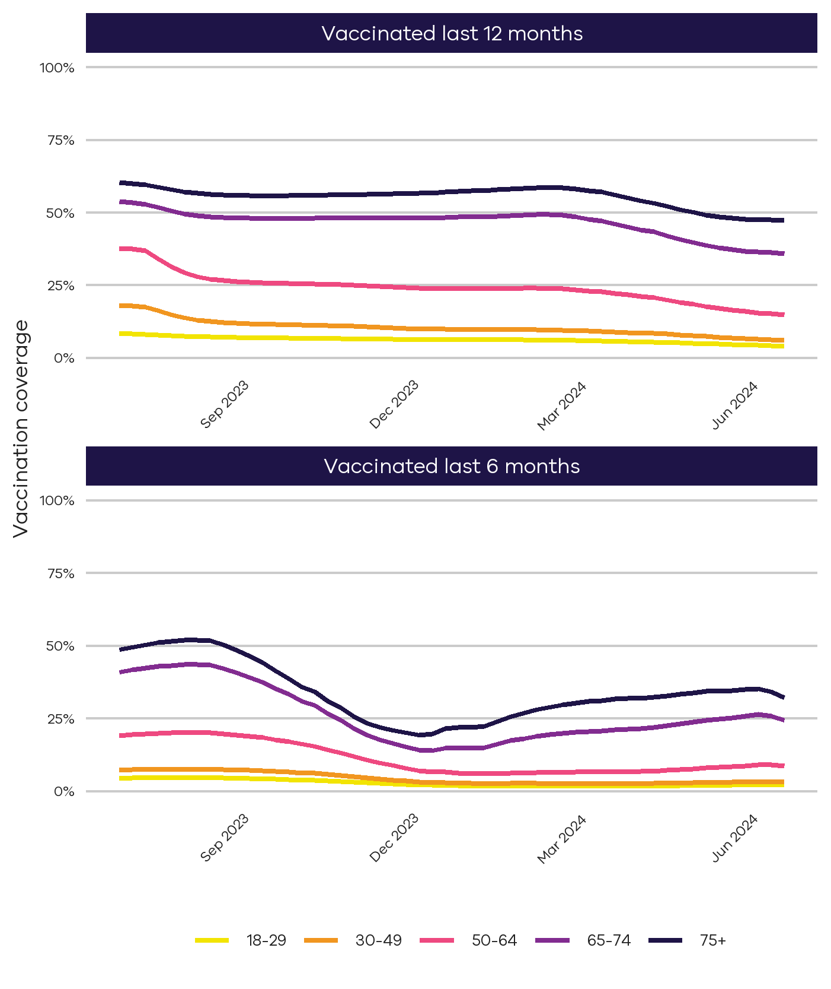
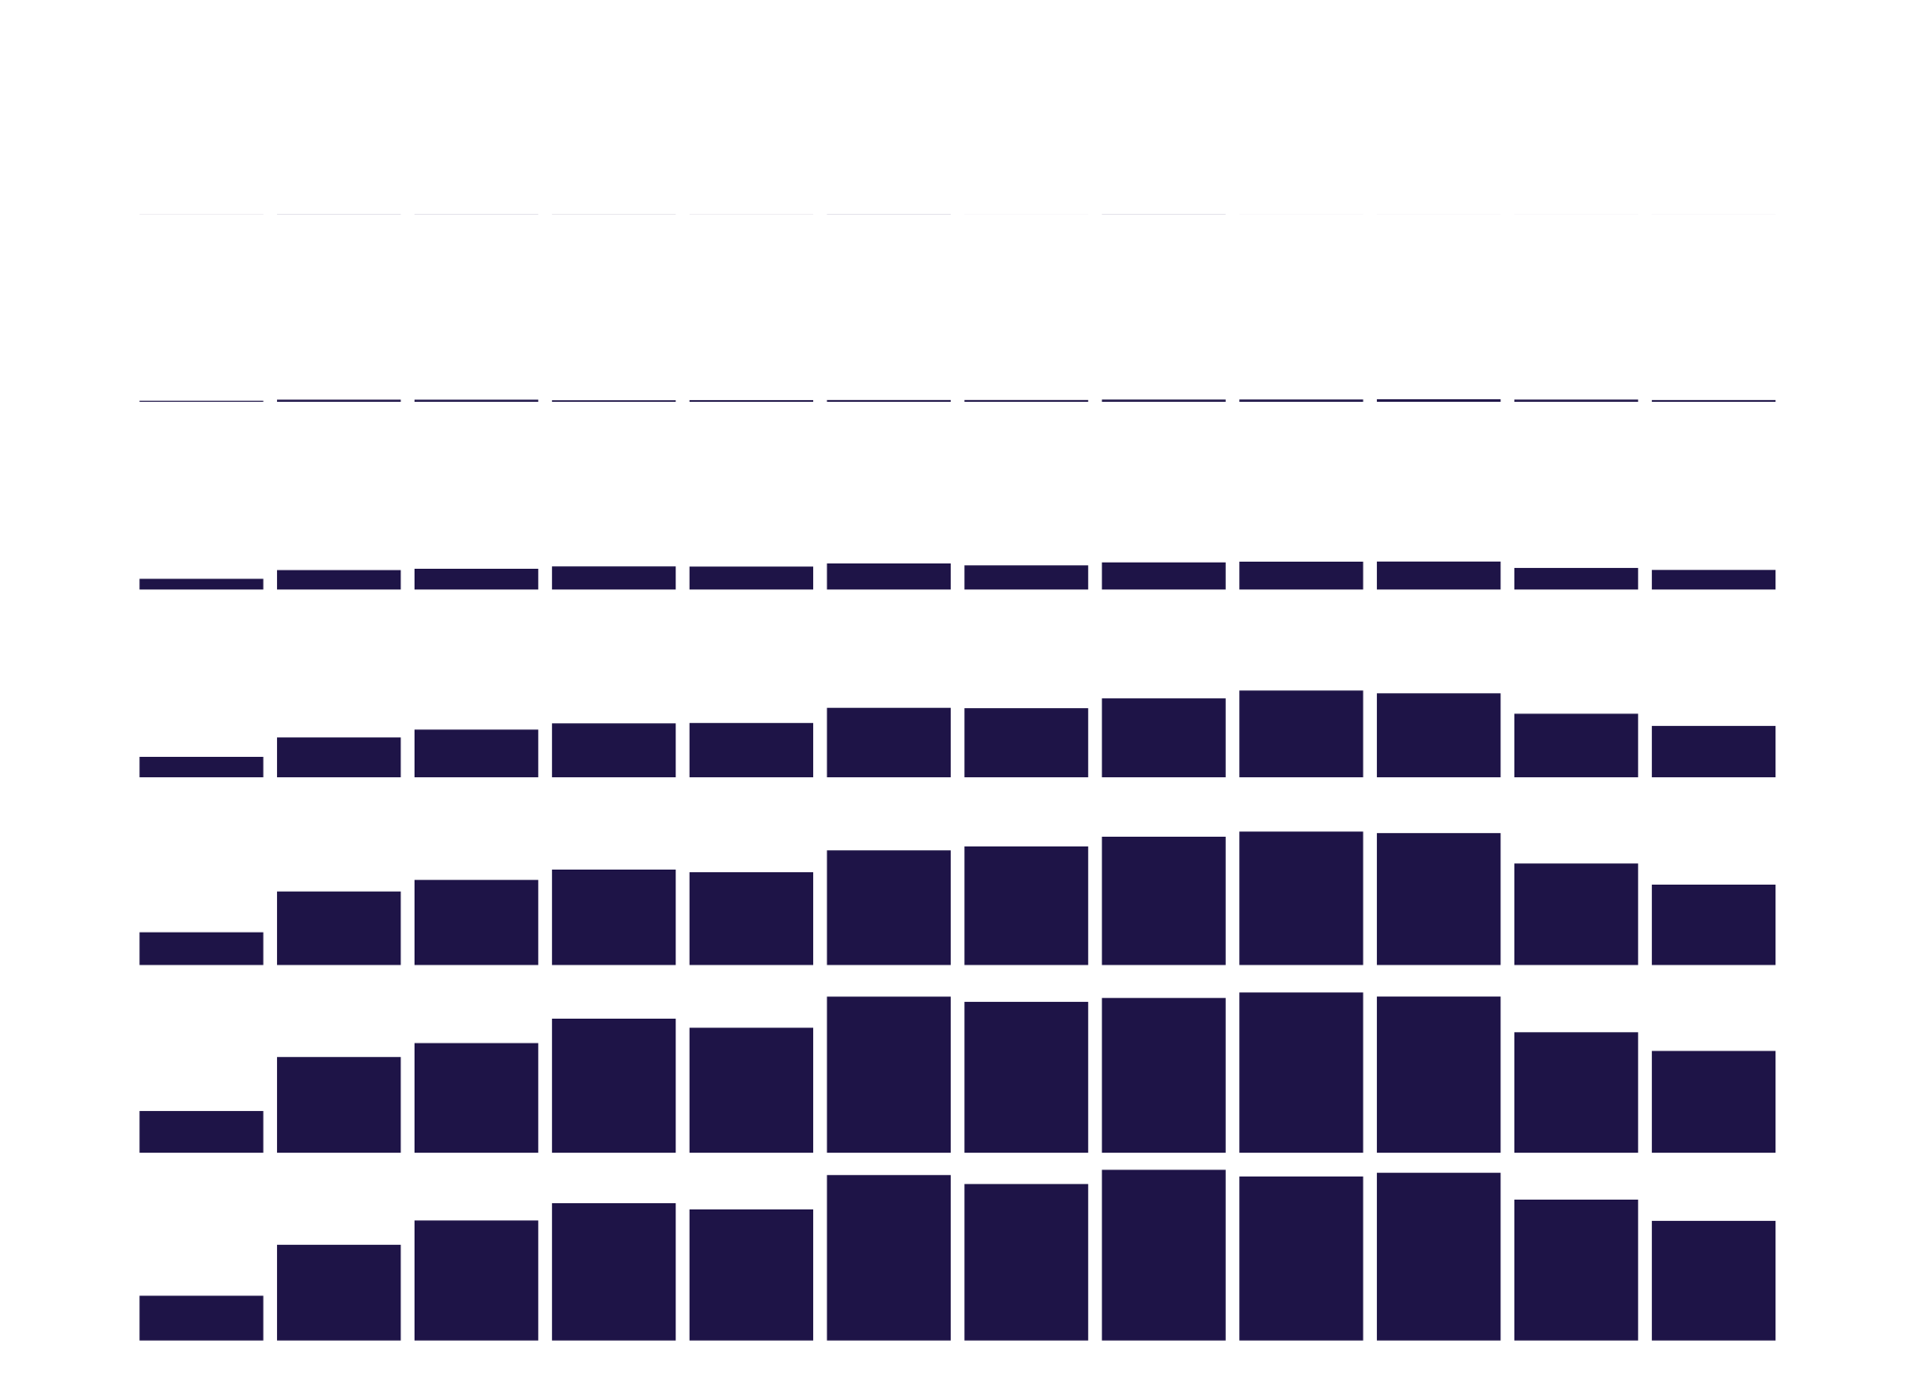
COVID-19 update - Vaccination (10 - 21 June 2024)
Age group | Vaccinated last 12 months* | Vaccinated last 6 months* | Doses last 7 days# | Doses last 12 weeks
00-04 | 0% | 0% | 1
05-17 | 1% | 0% | 88
18-29 | 4% | 2% | 994
30-49 | 6% | 3% | 2,604
50-64 | 15% | 9% | 4,078
65-74 | 36% | 24% | 5,164
75+ | 47% | 32% | 6,068
Total | 15% (18+ years) | 9% (18+ years) | 18,997
*Proportion of people with any vaccination who have received a dose in the past 365/180 days. | * | * | * | *
#Data to 18 June 2024 | # | # | # | #

Slide 47
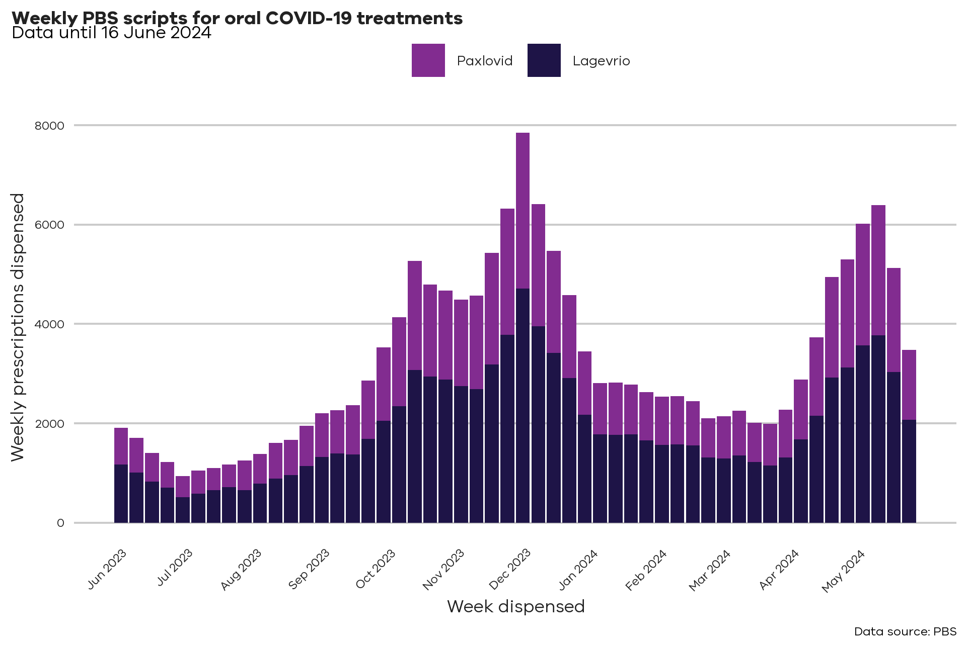
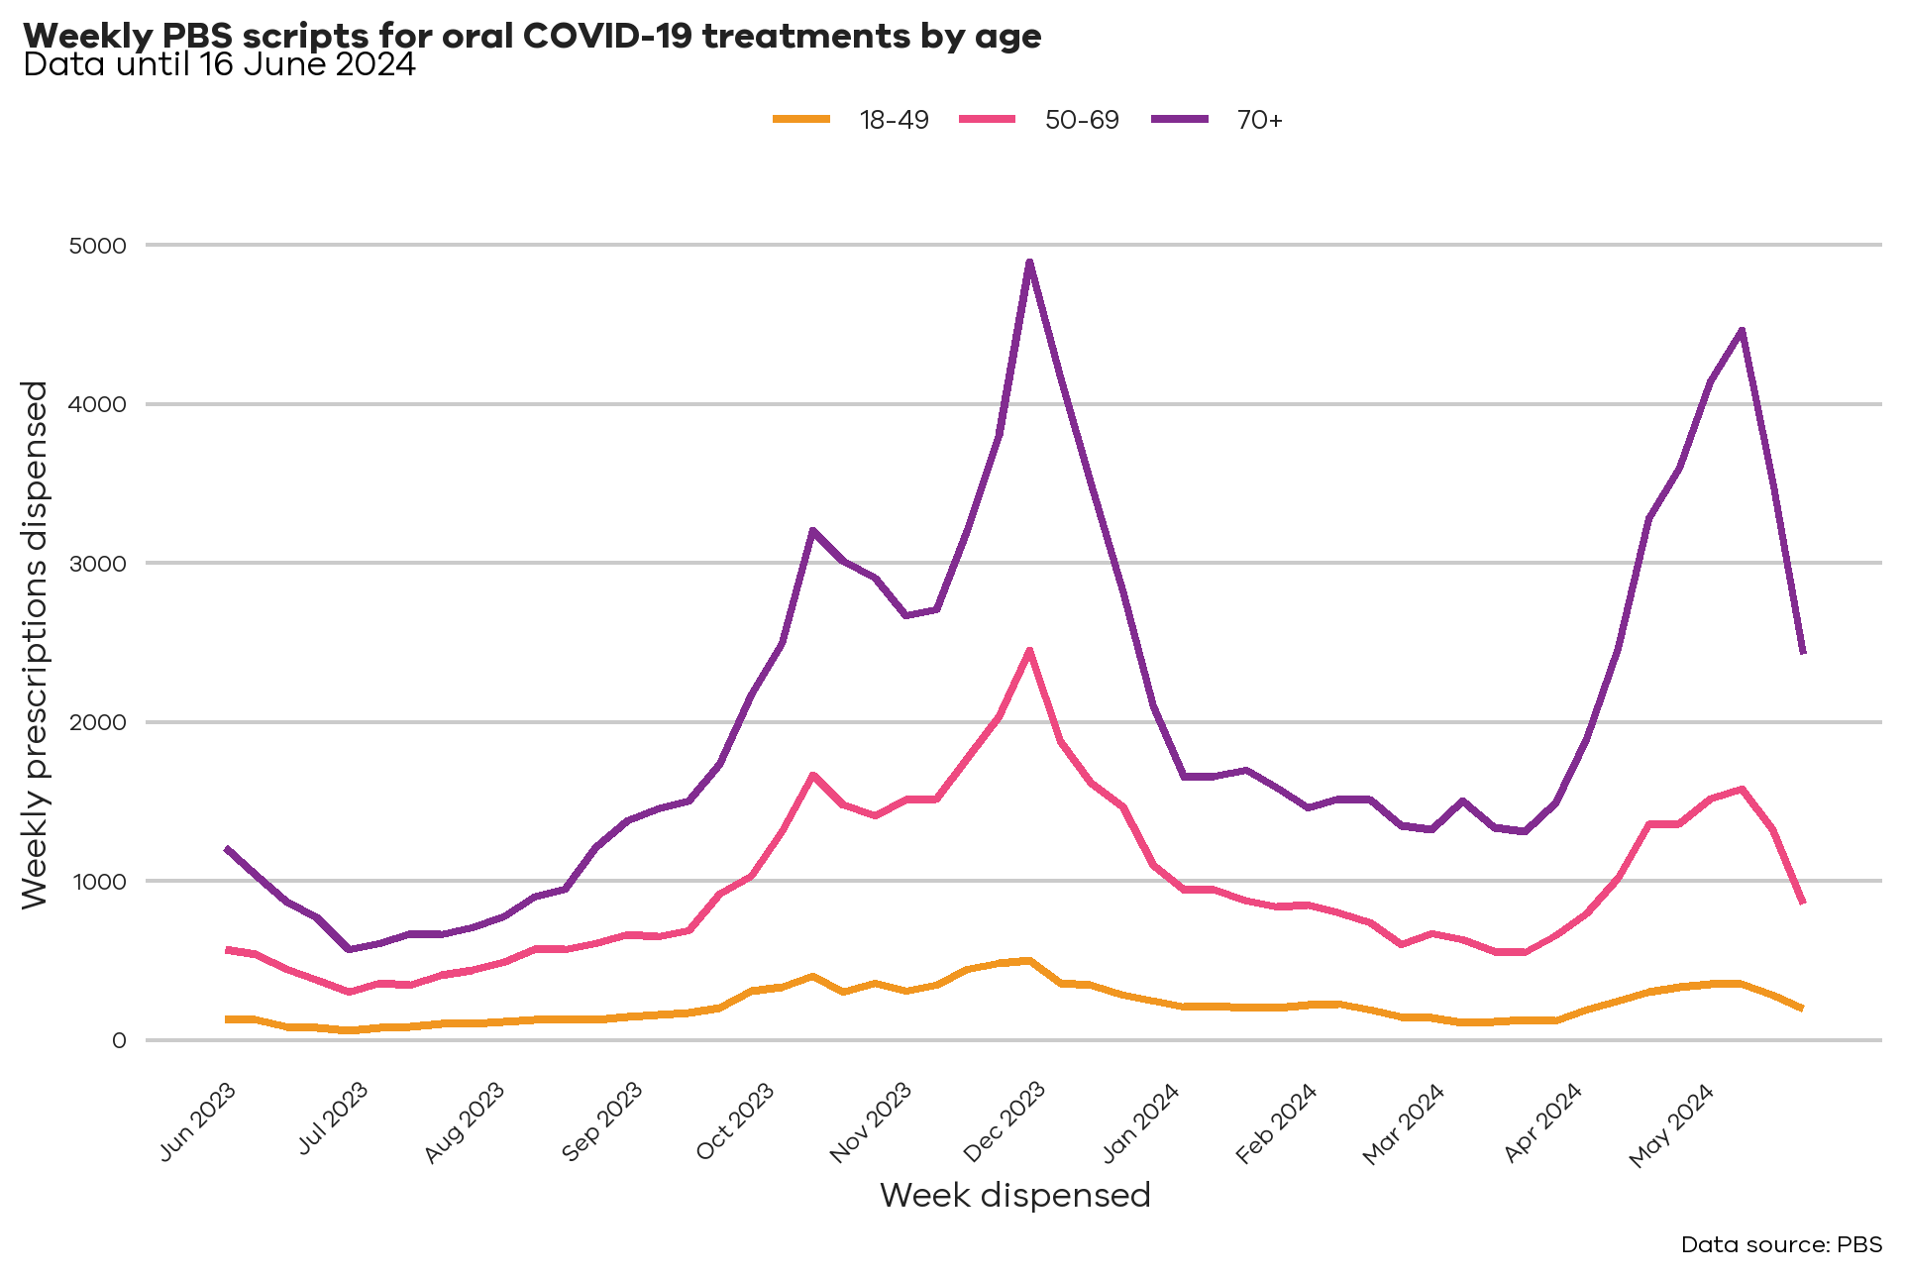
COVID-19 update - Treatments (10 - 21 June 2024)
PBS prescriptions dispensed within Victoria for PBS eligible oral COVID-19 treatments. Reporting week is Monday to Sunday. Note that totals may change week to week as more data is submitted, and totals may differ from other sources due to exclusions and/or differing dates from which the data is taken.

Slide 48
COVID-19 - Current Public Health Advice
Testing (symptomatic, contacts) | Rapid antigen tests (RATs) are the easiest way to test for COVID-19. You should take a test: if you have COVID-19 symptoms, even if they’re very mild if you have been in contact with someone who has COVID-19 before visiting a hospital, aged care facility, or disability care facility before visiting elderly people, people with disability or people at higher risk of severe COVID-19 illness. COVID-19 can spread before you have symptoms. You can protect others by checking that you are negative before you leave home.
Isolation of positive cases | It is recommended that you should isolate for at least 5 days and until you don’t have symptoms anymore. This means you should not go to work, school or grocery shopping. Especially if you work with people at a higher risk of becoming very sick with COVID-19.
Antiviral therapy (AVT) | If you are at risk of falling very sick you may be eligible for COVID-19 antiviral medicines. Plan ahead by checking your eligibility with your GP, so that you are prepared if you get COVID-19. COVID-19 antiviral medicines work best if you take them as soon as you get symptoms or within 5 days of getting sick. This is why it is important to test for COVID-19 as soon as you notice any symptoms. You should take the medicine even if your symptoms are mild.
Masks | Face masks can stop or slow viruses from spreading. Face masks lower your chance of catching and spreading an airborne virus. That’s why wearing a high-quality and well-fitted face mask can help protect you and those around you from COVID-19. Masks are recommended to be worn by: staff and visitors to high-risk settings a person who has COVID-19 for 10 days after a positive test, when they are leaving the house, indoors or unable to physically distance.
Vaccination | Ensure your ongoing protection against COVID-19 by understanding the latest Australian Government vaccination guidelines. Booster doses are recommended or can be considered based on your age and the presence of risk factors for severe illness. All adults are eligible for a booster dose every 12 months. Adults 65 years and over, or aged 18-64 who are severely immunocompromised, are eligible to receive a booster dose every 6 months. Children aged 5 to 17 who are severely immunocompromised can receive a single dose this year.
Ventilation | Ventilation means bringing fresh outdoor air into an indoor space. Ventilation is important because COVID-19 is airborne. Choose to meet or sit outdoors whenever you can. In most cases, outdoor settings have better natural airflow than indoor areas.

Slide 49
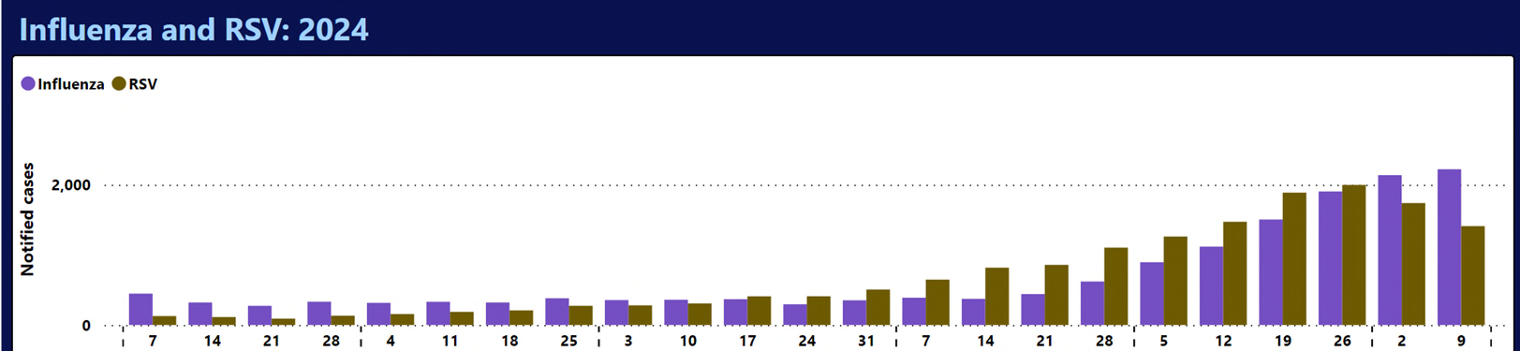
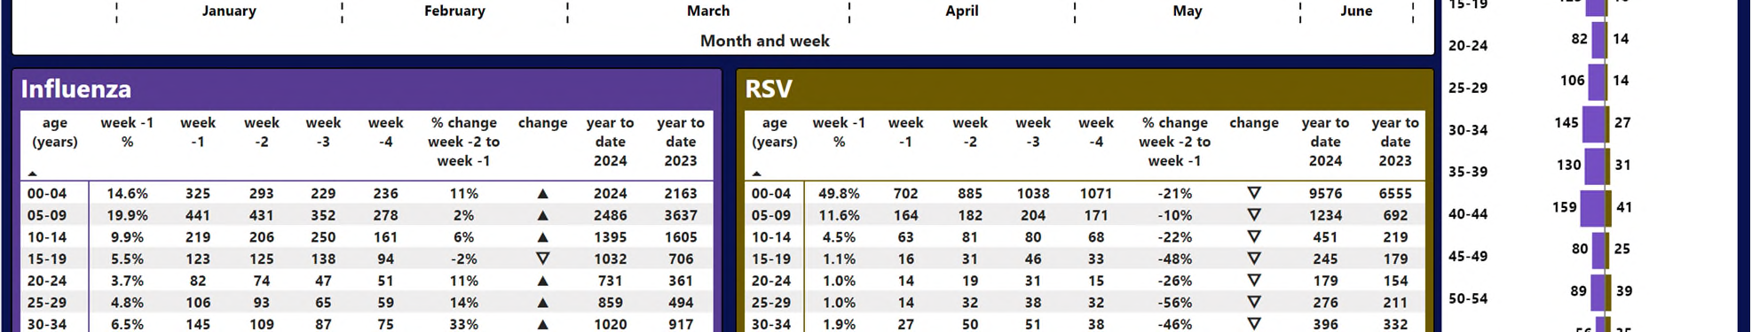
Influenza and RSV (10 - 21 June 2024)
Influenza cases have increased around 28% over the past fortnight
98% influenza notifications in the most recent week have been for Influenza A
Around 35% influenza notifications in the most recent week were in children aged under 10 years
RSV notifications decreased by 19% as compared to the previous fortnight

Slide 50
CHO Advisory 26 June 24 – Flu vaccination for all Victorians
From April – June 2024 in Victoria
4x increase in notified influenza cases
6x increase in ED presentations
Vaccination coverage remains low across all age groups, including 6 months to 5 years
Flu vaccination for all Victorians | health.vic.gov.au
Alert includes information on eligibility and access to influenza vaccines

Slide 51
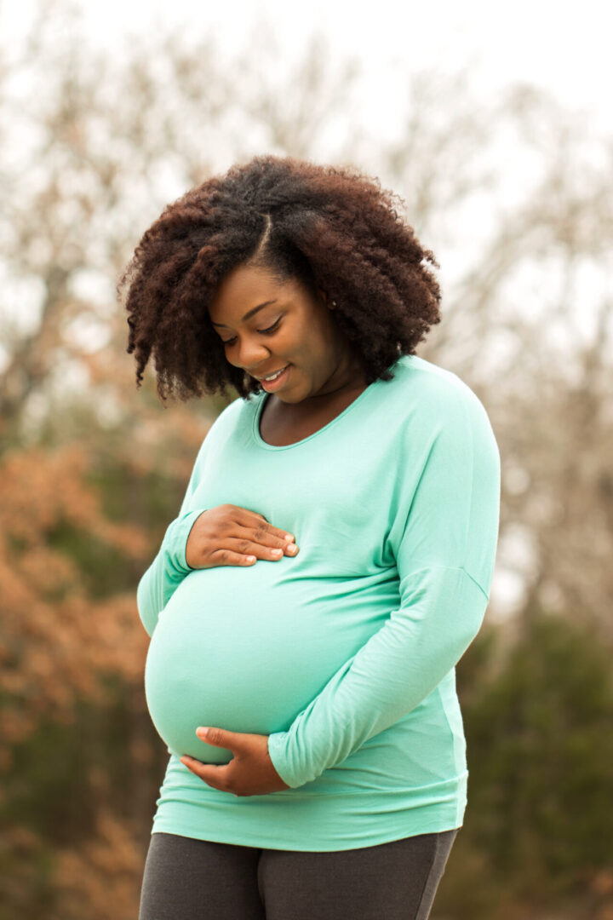

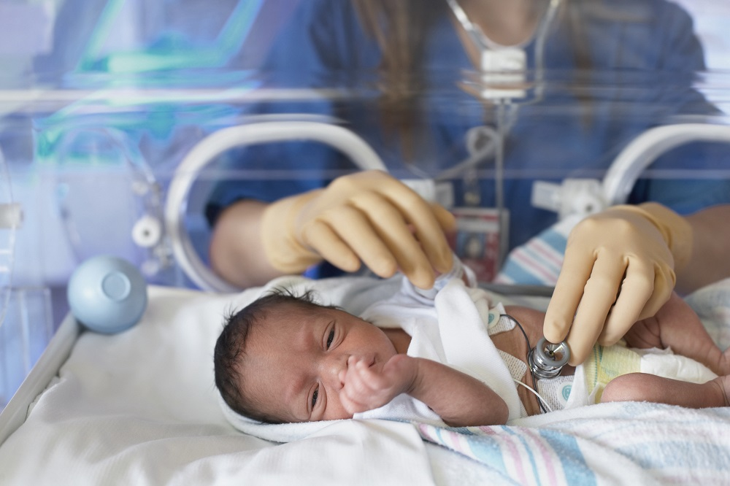
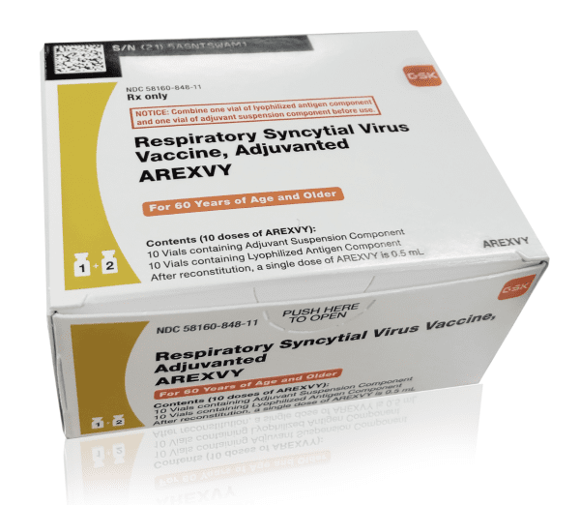
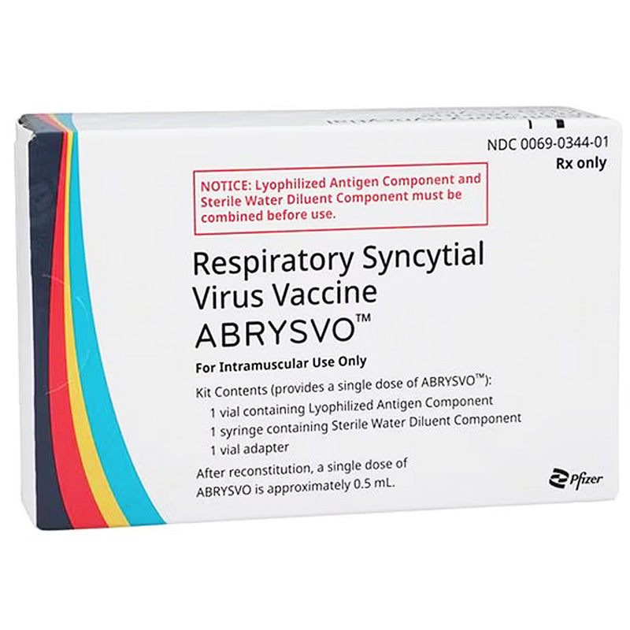
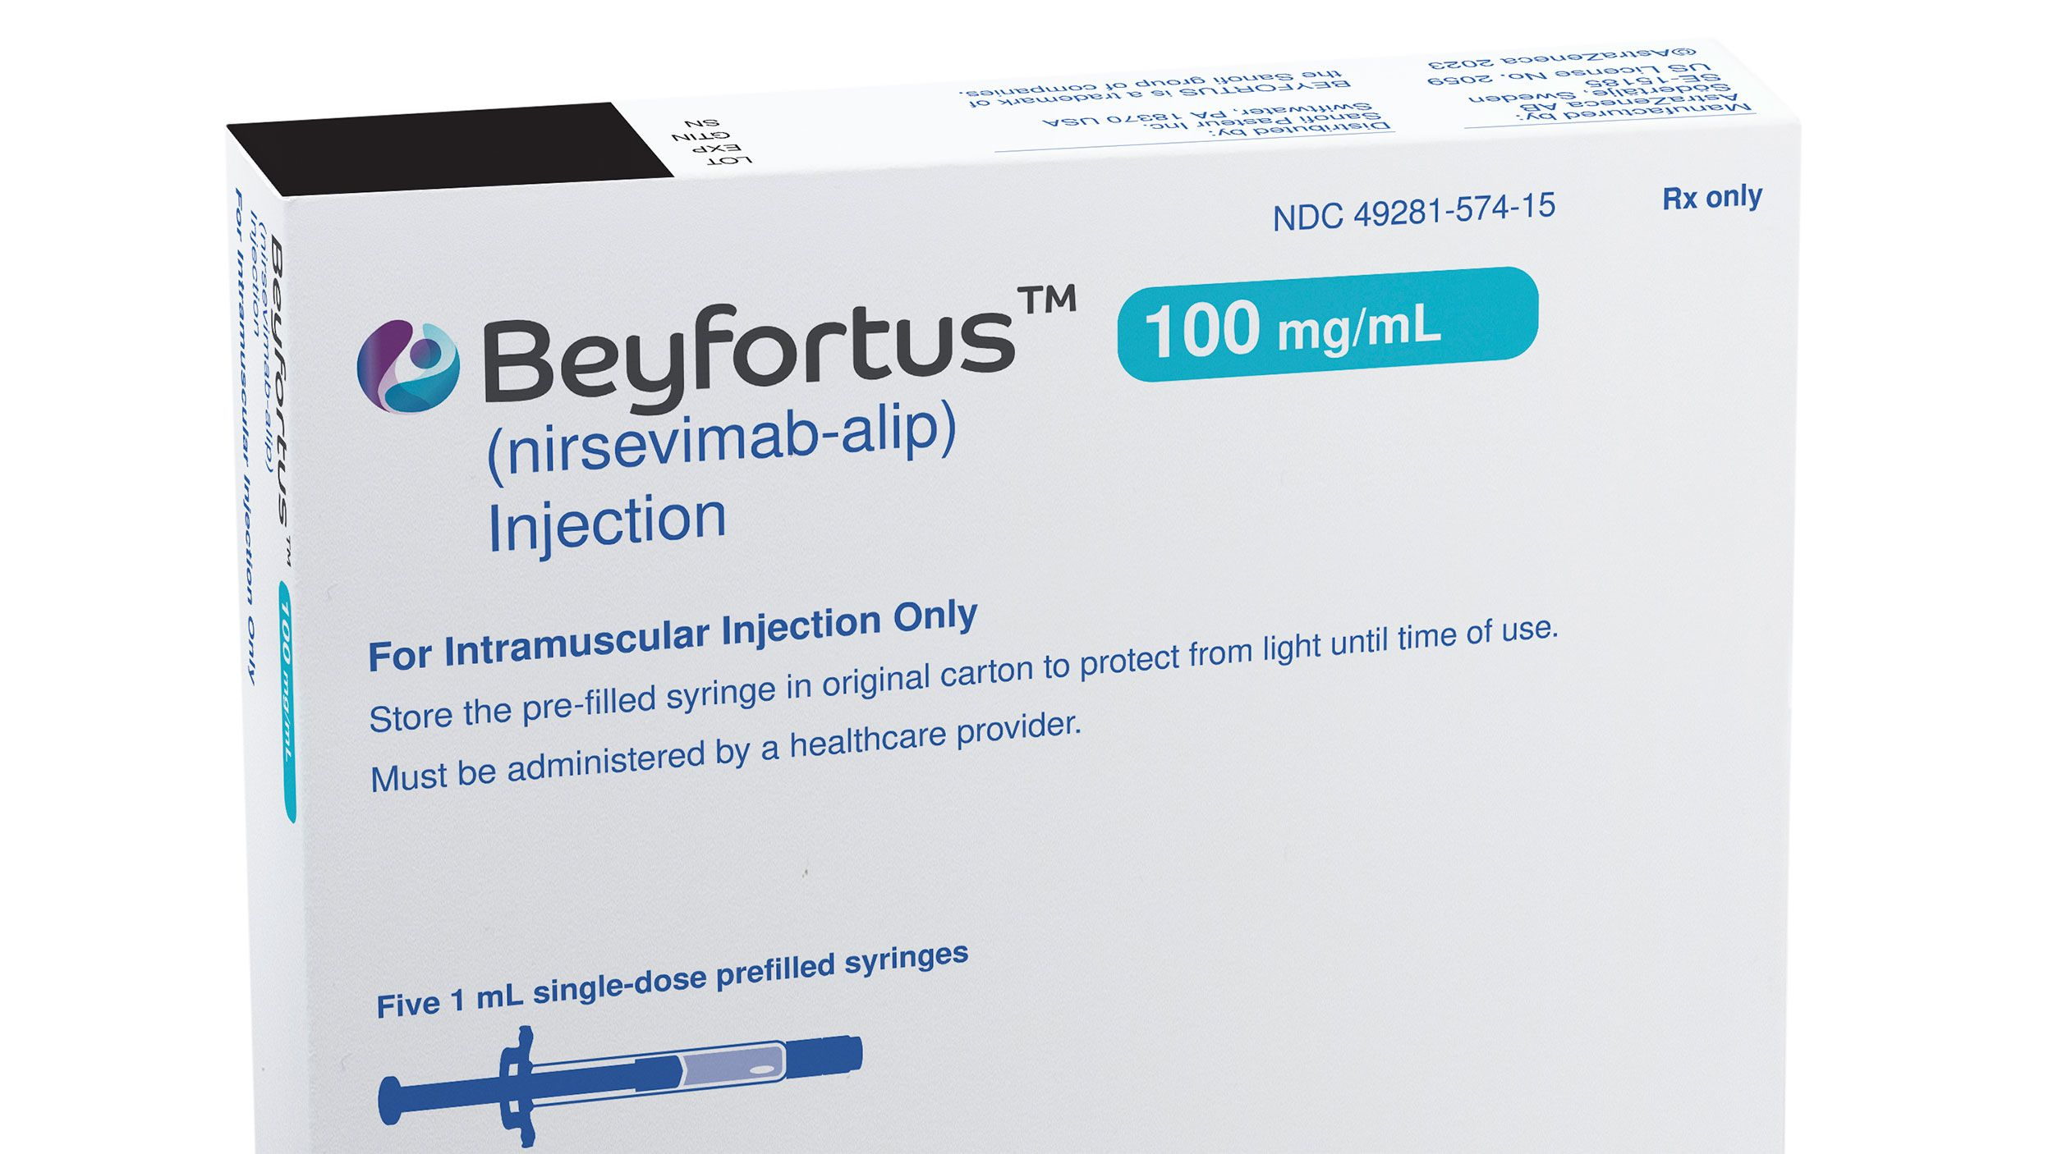
Prevention of RSV
Beyfortus (nirsevimab)
AREXVY
ABRYSVO

Slide 52
AREXVY
RSV vaccine available on the private market in Australia
A non-live vaccine registrered for use in adults aged ≥ 60 years to prevent illness and severe complications associated with RSV infection
Not currently funded under the National Immunisation Program

Slide 53
ABRYSVO
Pfizer RSV vaccine registered for use in Australia in
Individuals ≥ 60 years for prevention of lower respiratory tract disease caused by RSV
Pregnant women between 24-36 weeks gestation for prevention of lower respiratory tract disease caused by RSV in infants from birth through to 6 months of age
Potentially a more cost-effective measure of RSV prevention than nirsevimab given maternal indication

Slide 54
Beyfortus (nirsevimab)
Recombinant monoclonal antibody for the prevention of RSV lower respiratory tract disease in neonates, infants and children
TGA has approved nirsevimab for use in:
Newborns and infants born just before or during their first RSV season
Children up to 24 months who are at risk of severe RSV disease through their second RSV season
Not available privately, only available via some jurisdictions pilot schemes
In Victoria, high risk infants via health services in addition to Palivizumab

Slide 55
Questions?

Slide 56
References
https://www.smh.com.au/national/virus-soup-making-victorians-sick-could-get-worse-before-it-gets-better-20240503-p5foo4.html Accessed 1 July 2024
https://www.health.vic.gov.au/health-advisories/flu-vaccination-for-all-victorians Accessed 1 July 2024
https://www.health.vic.gov.au/immunisation/respiratory-syncytial-virus-immunisation Accessed 1 July 2024
https://www.tga.gov.au/resources/auspmd/beyfortus Accessed 1 July 2024
https://www.healthdirect.gov.au/respiratory-syncytial-virus-rsv#prevented Accessed 1 July 2024
https://www.tga.gov.au/resources/auspmd/abrysvo Accessed 2 July 2024
https://www.drugs.com/images/pills/custom/pill35142-1/arexvy.png Accessed 1 July 2024
https://qtxasset.com/quartz/qcloud5/media/image/AREXVY.jpg?VersionId=uoxhe6KKG6t7hsCKwwSITa0yP0twHlrK Accessed 1 July 2024
https://potomacpediatrics.com/wp-content/uploads/2023/08/Beyfortus.jpg Accessed 1 July 2024
https://www.empr.com/wp-content/uploads/sites/7/2020/12/newbornbabyg73773081_1345153.jpg Accessed 1 July 2024
Abrysvo-RSV-Vaccine-_Respiratory-Syncytial-Virus-Vaccine_-0.5-mL_6140b11a-b299-4dfa-a99b-f3c47a9425d9_800x800.jpg (800×800) (mountainside-medical.com) Accessed on 2 July 2024
https://mentalhealthcommission.ca/wp-content/uploads/2021/09/Seniors-Happy-diverse-scaled.jpeg Accessed 1 July 2024
shutterstock_381809164-scaled.jpg (720×1080) (acendahealth.org) Accessed 2 July 2024

