Slide 1
Mental Health and Wellbeing Locals - a front door to the Victorian mental health system
29 August 2024

Slide 2
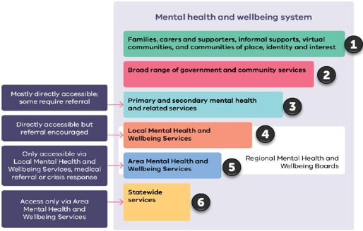
The reformed mental health and wellbeing system
The Royal Commission into Victoria’s Mental Health system outlines a reformed mental health and wellbeing system that is structured around a community-based model of care.
Local mental health and wellbeing services are a significant system reform – across age streams:
people aged 26 years and over – Mental Health and Wellbeing Locals
young people (12-25 years) – headspace centres
Infants, children (0-11 years) and their families – Child and Family Health and Wellbeing Locals
They are the new ‘front-door’ and are where most people will receive treatment, care and support.​
Source: Royal Commission into Victoria’s Mental Health System, Final Report, Vol 1, p.470

Slide 3
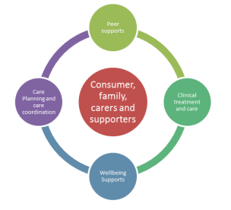
Core service components
Core service components include:
Clinical treatment and therapies – mental health assessment and psychological interventions and psychotherapeutic therapies, including integrated mental health and AOD treatment.
Wellbeing support – support to recover, strengthen relationships, build life skills, get involved in the community and address psychosocial stressors causing distress, such as homelessness, social isolation and financial problems.
Education, peer support and self-help – opportunities for people with lived experience of mental illness, families, carers and supporters to share experiences, insights and learn from each other.
Planning and care coordination – help to find, access and navigate the mental health system and other health and social support services.

Slide 4
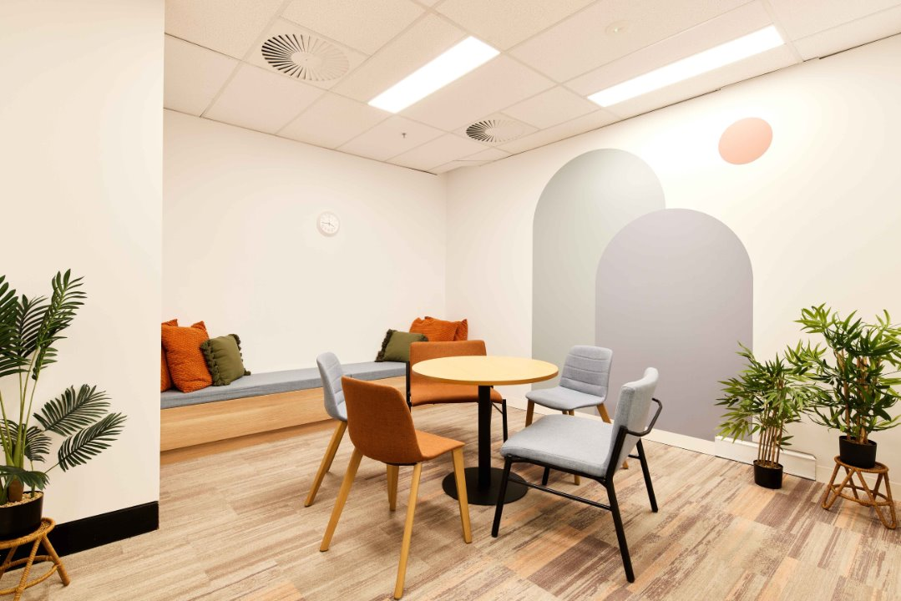
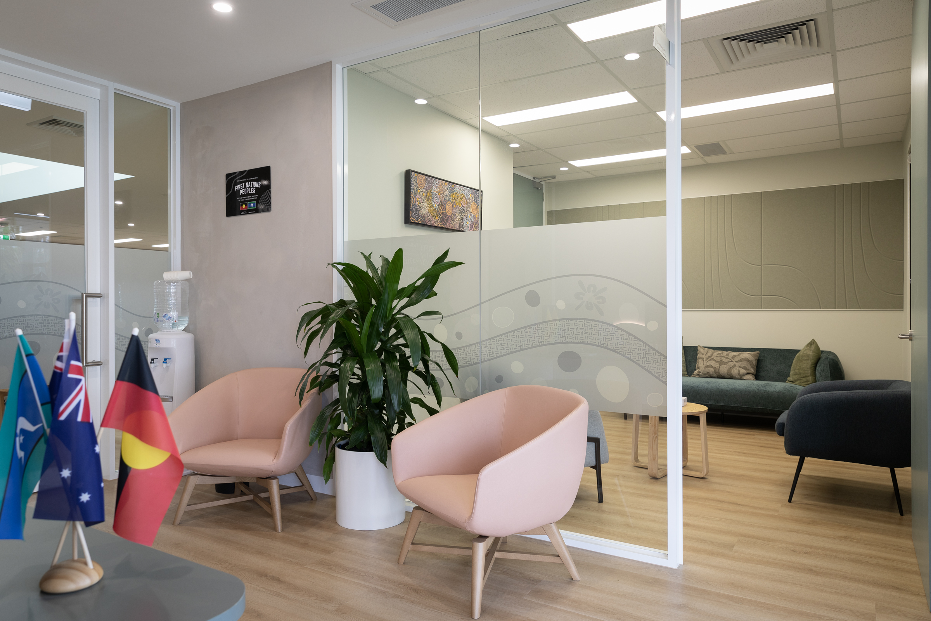
Key features
Local Services provide high quality treatment, care and support to people 26 years and over experiencing mental illness or psychological distress whose needs are too intensive for primary and secondary care alone but do not require intensive care from tertiary Area Mental Health and Wellbeing Services. ​
This includes integrated treatment, care and support for people with a mental illness and co-occurring substance use or addiction, co-existing disability and trauma. ​
Local Services are a welcoming front door that can be accessed without a referral or a Medicare card.
Duration of treatment, care and support based on the consumer needs and preferences and availability of alternative mental health services.​
Photo sources: Mental Health and Wellbeing Locals in Frankston and Latrobe

Slide 5
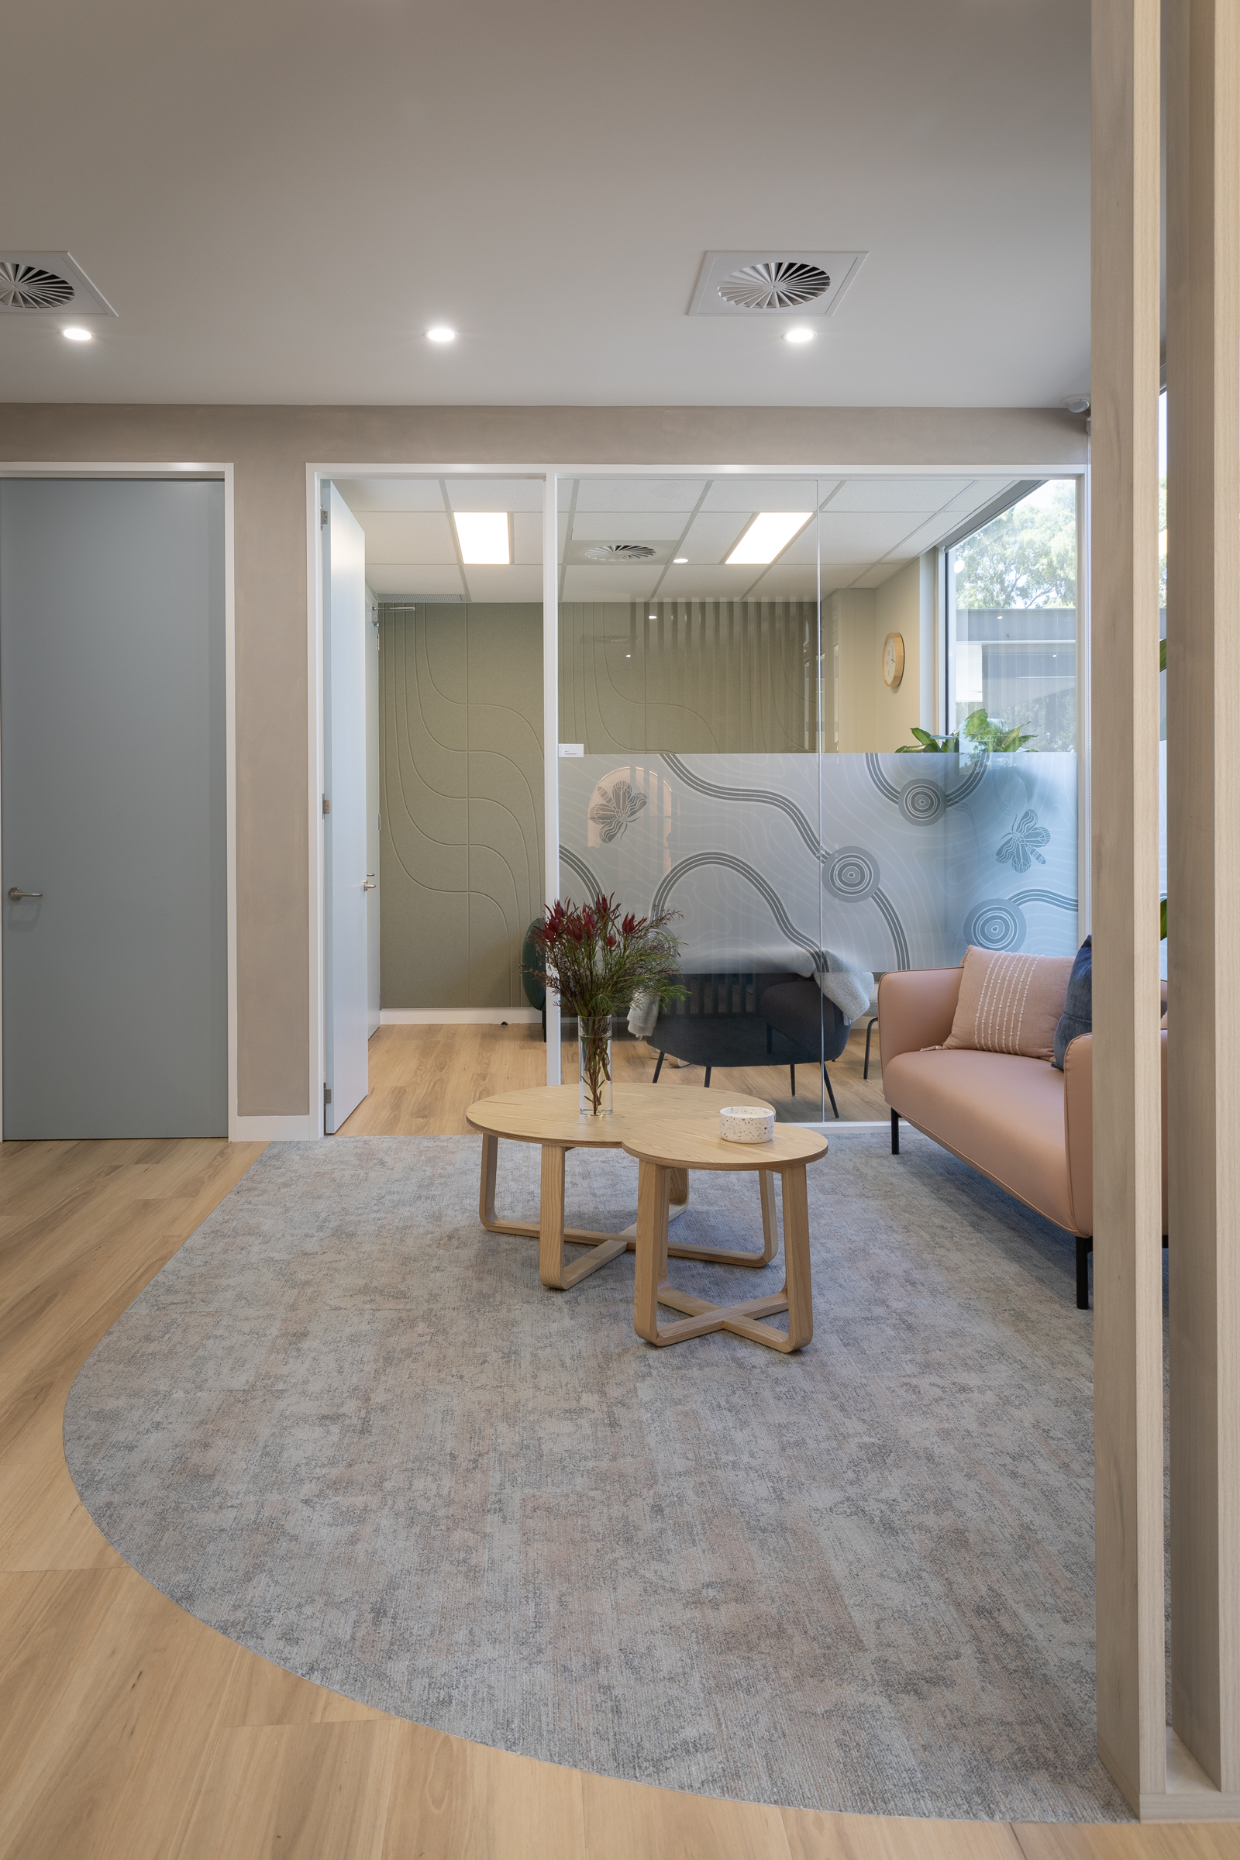
Referral Pathways
Service Framework guides the operation and service delivery of Local Services across Victoria.
Providers are to:
develop and maintain referral pathways with local health, social and community services.
support effective shared care arrangements for consumers receiving concurrent treatment and support from other service providers, such as (but not limited to) private primary and secondary mental health care providers (including general practitioners).
provide primary and secondary consultation to primary and secondary mental health care providers to support shared care.
Referral pathways from primary and secondary mental health care providers will be facilitated through the common use of the Initial Assessment and Referral (IAR) tool.
Photo source: Mental Health and Wellbeing Local in Whittlesea

Slide 6
Referral pathways with primary and secondary health care providers
Primary and secondary mental health and related services
For example: GPs, allied health
Short term or ongoing coordination
Initial support discussion
Mental Health and Wellbeing Locals
Comprehensive needs assessment and planning discussion
Support needs within the scope of local services
Area Mental Health and Wellbeing Service
High intensity support needs or assessment complexity
Short term or ongoing coordination
Adapted from Royal Commission into Victoria’s Mental Health System, Final Report, Vol 1, Figure 8.3, p. 472

Slide 7
Mental Health and Wellbeing Locals – Locations 1-6
Service areas and providers | Sites | Services | Modes
Benalla-Wangaratta-Mansfield Wellways in partnership with ACSO and Albury Wodonga Health | Benalla – permanent Wangaratta - interim Mansfield – permanent | Wellbeing supports Clinical supports | Face-to-face incl. walk in Phone Telehealth Outreach Group sessions
Brimbank cohealth in partnership with Clarity Health, University of Melbourne | Sunshine – permanent | Wellbeing supports Clinical supports | Face-to-face incl. walk in Phone Telehealth Outreach (group and 1:1) Group sessions
Frankston Wellways with Mentis Assist and Peninsula Health | Frankston – permanent | Wellbeing supports Clinical supports | Face to face incl. walk in Phone Telehealth Outreach Group sessions
Greater Geelong-Queenscliffe Barwon Health in partnership with Wellways, ermha365, Wathaurong Aboriginal Co-operative | Geelong CBD – permanent | Wellbeing supports Clinical supports | Face-to-face incl. walk in Phone Telehealth Outreach Group sessions
Latrobe Neami National in partnership with Drummond St, Uniting Vic Tas | Morwell – permanent | Wellbeing supports Clinical supports | Face-to-face incl. walk in Phone Telehealth Outreach Group sessions
Whittlesea Neami National in partnership with Drummond St, Uniting Vic Tas and VAHS | South Morang – permanent | Wellbeing supports Clinical supports | Face-to-face incl. walk in Phone Telehealth Outreach Group Sessions

Slide 8
Mental Health and Wellbeing Locals – Locations 7-15
Service areas and providers | Services | Modes
Bairnsdale and Orbost, servicing East Gippsland Wellways Australia in partnership with Gippsland Lakes Complete Health and Latrobe Regional Health | Wellbeing supports Limited clinical supports | Face to face by appt – Bairnsdale Phone Telehealth Outreach
Bendigo and Echuca, servicing Greater Bendigo-Loddon-Campaspe Mind Australia in partnership with Bendigo & District Aboriginal Co-operative, Bendigo Health, Echuca Regional Health, The Salvation Army and Thorne Harbour Health Ltd | Wellbeing supports Limited clinical supports | Face-to- face incl. walk in (limited) Phone Telehealth Outreach Group sessions (Bendigo)
Dandenong, servicing Greater Dandenong Mind Australia in partnership with Monash Health, The Victorian Foundation for Survivors of Torture Inc. and Thorne Harbour Health Ltd | Wellbeing supports Limited clinical supports | Face-to- face incl. walk in (limited) Phone Telehealth Outreach
Shepparton, servicing Greater Shepparton-Strathbogie-Moira Wellways Australia in partnership with APMHA Healthcare Ltd and Goulburn Valley Health | Wellbeing supports Limited clinical supports | Face-to-face incl. walk in Phone Telehealth Outreach
Melton, servicing Rural City of Melton Mind Australia in partnership with IPC Health, MidWest Area Mental Health Service, Thorne Harbour Health Ltd and Western Health | Wellbeing supports Limited clinical supports | Phone Telehealth Outreach
Mildura servicing Rural City of Mildura Wellways Australia in partnership with Mallee District Aboriginal Services, Mildura Base Public Hospital and Sunraysia Community Health Services | Wellbeing supports Limited clinical supports | Face-to-face incl. walk in Phone Telehealth Outreach
Lilydale, servicing Yarra Ranges Wellways Australia in partnership with Eastern Health, Inspiro and Oonah Belonging Place | Wellbeing supports Limited clinical supports | Face-to-face incl. walk in Phone Telehealth Limited Outreach

Slide 9



Other community based mental health and wellbeing services

Slide 10




Greater Geelong & Borough of Queenscliffe
Observations from consumer presentations at the Greater Geelong, Queenscliffe Local Service
Future adaptations to meet consumers where they are at, and to support the ‘no wrong door’ approach.
Continuous improvement at the Greater Geelong, Queenscliffe Local Service

