Slide 1
Medical Termination of Pregnancy
28 August 2025
Jill Butty
Director Women’s Health and Population Wellbeing

Slide 2


The Therapeutic Goods Administration (TGA) amendment has improved access to MS-2 Step (Mifepristone and Misoprostol)
In July 2023, the Therapeutic Goods Administration removed restrictions that had previously only allowed GPs and medical specialists to prescribe Mifepristone and Misoprostol (MS-2 step).
In Victoria this now means that Nurse Practitioners and Endorsed midwives can supply, administer and prescribe this drug in accordance with Victorian legislation.
Further, restrictions on supply that limited access to registered pharmacists have also been lifted.
The approved indication for MS-2 Step recommends that the duration of pregnancy (i.e., up to 63 days gestation) to be confirmed by ultrasound. RANZCOG guidelines recommend that the gestational age of the pregnancy be determined by clinical means or by ultrasound scan.
If an ultrasound is not possible, the last menstrual period date can be used, but with caution as gestation accuracy cannot be guaranteed. Ultrasound is beneficial to exclude ectopic pregnancy.

Slide 3
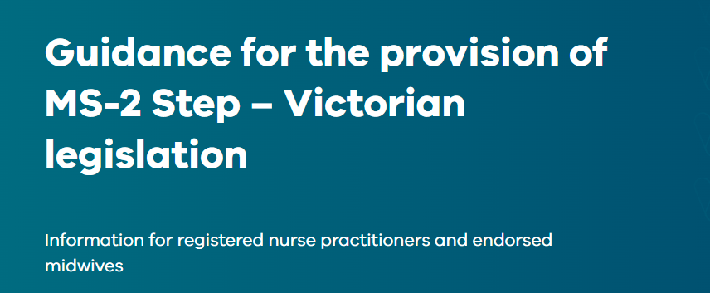
Clinical Guideline - Guidance for the provision of MS-2 Step
Guidance for the provision of MS-2 Step – Victorian legislation | Safer Care Victoria

Slide 4
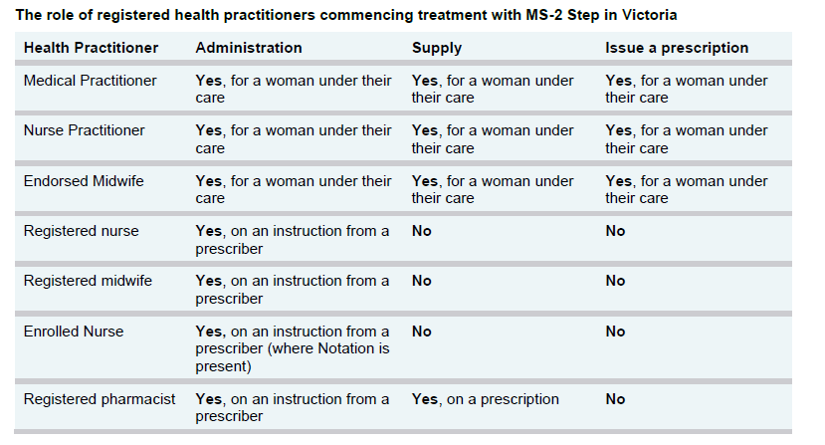
Roles for Registered Health Practitioners

Slide 5
Termination of Pregnancy
Across the 20 Sexual and Reproductive Healthcare hubs in the state in 2024/25 there were 4,434 services related to termination of pregnancy, including:
      1,626 Medical Termination of Pregnancy (MTOP)
      2,078 MTOP counselling
      1,074 referrals for Surgical Termination of Pregnancy

Slide 6
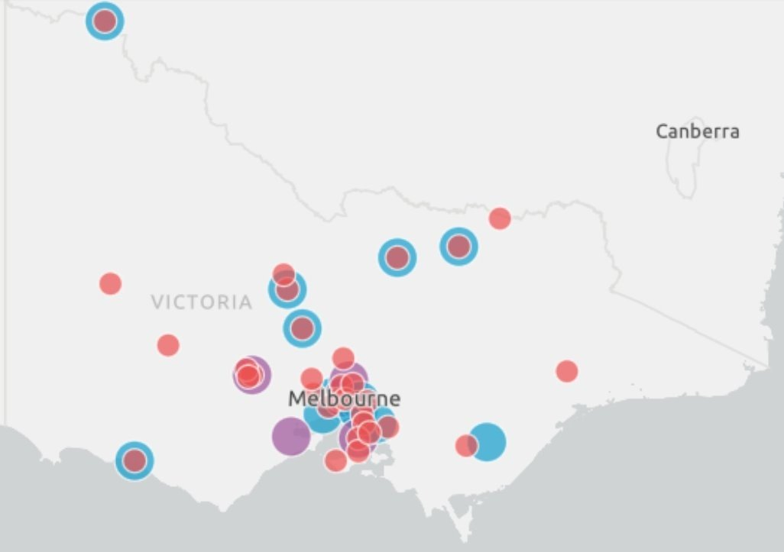
SRH Hubs and Women’s Health Clinics
SRH Hubs and Women’s Health Clinics
20 x Women’s SRH Hubs
5 x WH clinics opened 2024
15 x WH clinics recently established (2025) and proposed

