Slide 1
Growing GPs’ capacity for Eating Disorder Management
Dr Susan Barnett
GP Psychotherapist and Medical Educator
Tuesday 3rd December 2024

Slide 2
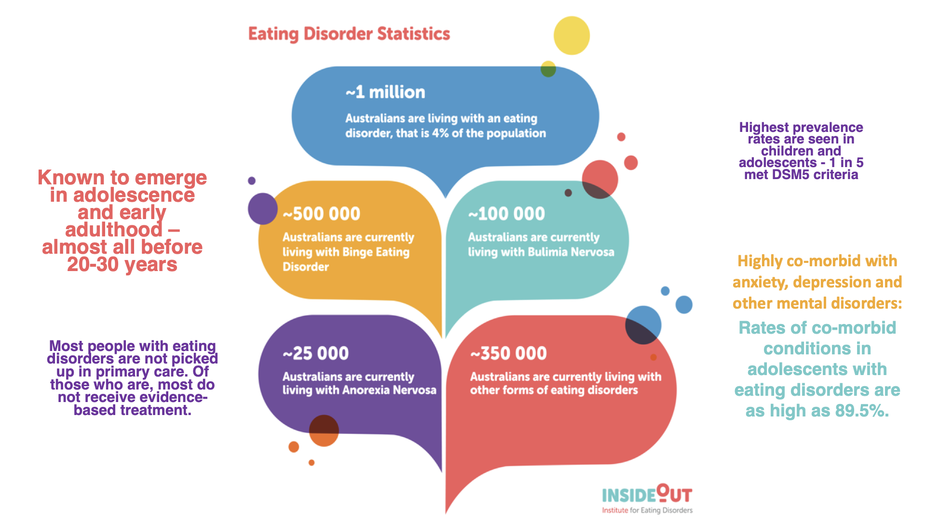
Notes:
Annemarie to introduce herself

Slide 3
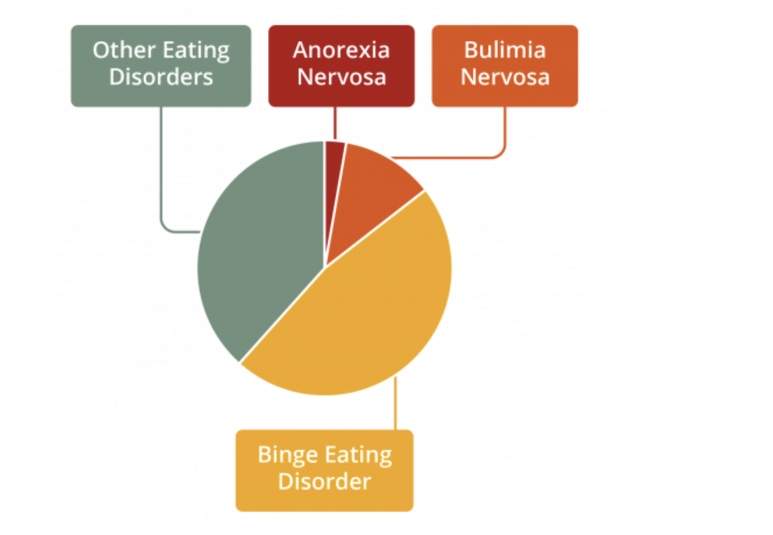
Notes:
Read out

Slide 4
GPs are integral in providing care to patients suffering from eating disorders

Slide 5
The role of GPs
Prevent eating disorders through early intervention and patient education
Identify Eating disorders by recognising early warning signs/ opportunistically screening at risk groups
Assess, diagnose and medical manage ED presentations
Refer for ED specific treatment
Co-ordinating with the care team across the course of treatment
Support/Education Family and loved ones
Relapse prevention

Slide 6
Identification
How to get the right history when patient often presents with undifferentiated symptoms?

Slide 7
Consider if…
Anxiety/Depression
Self-harm/Suicidal ideation
GIT issues
Period issues
Headaches
Fainting/dizzy spells
Nutritional deficiencies
Parental concerns -ask to see comparison photos
Non-healing sports injuries and chronic pain
Transition times e.g. menopause and perinatal
I’m tired

Slide 8
Patient may also have…
Mood esp anxiety
Autism Spectrum Disorder **
OCD
ADHD
Alcohol and other drugs
Personality disorder
Complex trauma
Gender and Sexual issues
Family Violence

Slide 9
Murtagh’s Diagnostic Probability model The diagnostic model for a presenting problem
Questions to ask oneself:
What is the probability diagnosis?
What serious disorders must not be missed?
What conditions ae often missed (the pitfalls)
Could the patient have one of the classic masquerades?
Is the patient trying to tell me something?

Slide 10
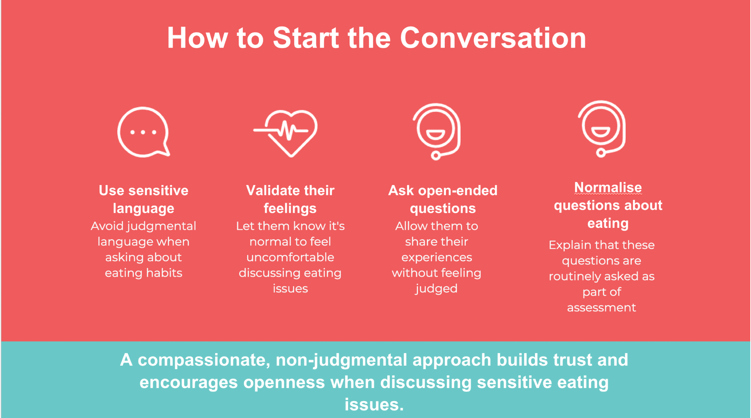

Slide 11
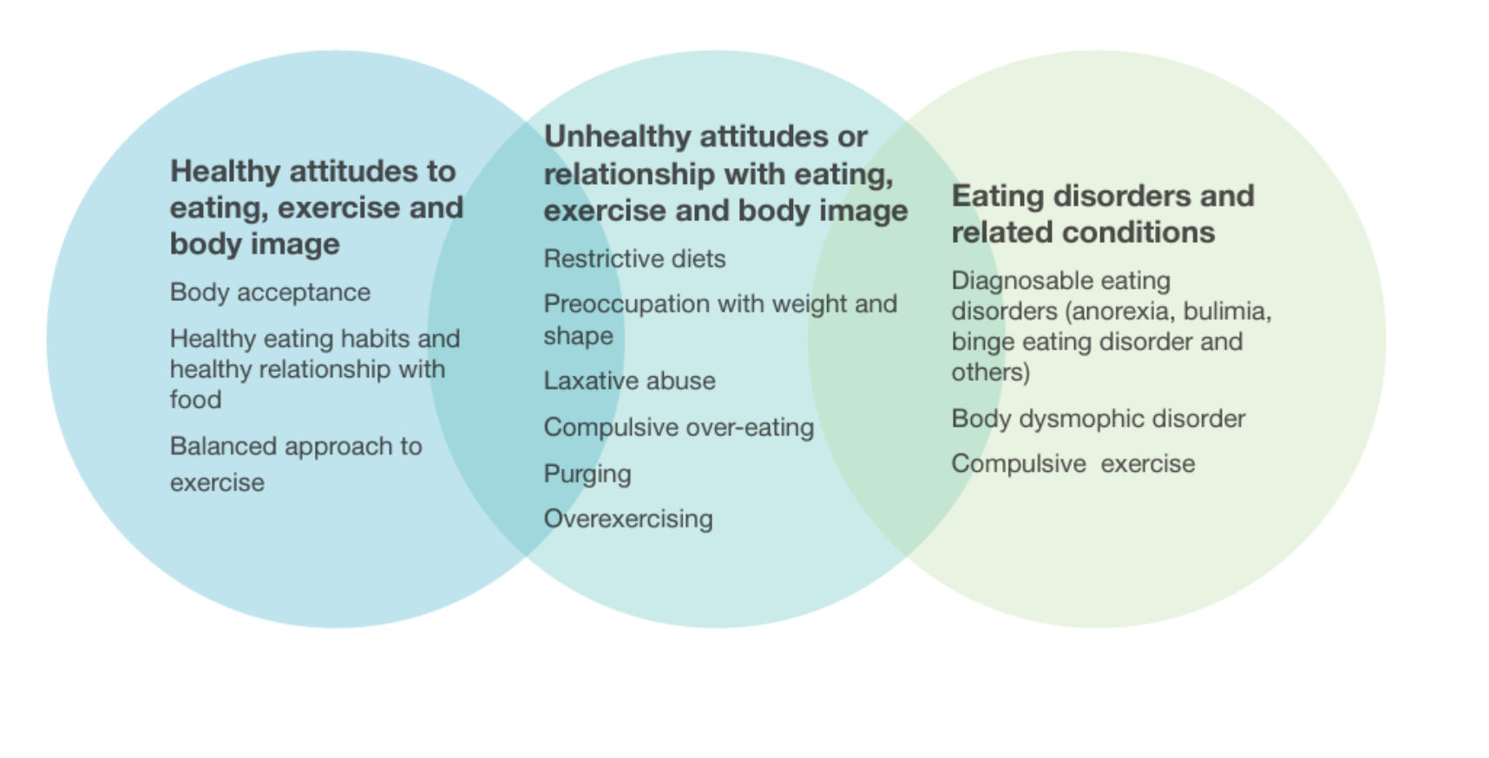
Do you have a healthy relationship with?
FOOD
BODY
MOVEMENT

Slide 12
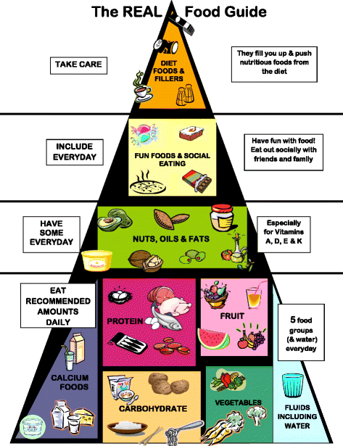
Do you have a healthy relationship with FOOD?
The R.E.A.L. Food Pyramid
The Recovery from Eating Disorders for Life Food Pyramid The REAL Food Pyramid has been created as a meal planning guide for individuals with eating disorders.
It is ideal if it is used in collaboration with a dietitian, as every person is unique, and there may be foods or amounts that need to be adjusted for you.
www.cci.health.wa.gov.au
Notes:
chrome-extension://efaidnbmnnnibpcajpcglclefindmkaj/https://www.cci.health.wa.gov.au/~/media/CCI/Mental-Health-Professionals/Eating-Disorders/Eating-Disorders---Information-Sheets/Eating-Disorders-Information-Sheet---The-REAL-Food-Pyramid.pdf

Slide 13
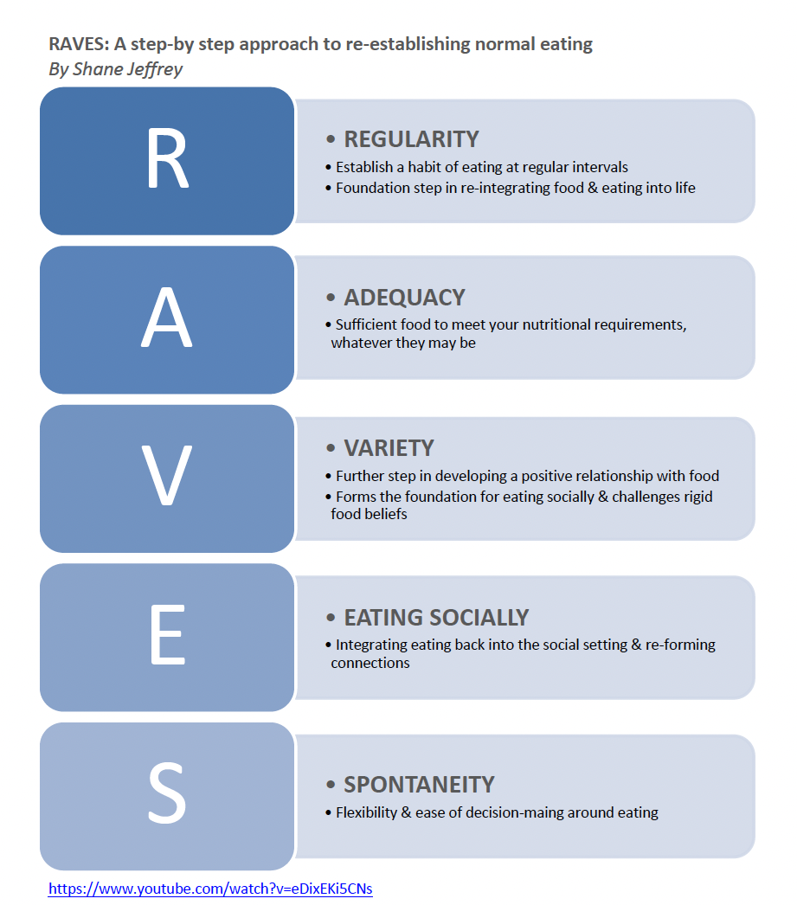
RAVES: A step-by-step approach to re-establishing normal eating
By Shane Jeffrey

Slide 14
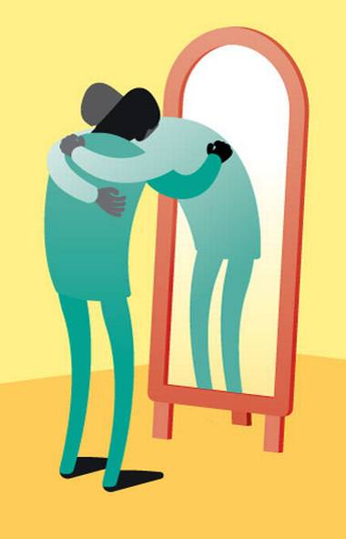

Do you have a healthy relationship with your BODY?

Slide 15

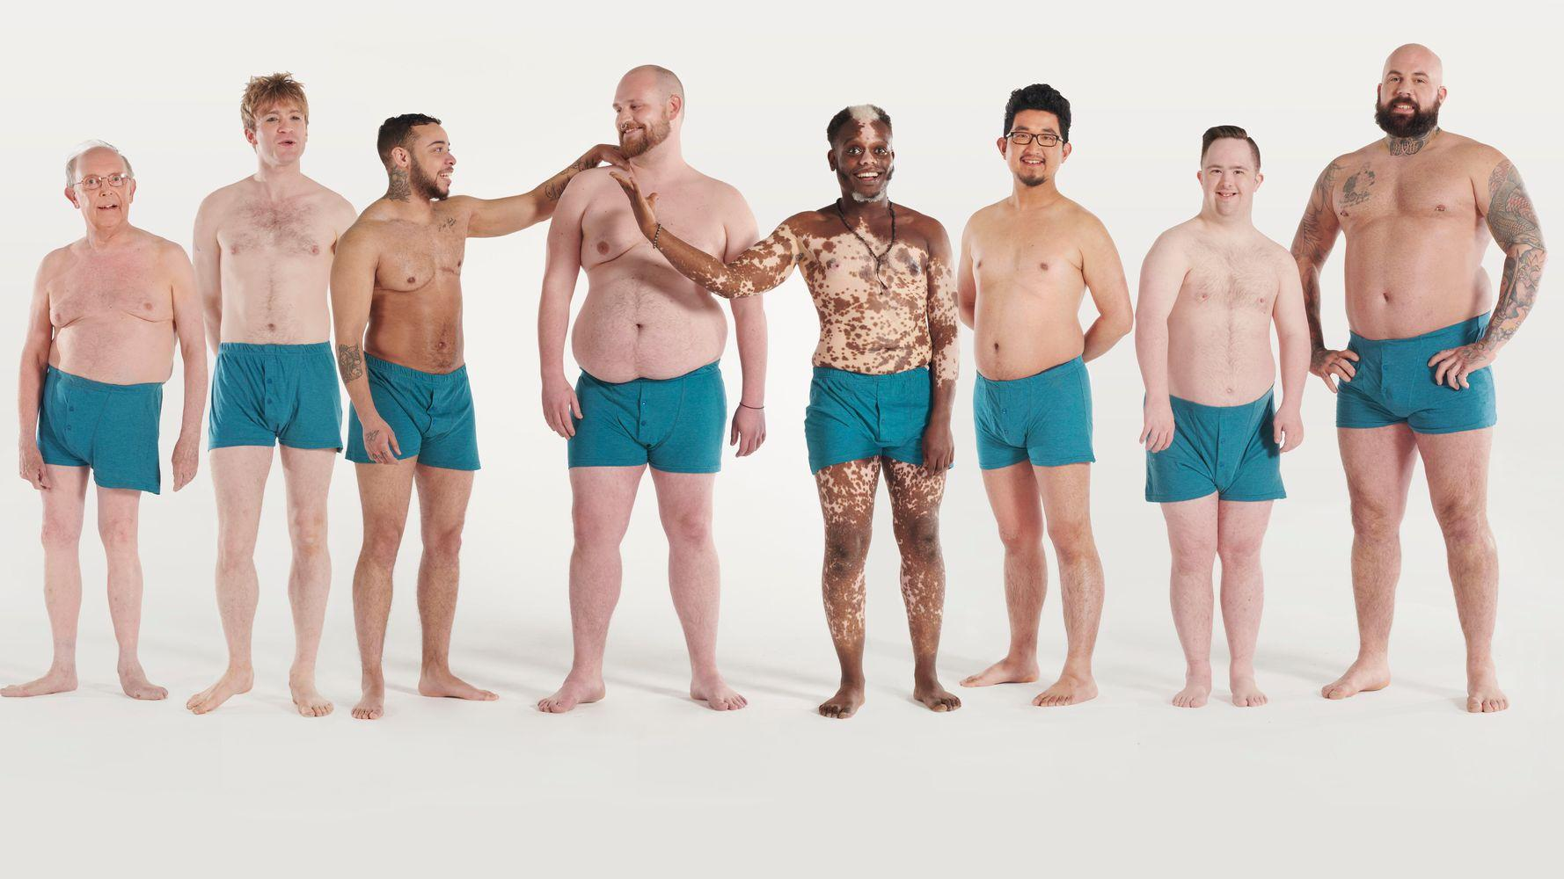
RESPECT
ACCEPT
APPRECIATE

Slide 16
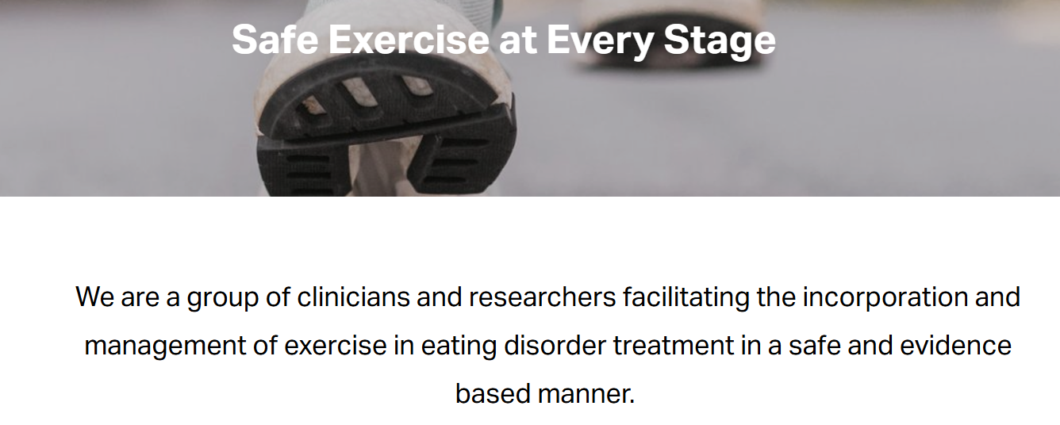
Do you have a healthy relationship with MOVEMENT?
www.safeexerciseateverystage.com

Slide 17
Psychoeducation is crucial
To begin with and ongoing…….
It is not you or their fault.
No-one would choose to suffer from an eating disorder.

Slide 18
Psychoeducation Involves
Explain the neuroscience of the brain simply
Starvation syndrome
What helps an ED persist
What changes need to happen to recover from an ED
What may the recovery journey look like
It takes time
No quick fix
The importance of a team approach
The importance of learning self-compassion
*OUR SOCIETY HAS A FAT BIAS – EXPLORE THIS WITH THE FAMILY/SUPPORTS*

Slide 19

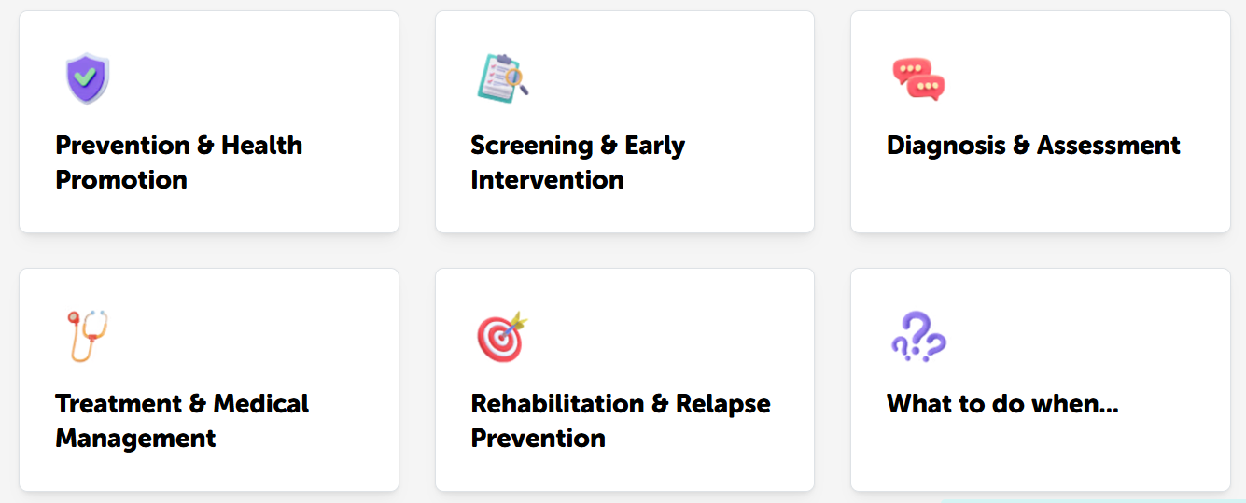
Medical assessment and management
https://insideoutinstitute.org.au

Slide 20
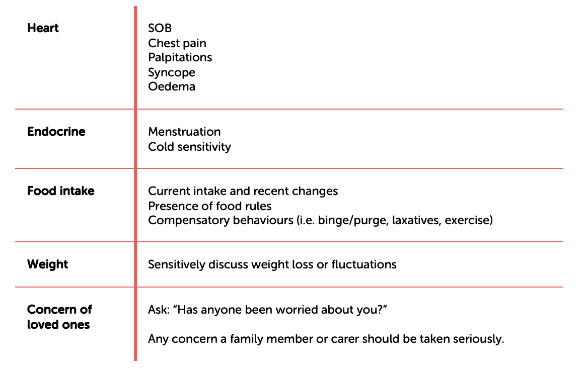
Rapidly assess risk

Slide 21
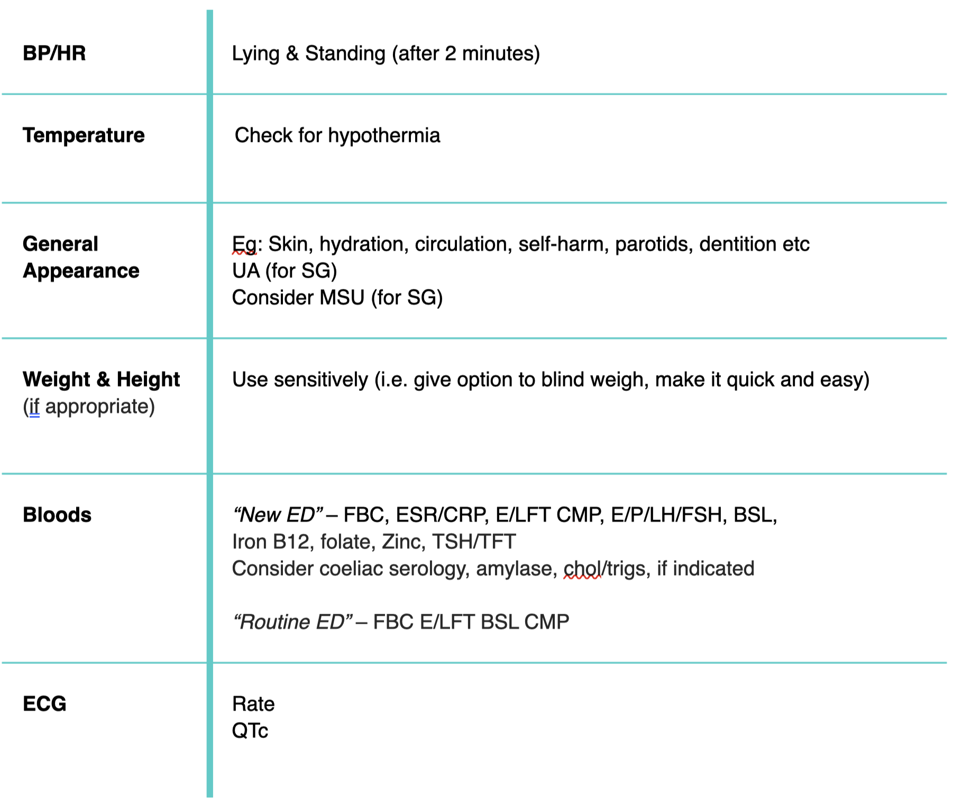
Physical examination

Slide 22
When to worry
Weight Rapid loss (i.e. 1kg weekly for 3 weeks)
CV Bradycardia
Postural drop and tachy
Hypotension if new or profound
Hypothermia
Bloods BSL, K, PO4, neutrophiles
Weights and height (if appropriate) Use sensitivity (i.e. ask permission to weigh, give options to blind weight, make it quick and easy)
Psych Suicidality

Slide 23
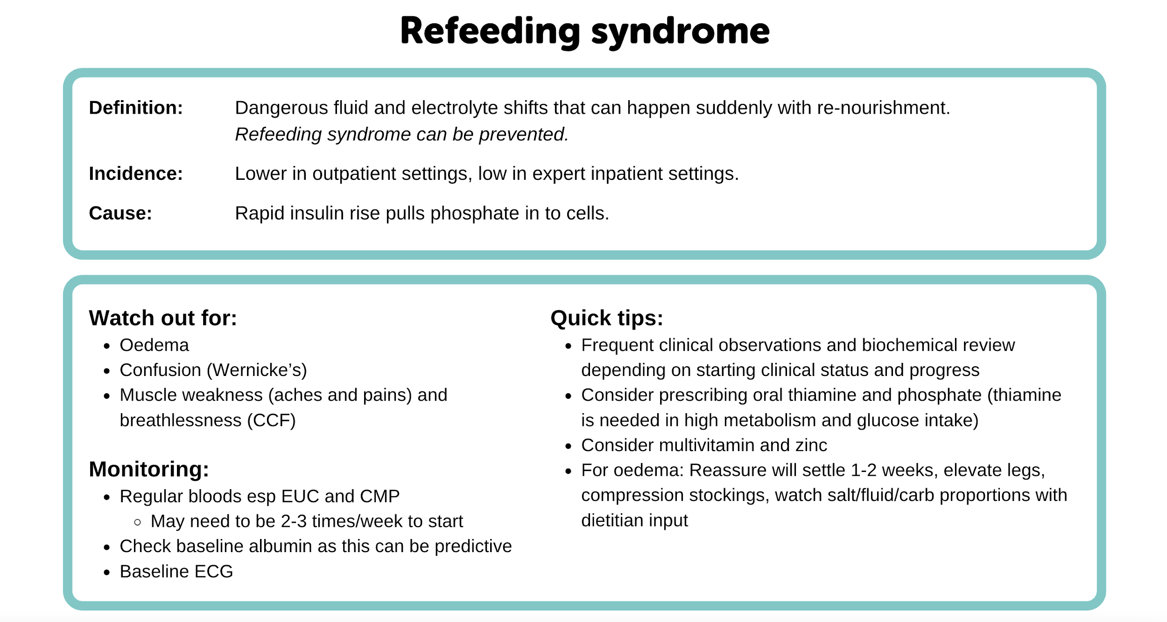


Slide 24
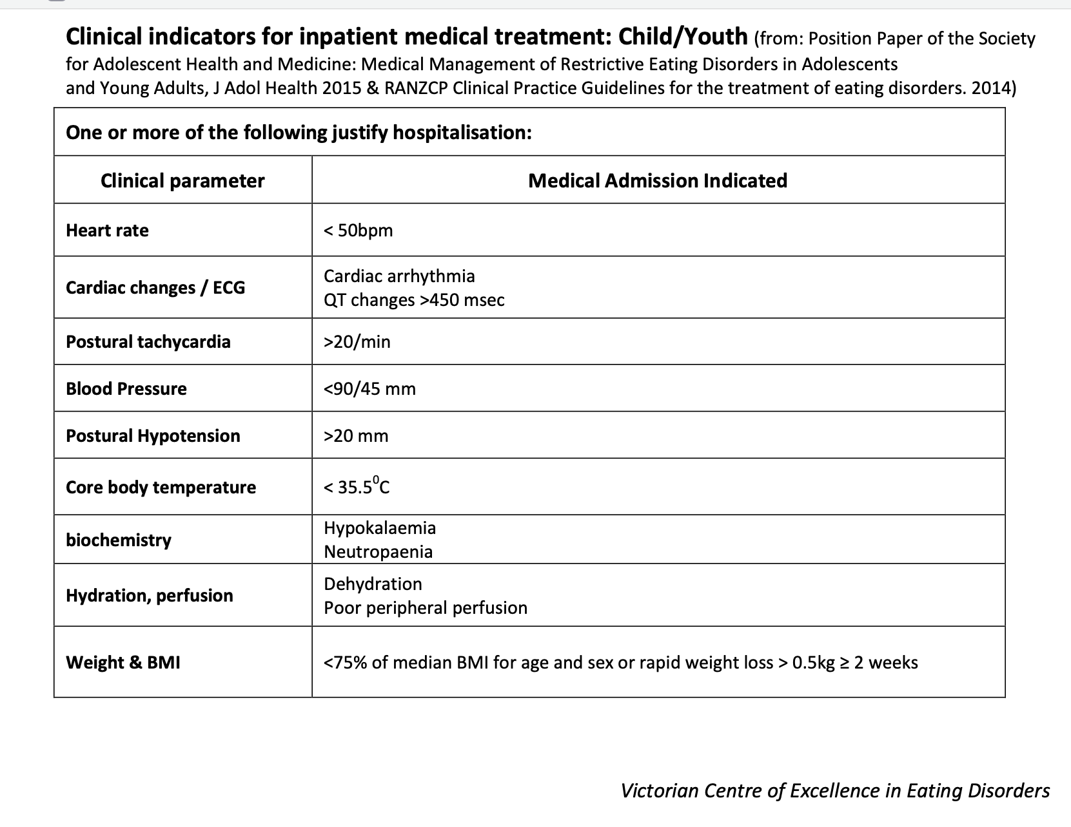
Clinical indicators for inpatient medical treatment

Slide 25
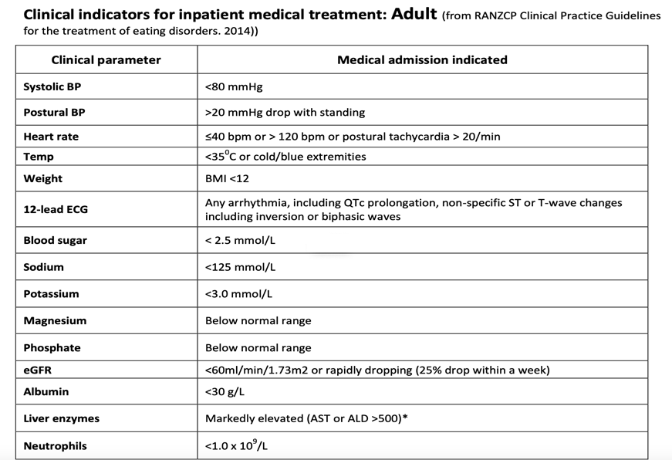

Slide 26
Creating a team is vital
To begin with and ongoing…….
Do not do this alone
Work out how to communicate
Utilise case conferences
Ideally refer to credentialled clinicians

Slide 27
Who could be on the team?
GP
Mental Health Professional
Dietitian
Psychiatrist
Paediatrician
Recovery Coach
Peer support worker
Dentist
Physiotherapist
Pelvic Floor Physio
ED outpatient staff ?
Gastroenterologist
Endocrinologist
Cardiologist
Exercise Physiologist
Speech pathologist
Podiatrist
Parents
Partner
Pet
Friends?
Teacher ?
School Counsellor?
Employer ?
Anyone else ????

Slide 28
MUM
GASTRO
PSYCHOLOGIST
TEAM TRACEY
BEST FRIEND
SALLY
DIETITIAN
GP
PSYCHIATRIST
EXE PHYSIOLOGIST
Notes:
Really powerful to draw on paper for your patient -themselves in the circle and who else is around them for support
Even if they only have you -thats one other person -so THEY ARE NOT ALONE
Make it a goal to ensure you create a good solid /collabarative team around your patient
Clarify what their roles are. Clarify what your role is (setting boundaries early)

Slide 29

Thinking systemically

Slide 30
What can a GP do with families?
Choose how much you do ….you need to feel comfortable
Simply listening goes along way
At a minimal organise a session with parents early on and provide psychoeducation
Inform parents of support groups available -encourage +++(a few times if need)
Encourage parents to seek own therapist if struggling
Encourage parents to monitor their own self care - recover can feel like an ultra marathon

Slide 31

Helping parents understand how to externalise this illness is very important

Slide 32
Parents or support person are integral to being on team
Identify what everyone’s role is
Empower parents and patient
Firm but nurturing

Slide 33
A word on the “other” issue
Obesity and Metabolic Syndrome
Think with a HAES (Health at Every Size) mindset
Forget focusing on weight loss

Slide 34
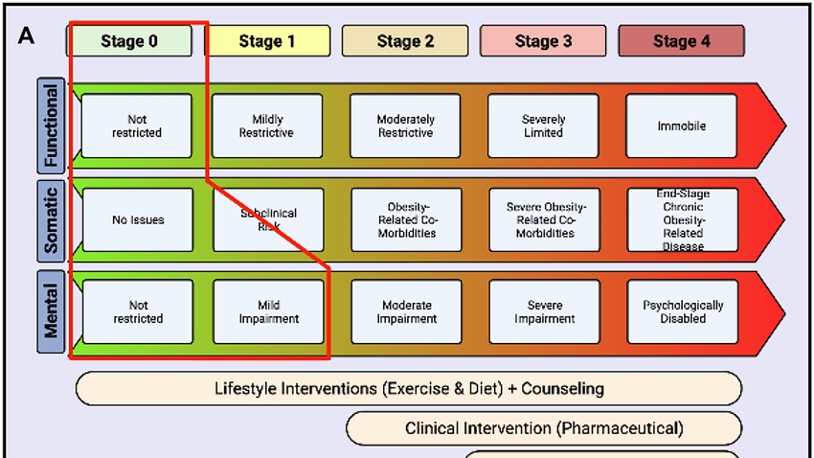
The Edmonton obesity staging system is a strong predictor of increasing mortality independent of BMI, metabolic syndrome and hypertriglyceridemic waist.
Notes:
Thank you to TerriLynne for bringing this to our attention

Slide 35
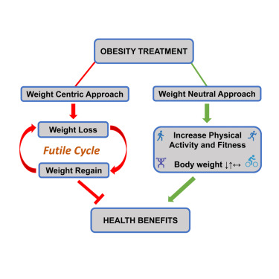
Notes:
Mention Obesity too
Explain how as Gp we are fighting a very strong Diet/ medical culture that promotes wt loss as the answer
HAES mention
1. Weight inclusivity
2. Health enhancement
3. Eating for wellbeing
4. Respectful care
5. Life-enhancing movement

Slide 36
Resources
There are many excellent resources available for us GPs I encourage you all to take the time to become familiar…in the long term it will help

Slide 37
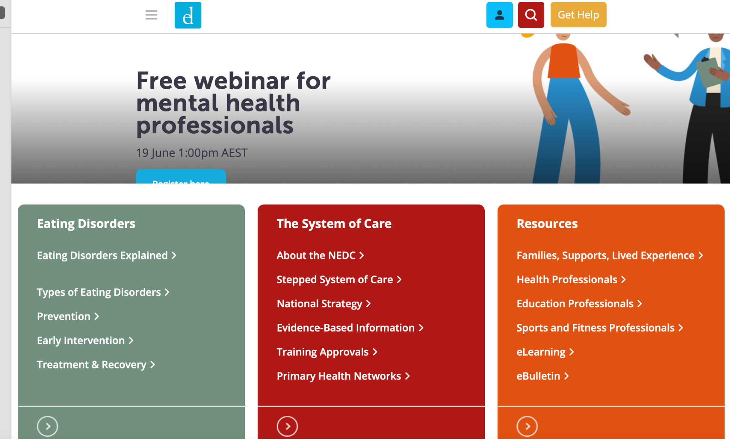



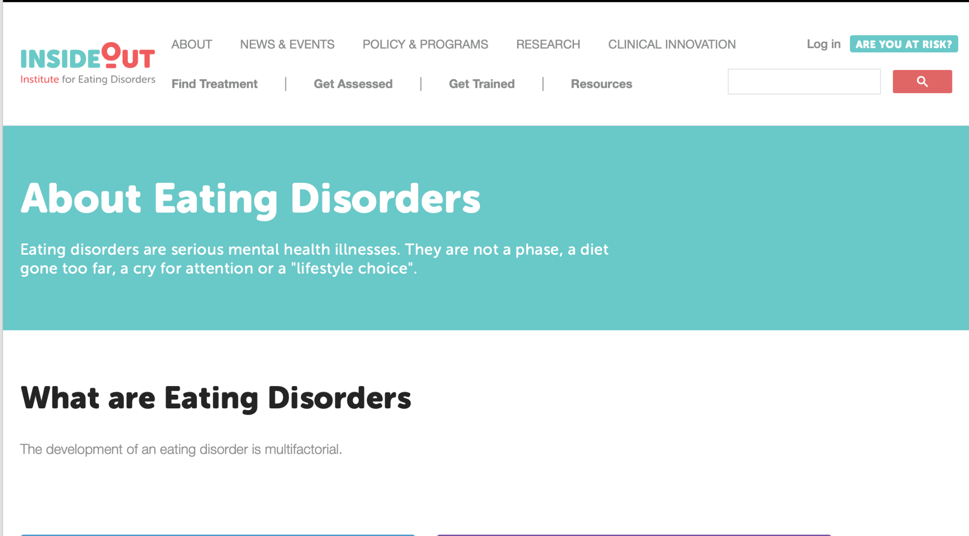

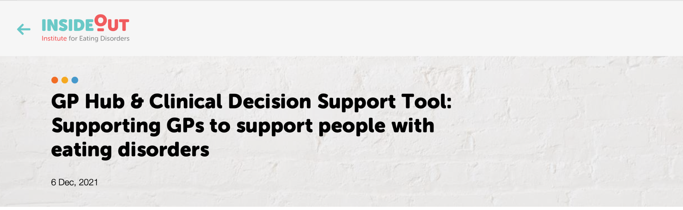

Slide 38
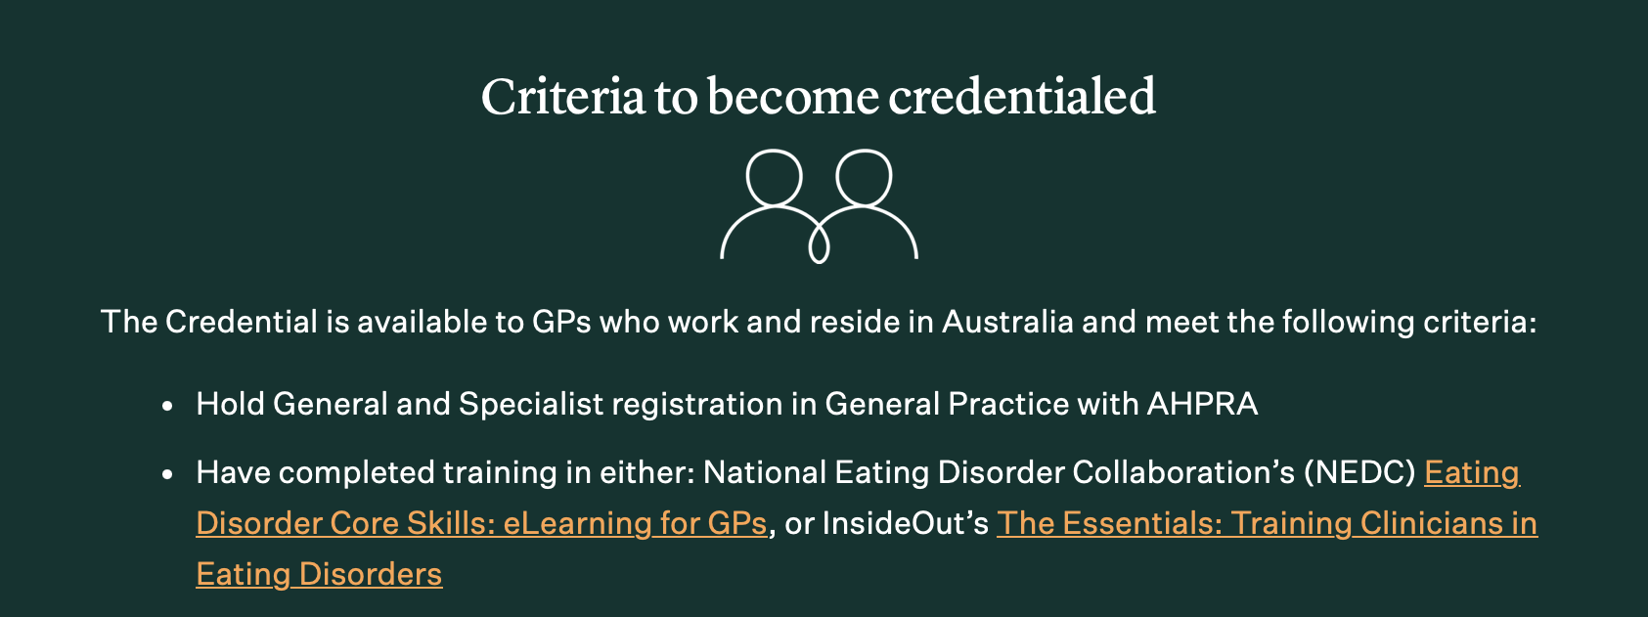


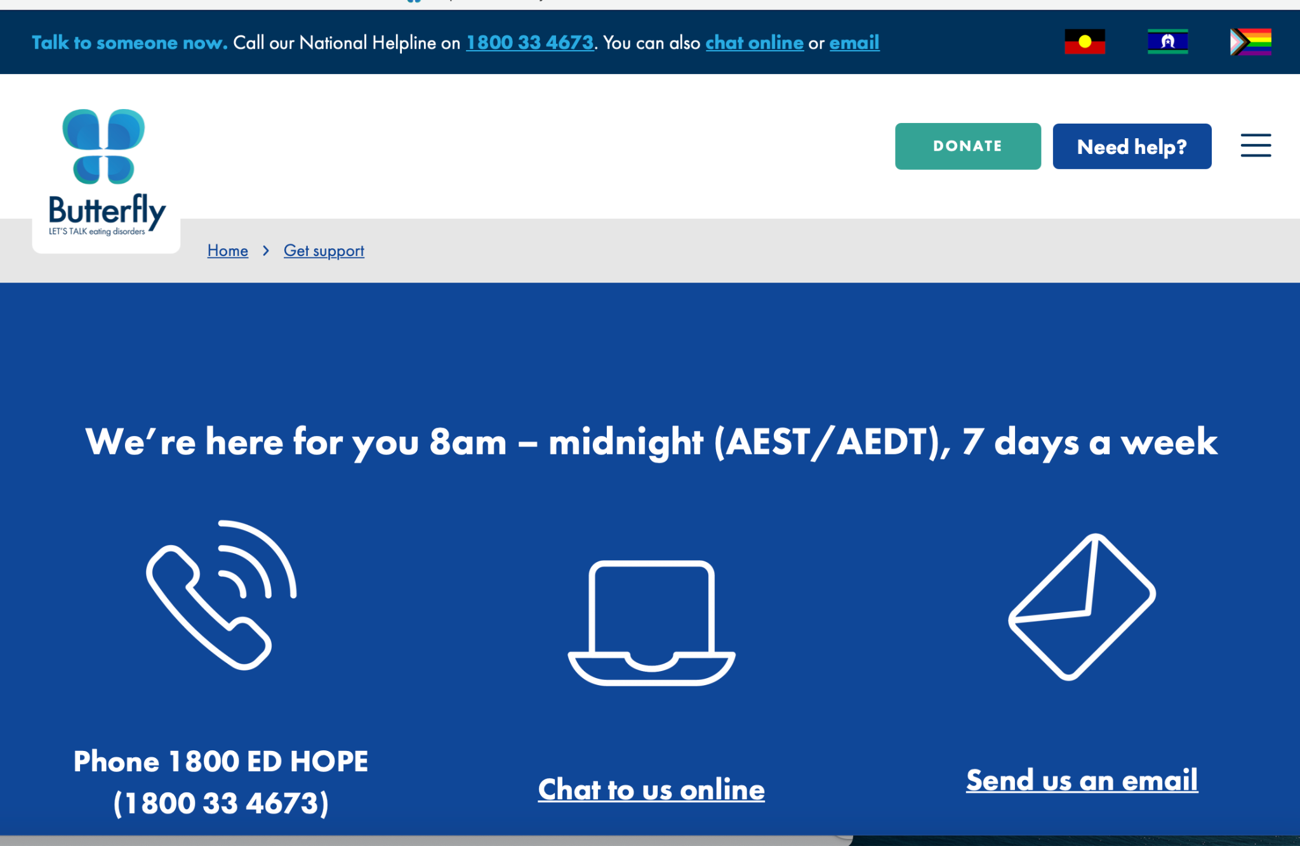
www.cci.health.wa.gov.au

Slide 39

Early intervention incredibly important Recovery can take time Ultra marathon

Slide 40

Always instil hope
Notes:
Mention the advice I have taken forward
May mention CHIME

Slide 41
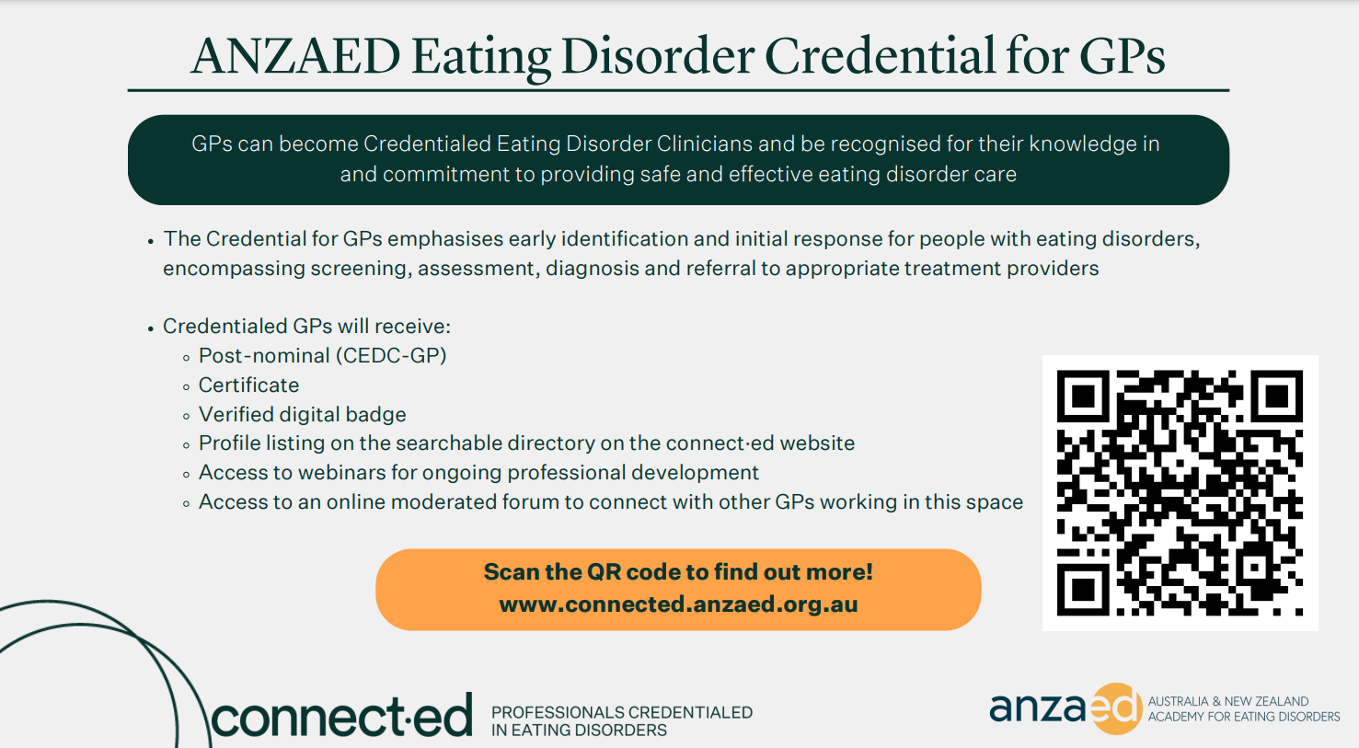

Slide 42

THANK YOU
Notes:
Thankyou

