Slide 1
GP update on medical abortion
Professor Danielle Mazza AM
Head, Department of General Practice, Monash University
Director, NHMRC SPHERE Centre of Research Excellence
Member, Victorian and National Women’s Health Advisory Councils

Slide 2
Learning Objectives
GPs will learn about key recommendations in the new National Abortion Guideline, Victorian Government initiatives supporting better abortion access and what supports are available to them to both provide medical abortion services and refer to where necessary
to become familiar with key recommendations relevant to GPs in the new national Abortion Guideline
to understand how the AusCAPPS network can help support abortion provision in general practice
to become aware of the support provided by 1800 myoptions
to understand how the Victorian Government is supporting increased access to abortion services

Slide 3


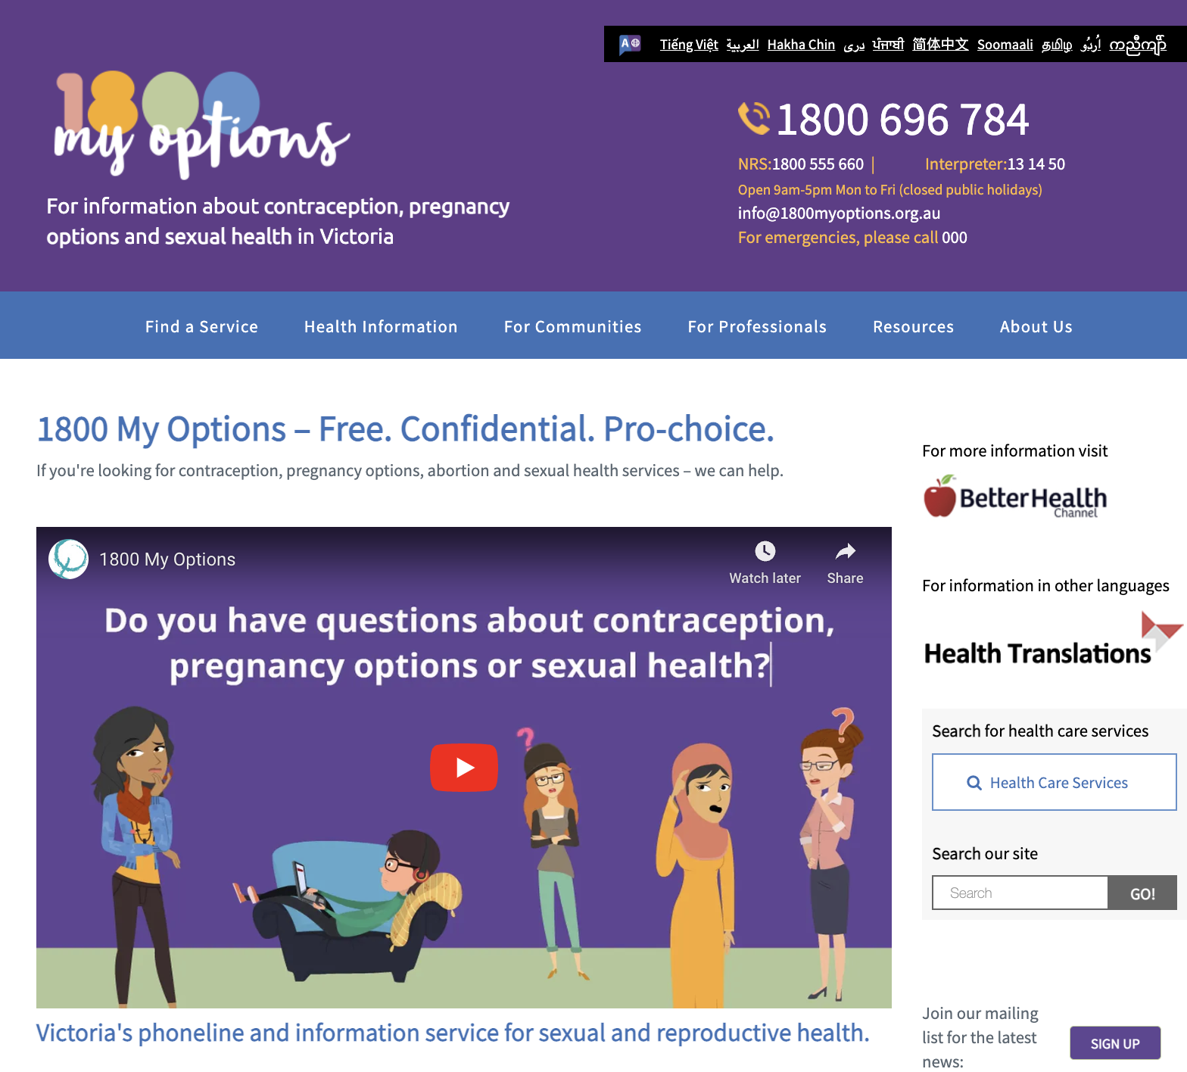
Support for Medical Abortion Providers
https://ranzcog.edu.au/wp-content/uploads/Clinical-Guideline-Abortion-Care.pdf

Slide 4

RANZCOG National Abortion Guideline
Evidence based guideline for Australia and New Zealand
Released Nov 24
Discusses early medical abortion >10 weeks gestation
Endorsed by the RACGP
https://ranzcog.edu.au/wp-content/uploads/Clinical-Guideline-Abortion-Care.pdf

Slide 5
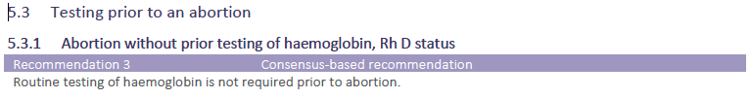
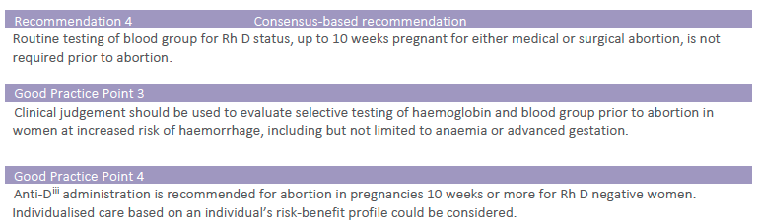
Key updates: No touch no test protocols

Slide 6
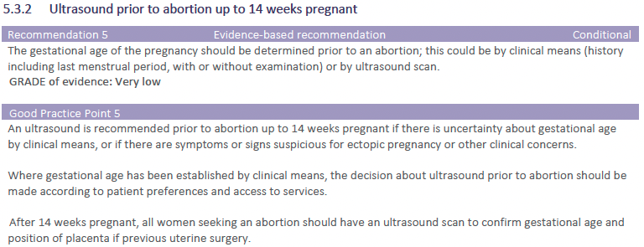
Key updates - Ultrasound

Slide 7
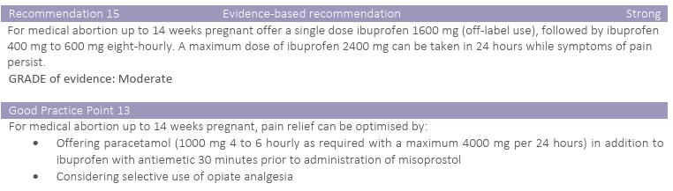
Key updates: Pain Relief Regimen

Slide 8
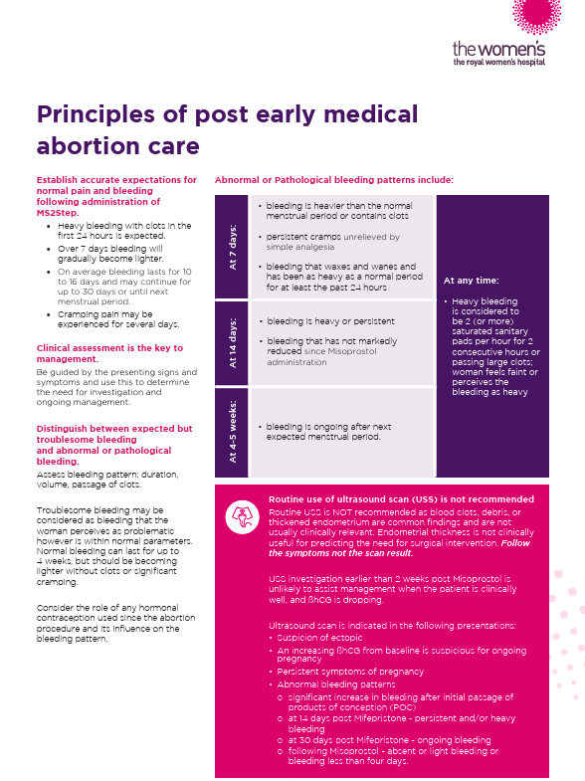
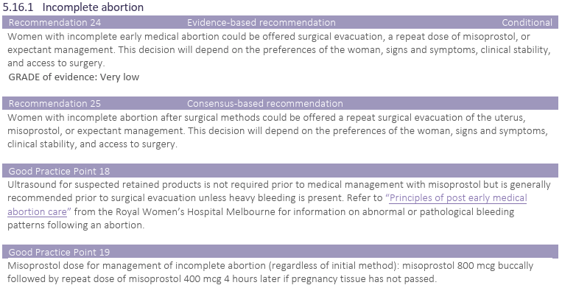
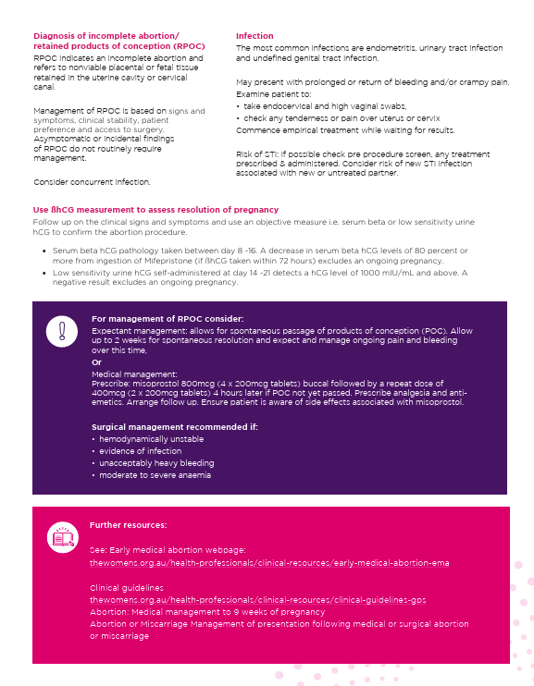
Key Updates: Incomplete abortion
https://thewomens.r.worldssl.net/images/uploads/downloadable-records/clinical-guidelines/Principles_of_follow_up_EMA_care_final_Aug_24.pdf

Slide 9

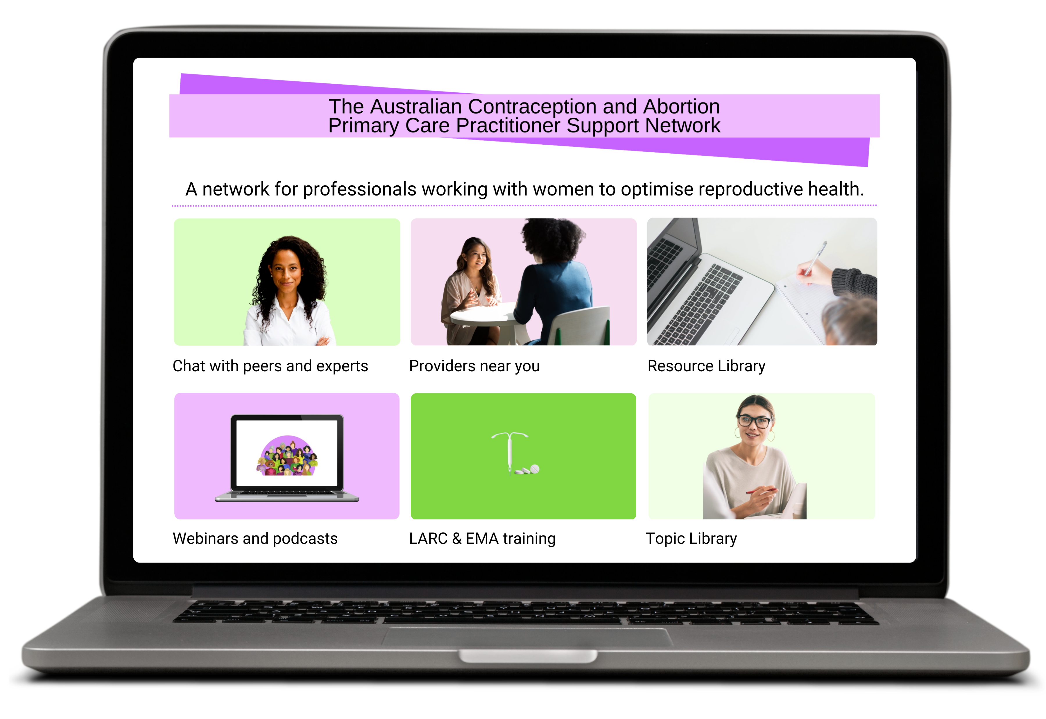
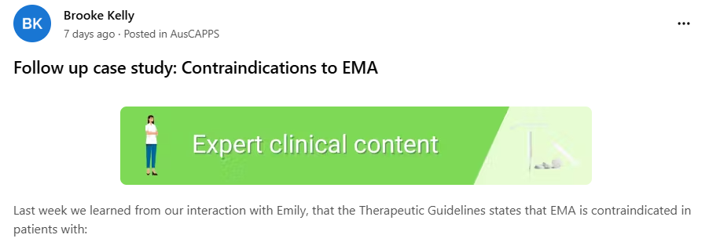
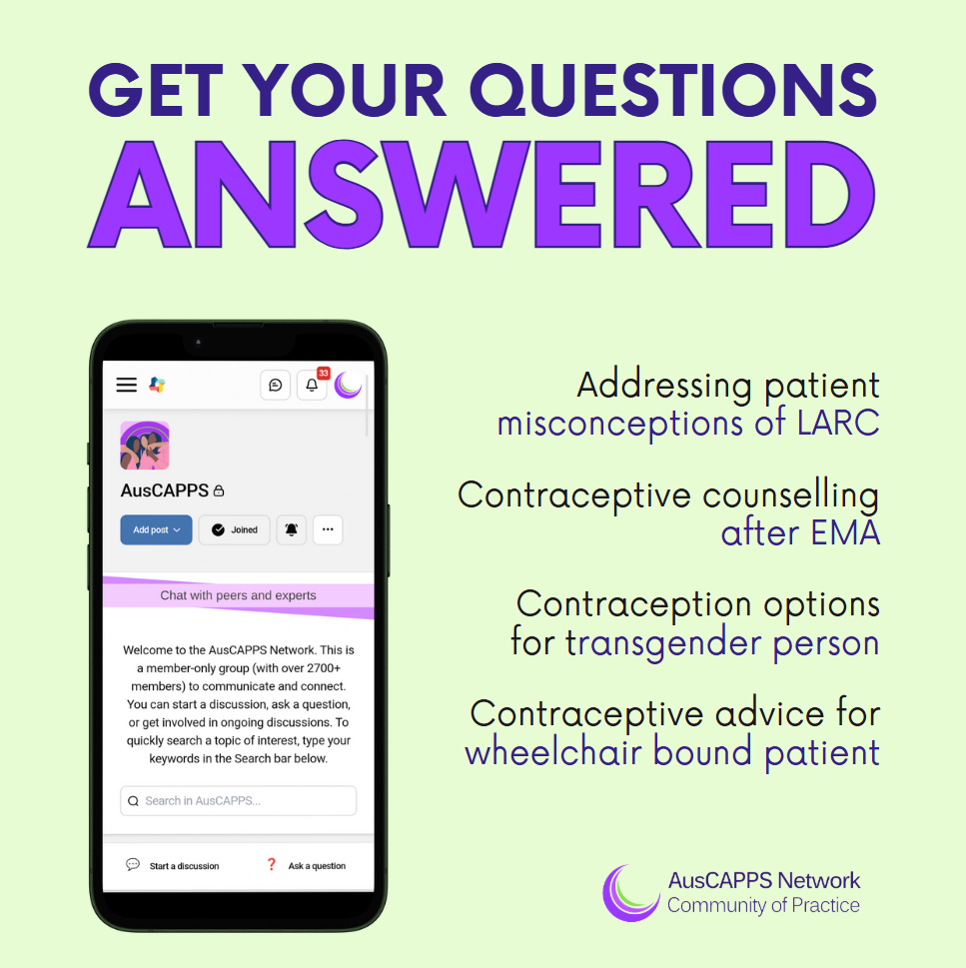
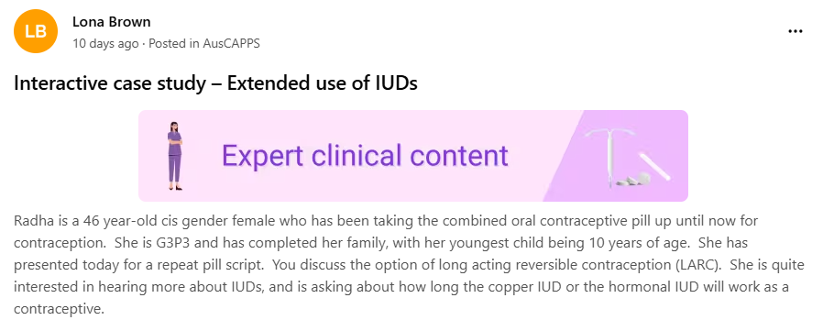
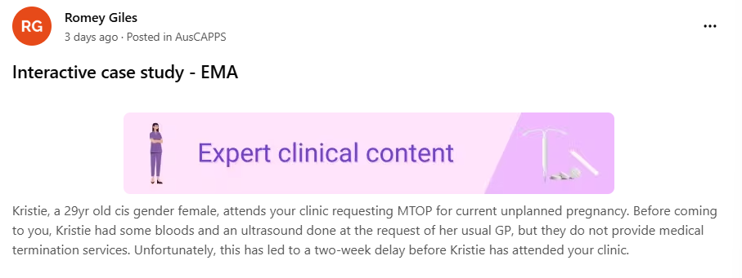
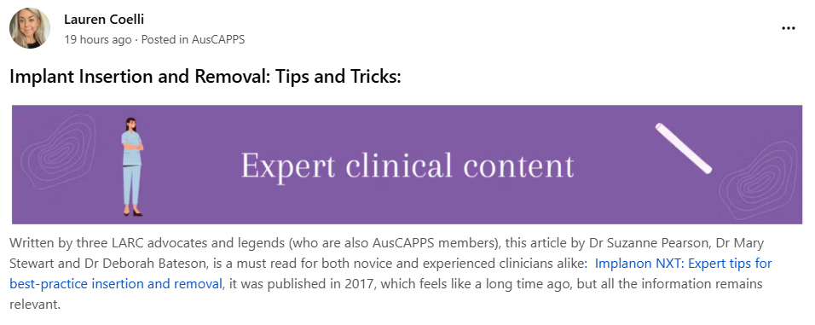
AusCAPPS 2.0
Notes:
Content from clinician leads (GPs, nurse, pharmacist) – support and content from family planning organisation clinicians through SRHA MOU. Developing MOU with ACM for additional clinical content from midwives.
Community members can post questions or start discussions which are supported by AusCAPPS clinical leads
Other pages include resource library, topic library, providers pages, training information, webinars and podcasts

Slide 10












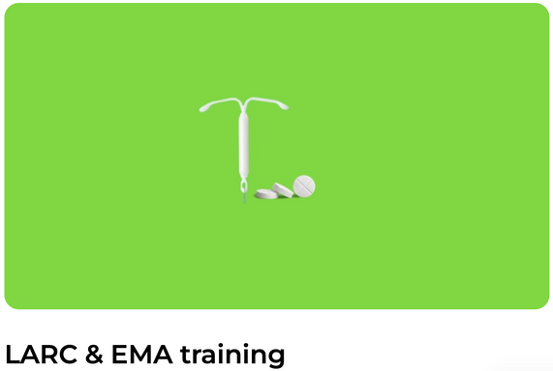































A free online network designed to support primary care clinicians to provide long-acting reversible contraception (LARC) and early medical abortion (EMA) services.
Benefits of joining AusCAPPS
  Connect with GPs, practice nurses, nurse practitioners, midwives, Aboriginal Health Practitioners and community pharmacists who have an interest in providing LARC and/or EMA services in Australia
Join AusCAPPS
  Discuss case studies and chat with peers and expert clinicians
  Find providers near you and build local networks
A network for professionals working with women to optimise reproductive health.
  Get access to the latest evidence-based resources, guidelines, webinars and podcasts
Chat with peers and experts
Providers near you
Resource Library
  Keep up to date with education and training opportunities related to LARC and EMA
Webinars and podcasts
LARC & EMA training
Topic Library
Project partners
The Department of Health, Disability and Ageing is an official partner of AusCAPPS
medcast.com.au/communities/auscapps
AusCAPPS.trial@monash.edu
AusCAPPS Network
AusCAPPS

Slide 11

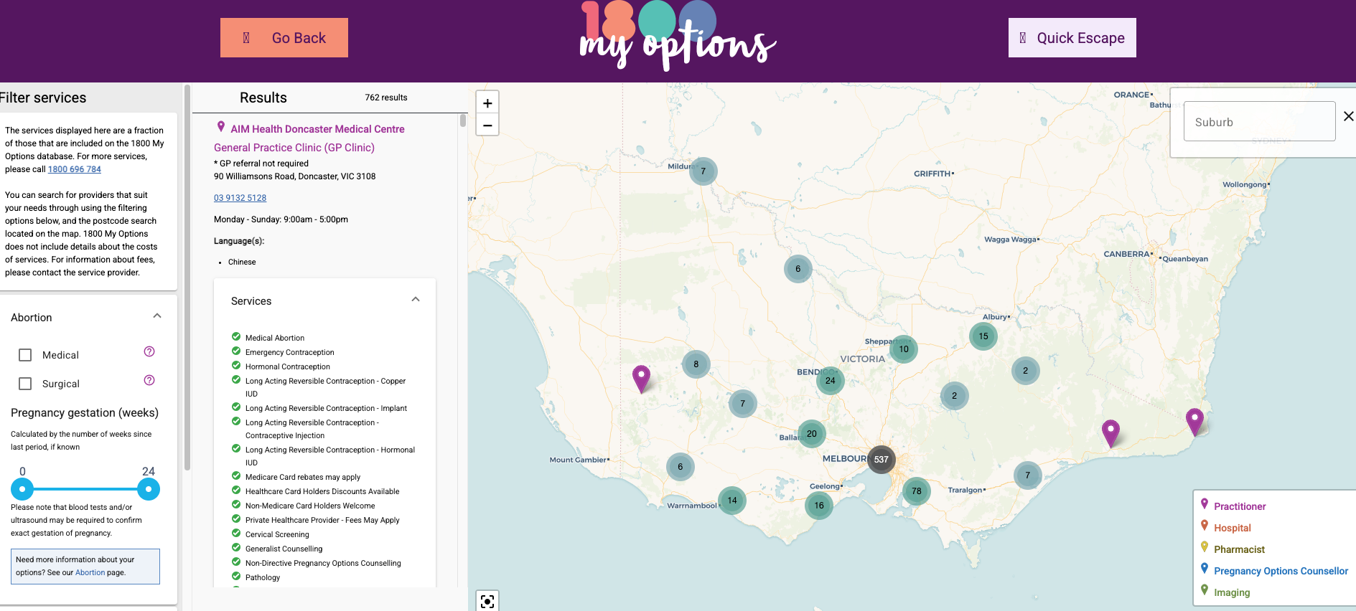

Slide 12

https://familyplanningallianceaustralia.org.au/learn/auslarc/

