Slide 1
Communicable disease update - Victoria
RACGP Webinar, 28 August 2025
Dr Taylah van Leerdam
Principal Public Health Medical Officer (Communicable Diseases)
Office of the Chief Health Officer, Victorian Department of Health
OFFICIAL

Slide 2
Objectives
Recognise current local epidemiological trends of respiratory diseases including COVID-19, influenza and respiratory syncytial virus (RSV)
Promote vaccination recommendations for these respiratory diseases
Update on emerging mpox cases in metropolitan Melbourne

Slide 3
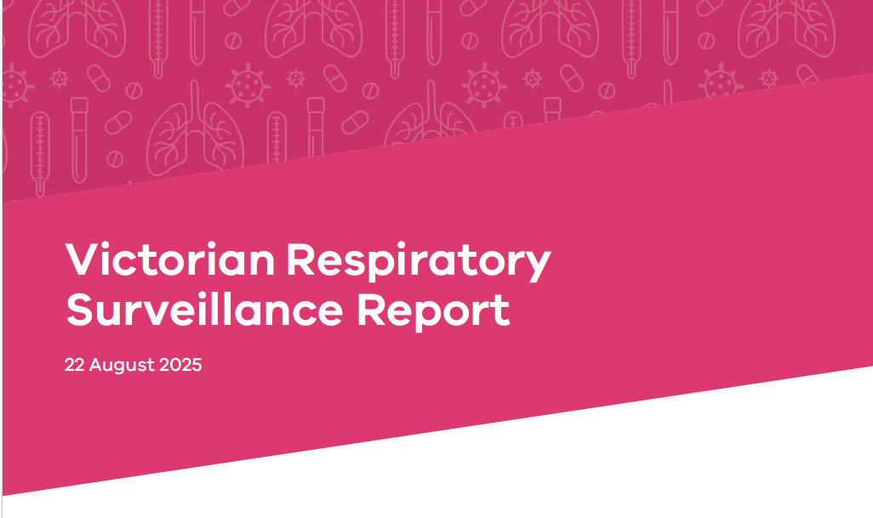
Victorian Respiratory Surveillance Report
Publicly available report (published on the Victorian Department of Health website)
Updated every 2 weeks
Overview of current levels and trends of COVID-19, influenza and RSV
Available at Victorian respiratory surveillance report | health.vic.gov.au

Slide 4
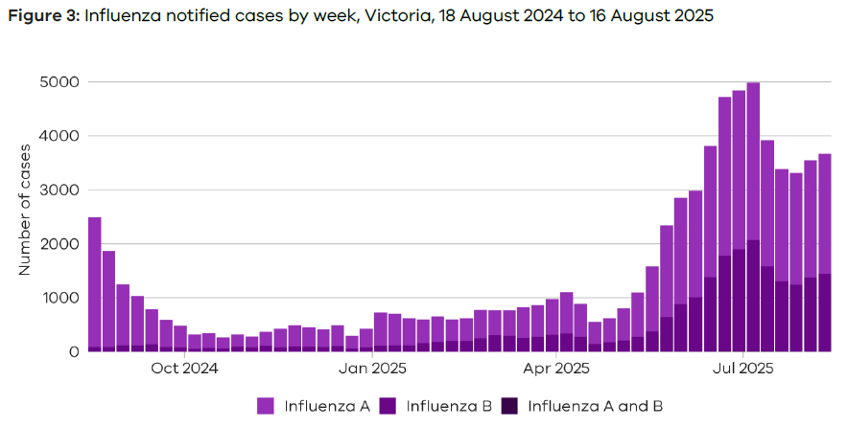
Influenza cases notified by week (10 Aug – 16 Aug)
Influenza activity peaked early July then declined
Decline has slowed in recent weeks and trends have stabilised
Influenza A - 2% increase in notified cases over the last week
Influenza B - 5% increase in notified cases over the last week

Slide 5
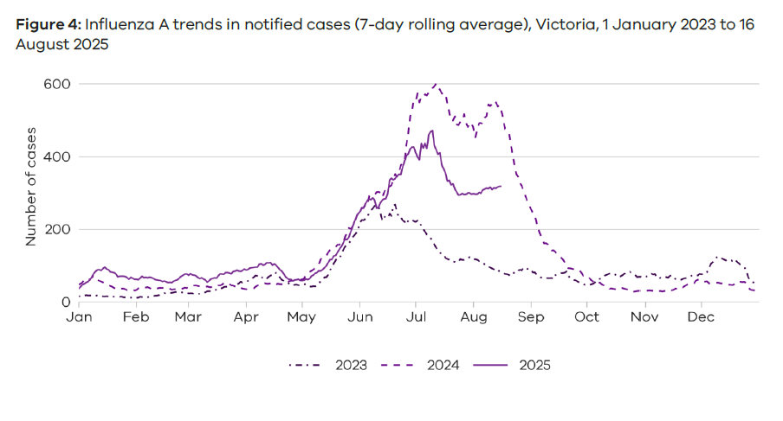
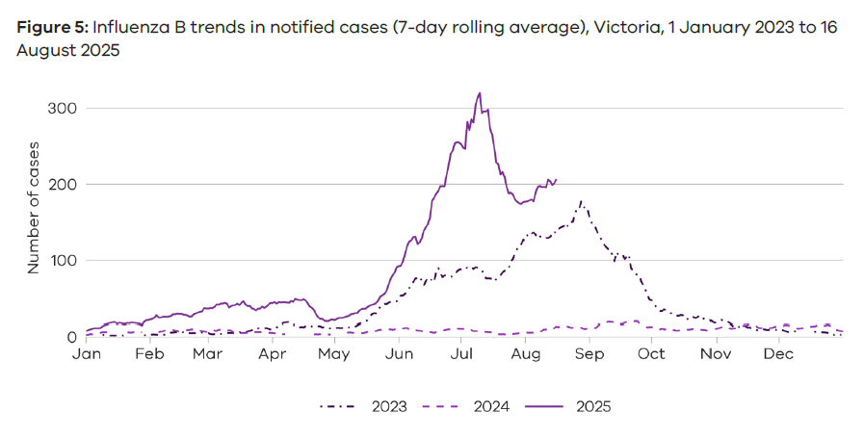
Influenza cases notified 2023 - 2025
2025
2025
Influenza A
Influenza A cases are at levels in between those in 2023 and 2024
Influenza B
Influenza B cases are at higher levels compared to the last two years and have peaked earlier

Slide 6
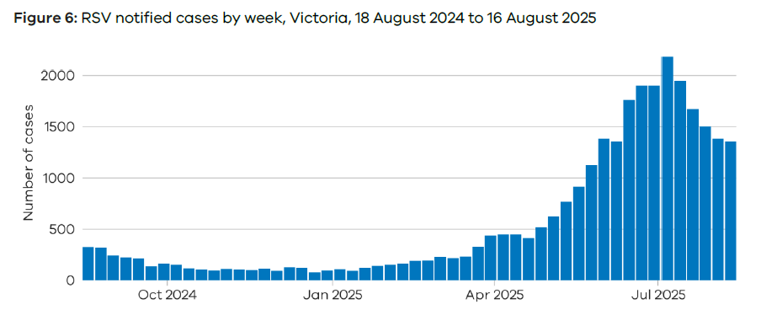
RSV cases notified by week (10 Aug – 16 Aug)
RSV activity peaked early July and has continued to decline
Notified cases have been stable over the last week
Children under 2 years old make up the majority of notified RSV cases
Young children and older adults (65+ years) are at greater risk of severe disease from RSV

Slide 7
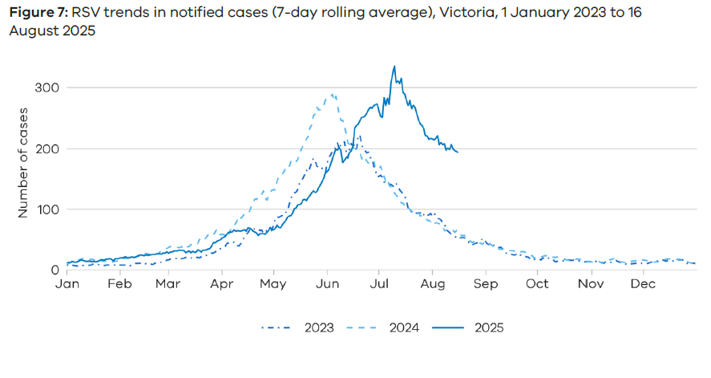
RSV cases notified 2023 - 2025
RSV cases are at higher levels compared to the same time in the past 2 years and have peaked later
2025

Slide 8
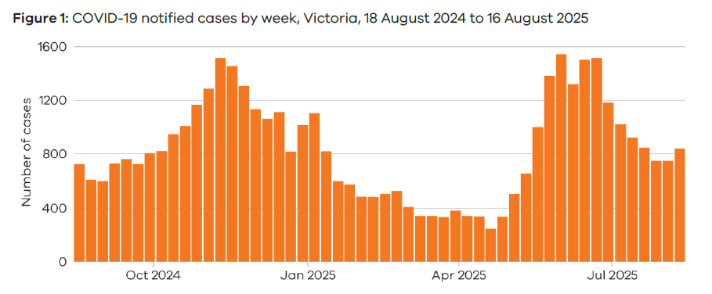
COVID-19 cases notified by week (10 Aug – 16 Aug)
COVID-19 activity peaked in June, followed by a decline before recent stabilisation of trends
12% increase in notified cases over the last week

Slide 9
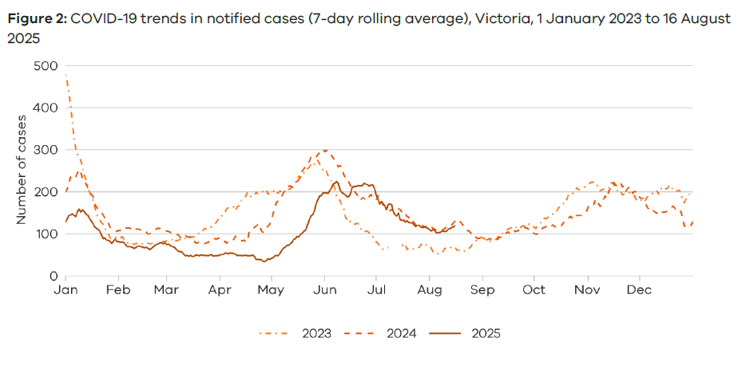
COVID-19 cases notified 2023 - 2025
COVID-19 cases are at similar levels compared to the same time last year
2025

Slide 10
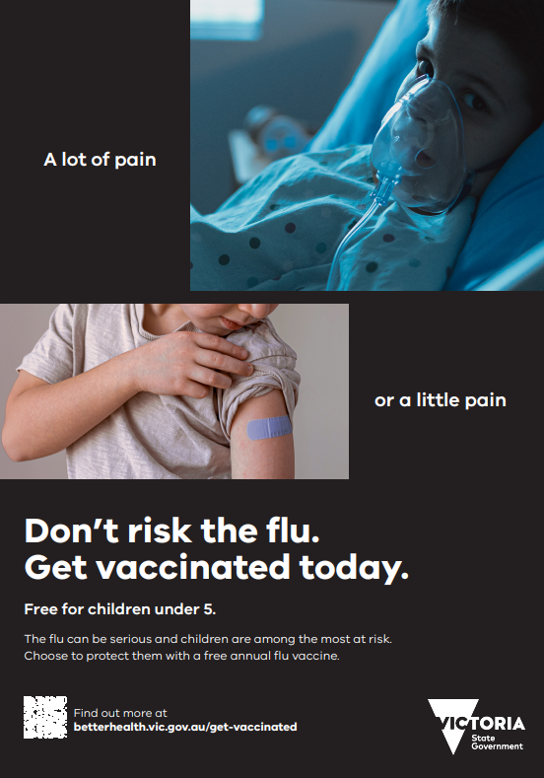
Influenza vaccination
Free influenza vaccine (under the NIP) is available for:
Children aged 6 months to under 5 years
Aboriginal or Torres Strait Islander people aged 6 months and older
Adults aged 65 years and older
Pregnant women (at any stage of pregnancy)
Individuals with certain medical conditions that increase the risk of severe influenza

Slide 11
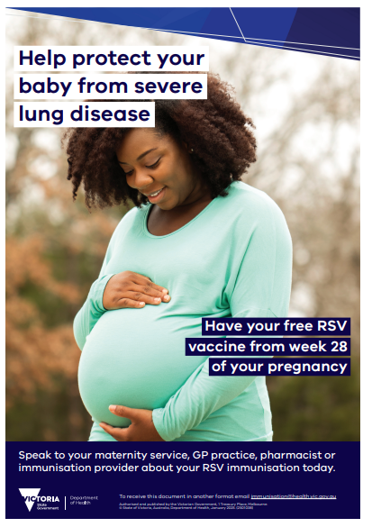
RSV vaccination
RSV Mother & Infant Protection Program (RSV-MIPP)
Vaccination for pregnant women
    Maternal RSV vaccine (Abrysvo ®) is free under the NIP at 28-36 weeks pregnancy
    Provides the baby with passive protection against RSV during the first 6 months of infancy
Infant immunisation
    Victorian Department of Health funded infant RSV immunisation program running 1 April to 30 September 2025
    Free long-acting RSV monoclonal antibody, Beyfortus™ (nirsevimab) offered to eligible infants and young children

Slide 12
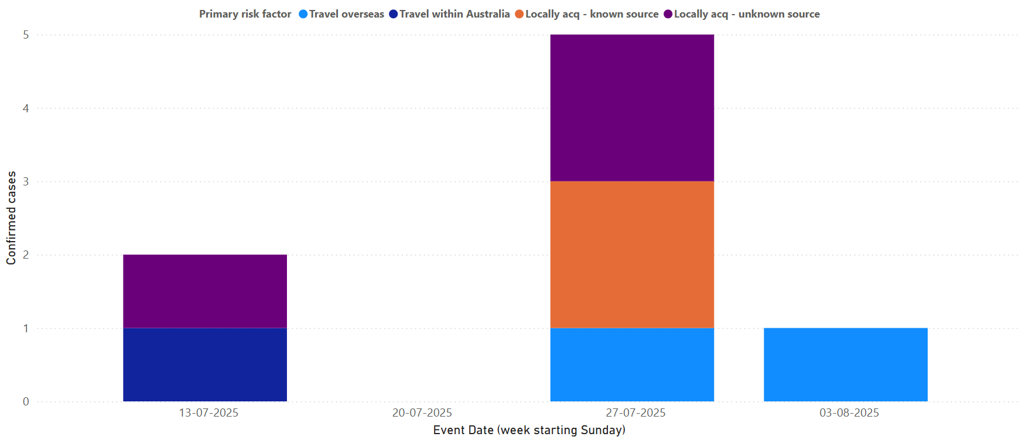
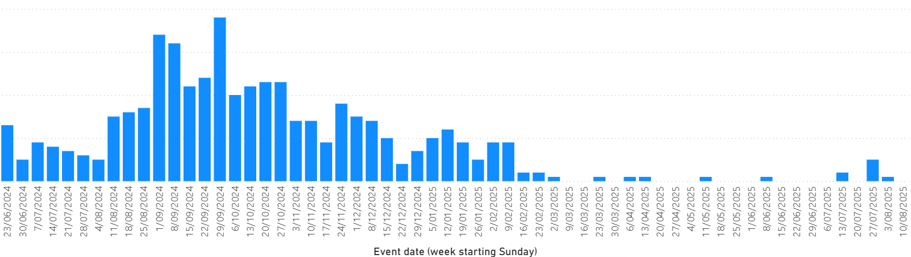
Recent increase in mpox cases in metropolitan Melbourne (as of 8 August 2025)
8 new cases of mpox notified since mid-July
    5 locally, 2 overseas, 1 interstate acquired
All clade II, mild severity
All assigned male sex at birth
6 fully, 1 partially and 1 unvaccinated
Following a period of reduced mpox activity in Victoria and interstate
Public health actions:
    Case and contact management
    Chief Health Officer Alert
    Increased communications to health services and healthcare providers
    Engagement with key stakeholders (Thorne Harbour Health, Sex on Premises Venues)

Slide 13

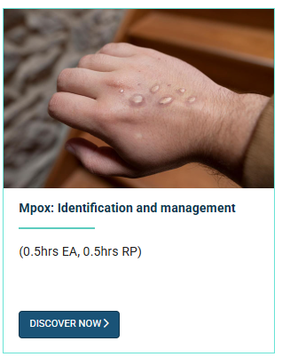
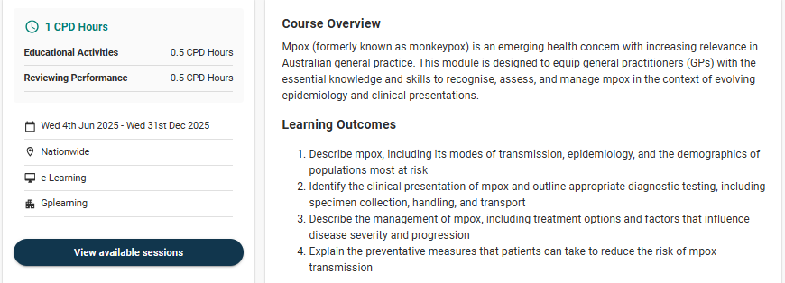
RACGP education module
Mpox: Identification and management
Available at RACGP - gplearning

Slide 14
Take home messages
Influenza, RSV and COVID-19 - cases are down-trending but remain high, important to remain vigilant and vaccinate eligible groups
Mpox – ongoing risk of incursions from overseas and interstate, continue to test patients with compatible symptoms, and encourage vaccination

Slide 15
Other resources / additional slides

Slide 16

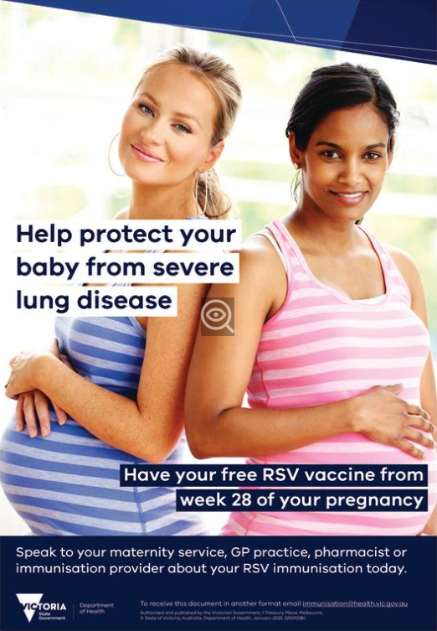
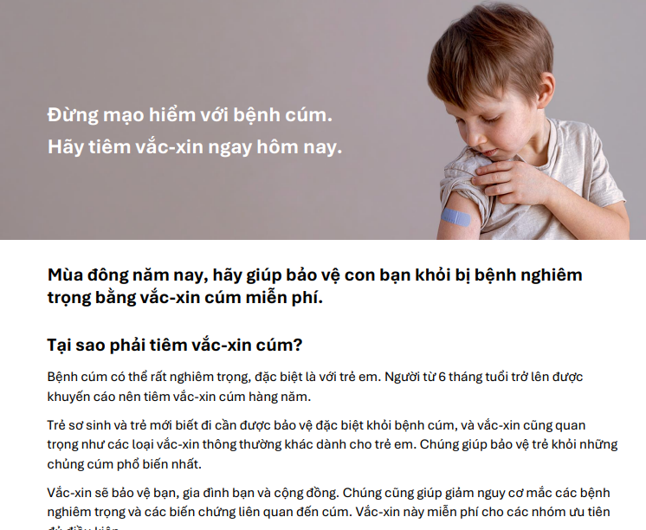
Don’t risk the flu and RSV vaccine stakeholder toolkit
Resources including social media tiles, posters, translated factsheets
Available for use by health services, GP clinics, community centres
Campaign aims to encourage vaccination rates and inform the community
Available at Don't risk the flu and RSV vaccine stakeholder toolkit | health.vic.gov.au

