Slide 1
Mental Bites: Insomnia
Dr Alexander Sweetman
Program Manager
Australasian Sleep Association
alexander.sweetman@sleep.org.au

Slide 2
Australasian Sleep Association (ASA)
The peak scientific body in Australia and New Zealand, representing ~1,000 clinicians, scientists and researchers working in sleep health and sleep medicine.
2021 Commonwealth funded Health Peak and Advisory Bodies grant. Aims to improve access and use of evidence-based sleep disorder resources by Australian GPs, psychologists and practice nurses.

Slide 3
New Online GP insomnia and sleep apnoea guideline: https://www.sleepprimarycareresources.org.au/

Slide 4
Sleep Disorder Implementation Network
It can take many years to translate research into practice.
Network aims to;
Provide GPs access to evidence-based information and assessment/treatment tools,
Help sleep researchers translate evidence into practice,
Improve patients’ lives.
Register: https://redcap.link/ASAnetwork

Slide 5
Overview
Insomnia diagnosis, prevalence, consequences.
Insomnia management in general practice.
Will share all slides after presentation.
Presentation ‘take-home’ messages look like this

Slide 6
Diagnostic criteria
Self-reported dissatisfaction with sleep quantity or quality occurring ≥3 nights / week;
Significant distress or impaired daytime function;
Fatigue, poor mood, concentration or memory difficulties,
Reduced work productivity or social functioning.
Insomnia can be an acute (<3 months), or chronic disorder (≥3 months).
Difficulties falling asleep
Difficulties maintaining sleep
Early morning awakenings

Slide 7
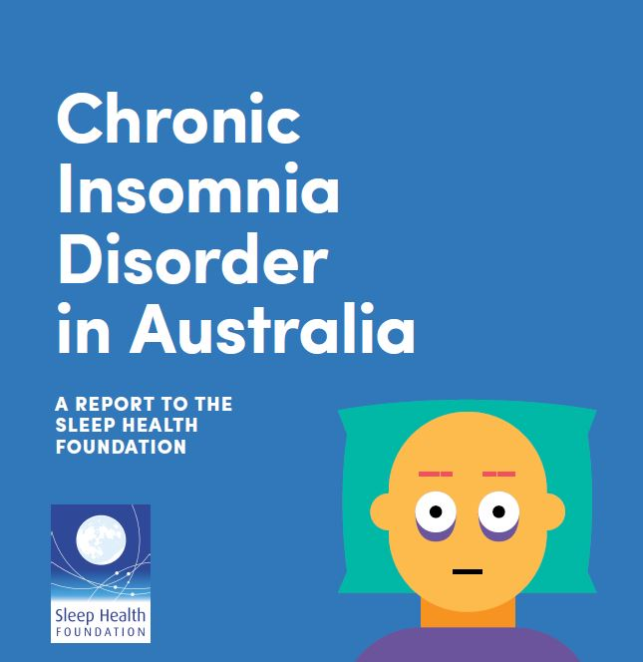
Prevalence
Sleep disturbances are among the most common reasons for GP appointments (RACGP, Health of the Nation, 2017-2022).
Acute insomnia occurs in 30-50% of the general population.
Chronic insomnia occurs in 10% of Australian adults.
30-50%
Acute Insomnia
~10%
Chronic insomnia
Reynolds et al., 2019

Slide 8
Insomnia and Depression
Commonly co-exist.
Share bi-directional relationships.
Insomnia predicts future depression.
Insomnia
Depression
Insomnia treatment improves depression.
Insomnia treatment reduces risk of future depression.
Gebara et al., 2018
Sweetman et al., 2021, MJA
Cheung et al., 2020

Slide 9
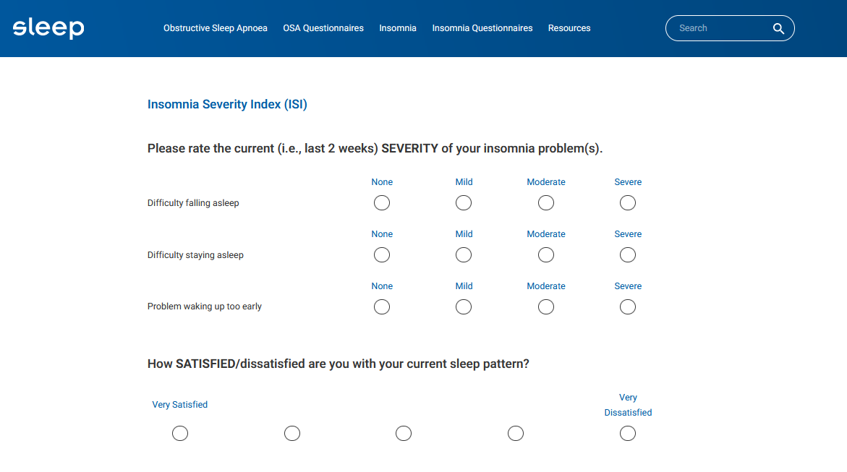
Assessment tools
Insomnia assessment
Insomnia Severity Index
Sleep Condition Indicator
Sleep Diary
Daytime impacts
Epworth Sleepiness Scale
Fatigue
Depression
https://www.sleepprimarycareresources.org.au/

Slide 10
Cognitive Behavioural Therapy for insomnia (CBTi) is the recommended ‘first line’ treatment for insomnia.
Over 25 meta-analyses showing that CBTi improves...
Insomnia
Daytime function
Quality of life
Depression
Reduces sedative-hypnotic dependence ... all with sustained effects.
However, only ~1% of Australian adults with insomnia access CBTi.

Slide 11
Chronic insomnia is maintained by psychological and behavioural factors
Inadequate sleep
Daytime impairments
Too much time in bed
Irregular sleep pattern
Clock watching
Mis-perceive sleep as wake
Electronics in bedroom
Conditioned ‘arousal’ response
Environmental factors
Timing of food, exercise, caffeine
Sleep-related anxiety
Anticipated consequences of sleep loss

Slide 12
Cognitive Behavioural Therapy for Insomnia (CBTi) options are available to GPs.
CBTi
GPs can deliver CBTi
Self-guided and digital CBTi referral
MHTP referral to Psychologist for CBTi

Slide 13
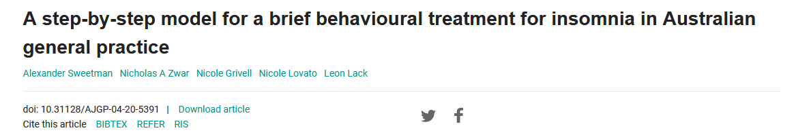
GP behavioural insomnia treatment program
4-5 weekly sessions
1 x longer initial session
4 x brief follow-up sessions
Three main therapies:
Sleep Education
Bedtime Restriction Therapy
Stimulus Control Therapy

Slide 14
Bedtime Restriction Therapy
One of the most effective treatments for insomnia.
Spending too much time in bed can make our sleep problems worse.
Spending more time in bed allows for more time spent awake in bed.
This can lead to feelings of frustration, anxiety, and worry in bed.
Takes 2-3 weeks to start improving sleep.
This therapy aims to increase evening sleep pressure to help patients fall asleep quicker, and reduce how long they spend awake during the night.
Uses the Sleep-Wake diary.

Slide 15
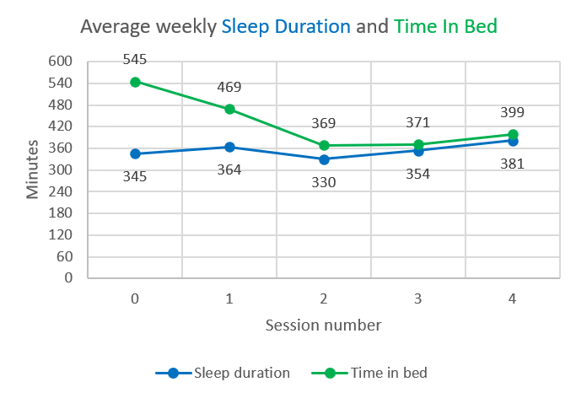
Bedtime Restriction Therapy
Bedtime Restriction Therapy administration: https://www.sleepprimarycareresources.org.au/

Slide 16
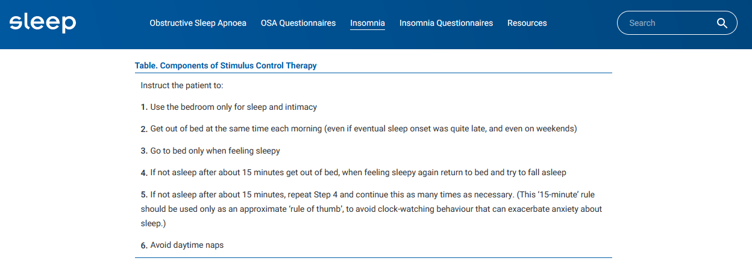
Stimulus Control Therapy
https://www.sleepprimarycareresources.org.au/

Slide 17
Sleep Disorder Implementation Network
It can take many years to translate research into practice.
Network aims to;
Provide GPs access to evidence-based information and assessment/treatment tools,
Help sleep researchers translate evidence into practice,
Improve patients’ lives.
Register: https://redcap.link/ASAnetwork

Slide 18
References and Resources
New Online GP insomnia and sleep apnoea guideline: https://www.sleepprimarycareresources.org.au/
gpLearning Insomnia Management module.
Cheng et al., (2019). Depression prevention via digital cognitive behavioral therapy for insomnia: a randomized controlled trial. Sleep, 42(10).
Gebara et al., (2018). Effect of insomnia treatments on depression: A systematic review and meta‐analysis. Depression and anxiety, 35(8).
Reynolds et al., (2019). Chronic Insomnia Disorder in Australia. Sleep Health Foundation.
Riemann et al., (2017). European guideline for the diagnosis and treatment of insomnia. Journal of sleep research, 26(6).
Sweetman et al., (2021). A step-by-step model for a brief behavioural treatment for insomnia in Australian general practice. Australian journal of general practice, 50(5).
Sweetman et al., (2021). Co‐occurring depression and insomnia in Australian primary care: recent scientific evidence. Medical Journal of Australia, 215(5).

Slide 19
Questions / Discussion
Dr Alexander Sweetman
alexander.sweetman@sleep.org.au

